Slide 1

Some Common Misconceptions About Memory Management in .NET
Clive Tong Red Gate

Slide 2
Contents
Five misconceptions A garbage collector collects garbage Doing lots of gen0 collections is bad Performance counters are great for understanding what is happening .NET doesn’t leak memory All objects are treated the same

Slide 3
Garbage Collectors Collect Garbage
The focus is really on the non-garbage
Most (young) objects die young
Designed to collect dead items without processing them individually
Additionally this allows quick allocation
Note this is for generation 0

Slide 4
A simple mutator
var collect = new List<B>(); while(true) { collect.Add(new A()); new A(); new A(); }

Slide 5
Collecting generation 0
Generation 0
After one iteration
As we go into the fourth iteration
Notes:
By the time the program starts the heap isn’t empty – the runtime itself allocates lots of stuff when it starts up.
We’re not bothering to show the List<> object here.

Slide 6
No space, so copy
Promote
gen0
gen1

Slide 7
And recycle
gen0
gen1

Slide 8
Fix-up
gen0
gen1

Slide 9
Observations
Trick is that objects are allowed to move
Need to get to a safe point when pointers can be fixed

Slide 10
Fast allocation
0:000> u 002c2020
mov eax,dword ptr [ecx+4]
mov edx,dword ptr fs:[0E40h]
add eax,dword ptr [edx+48h]
cmp eax,dword ptr [edx+4Ch]
ja 002c203b
mov dword ptr [edx+48h],eax
sub eax,dword ptr [ecx+4]
mov dword ptr [eax],ecx
ret 002c203b:
jmp clr!JIT_NewFast (5cbded01)
Notes:
There is no locking around this routine – prize to the person who can tells me why that doesn’t cause a problem
Note that there is a thread local variable here (so that there is no locking around the bump)

Slide 11
And there is one other trick
Use generations to focus attention
Need to track object references
0:000> u 5cbc2fb0
clr!JIT_WriteBarrierEAX:
mov dword ptr [edx],eax
cmp eax,271100Ch
jb clr!JIT_WriteBarrierEAX+0x17 (5cbc2fc7)
shr edx,0Ah
nop
cmp byte ptr [edx+0BD63E0h],0FFh
jne clr!JIT_WriteBarrierEAX+0x1a (5cbc2fca)
ret
clr!JIT_WriteBarrierEAX+0x18:
nop
nop
mov byte ptr [edx+0BD63E0h],0FFh
ret

Slide 12
Lots of gen0 collections is bad
We have covered this already
Time proportional to live data
Though with (fixed) overheads
Worse case double allocation
Notes:
Time required to bring the threads to a safe point

Slide 13
Performance counters are accurate
Quick demonstration
Notes:
Reflector
- show the count of collections
- %time in GC and allocation in bytes/sec
See http://msdn.microsoft.com/en-us/magazine/cc163528.aspx
“If, instead, % Time in GC does not go above 10 percent, it usually is not worth spending time trying to reduce the time the GC spends in collections because the benefits will be marginal.”
“As a rule of thumb, a healthy ratio between generation collections is one Gen 2 collection for every ten Gen 1 collections. If you are seeing a lot of time spent in garbage collection, it could be that Gen 2 collections are being done too often. You should check this ratio to ensure there aren't too many Gen 2 collections relative to the number of Gen 1 collections.”

Slide 14
Periodic measurements
It’s important to remember that these are updated when a collection happens
No collection means the counter is stuck
Which means that the average value can be misleading

Slide 15
static void Main(string[] args)
{
var accumulator = new List<Program>();
while (true)
{
DateTime start = DateTime.Now;
while ((DateTime.Now - start).TotalSeconds < 15)
{
accumulator.Add(new Program());
Thread.Sleep(1);
}
Console.WriteLine(accumulator.Count);
}
}

Slide 16
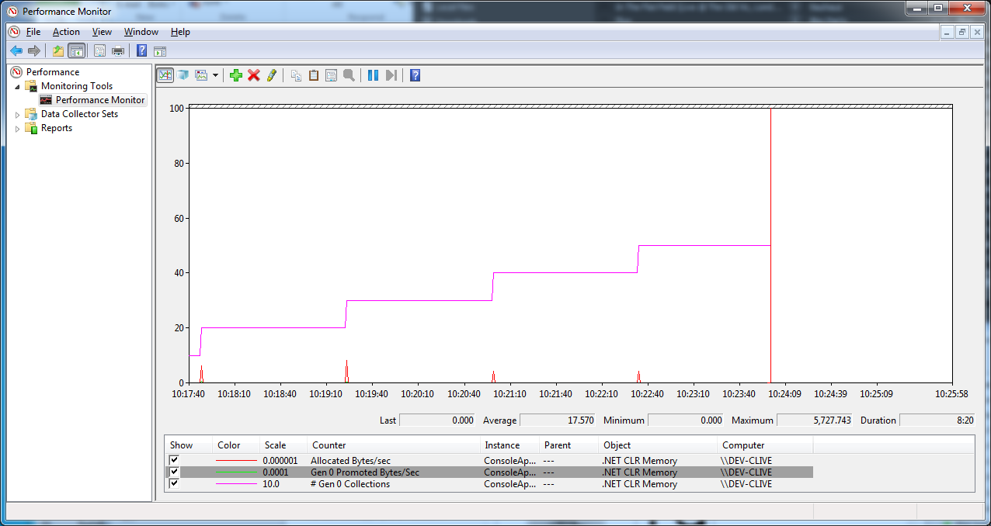

Slide 17
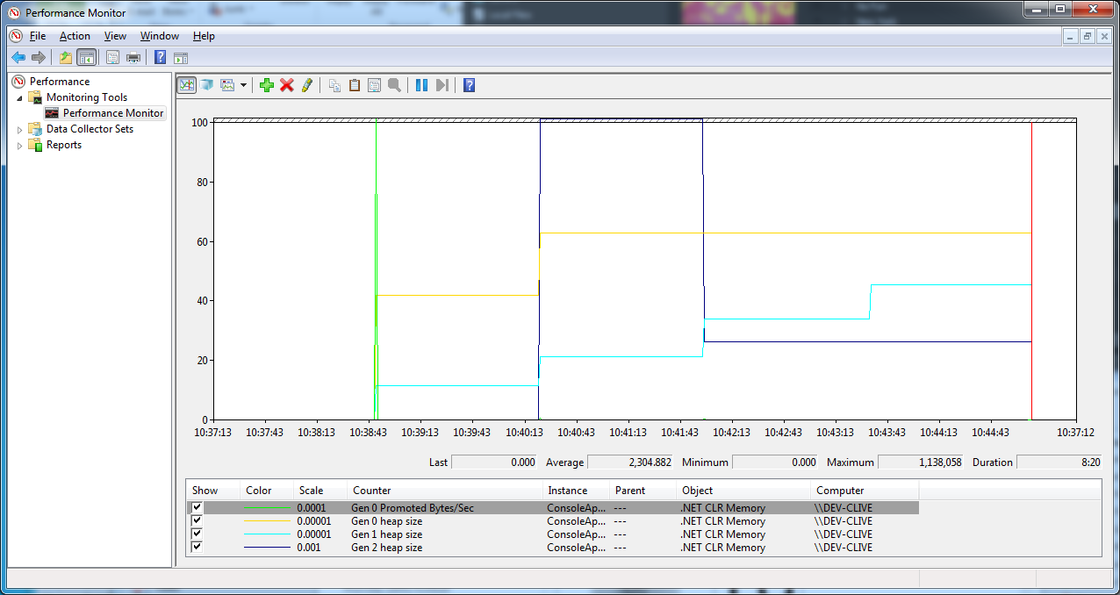
Notes:
Size of a generation accurately reflecting how much data there is in it.

Slide 18
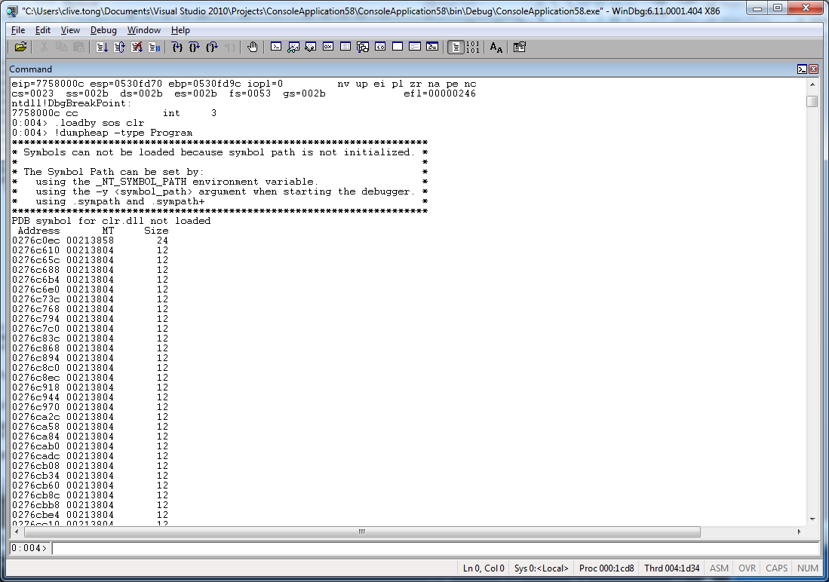

Slide 19
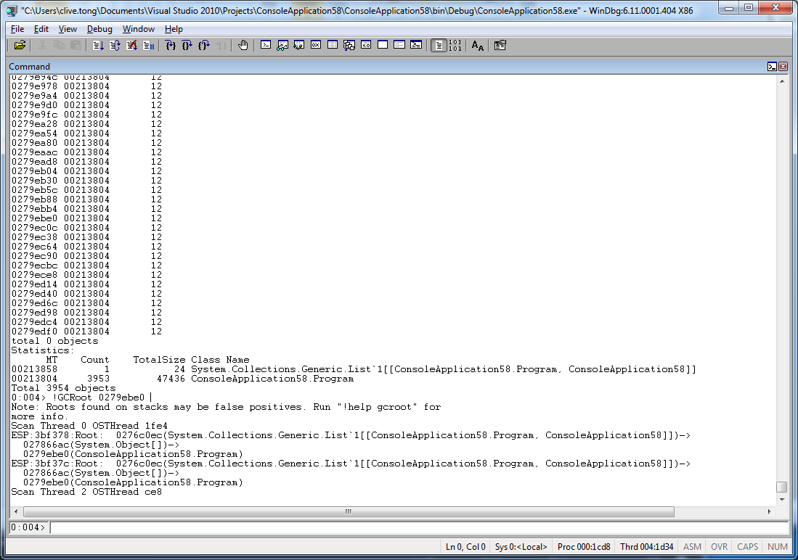

Slide 20
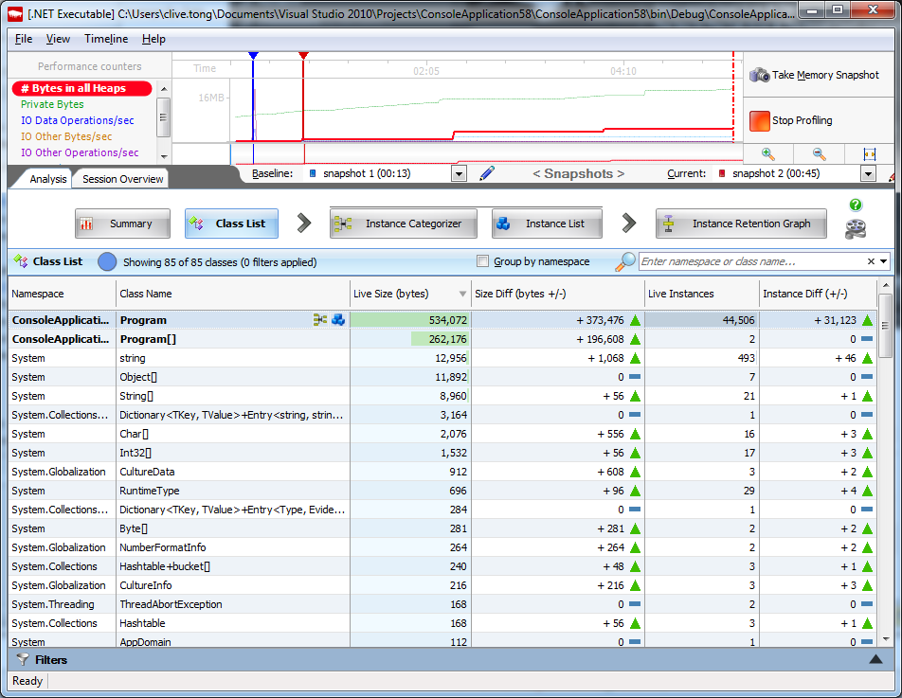

Slide 21
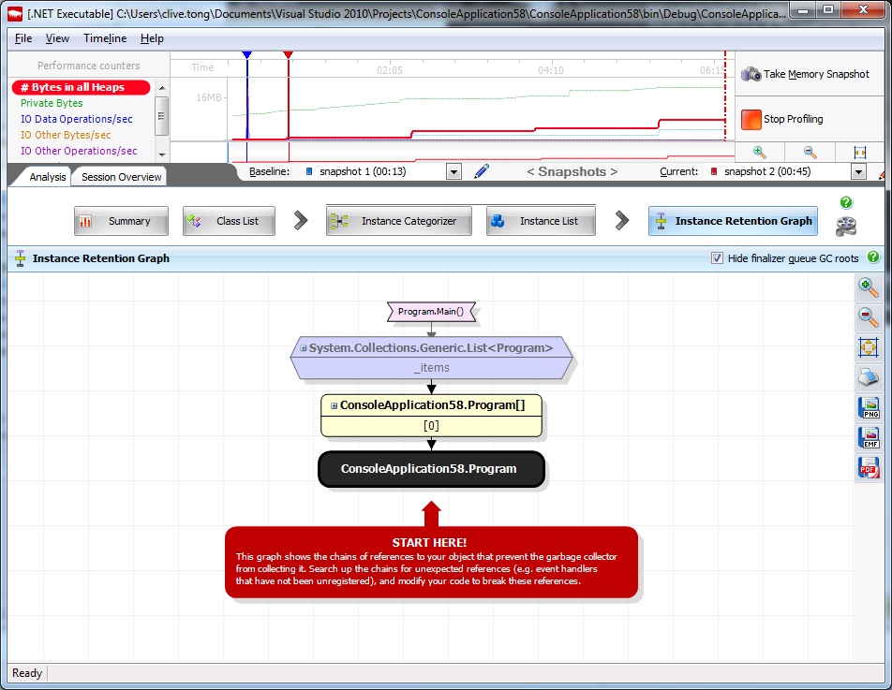

Slide 22
.NET doesn’t leak
It’s a question of definition
Old definition Forgot to de-allocate after use Lost the final pointer to some memory Forgot your responsibilities

Slide 23
New definition
Premature release was often fatal
Those days are gone (*)
The runtime is ultra-cautious
It’s difficult to have an effective cost model
(*) except when you aggressively dispose

Slide 24
What makes things live longer?
Application
User
Library
Compiler

Slide 25
Application
Type of build
Having a debugger attached
Notes:
Debug/Release builds

Slide 26
User
Event handlers
Assigning temporary values to fields

Slide 27
Library
Data binding
Caches without a lifetime policy

Slide 28
Compiler
Closures

Slide 29
Closures
class Program
{
private static Func<int> s_LongLived;
static void Main(string[] args)
{
var x = 20;
var y = new int[20200];
Func<int> getSum = () => x + y.Length;
Func<int> getFirst = () => x;
s_LongLived = getFirst;
}
}

Slide 30
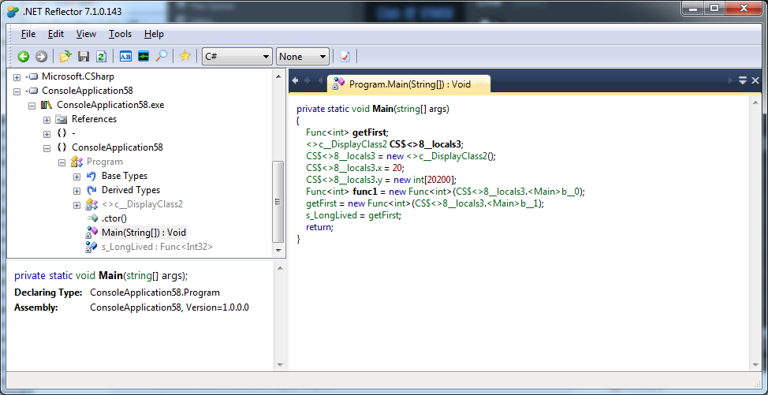

Slide 31
All objects are created equal
Copying takes a while
Need a better way to handle large objects
Resort to standard mark-and-sweep
No compact at the moment
Only do when gen2 is collected
Temporary large objects don’t fit model

Slide 32
No copying during collection
Before
After

Slide 33
Some observations
No movement, so no fix-ups
Potential parallelism
But potential fragmentation

Slide 34
The problem of fragmentation
Before collection
After collection
Allocate block of this size:
Next allocation

Slide 35
Conclusion
There’s a lot going on inside your process heap
The only way to really understand what is going on is to use tools to visualise things

