Slide 1

C# 5 - It’s more than Async
Clive Tong Red Gate Software

Slide 2
What we’ll cover
Brief history of C# so far
The theme behind .NET 4.5
Breaking changes
New features
Asynchronous programming

Slide 3
Background
Various versions seem to have themes
Language version | Theme | Year | .NET
C# 1.0 | Managed language | 2002 | 1.0
C# 2.0 | Generics | 2005 | 2.0
C# 3.0 | LINQ | 2007 | 3.5
C# 4.0 | Dynamic | 2010 | 4.0
C# 5.0 | Asynchrony | 2012 | 4.5
Notes:
1.0 was essentially a better Java. Valuetypes/non-virtual methods for performance and a focus on more component oriented features like events/properties. Good interaction with unmanaged code and COM.
2.0 generics was an improvement allowing more efficient collections – not all stored as Object and then cast when fetched from the collection. Major change to the virtual machine itself as the generics are represented at runtime and used in the IL instructions (cf Java)
3.0 introduced a DSL for general purpose querying into the language (plus new GUI technology WPF with its XAML that led to Silverlight). Anonymous typed and lambda expressions, but all implemented by the compiler via code generation with no support from the underlying CLR.
4.0 introduced dynamic language support, adding a dynamic type that deferred the method lookup until runtime (side-stepping the usual strong type checking of the C# compiler). No need for .Item all over the place.
5.0 main feature is asynchrony… the world is full of applications that need to talk to other applications, while band width and other concerns mean that we may be waiting for the reply for some time.

Slide 4
The theme for 4.5
Fixing some long standing language issues
Language/framework support for responsive applications
Notes:
One a common source of bugs, the second a way of optimising a common pattern.
The big feature is a major change to the language to support new patterns of application caused by mobile/web and multithreading

Slide 5
Breaking changes
Closure over a loop variable
Evaluation order of named arguments
Some changes to overload resolution

Slide 6

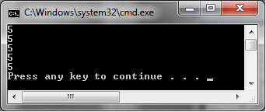
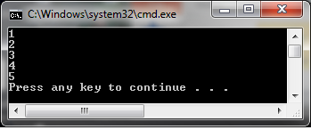
Closure over a loop variable
VS2010
VS2012

Slide 7
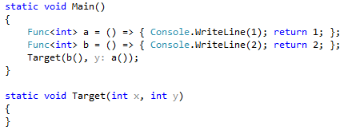


Evaluation order of named arguments
VS2010
VS2012

Slide 8
Changes to overload resolution
Improved for calls that use named arguments to call methods that contain a params parameter
Improved for calls where there is a choice between a Func<object> and a Func of some other type

Slide 9
New features
Help with implementation of INotifyPropertyChanged
async

Slide 10
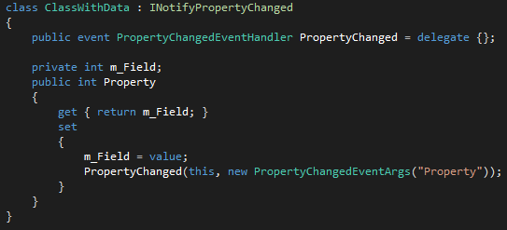
Basic change notification
Notes:
Databinding
Spirit of consiseness

Slide 11
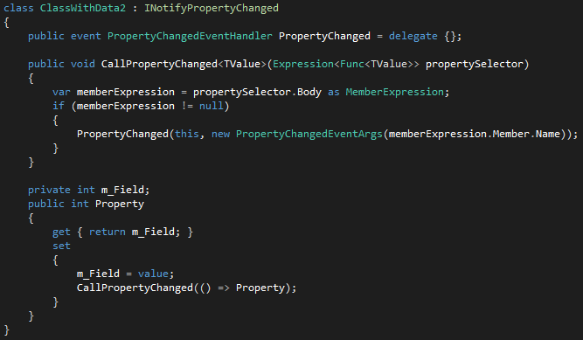
Towards Notification Nirvana

Slide 12
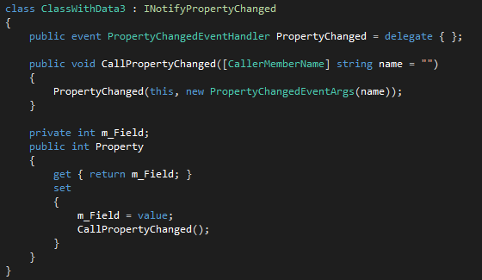
Notification nirvana
Notes:
All implemented by the compiler which inlines the unsupplied parameters at the callsite.

Slide 13
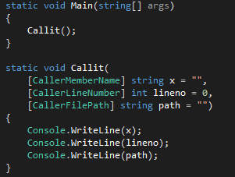
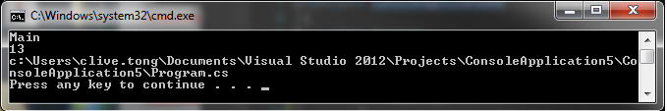
What Caller attributes are there?
Notes:
Like all of the optional parameters, the extra parameters are generated and then passed at the call site

Slide 14
async
The feature that has got all the attention
Why?
Notes:
Essence of web/cloud/mobile is asynchronous programming. Getting data from a remote source adds unexpected delays owing to latency, and we don’t want resources on the client held while the call happens.

Slide 15
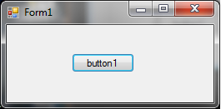
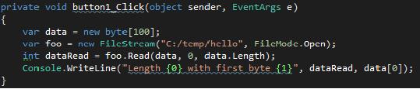
The Canonical Example
Notes:
Windows Forms application with a form containing a single button. The button has a click handler that runs the shown code.
The code supposed to represent a potentially time consuming operation, and even though we don’t think that way, a file operation can take a surprising amount of time.
Certainly the view of the Windows 8 implementers who have added non-blocking API methods for all functions that can take more than 50 milliseconds.
For a touch device we need to keep responsive or we lose the advantages of the UI

Slide 16
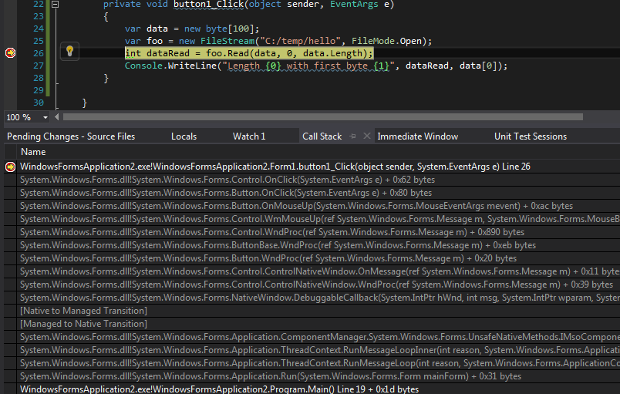
What’s the cost of this?

Slide 17

The message loop
Button click handler
Paint handler
Code running the message loop
Window system
Notes:
Most window system demand that all interaction with the windows happens on a single thread – this prevents complicated synchronisation code to stop modifications while the system responds to a previous action.
In this example we’ll just pretend that the system sends the button click to the application followed by a paint message because some of the screen needs updating.

Slide 18
How could we restructure?
break down the method at this point
Notes:
We need the method to return quickly, so that we get back into the processing of the message loop, but we also don’t want to lose the state of the local variables that are live at the point that we return as we need them in the following code.

Slide 19
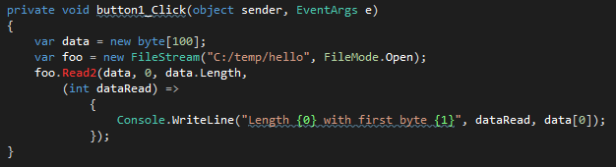
How to do this
Notes:
Use Lambda expression to capture the state – this is the kind of thing that nodeJs does.
Demand that Read2 calls us back then the operation completes
- though there are some subtle effects here
– some operations are bound to the thread on which they happen
- maybe the continuation code wants to set a value into a label of the GUI
(we’ll talk more about the issue of keeping the rest of the method on the right thread).
We can then return from the button click handler, back to the message loop… this is saving resources as we aren’t locking the thread

Slide 20


Don’t just sit there waiting
Read2
Button click handler
Paint handler
Code running the message loop
Notes:
Just to make it clear what this has bought us…
Read2 maybe executes and blocks on a thread pool thread
- better still gets the OS to start the read and then gets called back (on a thread pool thread) by the OS when it can continue

Slide 21
Re-entrancy
Note that things are more re-entrant now … disable the button until finish
Notes:
While the button click is being handled, other messages can get in there, most obviously multiple clicks to the button unless we go to the trouble of disabling and re-enabling it.
[That’s something we should be doing anyway]

Slide 22
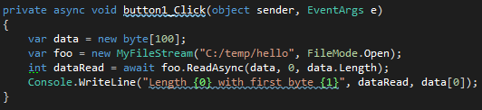
Help from the compiler
Notes:
We’ll change to using some user written classes to
Make it clear that this isn’t just for framework classes
Make it clear that anyone can implement the relevant pattern and interface
What we’d really like is a way to mark where the method should return, and obviously we’d like the compiler to know which methods it is expected to modify in this way(so that it can check our expectations). The compiler is going to take our existing method, work out the places where the method can return and hook into the classes so that execution continues once the spawned operation completes.
Asynchronous lambda expressions and delegates too

Slide 23
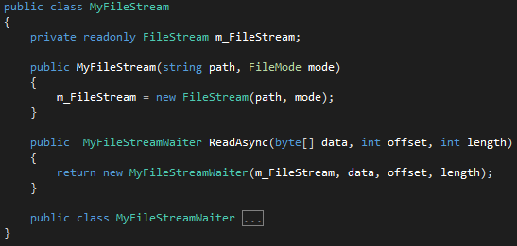
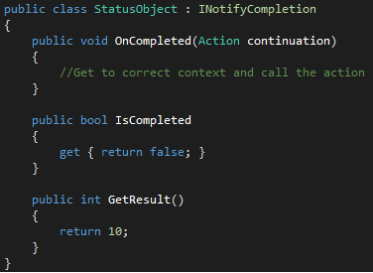
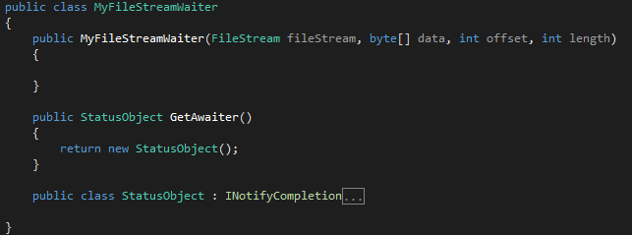
So what do we implement?
Notes:
What hooks does the compiler need us to implement to let it do the method breaking for us?
Much like Enumerators, where the compiler looks for a public GetEnumerator method.
The compiler looks for a top level method called GetAwaiter. This is often implemented to return this, but here we generate a new instance… this returned instance offers the hooks that the compiler needs:
Has the method completed already
Get the result if it has completed
A hook that the client calls once it has finished.

Slide 24
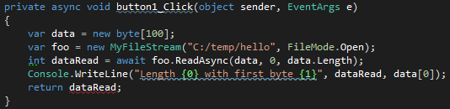
But what if we need to return something?
Notes:
The example we have so far is quite simple. In particular it returns nothing (ie void). The question is, how do we modify things to allow us to return a value from the async method.
We can’t keep the void – we need something else.
This method returns at the time it hits the await expression, and the int value will not be available until much later

Slide 25
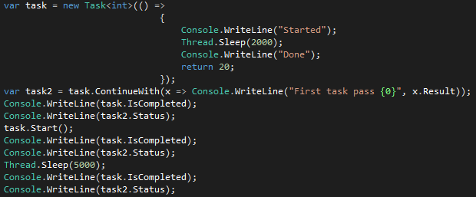
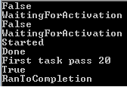
The Task Parallel Library
Notes:
And the answer lies in a very cool library that was included in .NET 4 – the TPL (task parallel library).
Tasks give us a way of representing a future – a value that isn’t yet available at the current time, but will be available in the future.
Moreover, there is a series of operators that let us combine tasks – for example, we can link two tasks so that the second begins when the first finishes.

Slide 26
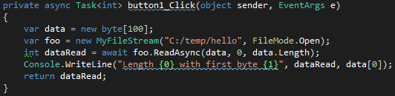
So we use that
Notes:
So we can use a Task<int> as a placeholder for the integer value that will eventually be available.

Slide 27
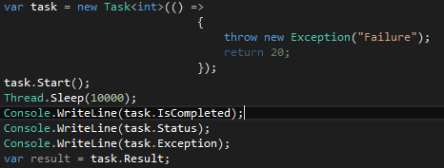
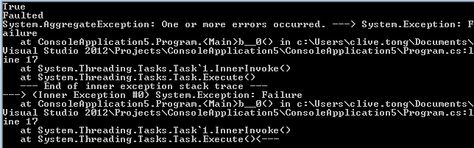
And exceptions?
Notes:
There are several other things that we need too.
Some way to handle exceptions which will inevitably happen when we do things for real.
There is a slight difficulty with void returning methods and exceptions
- where does the exception get raised, as there can’t be anyone waiting for the result

Slide 28
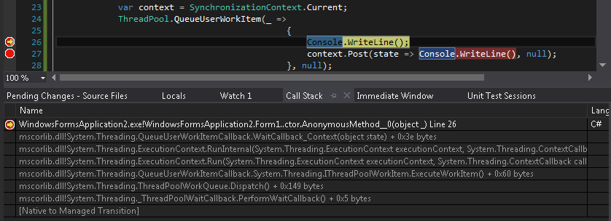
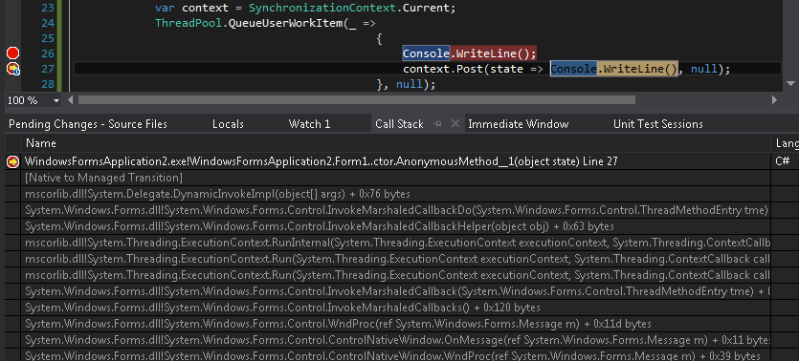
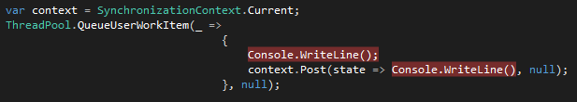
But we need context…
…and we’ll come back to this
Notes:
The context problem is also solvable. .NET 2 introduced the notion of Synchronisation and execution contexts which capture (some of) the state of the thread, allowing us to restore that state when we want to continue the execution of the method.
This example demonstrates the synchronisation context which supports posting something back to the thread – Windows Forms sets up such a context, but thread pool threads and console application main threads simple return null.
For void returning methods
- the specification talks about the exception getting thrown in the right synchronisation context
Compiler generated code will flow the execution context (as it’s a very low level notion), but not the synchronisation context
- specially implemented as the synchronisation context is included in the execution context

Slide 29
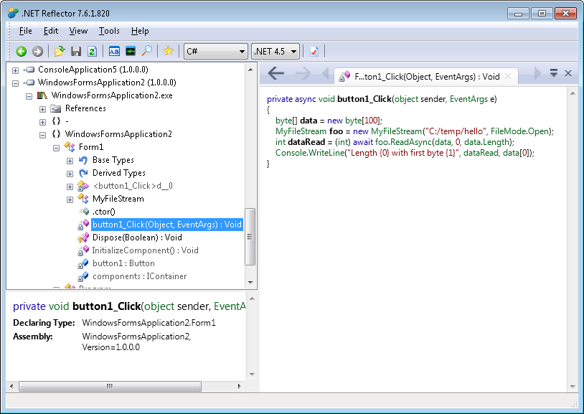
Notes:
We’re going to take a look at the results of the transformation that the compiler, to see how it interacts with the awaiter pattern that we looked at earlier.
We’ll continue to work with the click handler that we’ve been using up to now.
When we load the compiled code into Reflector, it uses its knowledge of the pattern to paste the compiler implementation back into something that looks very much like the original C# implementation.

Slide 30
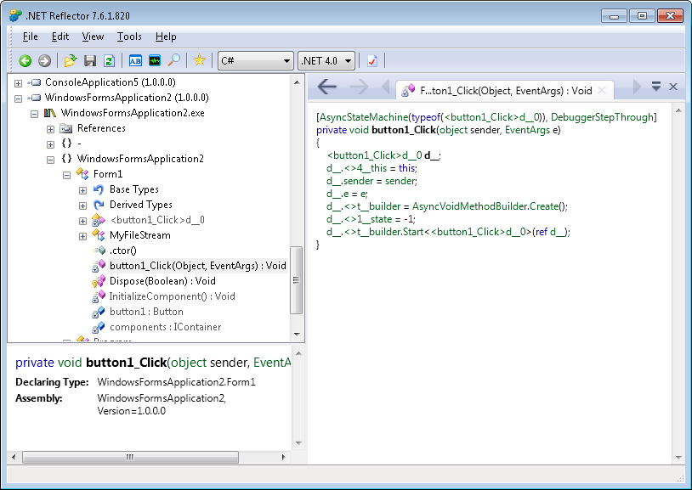
Notes:
Turning down the framework level, stops Reflector hiding the generating code so we get to see more what it looks like.
It looks like the code we started has been thrown away, and replaced by something that manipulations an instance of a new struct.

Slide 31
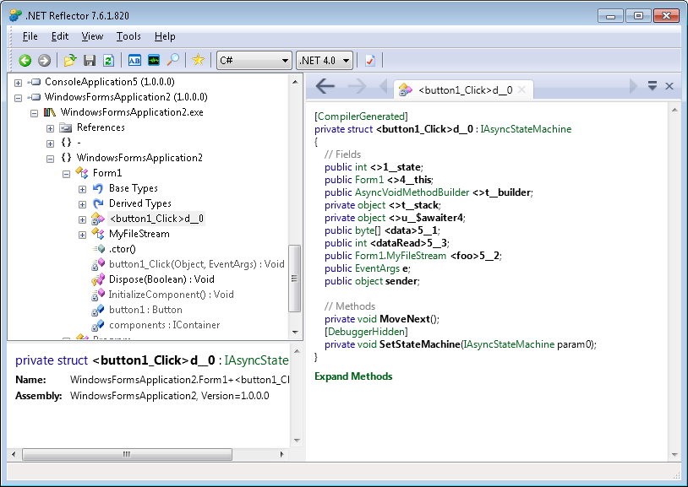
Notes:
We have fields in this structure that correspond to the local variables from the original method – this kind of technique you see in the compilation of lambda expressions – the hoisting of closed over variables into an object with a longer lifetime.
Stack is used to handle the case where we have multiple await expressions in a statement
- int x = await foo1() + await foo2()
The key element here is the MoveNext method. The name is based on the way that enumerators are implemented, and is used to transition a stopped method to its next stopping point.

Slide 32
Notes:
MoveNext needs to know where it is at the moment, so the object maintains an integer state that will change to allow us to determine how far we are through the method.

Slide 33
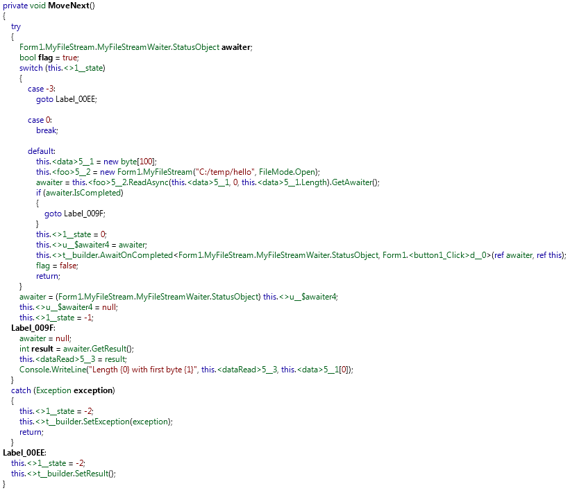
Notes:
And now we are in a position to look at the MoveNext method in all its glory.
Remember when we looked at the code for this in 4.5 mode it was four lines.
Point out the change of state for next time before we go into the awaiter.

Slide 34
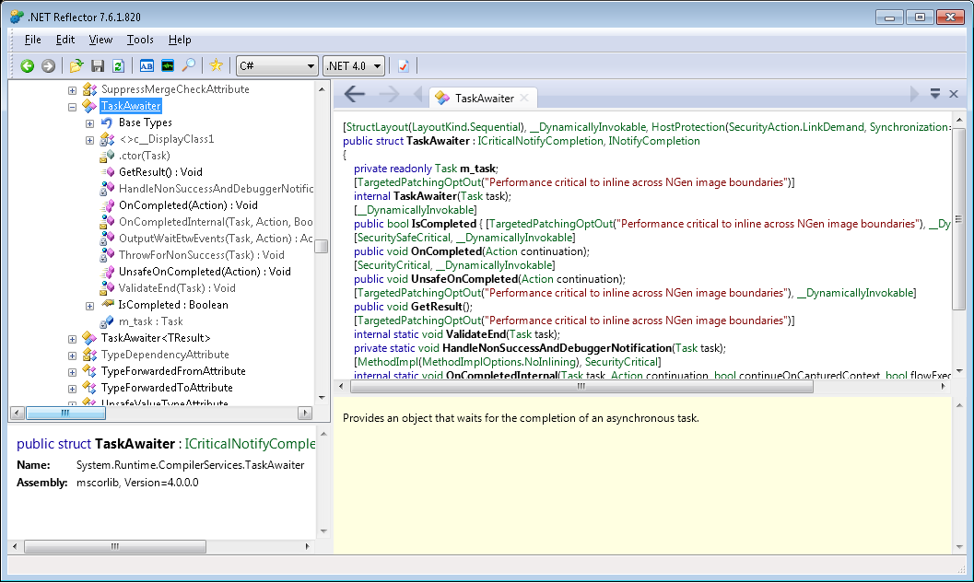
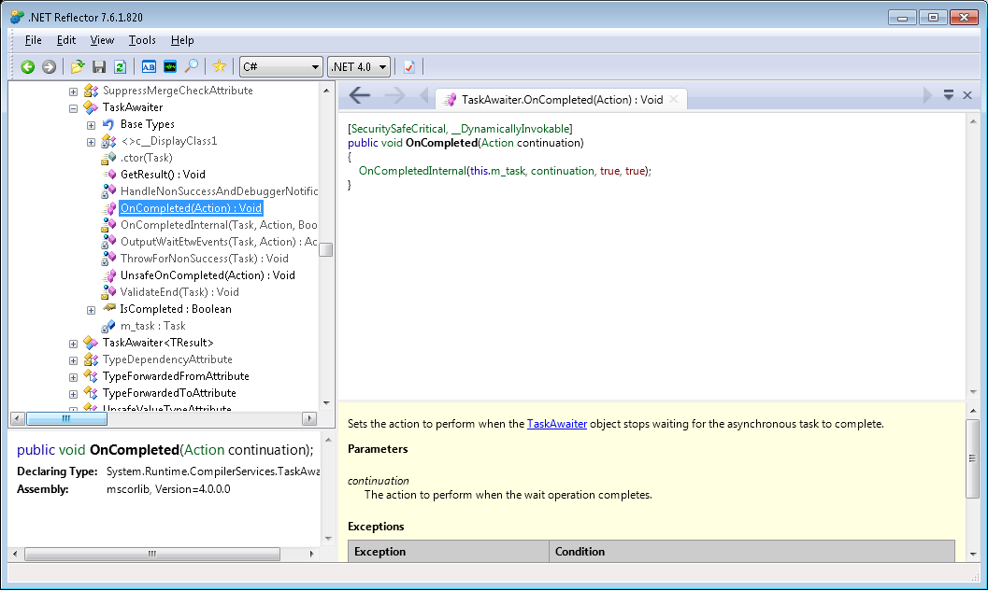
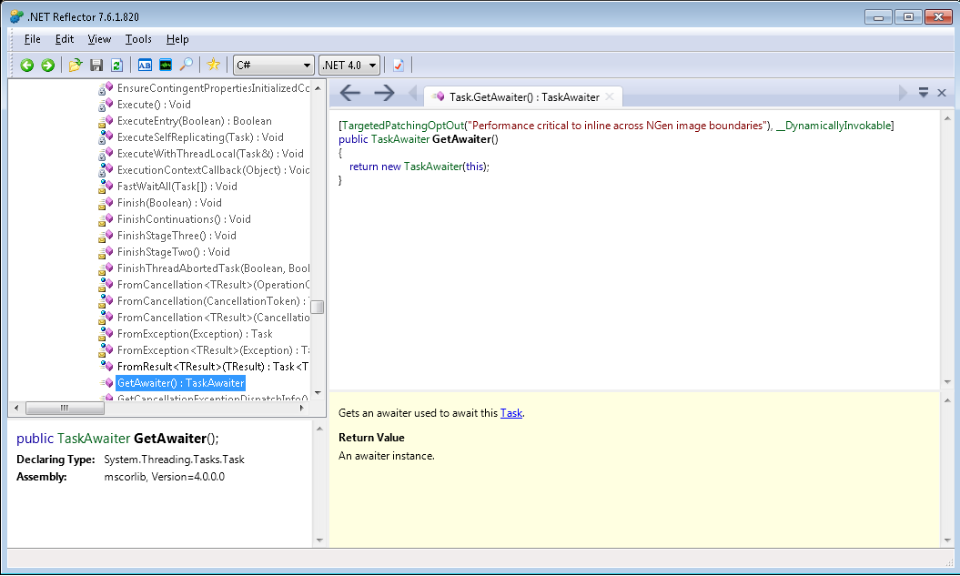
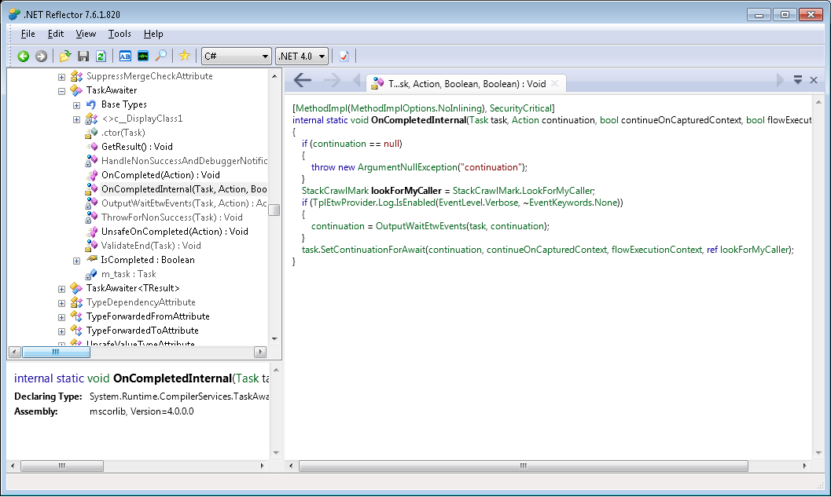
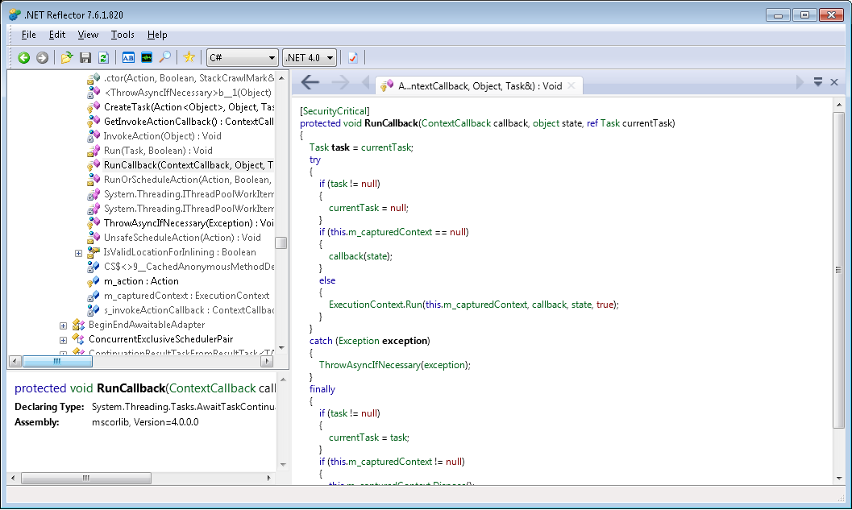
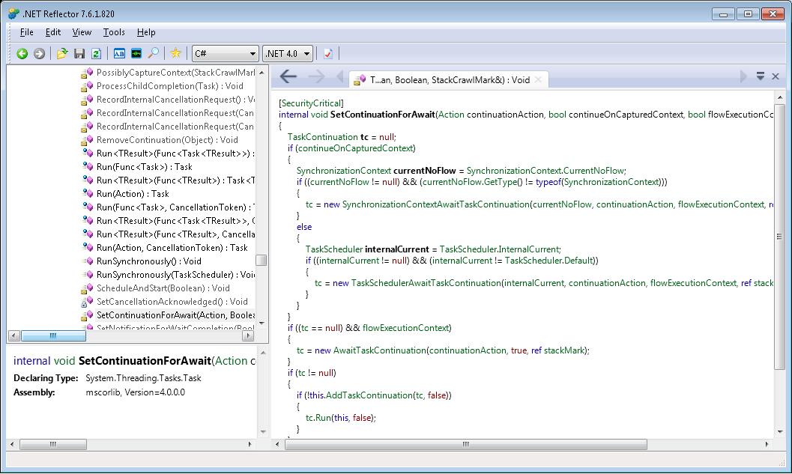
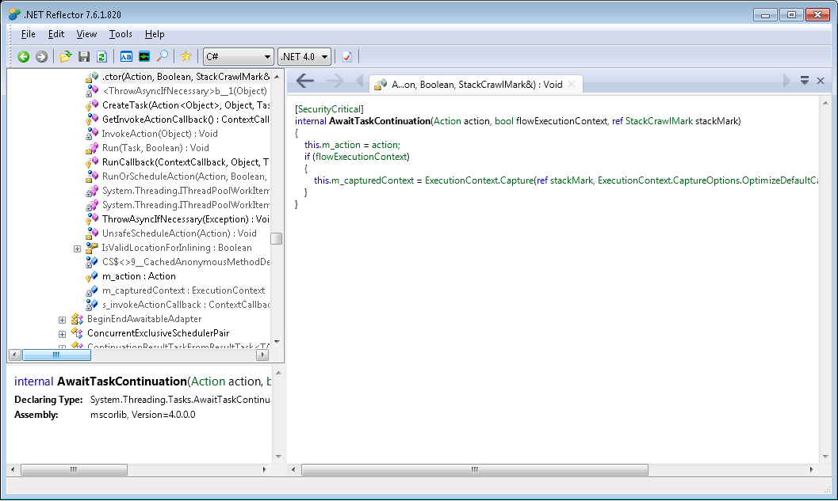
Awaiting a Task
Notes:
Never have to implement yourself
- lots of hard work to get it right and subtle interaction with the state like the synchronisation context
– Microsoft have got the task type to obey the await mechanism

Slide 35

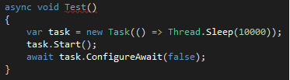
Some useful Task items

Slide 36
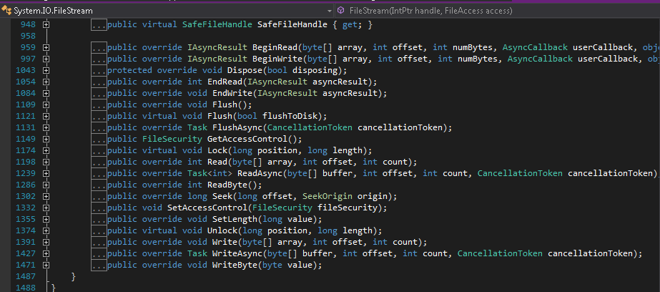
FileStream
Notes:
Talked before about all the places where the libraries have been extended.

Slide 37
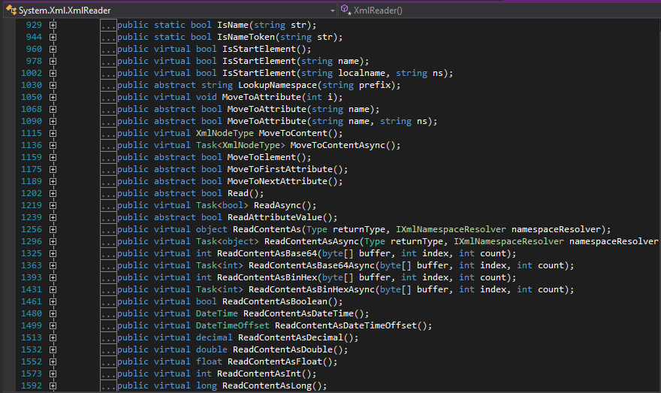
XmlReader

Slide 38
What did async give us?
A way to write linear code that pauses without locking a resource
A way to encourage responsive applications

Slide 39
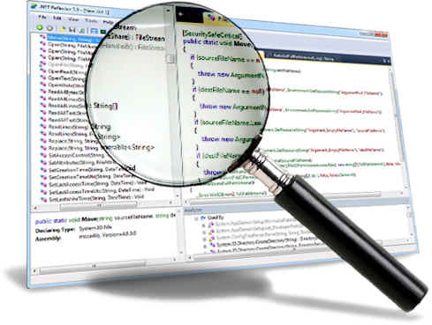
www.reflector.net
Understand and debug any .NET code. Try it out.

