Slide 1
OAuth and OpenID Connect
OAuth is not an authentication protocol

Slide 2
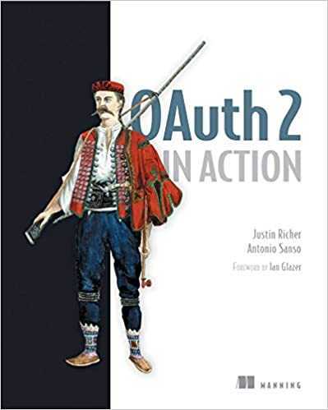

Slide 3
OAuth’s flows
OAuth 2.0 fits many scenarios
Let’s look at the classic Authorization Flow

Slide 4
The Browser Dance
Resource Owner (me)
Browser
Authorization Server
Application
Protected Resource

Slide 5
Ask client to do something
Resource Owner (me)
Browser
Authorization Server
Application
Protected Resource

Slide 6
Please authenticate
Resource Owner (me)
Browser
Authorization Server
Scopes
Application
Protected Resource

Slide 7
Issue a token
Resource Owner (me)
Browser
Code
Authorization Server
Application
Protected Resource

Slide 8
Convert code to token
Resource Owner (me)
Browser
Authorization Server
Get access token
Application
Protected Resource

Slide 9
Client access (within allowed scopes)
Resource Owner (me)
Browser
Authorization Server
Application
Bearer token
Protected Resource

Slide 10
And I can go away
Authorization Server
Application
Protected Resource
Refresh token

Slide 11
Some key points
The client has my delegated authority after my single authentication
The access token can be refreshed using a refresh token
There was some form of authentication going on
The authentication and resource know and share information
There are other flows inside the OAuth specification

Slide 12
But OAuth is not an authentication protocol
Even though some authentication happened
The client can’t tell who we are
Or how we authenticated
Or if we are even present (as we may have generated the token a long time ago)

Slide 13
OpenID Connect
{
“access_token”: “438jdjie3ue2u8989”,
“token_type”: “bearer”,
“id_token”: “hfdhjdfjhfj.3io3ioi23ioeio3ei3io3eoi3eoie3oieioeioe3io.dj739r97r9r8987r”
}
Signed JWT containing at least sub/iss/aud (who, issued by, for client) and an validity window

Slide 14
And an endpoint (protected resource)
/UserInfo
Scopes to control access to the profile (openid/profile/email/address/phone)
{
“sub”: “sksksksksk”,
“preferred_username”: “tarquin”,
“name”: “Peter”,
“email”: tony@tiger.com
}

Slide 15
Summary
Authentication on Authorization on Authentication
See chapter 13 of the book where you get to implement this
You may sue someone like Google for the Authentication (using static configuration for the client) or there are dynamic client registration protocols defined

