Slide 1
Streams and Tables

Slide 2
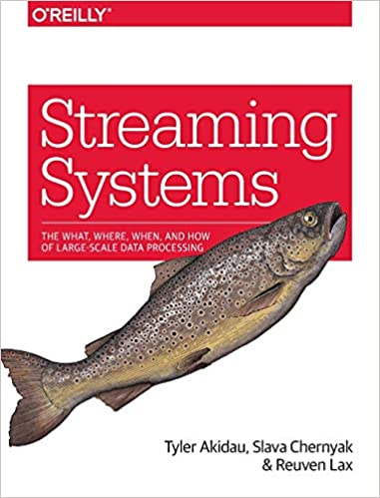


Slide 3
Big Data
Lots of data requiring a fleet of machines to process
Think log aggregation across a server farm Ad attribution for a company like Facebook log aggregation from Facebook running on your phone

Slide 4
Lambda Architecture
But we want the answers quicker!!
Two paths through the architecture fast approximate algorithms (clever but probabilistic, restarts so not strongly consistent) overnight batch processing system (say MapReduce)

Slide 5
Concepts
Bounded data
Unbounded data
Windowing – tumbling, sliding, session
Watermarks – completeness
Triggers - when is the data materialized
Difference between event time and processing time

Slide 6
Why is streaming hard?
You need to survive crashes
You need to restart parts of the computation
You need to handle side-effects
Out of order data
You need to commit at some point

Slide 7
Implementations batch /micro-batch /streaming
2003 MapReduce (scalability/simplicity)
2004 Hadoop (open source)
2008 Flume (pipelines/optimization)
2011 Storm (low latency weak consistency)
2009 Spark (strong consistency)
2007 MillWheel (out-of-order processing)
2011 Kafka (durable streams, streams and tables)
2014 Cloud dataflow (unified batch plus streaming)
2009 Flink (*) (open source innovator)
2016 Beam (**) (portability) (*) strongly consistent (**) sits on top of other runtimes/language bindings

Slide 8
Why is streaming interesting?
Compilation to a dataflow graph
This allows optimizations like fusion … without a fixed pattern

Slide 9
And to us
SQL can be used as the DSL for these engines
SQL's materialized views are already doing stream to table conversion (conceptually)
But a SQL with a notion of time … extend relations to time varying relations to get a semantics
Tables are streams of data at rest at a particular time … and naturally represent grouping

Slide 10
I didn't understand what you were on about
Have a look at Materialize - https://materialize.com/
They have SQL processing a stream of events
And they have a great demo of processing changes to wikipedia which you can run in your browser - https://materialize.com/docs/katacoda/?intro-wikipedia

