Slide 1
gRPC: A framework that keeps giving and giving and giving...

Slide 2
What is an RPC?
Think function call in your favorite language

Slide 3
Long heritage
Sun RPC in 1980s (ONC)
CORBA in 1990s - object based and location transparent - including languages like Dylan
Stubby and Thrift - Google and Facebook

Slide 4

Why GRPC?
Efficient in terms of message size
Contract first
Strongly typed
Polyglot
Duplex streaming
Commodity features
Cloud native friendly
Mature

Slide 5
Why not gRPC?
Not suitable for external facing services
Drastic service definition changes are hard
Small Ecosystem

Slide 6
Start at the beginning
We'll look through the standard counter example https://github.com/grpc/grpc-dotnet/tree/master/examples/Counter

Slide 7
syntax = "proto3";
import "google/protobuf/empty.proto";
package count;
service Counter {
rpc IncrementCount (google.protobuf.Empty) returns (CounterReply);
rpc AccumulateCount (stream CounterRequest) returns (CounterReply);
rpc Countdown (google.protobuf.Empty) returns (stream CounterReply);
}
message CounterRequest {
int32 count = 1;
}
message CounterReply {
int32 count = 1;
}

Slide 8
message HistoryResponse {
oneof ResponseType {
int32 progress = 1;
HistoryResult result = 2;
}
}
message HistoryResult {
repeated string items = 1;
}
message Product {
string id = 1;
string name = 2;
string description = 3;
float price = 4;
}
message Test {
optional int id = 4;
}
https://developers.google.com/protocol-buffers/docs/proto

Slide 9
Notes on IDL
Messages are call-by-value
Traditional RPC is unary - streaming was an interface defined on top
No notion of exception in the IDL (which CORBA had) - standard error codes and message text

Slide 10

Codegen CENTRIC
Bring me a stubbery shrubbery. One that looks nice...And not too expensive.

Slide 11
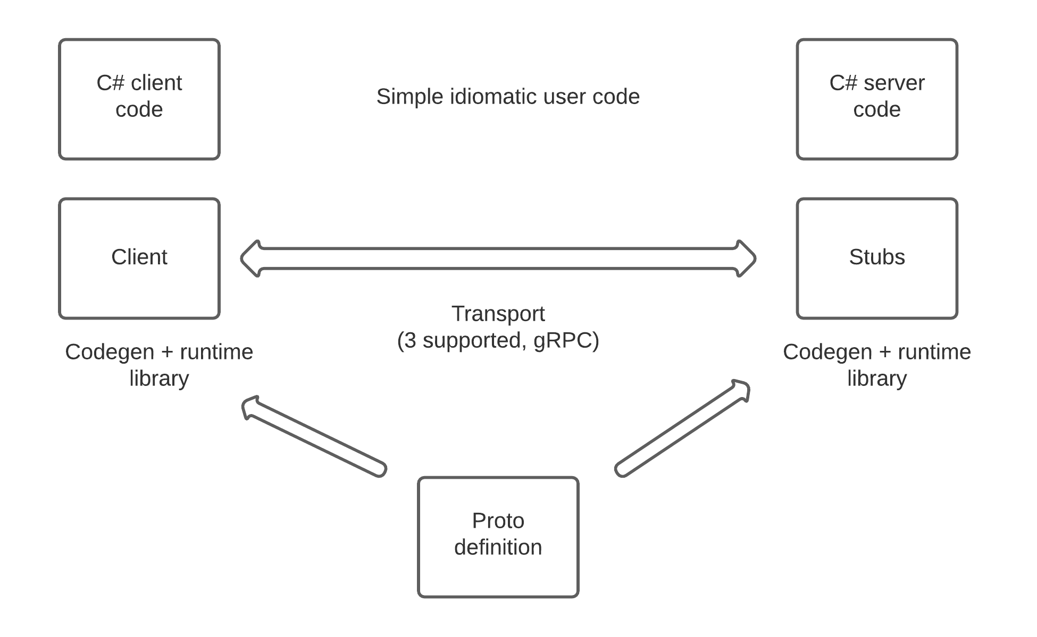

Slide 12
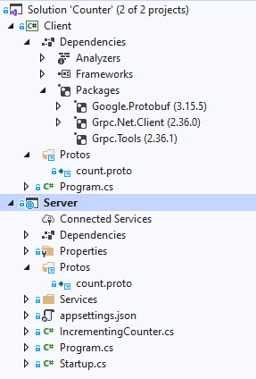
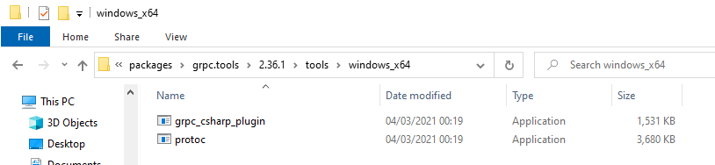

Slide 13
Idiomatic client side
using var channel = GrpcChannel.ForAddress("https://localhost:5001");
var client = new Counter.CounterClient(channel);

Slide 14
Idiomatic client side
private static async Task UnaryCallExample(Counter.CounterClient client)​
{​
var reply = await client.IncrementCountAsync(new Empty());​
Console.WriteLine("Count: " + reply.Count);​
}
rpc IncrementCount (google.protobuf.Empty) returns (CounterReply);​

Slide 15
Client side streaming to server
private static async Task ClientStreamingCallExample(Counter.CounterClient client)
{
using var call = client.AccumulateCount();
for (var i = 0; i < 3; i++)
{
var count = Random.Next(5);
await call.RequestStream.WriteAsync(new CounterRequest { Count = count });
}
await call.RequestStream.CompleteAsync();
var response = await call;
Console.WriteLine($"Count: {response.Count}");
}
rpc AccumulateCount (stream CounterRequest) returns (CounterReply);​

Slide 16
Client side HANDLES streaming from server
private static async Task ServerStreamingCallExample(Counter.CounterClient client)
{
using var call = client.Countdown(new Empty());
await foreach (var message in call.ResponseStream.ReadAllAsync())
{
Console.WriteLine($"Countdown: {message.Count}");
}
}
rpc Countdown (google.protobuf.Empty) returns (stream CounterReply);​

Slide 17
Server side stub supported
public class CounterService : Counter.CounterBase
{
private readonly ILogger _logger;
private readonly IncrementingCounter _counter;
public CounterService(IncrementingCounter counter, ILoggerFactory loggerFactory)
{
_counter = counter;
_logger = loggerFactory.CreateLogger<CounterService>();
}

Slide 18
Server side Unary calls
public override Task<CounterReply> IncrementCount(Empty request, ServerCallContext context)
{
_logger.LogInformation("Incrementing count by 1");
_counter.Increment(1);
return Task.FromResult(new CounterReply { Count = _counter.Count });
}
rpc IncrementCount (google.protobuf.Empty) returns (CounterReply);​

Slide 19
Server side streaming
public override async Task<CounterReply> AccumulateCount( IAsyncStreamReader<CounterRequest> requestStream, ServerCallContext context)
{
await foreach (var message in requestStream.ReadAllAsync()) {
_counter.Increment(message.Count); }
return new CounterReply { Count = _counter.Count };
}
rpc AccumulateCount (stream CounterRequest) returns (CounterReply);​

Slide 20
Server side streaming
public override async Task Countdown(Empty request, IServerStreamWriter<CounterReply> responseStream, ServerCallContext context)
{
for (var i = _counter.Count; i >= 0; i--)
{
await responseStream.WriteAsync(new CounterReply { Count = i });
await Task.Delay(TimeSpan.FromSeconds(1));
}
}
rpc Countdown (google.protobuf.Empty) returns (stream CounterReply);

Slide 21
EFFICIENT Marshalling
Marshalled using protobuf which has a versioning story using tagged fields
Strings using UTF-8 (self-synchronizing, find rune by byte search) 0xxxxxxx, 110xxxxx 10xxxxxx, 1110xxxx 10xxxxxx 10xxxxxx, 11110xxxx 10xxxxxx 10xxxxxx 10xxxxxx
Numbers in two formats 7-bits per byte from the low end zigzag encoding
Each item preceded by a byte (tag << 3 | type)

Slide 22
Let's have a look at HTTP/2
No Fiddler, which doesn't do HTTP/2
Wireshark which cannot capture localhost on windows
Modify to use a VM
using var channel = GrpcChannel.ForAddress("http://192.168.254.119:55555");
.ConfigureWebHostDefaults(webBuilder =>
{
webBuilder.UseStartup<Startup>();
webBuilder.UseUrls("http://0.0.0.0:55555");
});

Slide 23
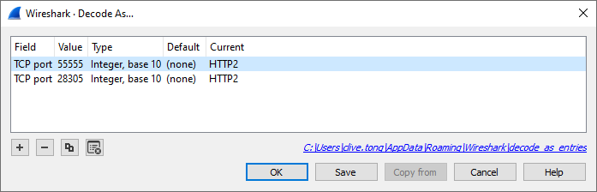
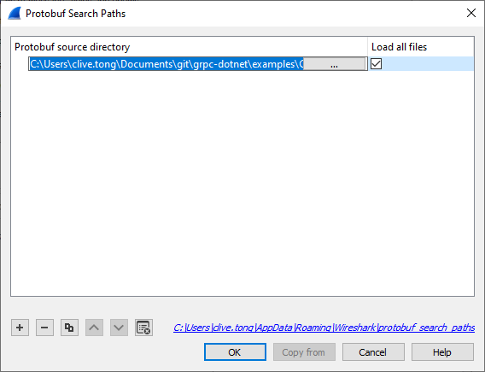
Set the protocol and proto paths

Slide 24
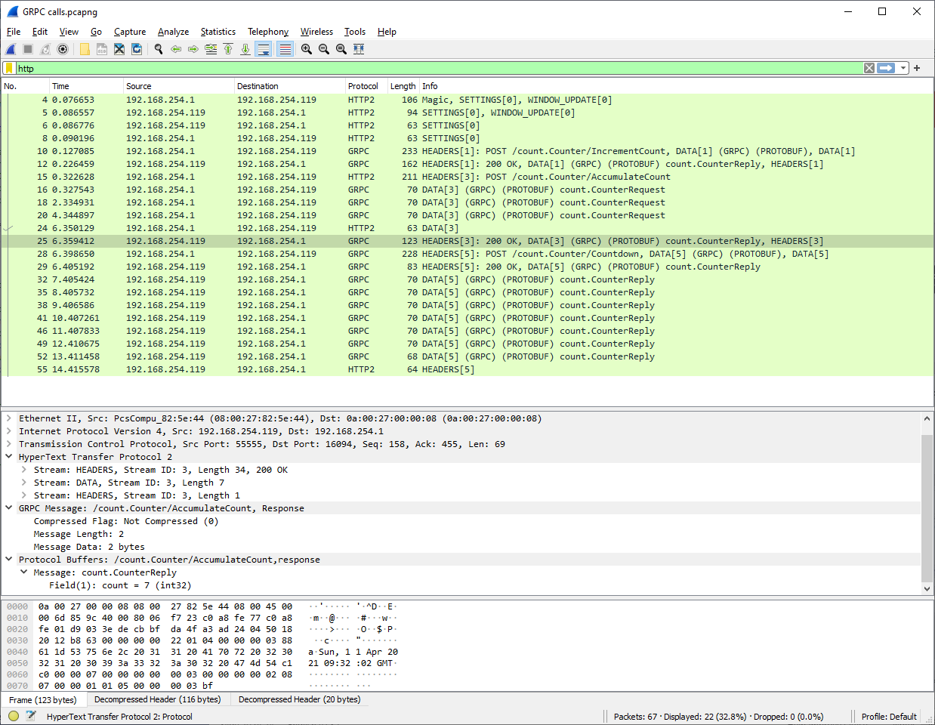

Slide 25
Other messagING features
Deadlines var reply = await client.IncrementCountAsync(new Empty(), deadline: DateTime.UtcNow.AddMilliseconds(50));
Cancellation
client.AccumulateCount(cancellationToken: cts.Token); if (context.CancellationToken.IsCancellationRequested)
Metadata
Extra information (think LogicalCallContext)

Slide 26
Middleware (interceptors)
Client and Server side (for cross cutting concerns)
Many predefined implementations for tracing or Prometheus
public class ClientLoggerInterceptor : Interceptor
{
public override AsyncUnaryCall<TResponse> AsyncUnaryCall<TRequest, TResponse>(
TRequest request,
ClientInterceptorContext<TRequest, TResponse> context,
AsyncUnaryCallContinuation<TRequest, TResponse> continuation)
{
…...................

Slide 27
Microsoft Client Extensions And Limitations
Retry and Hedging policies - https://docs.microsoft.com/en-us/aspnet/core/grpc/retries?view=aspnetcore-5.0
Limited Exception policy based on status codes - https://docs.microsoft.com/en-us/dotnet/architecture/grpc-for-wcf-developers/error-handling
throw new RpcException(new Status(StatusCode.PermissionDenied, "Permission denied"), metadata);

Slide 28
But I WANT REST as well
Various transcoding proxies that will handle this (Envoy)
And Microsoft have an experiment - https://docs.microsoft.com/en-us/aspnet/core/grpc/httpapi?view=aspnetcore-5.0

Slide 29
But the Browser API fetch API isn't HTTP/2
Proxies again, where Microsoft have first class support for this The client is codegen'd and can be called from your JavaScript
See https://docs.microsoft.com/en-us/aspnet/core/grpc/browser?view=aspnetcore-5.0

Slide 30
Extra notes
Standardize interfaces like health checking - https://github.com/grpc/grpc-proto
Versioning - https://docs.microsoft.com/en-us/aspnet/core/grpc/versioning?view=aspnetcore-5.0

