Slide 1
Hot Reload
(aka Edit and Continue ++)

Slide 2
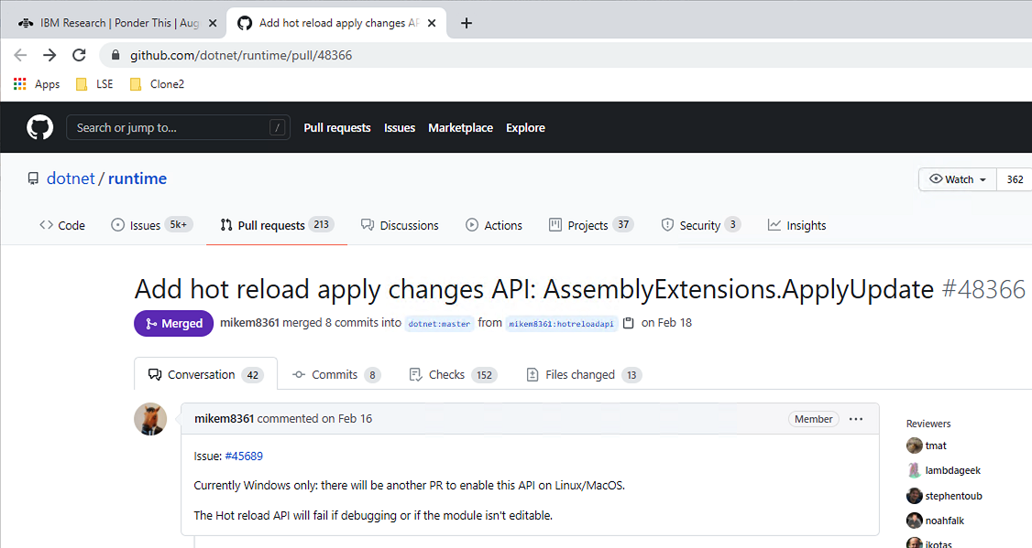
This PR from February https://github.com/dotnet/runtime/pull/48366

Slide 3
Edit and Continue (damp squib)
2005 Mike Stall article https://docs.microsoft.com/en-us/archive/blogs/jmstall/3rd-parties-and-edit-and-continue-part-1-editors-compilers
Hidden behind experimental Ilasm flag and early Roslyn
2016 Josh Varty (Alive) https://joshvarty.com/2016/04/18/edit-and-continue-part-1-introduction/
Under investment (bitness/limited changes)

Slide 4
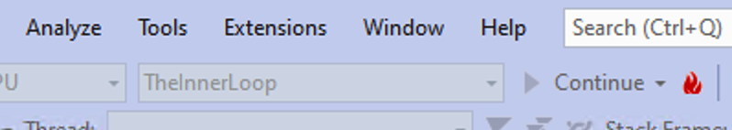
The second coming

Slide 5
The inner loop
Those small changes where you don’t want to throw away state and have to wait for a reload [DEMO]

Slide 6
Why now?
Competition against more dynamic languages
Competition against developer tools for specific domains (CSS)
The push to get development as fast as other platforms C# top level statements and global using minimal API for ASP.NET

Slide 7
But what’s still missing
<Rant enabled>
Exploratory programming
In particular, using code to investigate the state of the system
<Rant disabled>

Slide 8
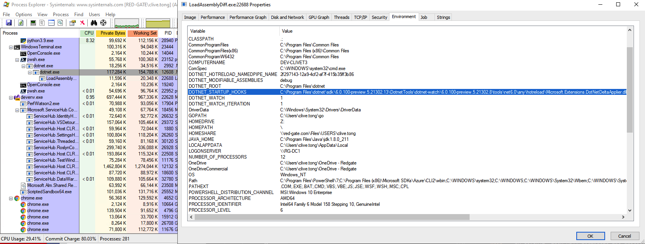
Under the covers
Made available by dotnet watch [DEMO]

Slide 9
And some CLR support
Start up hooks
Mark the assembly as modifiable

Slide 10
Loading the modifications
First we need a metadata, il and pdb diff
We can use Roslyn to generate these
Weird that csc is no longer aimed at humans but is expected to be wrapped by a tool (see build.txt, Cutdown.txt)
See Builder project

Slide 11
Dynamic loading
We can call the update method to load the changes … but we need to tell the CLR first to get ready

Slide 12
What does an edit mean?
Typically changes to IL for methods
But you can also add fields (uses the ideas of Conditional Weak Tables they added for dependency properties)
But note this isn’t real on-stack replacement

