Slide 1
Hot Reload
(aka Edit and Continue ++)

Slide 2
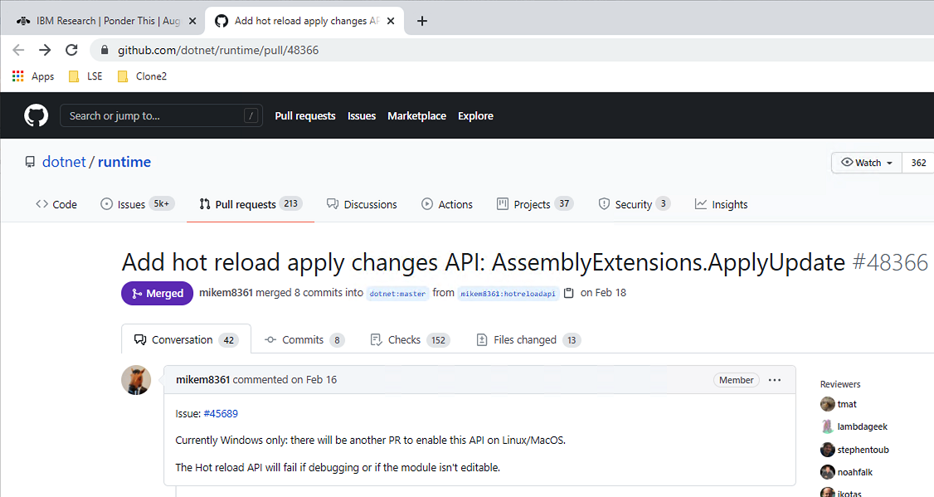
This PR from February https://github.com/dotnet/runtime/pull/48366

Slide 3
Edit and Continue (damp squib)
2005 Mike Stall article https://docs.microsoft.com/en-us/archive/blogs/jmstall/3rd-parties-and-edit-and-continue-part-1-editors-compilers
Hidden behind experimental Ilasm flag (/Enc) and early Roslyn
2016 Josh Varty (Alive) https://joshvarty.com/2016/04/18/edit-and-continue-part-1-introduction/
Under investment (bitness/limited changes)

Slide 4
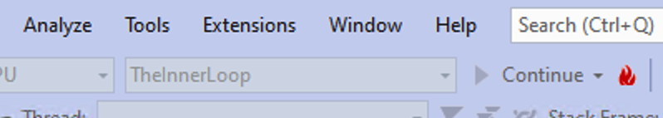
The second coming

Slide 5
The inner loop
Those small changes where you don’t want to throw away state and have to wait for a reload [DEMO – the flame - TheInnerLoop]

Slide 6
Why now?
Competition against more dynamic languages
Competition against developer tools for specific domains (CSS)
The push to get development as fast as other platforms C# top level statements and global using minimal API for ASP.NET

Slide 7
But what’s still missing
<Rant enabled>
Exploratory programming
In particular, using code to investigate the state of the system
<Rant disabled>
[Demo – TheInnerLoop – call from inside immediate]

Slide 8
Not just debugger supported anymore
ICorDebug2 interface added ApplyChanges https://docs.microsoft.com/en-us/dotnet/framework/unmanaged-api/debugging/icordebugmodule2-applychanges-method
There’s also function remapping to change to a given IL offset
[DEMO – dotnet watch - TheInnerLoop]

Slide 9
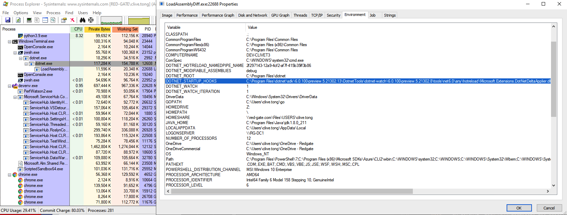
Under the covers

Slide 10
And some CLR support
Make the load available in managed code
Start up hooks so started by dotnet run
Mark the assembly as modifiable

Slide 11
Loading the modifications
First we need a metadata, il and pdb diff
We can use Roslyn to generate these
Weird that csc is no longer aimed at humans but is expected to be wrapped by a tool (see build.txt, Cutdown.txt)
[DEMO See Builder project]

Slide 12
Dynamic loading
We can call the update method to load the changes … but we need to tell the CLR first to get ready
[DEMO run outside dotnet watch]

Slide 13
What does an edit mean?
Typically changes to IL for methods
But you can also add fields (uses the ideas of Conditional Weak Tables they added for dependency properties)

Slide 14
On stack replacement?
No
[DEMO see NotOSR project first in dotnet watch and then debugger]

