Slide 2
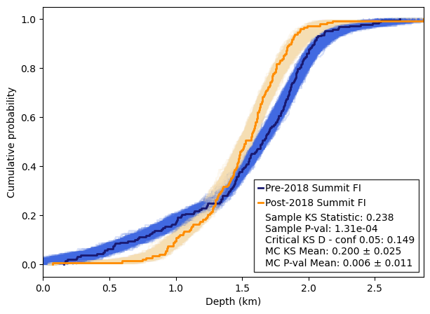
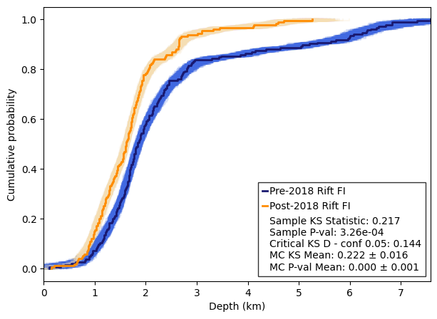
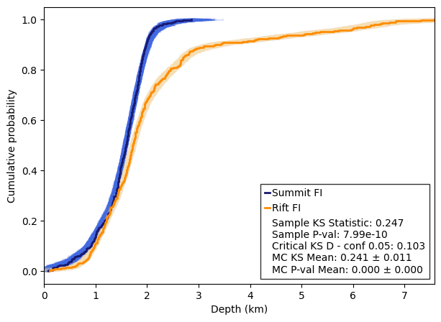
Pre-Post 2018
Summit FI
Pre-Post 2018
Rift Zone FI
All Rift vs
All Summit FI

