Slide 1
PrePost Caldera Collapse project Kilauea
Updated Jan8 2025
Charlotte Devitre

Slide 2
On Jan 7 and Jan 8 2025, I reacquainted myself with the data and created the github folder. I combined all the data
Versions to that one. The Wip files are the only ones that can’t be synced to github, too heavy.
The most current of everything is in the folder “Version_on_pcloud” at present. But I reorganized the data folders in the
One that will be synced to github.
I manged to cleanup the merging up to EDS minerals and calculating pressures and depth corrected with XH2O
EBSD is merged
There are a few I don’t have 6mw data for, but for the ones I do, there isn’t necessarily a systematic offset to higher)
Check if these survived, if so, maybe rehit them. For now, leave it in and average 6 mw and 12 mw data.
919-005,008,56,58,60 and K24_36A (B,C,D are at 6mw for that one).
I’ve remerged the SWRZ data to match better the other data. Jan 22
For K21 (Keanakakoi data), I plotted laser power series for 2 FI with the highest densities, there is no appreciable diff
So I removed the lowest power (2mW) as precision is worse, and I just took a mean of all the reps for those FI, including
12 mW. The figs are saved in the notebook and in the processing fig folder for keanakakoi.
I processed and merged all the L84 and UW data as well. And combined with the EPMA data
(I will need to use the T correction for Cambridge to make sure I can comp with the LERZ FI)
I have not merged any glasses oand there is no EBSD (JAN 30, 2025)

Slide 3
Jan 30 2025
I will have to decide how to combine the data that has epma, right now it ends up in the same columns as EDS, which is fine but maybe not ideal
Also I will have to maybe use the T correction from Kil MIFI paper to be consistent with the Kil data

Slide 4
From Allan’s 2024 paper in EPSL about Keanakakoi and Uekahuna
Kīlauea's most recent explosive period occurred after a major caldera collapse at the end of the ‘Ailā‘au eruptions (1410–1470 CE) that output 4–6 km³of lava flows (Swanson et al., 2012). Subsequent centuries of explosive activity produced the Keanakākoʻi Tephra sequence (∼1500–1840 CE), which consists of up to 10-m-thick deposits of well-bedded ash, lapilli, and lithic clasts around Kīlauea's summit (Swanson et al., 2012; Swanson and Houghton, 2019; note: the sequence's minimum age is after 1823 CE but before 1840 CE [D. Swanson, U.S. Geological Survey, written communication, 2022], and we consider 1840 CE as the minimum age here). Earlier explosive periods at Kīlauea produced the Uēkahuna Ash (200 BCE–1000 CE) and Pahala Ash (24–10 ka) sequences (e.g., Decker and Christiansen, 1984; Easton, 1987; Fiske et al., 2009, 2019). Erupted tephra volumes were much less during these explosive periods compared to erupted lava volumes during the modern effusive era (i.e., since ∼1840 CE) (Swanson et al., 2014; Wright and Klein, 2014). Trace element patterns in olivine are consistent with decreased mantle melt fraction during the most recent (Keanakākoʻi) explosive period (Mourey et al., 2022). The observations suggest that magma supply rates during explosive eras may have been notably decreased compared to effusive periods. Magmas erupted during explosive periods are commonly more primitive and contain higher proportions of high-forsterite (Fo) olivine (Fo_{86–89}) than magmas erupted during the modern effusive era, suggesting differences in magma storage and mixing processes during explosive and effusive eras (Helz et al., 2015; Lynn et al., 2017; Garcia et al., 2018; Mourey et al., 2022; Lynn and Swanson, 2022). For example, it is commonly assumed that eruption of primitive magma indicates deeper magma storage and rapid ascent to the surface, and this hypothesis has been invoked to explain the high-temperature magmas erupted during Kīlauea's explosive eras (Sides et al., 2014; Helz et al., 2015; Lynn et al., 2017). However, this explanation remains largely untested, as detailed geophysical and petrologic geobarometry studies are only available for recent Kīlauea eruptions that involved less-primitive magmas.

Slide 5
Sample descriptions
K24 (June 2024 eruption summit)
K20 (2020 summit eruption)
KD24 (December 2024 SWRZ eruption)
Name | Vent | Site Lat DD | Site Lon DD | Site Datum | Sample Collected Date | Sample Formed Date | Sample Type | Sample Method | Quench Type
KS20-527 | Halemaumau 2020-12-20 Vents | 19.398634 | -155.291963 | WGS84 | 21-Dec-20 | 20 to 21 December 2020 | Tephra | Swept clasts from road surface | Air

Slide 6
Sample descriptions
From Izzy Sides notebook:
KL0919 (Dec 1974 eruption- Labeled 919) (site 17 Sides) 1071m
Fountain fissure with unusual morphology. No big ramparts or cones, just rounded structures on edges covered with
spatter and around which lava has flowed. Look like tree moulds but they aren’t. Spatter material is very dense, abundant
Pele’s tears, morphology of fissure (smooth lobe surfaces) suggest drainback a dominant process
N 19º22.649’ W 155º17.609’
KL0921 (K21) 1097m site 19 Sides
Keanakakoi old weathered spatter ramparts near 4x4 track. Weathered brown Material, relatively dense, smallish
Structures, focused along caldera ring faults.
Mid 1600s-mid1700s more likely early 1700s.
N 19º22.989’ W 155º17.464’

Slide 7
Sample descriptions pt2
From Izzy Sides notebook:
Uwekahuna bluff (UW) (site 27)
Uwekahuna pit excursion with Don. Samples collected from put at base of caldera wall, below HVO and approx. 25 m
From caldera floor. Massive pit dug out by don. Tim rose and Richard fiske. Corresponds to 2009 fiske et al paper in
American GSA bulleting april-may.
Explosive eruptions only occur in historical record when caldera is present. Position of water table may be important
Currently 500 m below caldera floor. In the past there is evidence that caldera might have been up to 400m deep.
Possibility that at one stage, may have been phreatomagmatic nature of eruptions in past. Check out paper by Mastin?
Samples from Kulanaokuaiki eruption (AD 400-1000). 1.8-2.0m Pit. Originally 3.12m tephra section
UW0903 also KU0903 (Labeled UW3)
TiO₂ + K₂O Rich Band. Unit 1 in pit (unit 2 overall)
UW0904 also KU0904 (Labeled UW4)
Band 13. Coarse layer with large vitric fragments up to 0.5 c size. Vesicular material. Fines upward into ash.
UW0905 also KU0905 (Labeled UW5)
Band 13. Med-coarse ash. Finer than material below. Contains some visible crystals fining upwards.

Slide 8
Sample descriptions pt3
From Izzy Sides notebook:
Uwekahuna bluff (UW) Site 28 965m
Kulanaokuaiki type section. Beneath the edge of an old Kalu’e lava flow on upper S flank ~600 m south of Kulanaokuaiki pit.
N 19º20.185’ W 155º16.462’
UW0907 also KU0907 (Labeled UW7)
Same pit (~1m deep_. K3 layer crystalline material (band ~7cm thick). Unit/band contained large clast up to 18cm
Diameter, pumiceous material. Abundant lithics, approx. 3-5% volume gabbroic material.

Slide 9
Sample descriptions pt 4
L84
1840, entry of a lava flow into the ocean at Honolulu Landing, near the present community of Hawaiian Beaches, constructed
a series of overlapping littoral cones called Sand Hill—the largest littoral cones preserved on the coast of Kīlauea (Lerner et al.,
2024) and Hill, in Nānāwale, consists of three overlapping ash and spatter cones originally rising as high as 60–90 m.
These littoral cones formed as a lava flow explosively entered the ocean beginning on 3 June 1840
(Coan, 1882; Wentworth, 1938; Trusdell, 2003) (Figs. 1a, 2k). Cone-building phreatomagmatic activity was sustained for about
three weeks, after which wave erosion quickly began removing the poorly unconsolidated pyroclastic material.
Brigham (1909) stated that by 1865 the tallest Sand Hill cone was only about a third of its original height.
Littoral deposits stretch along 270 m of the present-day shoreline in a band as much as 80 m wide.
By comparison with more completely exposed littoral cone deposits elsewhere in Hawaii, we estimate that the original,
pre-erosional area of tephra coverage was roughly on the order of a half square kilometer, though most of this material
fell atop new land added to the island by the advancing lava flow, which shifted the coast about 400 m seaward.
Wentworth (1938) noted that, in contrast to the KTC, Puʻulena Crater, and most other lower East Rift Zone tephra eruptions,
explosive activity building Sand Hill did not take place around a primary vent, but is entirely secondary in nature—a string of
shoreline rootless half-cones.

Slide 10
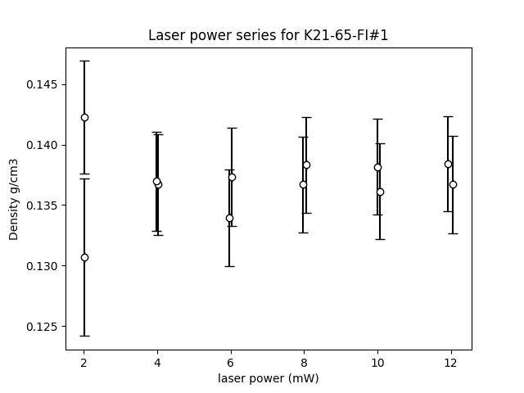
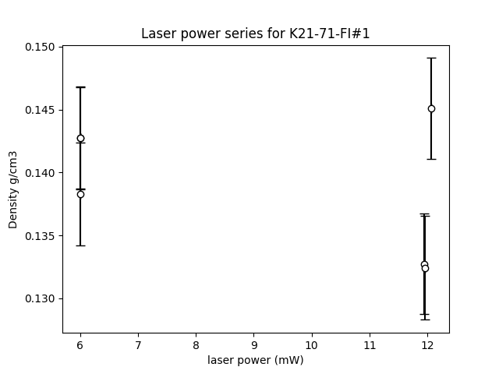
For K21 (Keanakakoi data), I plotted laser power series for 2 FI with the highest densities, there is no appreciable diff
So I removed the lowest power (2mW) as precision is worse, and I just took a mean of all the reps for those FI, including
12 mW. The figs are saved in the notebook and in the processing fig folder for keanakakoi. This is the github folder.
‘/PrePostCalderaKil_2025/Version_on_pcloud/
Data_processing_notebooks/Data_processing_Keana_Uwe_Litt/Data_processing_K21/Processing figs'

Slide 11
For K21 (Keanakakoi data), I plotted laser power series for 2 FI with the highest densities, there is no appreciable diff
So I removed the lowest power (2mW) as precision is worse, and I just took a mean of all the reps for those FI, including
12 mW. The figs are saved in the notebook and in the processing fig folder for keanakakoi. This is the github folder.
‘/PrePostCalderaKil_2025/Version_on_pcloud/
Data_processing_notebooks/Data_processing_Keana_Uwe_Litt/Data_processing_K21/Processing figs'

Slide 12
For K21 (Keanakakoi data), I plotted laser power series for 2 FI with the highest densities, there is no appreciable diff
So I removed the lowest power (2mW) as precision is worse, and I just took a mean of all the reps for those FI, including
12 mW. The figs are saved in the notebook and in the processing fig folder for keanakakoi. This is the github folder.
‘/PrePostCalderaKil_2025/Version_on_pcloud/
Data_processing_notebooks/Data_processing_Keana_Uwe_Litt/Data_processing_K21/Processing figs'

Slide 13
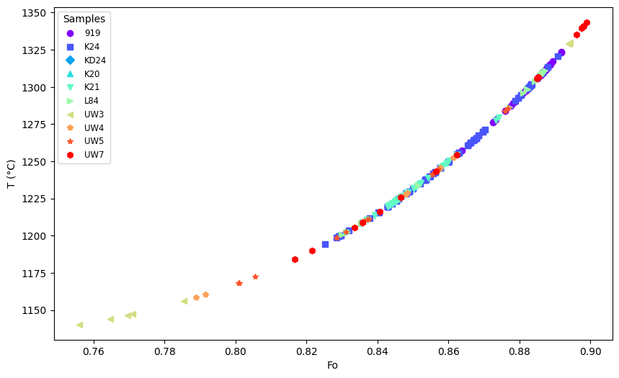
Full temp plot for all merged new data. Not corrected the old EPMA data

Slide 14
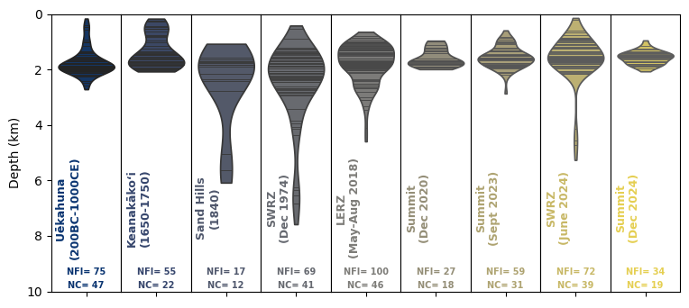
All depths so far. Pretty stable HMM dominated. Period between collapses is deeper.

Slide 15
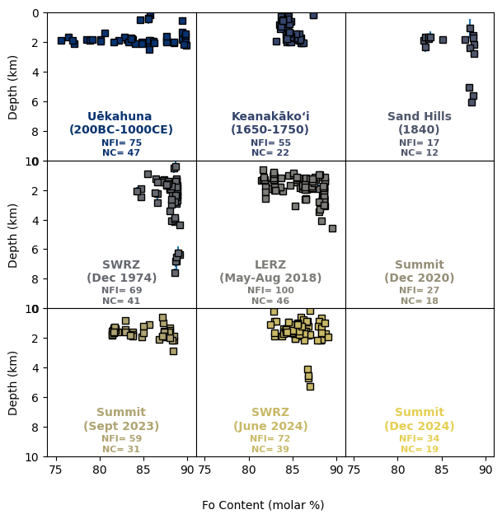
All depths so far. Pretty stable HMM dominated. Period between collapses is deeper.

