Slide 1
Approximate Solution

Slide 2
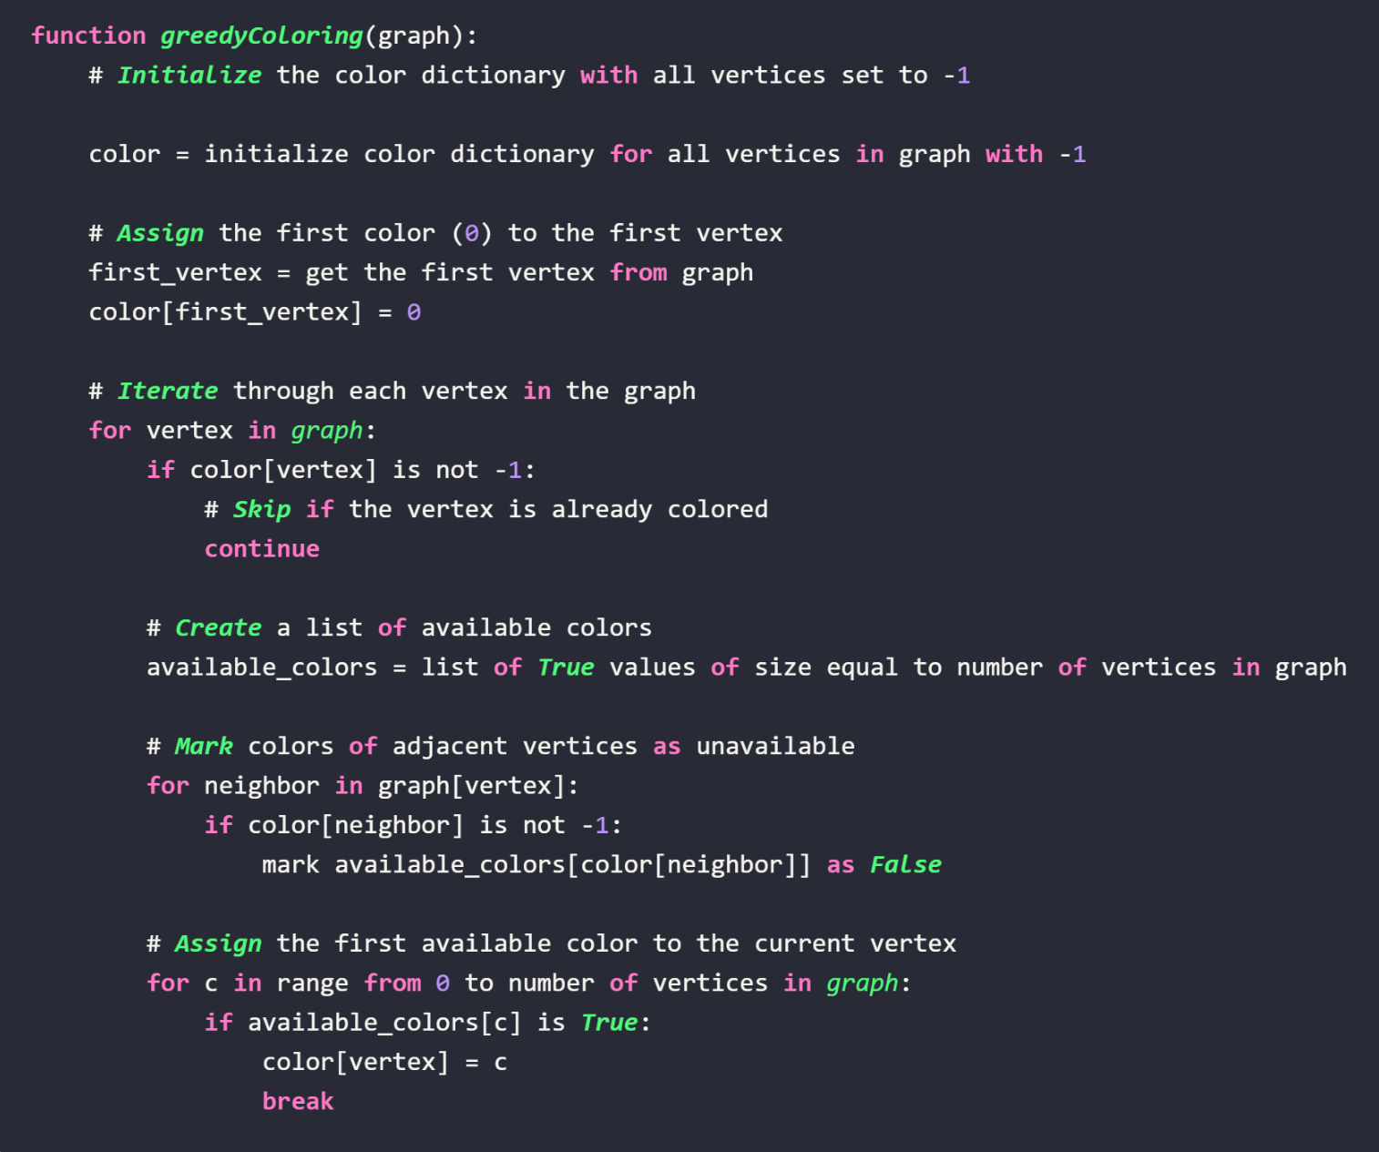
Pseudocode
Chose a greedy approach
Processes each vertex iteratively
Prevents the chance of neighboring colors by removing that color from neighboring vertices “available_colors” list

Slide 3
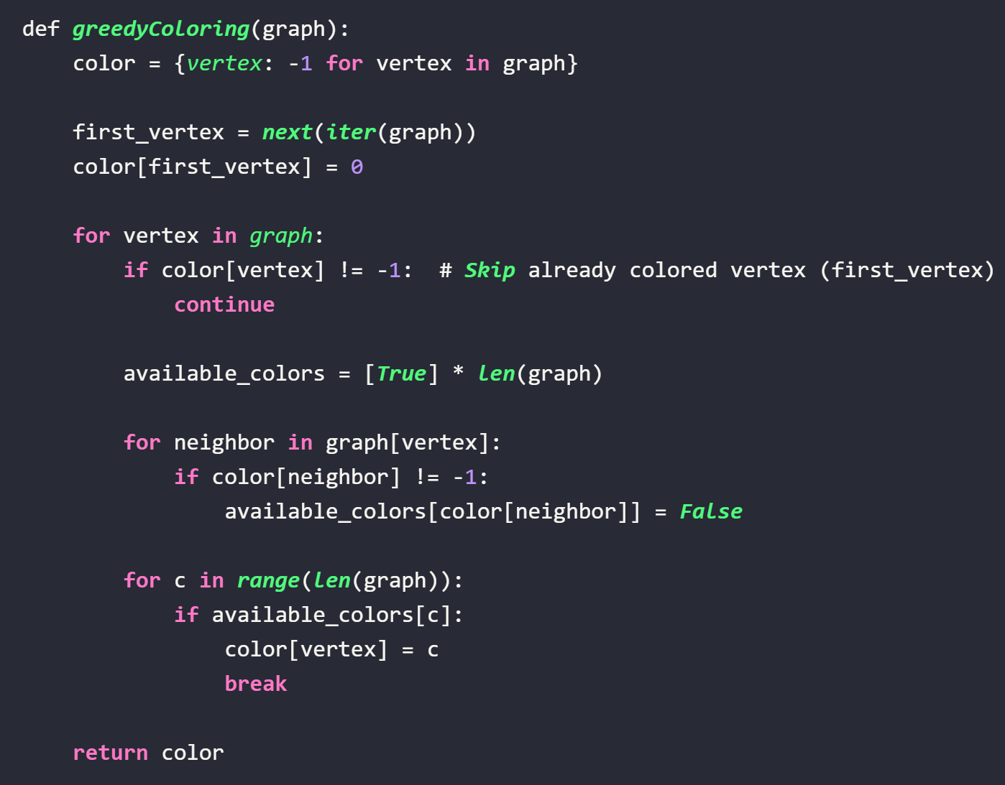
Approximate Solution Runtime
O(V² + E)
V = number of vertices
E = number of edges
Dictionary created for each vertex (V)
O(V)
Iterating over each vertex to create a list of available colors, mark unavailable colors, and find the first available color
O(V + E)

Slide 4
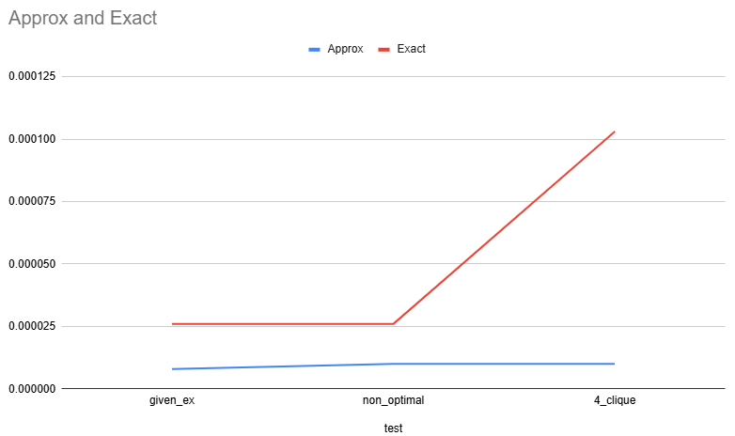
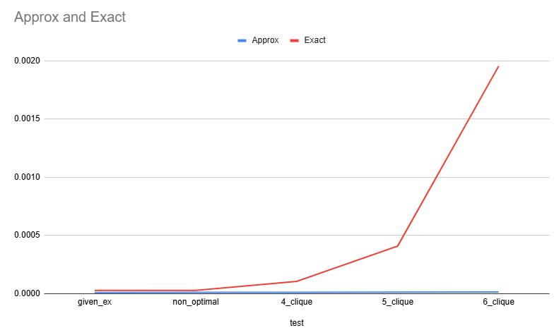
Runtime Differences

Slide 5
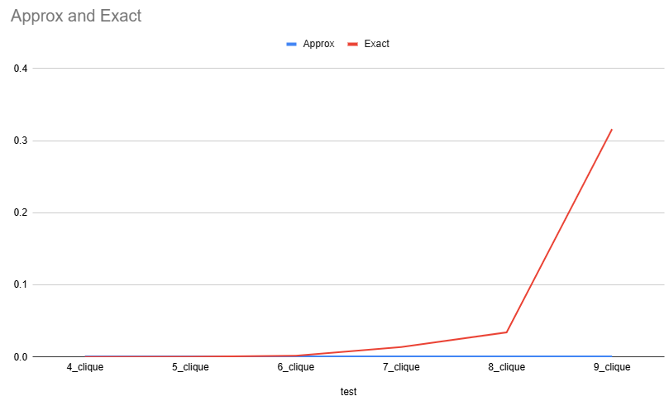
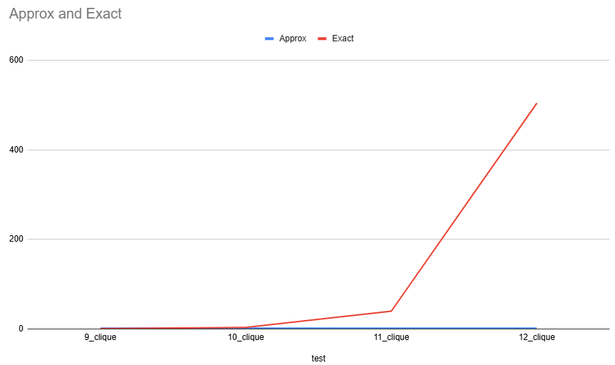
Runtime Differences
cont.

Slide 6
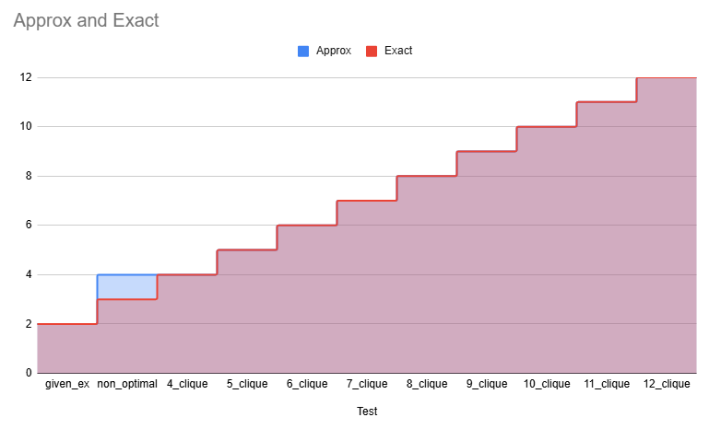
Solution Differences

Slide 7
Solution Differences
This is the issue

Slide 8
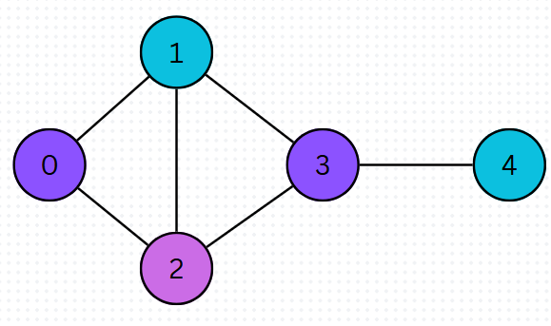
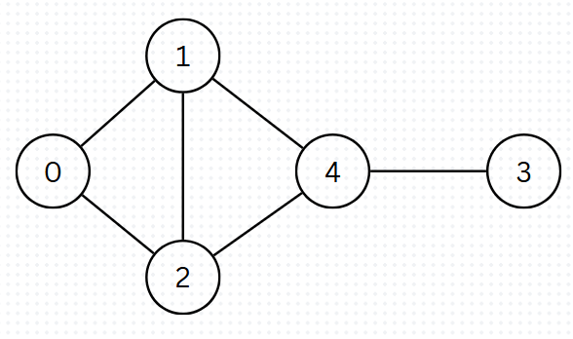
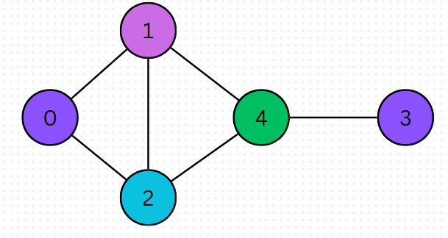
Solution Differences
Exact output
4
3
Approx output

Slide 9
Why this solution is an approximation:
First input
Order that the vertices are processed in matters
Second input

