Slide 1



Blocks World Project
Chappell Jones

Slide 2
Description of Methodology
Input
First, the user will input the blocks for the initial state in all three locations.
Output
Next, the user will enter the blocks for the final state.
Concatenate
After the inputs and output have been entered, concatenation will take place for the locations.
The Process
The blocks will then be moved by the robot arm, the states and commands will be printed until the desired state is reached.

Slide 3

The Format of the States and Commands
Top of the stack
The 3 locations of the states are represented in stack. The leftmost block is bottom of the stack and the rightmost block is the top of the stack.
Bottom of the stack
Bottom of the stack
Top of the stack

Slide 4
Check Location
If initial locations are not equal to the desired locations, then enter the loop.
If all locations are equal, then the process completed.
Loop Through Locations
If the stack is empty do nothing.
When a non-empty stack is detected, a decision of where to put a block will be made.
Pick and place
The blocks will be moved and placed based on a decided location.
Once the placing of a block is finished the status will print and the process will start again until the final state is reached.

Slide 5
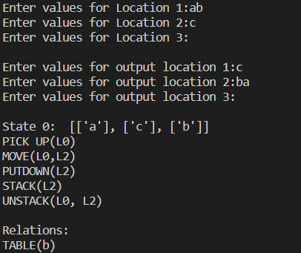
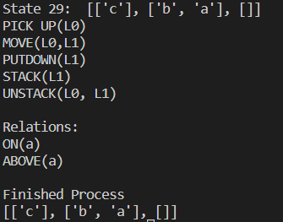
Example
Initial State
Final State

