Slide 1

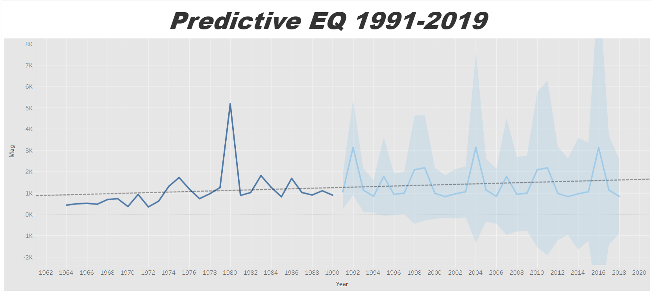
Average EQ with Prediction
Actual average earthquakes from 1964-1991
Forecasting Algorithm for 1992-2019
MASE of 0.45

Slide 2
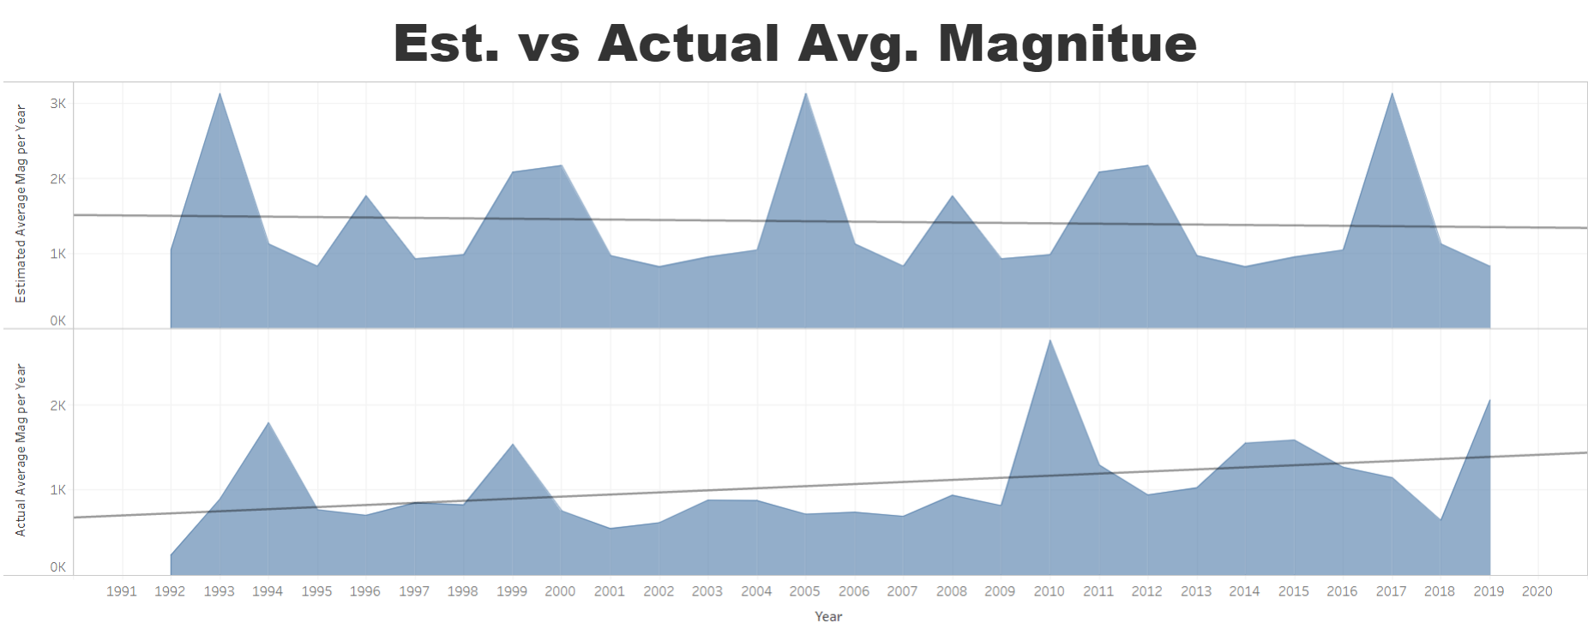
Estimate vs Actual 1991-2019
Estimated Slope is -5.6
Actual Slope is 24.48

Slide 3
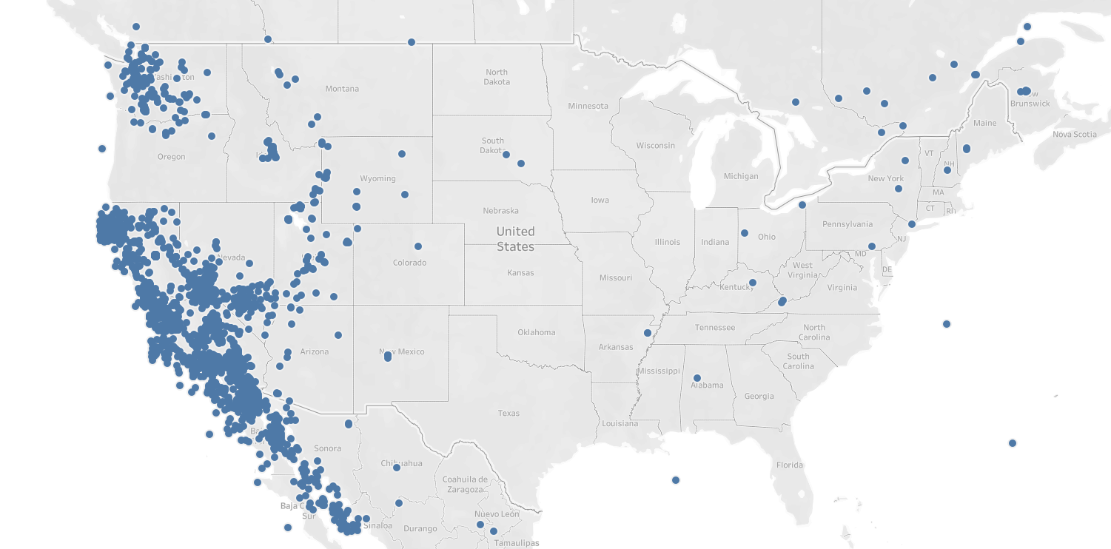
1964-1991 Earthquakes

Slide 4
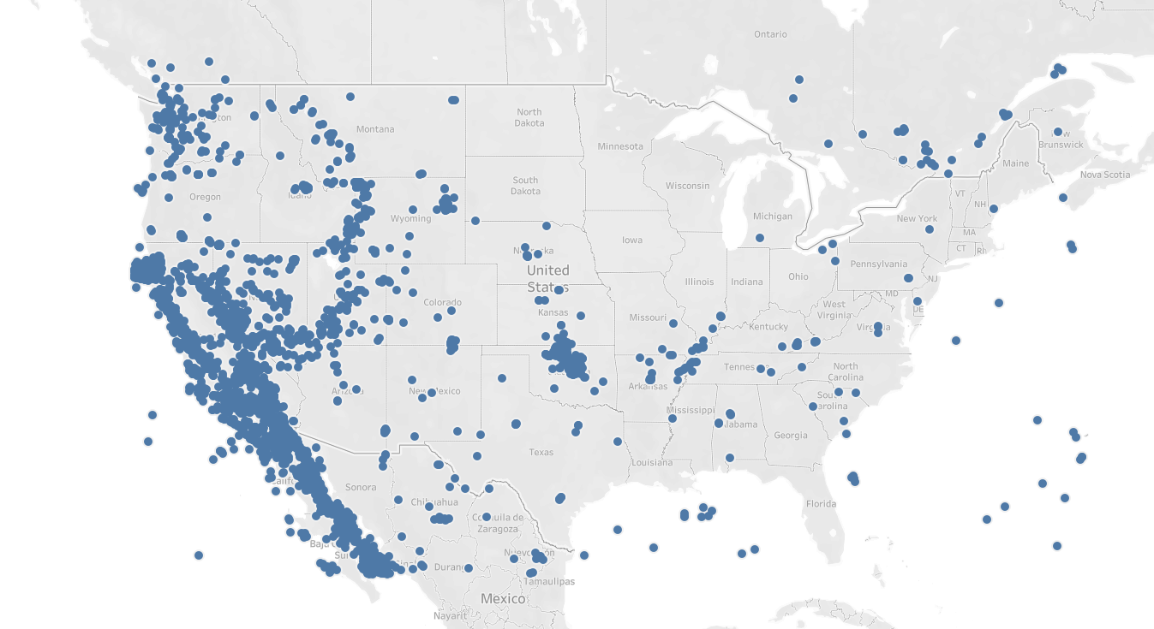
1992-2019 Earthquakes

