Slide 1
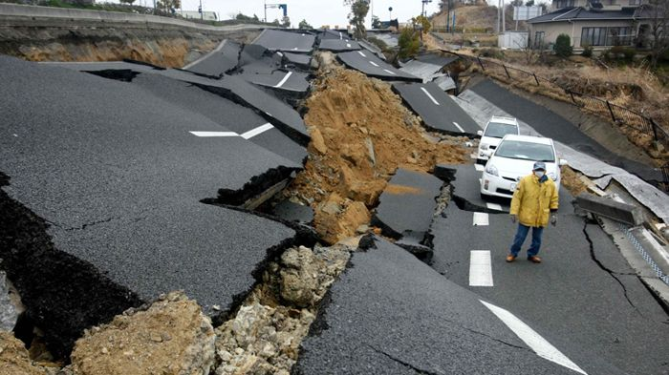
RICHTER
PREDICTOR
Exploring recorded earthquakes in the US
Kendall Phillip Choi Chris Ljungkull Max Oneill Finn Wurtz

Slide 2

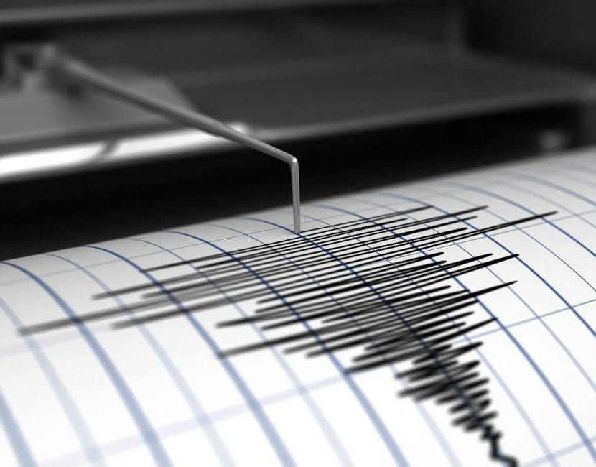
background

Slide 3
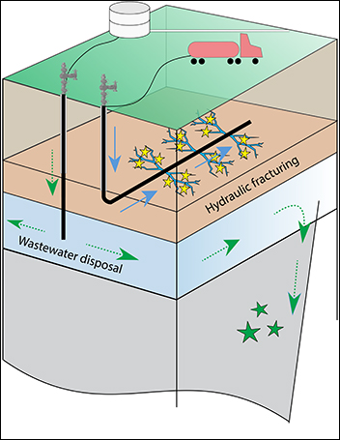
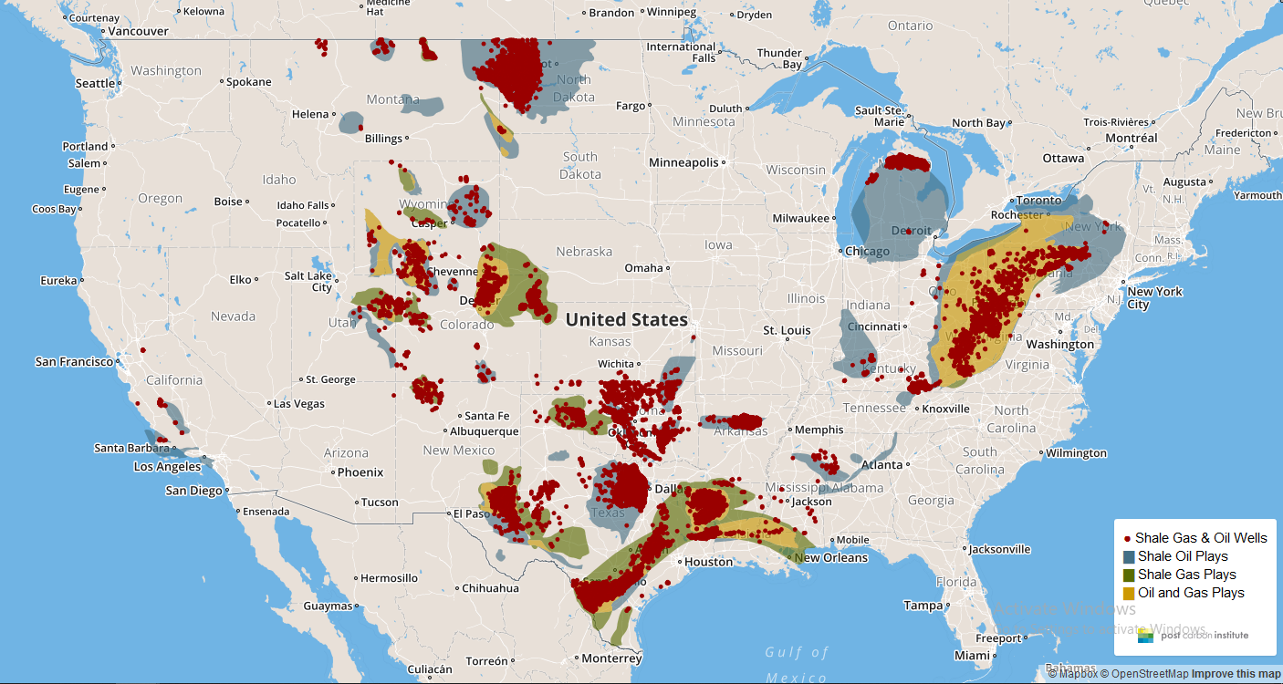
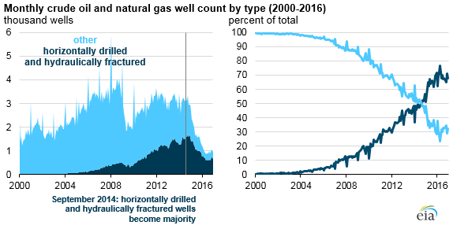
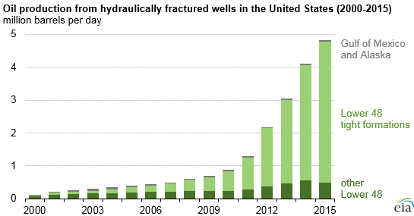
https://shalebubble.org/dbd-map/
background

Slide 4
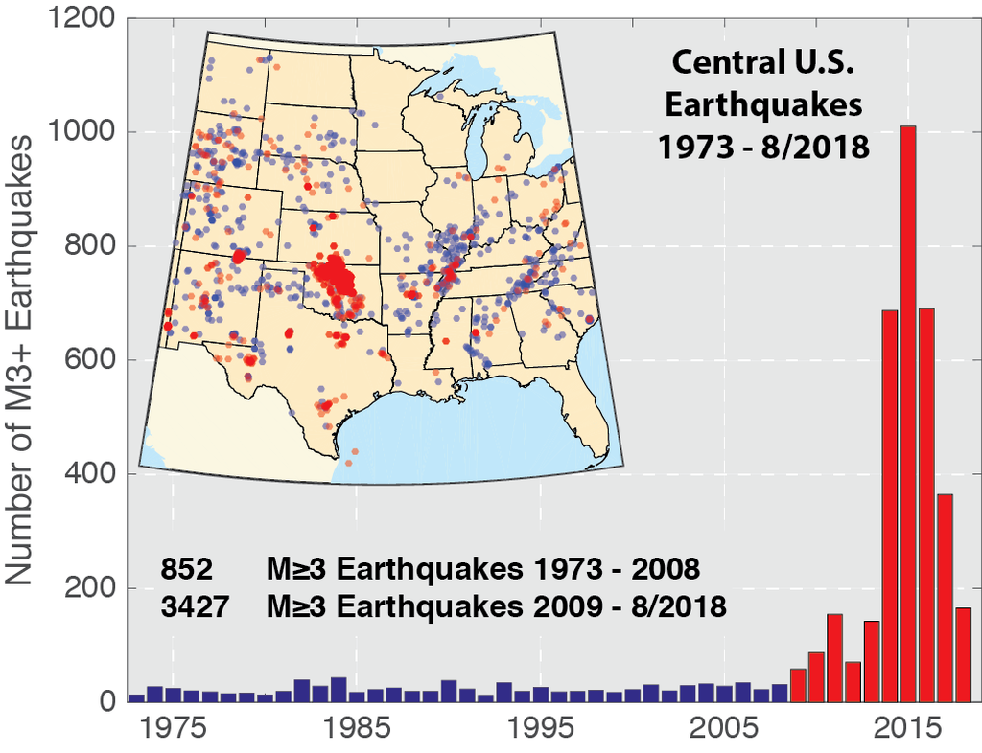
background

Slide 5
PROJECt scope
Geocoordinates and timeline of earthquakes in US > 3.5 M
Geocoordinates of Oklahoma fracking wells
Explore possible factors in unusual earthquake activities

Slide 6
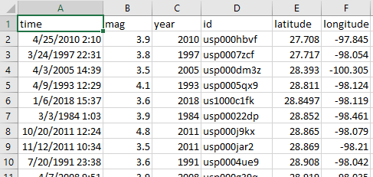
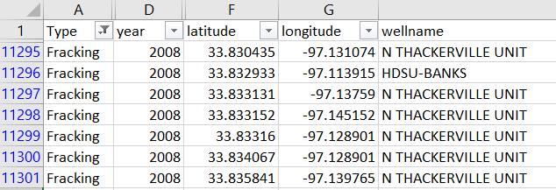
Data collection
usgs.gov
fractracker.org

Slide 7


METHODOLOGY

Slide 8
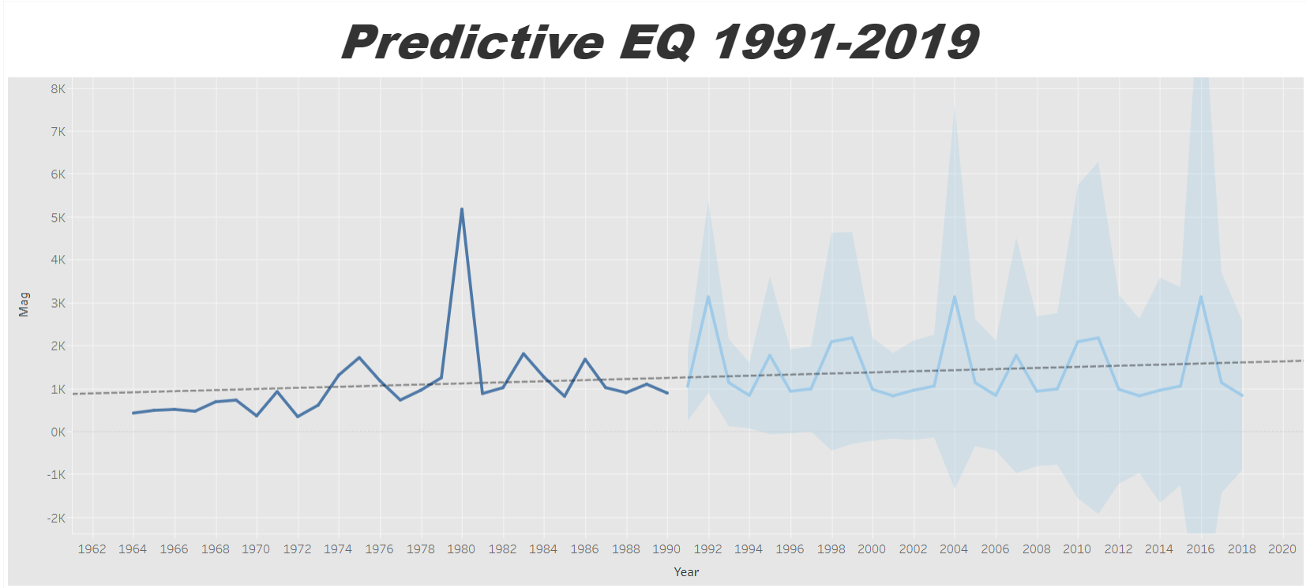

results
Actual average earthquakes from 1964-1991
Forecasting Algorithm for 1992-2019
MASE of 0.45

Slide 9
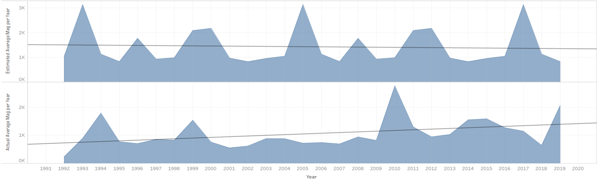
results
Estimate vs Actual 1991-2019
Estimated slope is -5.6
Actual slope 24.48
Tableau publication link

