Slide 1
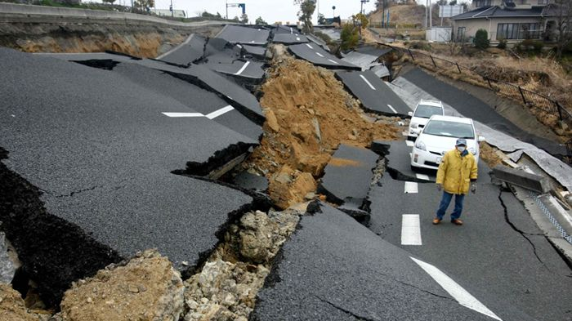
RICHTER
PREDICTOR
Exploring recorded earthquakes in the US
Kendall Phillip Choi Chris Ljungkull Max Oneill Finn Wurtz

Slide 2
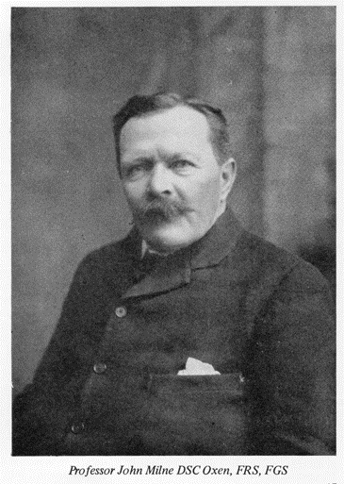
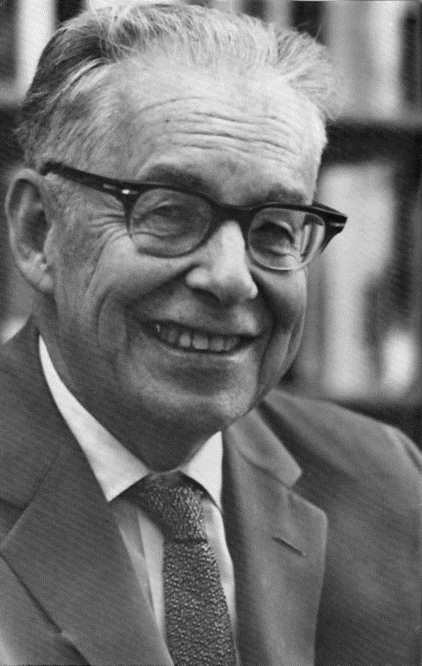
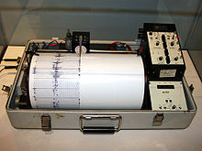
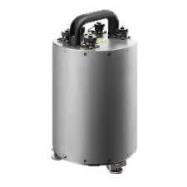
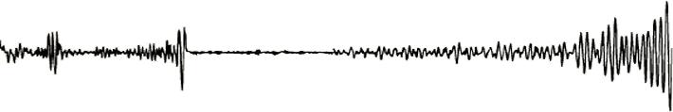
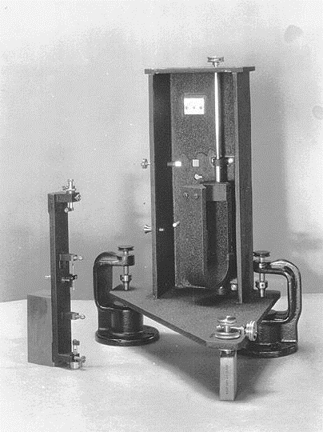
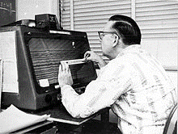
background
Entering 1900s:
seismology expands worldwide as the seismometer evolves
Mid-1900s:
Precise measurement and recordkeeping with improved computing
1880:
John Milne credited with first modern seismometer
1935:
Charles Richter introduces magnitude scale system
Today:
Earthquakes measured real-time, but no closer to predicting

Slide 3
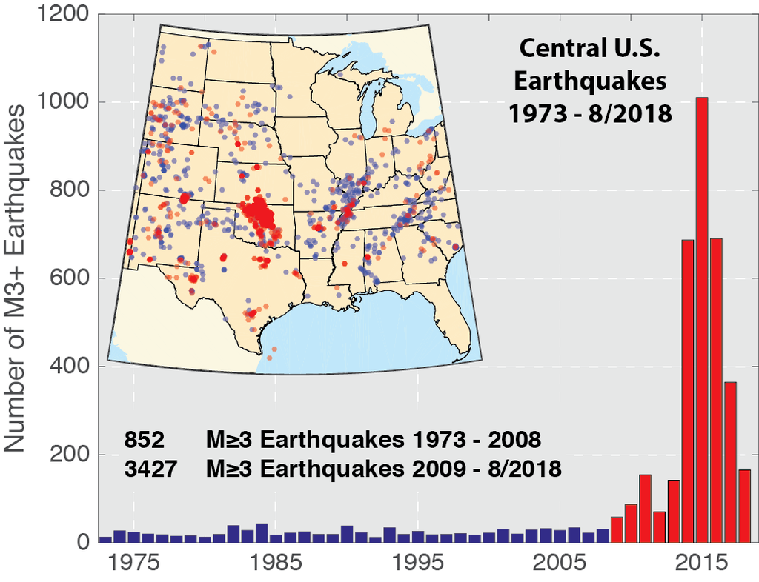
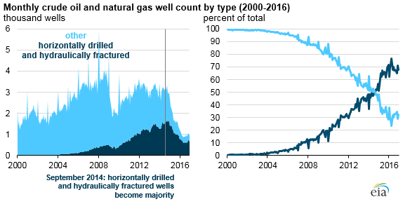
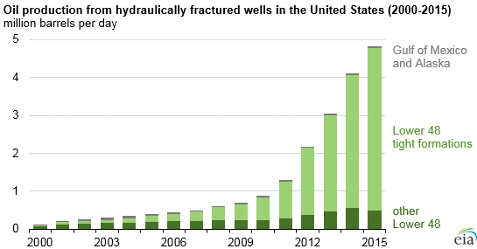
background

Slide 4
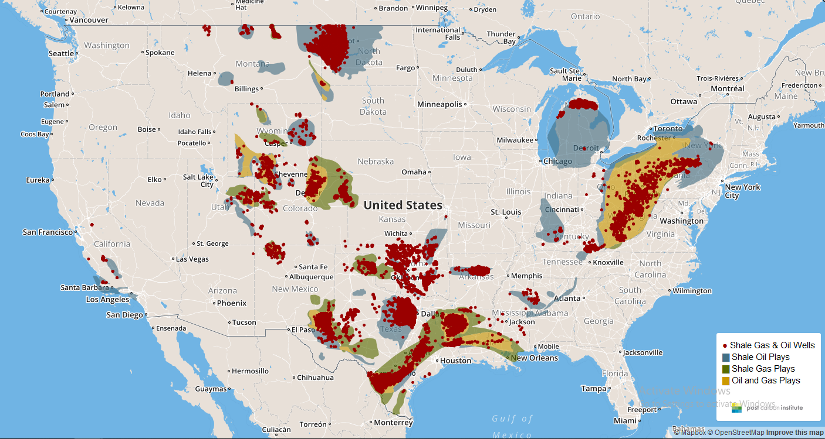
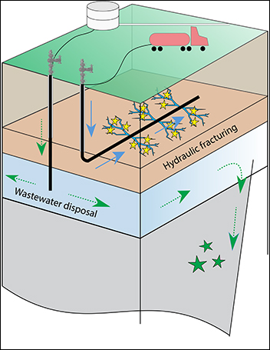
background
https://shalebubble.org/dbd-map/

Slide 5
PROJECt scope
Geocoordinates and timeline of earthquakes in US > 3.5 M
Geocoordinates of Oklahoma fracking wells
Dataset limited to active wells in 2011-2015

Slide 6


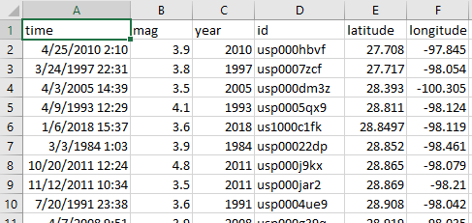
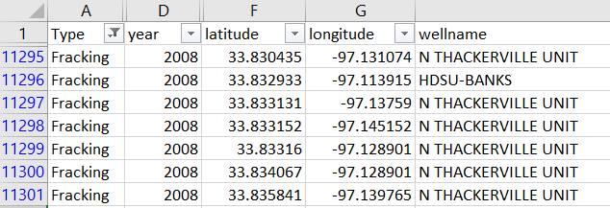
Data collection

Slide 7


METHODOLOGY

Slide 8
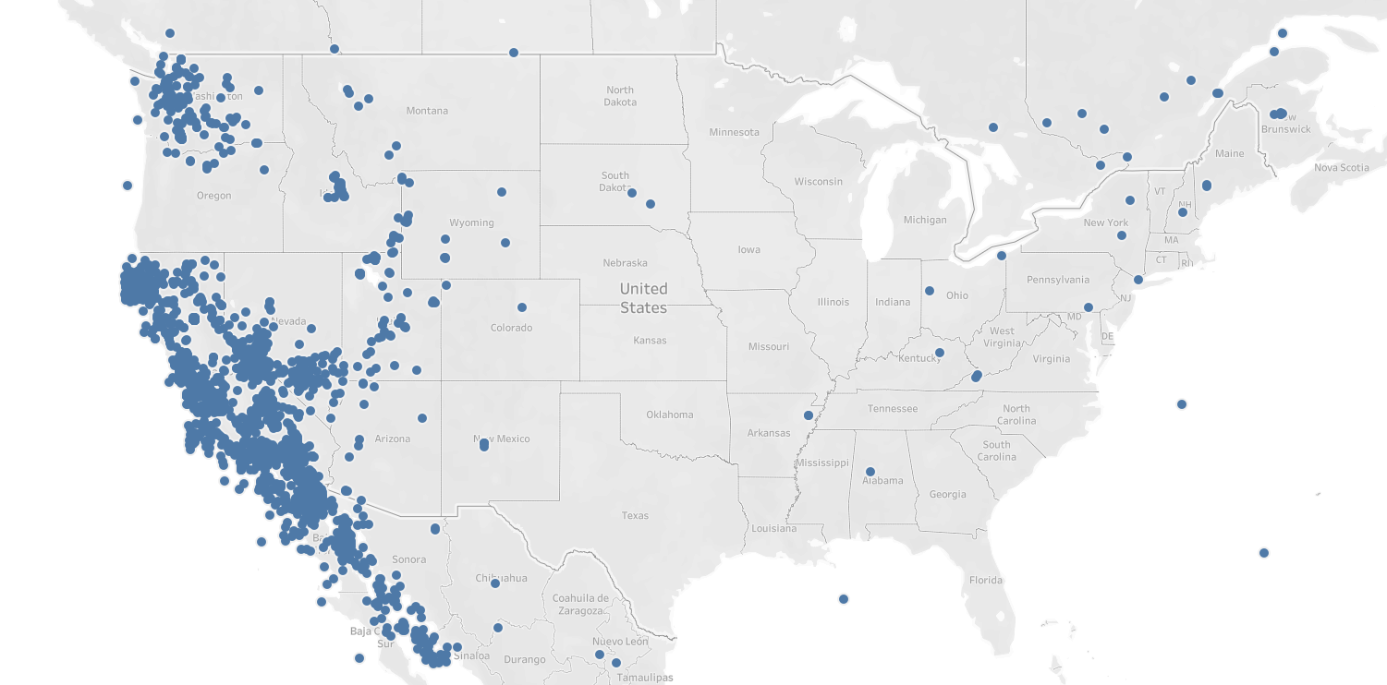
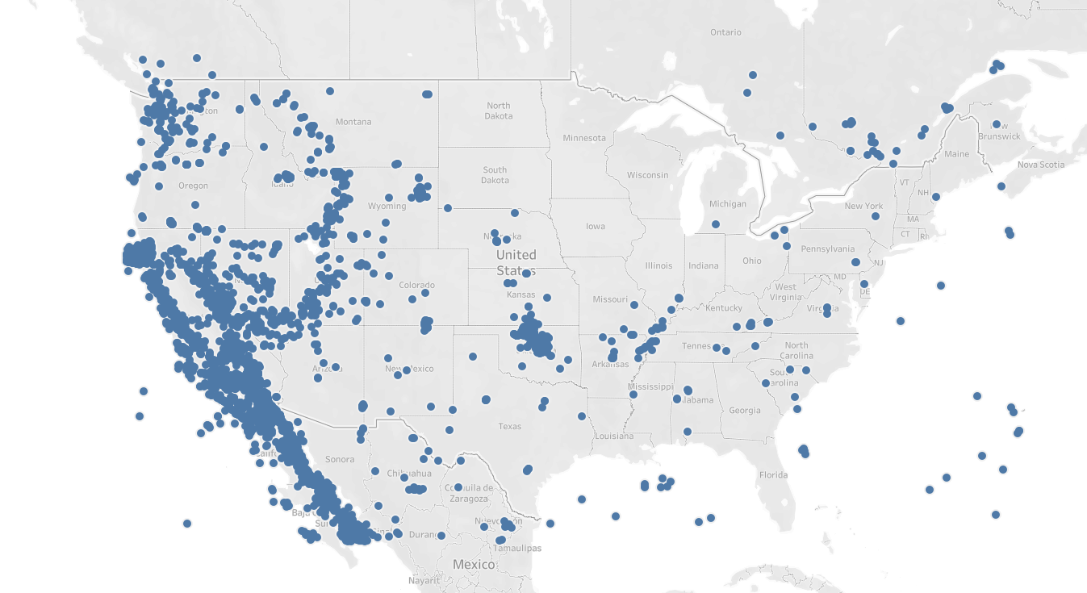
results
Comparing Earthquake Activity
Prefracking
1964-1991
Postfracking
1991-Present

Slide 9
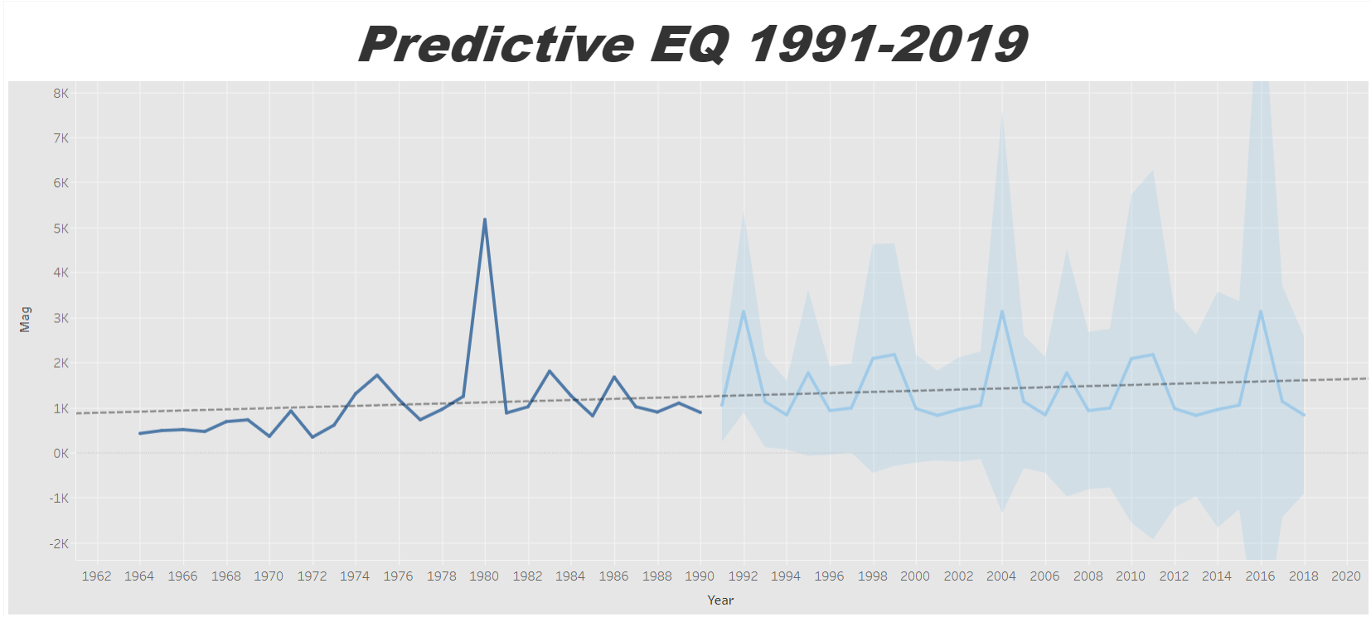

results
Actual average earthquakes from 1964-1991
Forecasting Algorithm for 1992-2019
MASE of 0.45

Slide 10
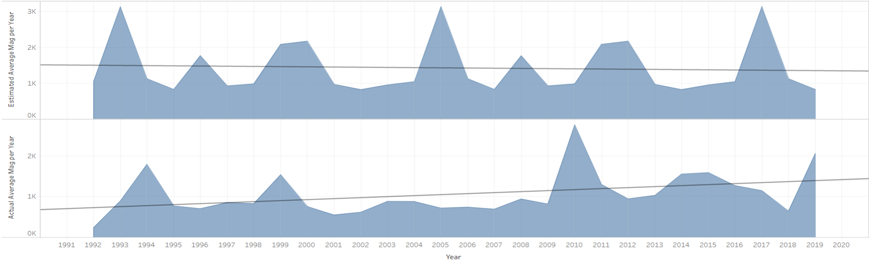
results
Estimate vs Actual 1991-2019
Estimated slope is -5.6
Actual slope 24.48
Tableau publication link

