Slide 1
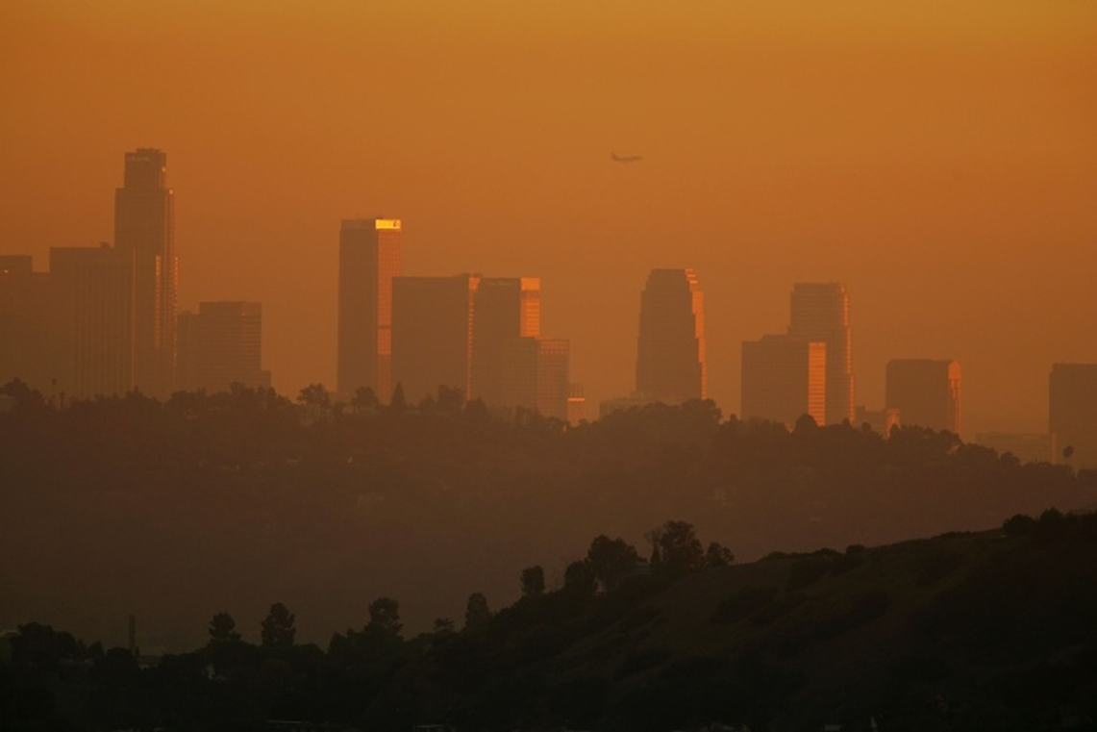
Asthmapper
Exploring possible relationships between:
traffic density
pollution
asthma
poverty
Phillip Choi Chris Ljungkull Max Oneill Finn Wurtz

Slide 2



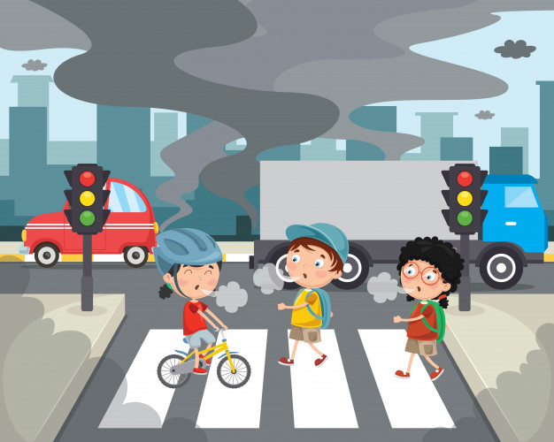

INTRODUCTION
7 of the 10 most polluted cities are located in California
Main cause wildfires but traffic & industrial factors also impactful
Research shows pollution can cause & worsen asthma

Slide 3
Project scope
Risk factors for asthma:
Poverty, Poor Air Quality, Pollen, Smoking Laws
Analyze traffic density, air quality index, asthma rates, poverty
Determine any correlations, visualize data in heat map and charts, identify most and least polluted areas in Cali
Compare with affordability statistics

Slide 4
Data collection
CalEnviroScreen v3.0 dataset
Released 2017 and updated 2018
Various metrics calculated using datasets ranging from 2010-2014
Already compiles poverty, traffic, pollution, asthma rates by census tract
For each census tract:
Find out various statistics on living cost
Households renting, automobiles owned, number houses, avg rent, household density, median income

Slide 5
methodology
Saved csv of ces and affordability datasets, converted to pandas dataframe, merged on census tract, chain data into leaflet and d3

Slide 6
demo

Slide 7
conclusion

Slide 8
Further study

Slide 9
QUESTIONS?

Slide 10
Works cited
SLIDE 2
State of Air Report 2019, American Lung Association, 2015-2017
https://www.lung.org/our-initiatives/healthy-air/sota/city-rankings/states/
Aafa.org

Slide 11


QUESTIONS?

