Slide 1
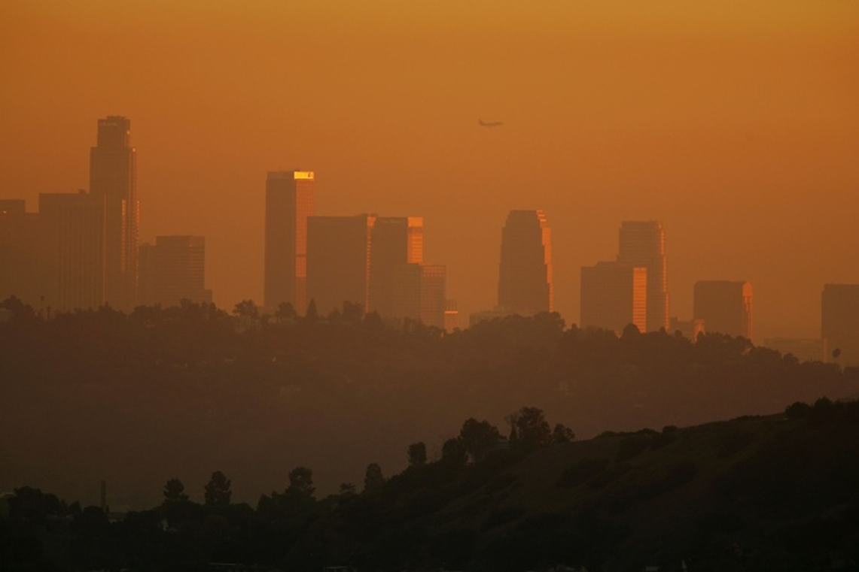
Asthmap
Exploring possible relationships between:
traffic density
pollution
asthma
poverty
Phillip Choi Chris Ljungkull Max Oneill Finn Wurtz

Slide 2





INTRODUCTION
7 of the 10 most polluted cities are located in California
Primarily due to wildfires but traffic & industrial factors also impactful
Research shows pollution can cause & worsen asthma

Slide 3
Project scope
Risk factors for asthma:
For different locations in CA, compare the following:
Poverty
Poor Air Quality
Pollen
Asthma Rates
Traffic Density
Air Quality Index
Poverty Rates
Household Demographics

Slide 4
Data collection
Dataset Name | CalEnviroScreen (CES) v3.0 | Location Affordability Index (LAID) v3.0
Relevant Measurements | Poverty Traffic Density Pollution Asthma | Average Rent Automobiles/HH HH Density Median Income
Geographic Unit | Census Tract | Census Tract
Timeframe of Study | 2010-2014 | 2016-2018
Source | California Open Data Portal | US Dept of Housing and Urban Development
Merged dataset ~8k
census tract rows

Slide 5
methodology
,
Download csv datasets
Python and Jupyter notebook to convert to pandas
Merge on census tract
Convert to geojson
Build webpage code
Chain data into leaflet and d3

Slide 6
DEMO
Click Me!

Slide 7
conclusion
What we learned…
How is data applicable

Slide 8
Further study
Source different timeframes to observe trends over time
Explore intervening solutions
Look into asthma data for top 500
polluted cities worldwide
No US city listed in rankings

Slide 9
QUESTIONS?

Slide 10
Works cited
SLIDE 2
-American Lung Association
-Aafa.org
Link to datasets:
https://data.ca.gov/dataset/calenviroscreen-3-0-results/resource/89b3f4e9-0bf8-4690-8c6f-715a717f3fae
https://hudgis-hud.opendata.arcgis.com/datasets/location-affordability-index-v-3

Slide 11


QUESTIONS?

