Slide 1
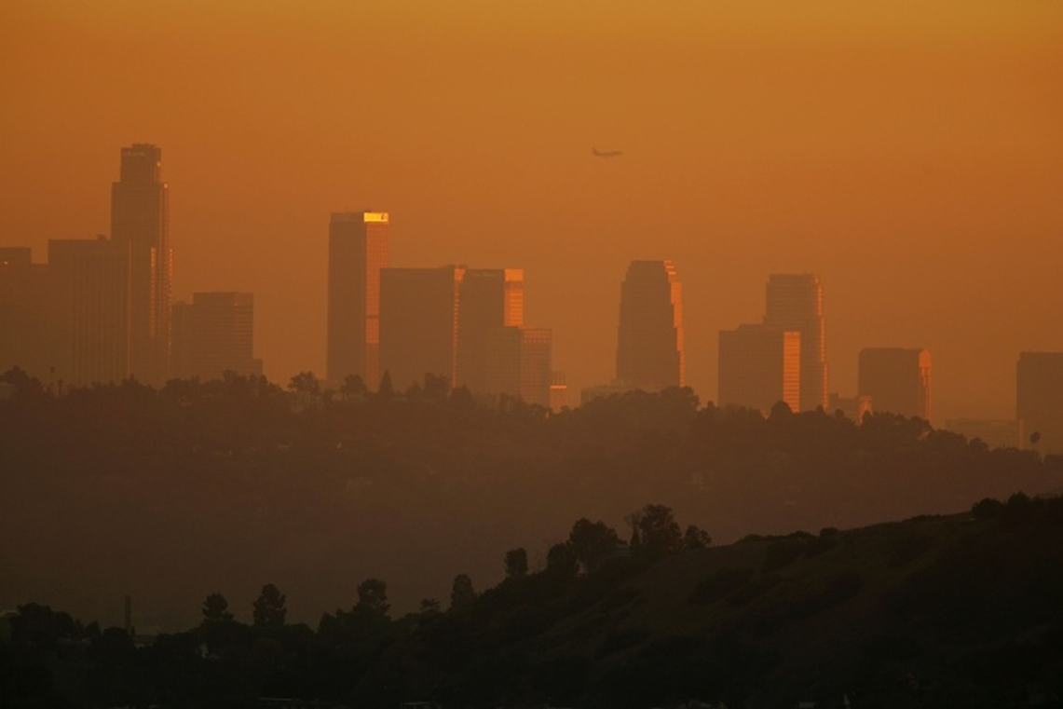
Asthmap
Exploring possible relationships between:
traffic density
pollution
asthma
poverty
Phillip Choi Chris Ljungkull Max Oneill Finn Wurtz

Slide 2





INTRODUCTION
7 of the 10 most polluted cities are located in California
Primarily due to wildfires but traffic & industrial factors also impactful
Research shows pollution can cause & worsen asthma

Slide 3
Project scope
Risk factors for asthma:
Metrics to analyze:
Asthma Rates
Traffic Density
Air Quality Index
Poverty Rates
Household Demographics
Poverty
Poor Air Quality
Pollen
Smoking Laws
Determine any correlations, visualize data in heat map and charts, identify most and least polluted areas in Cali
Compare with affordability statistics

Slide 4
Data collection
Dataset Name | CalEnviroScreen (CES) v3.0 | Location Affordability Index (LAID) v3.0
Relevant Measurements | Poverty Traffic Density Pollution Asthma | Average Rent Automobiles/HH HH Density Median Income
Geographic Unit | Census Tract | Census Tract
Timeframe of Study | 2010-2014 | 2016-2018
Source | California Open Data Portal | US Dept of Housing and Urban Development
Merged dataset ~8k
census tract rows

Slide 5
methodology
,
Download csv datasets
Python and Jupyter notebook to convert to pandas
Merge on census tract
Convert to geojson
Build webpage code
Chain data into leaflet and d3

Slide 6
DEMO
Click Me!

Slide 7
conclusion
What we learned…
How is data applicable

Slide 8
Further study
Source different timeframes to observe trends over time
Explore intervening solutions
Look into asthma data for top 500
polluted cities worldwide
No US city listed in rankings

Slide 9
QUESTIONS?

Slide 10
Works cited
SLIDE 2
-American Lung Association
-Aafa.org
Link to datasets:
https://data.ca.gov/dataset/calenviroscreen-3-0-results/resource/89b3f4e9-0bf8-4690-8c6f-715a717f3fae
https://hudgis-hud.opendata.arcgis.com/datasets/location-affordability-index-v-3

Slide 11


QUESTIONS?

