Slide 1
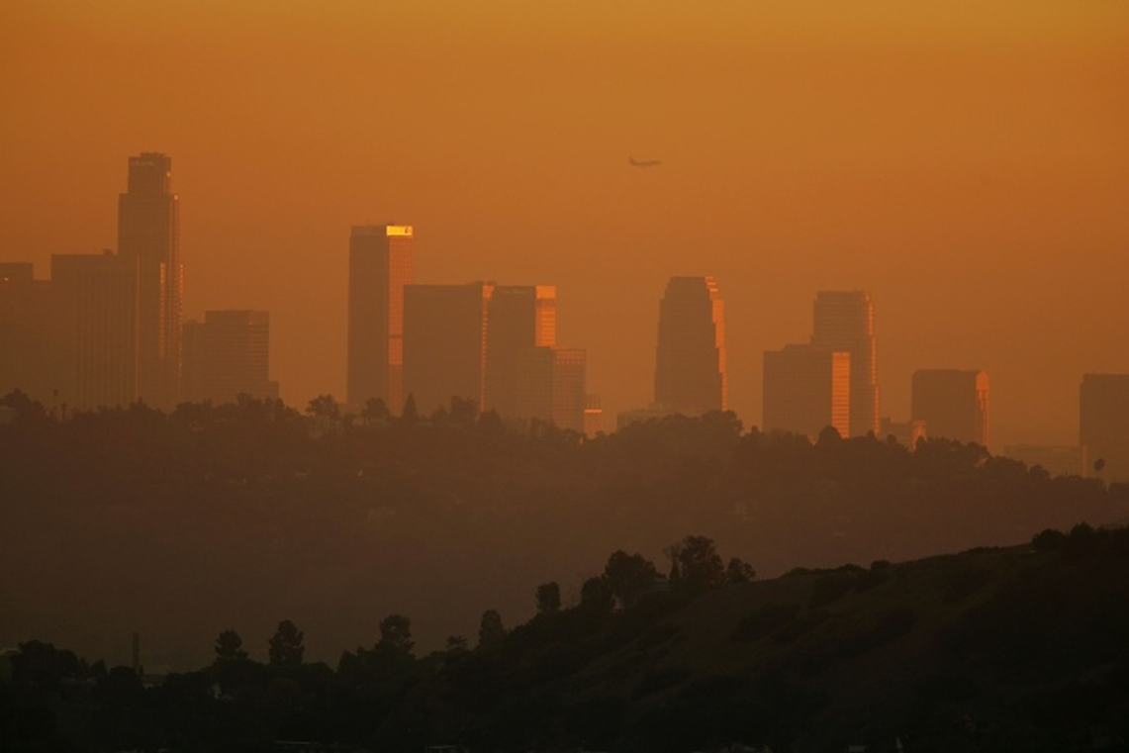
CALIPOLLUTS
Exploring possible relationships between traffic, pollution, poverty, asthma
Phillip Choi Chris Ljungkull Max Oneill Finn Wurtz

Slide 2



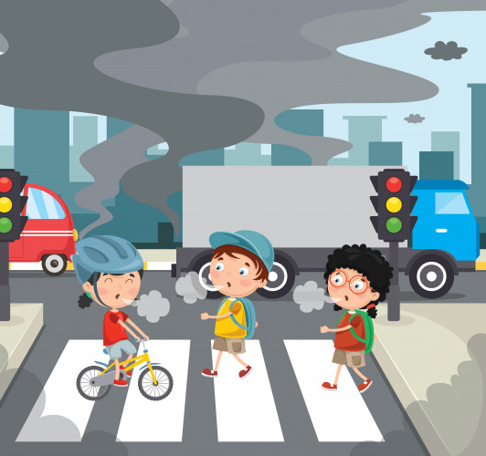

INTRODUCTION
7 of the 10 most polluted cities are located in California
Primarily due to wildfires but traffic & industrial factors also impactful
Research shows pollution can cause & worsen asthma

Slide 3
Project scope
For different locations in CA, compare the following:
Risk factors for asthma:
Poverty
Poor Air Quality
Pollen
Asthma Rates
Traffic Density
Air Quality Index
Poverty Rates
Household Demographics

Slide 4
Data collection
Dataset Name | CalEnviroScreen (CES) v3.0 | Location Affordability Index (LAI) v3.0
Relevant Measurements | Poverty Traffic Density Pollution Asthma | Average Rent Automobiles/HH HH Density Median Income
Geographic Unit | Census Tract | Census Tract
Timeframe of Study | 2010-2014 | 2016-2018
Source | California Open Data Portal | US Dept of Housing and Urban Development
Merged dataset ~8k
census tract rows

Slide 5
methodology
,
CSV datasets from CES and LAI reports
Python and Jupyter notebook to convert to pandas
Merge on census tract
Convert to geojson
Build webpage code
Chain data into leaflet and d3

Slide 6
DEMO
Click Me!

Slide 7
conclusion

Slide 8
Further study
Look into asthma data for top 500
polluted cities worldwide
No US city listed in rankings
Source different timeframes to observe trends over time
Explore intervening solutions

Slide 9
QUESTIONS?

Slide 10
Works cited
SLIDE 2
-American Lung Association
-Aafa.org
Link to datasets:
https://data.ca.gov/dataset/calenviroscreen-3-0-results/resource/89b3f4e9-0bf8-4690-8c6f-715a717f3fae
https://hudgis-hud.opendata.arcgis.com/datasets/location-affordability-index-v-3

