Slide 1
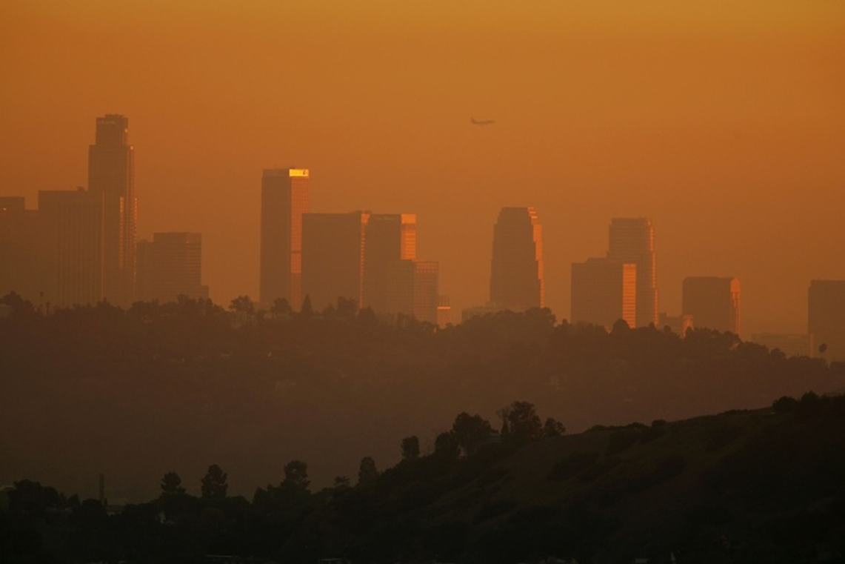
Asthmap
Exploring possible relationships between:
traffic density
pollution
asthma
poverty
Phillip Choi Chris Ljungkull Max Oneill Finn Wurtz

Slide 2



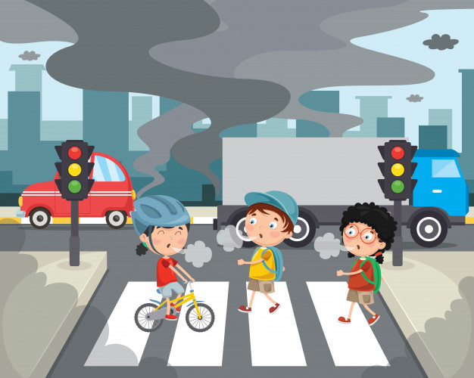

INTRODUCTION
7 of the 10 most polluted cities are located in California
Primarily due to wildfires but traffic & industrial factors also impactful
Research shows pollution can cause & worsen asthma

Slide 3
Project scope
Risk factors for asthma:
Metrics to analyze:
Asthma Rates
Traffic Density
Air Quality Index
Poverty Rates
Household Demographics
Poverty
Poor Air Quality
Pollen
Smoking Laws
Determine any correlations, visualize data in heat map and charts, identify most and least polluted areas in Cali
Compare with affordability statistics

Slide 4
Data collection
CalEnviroScreen (CES) Dataset v3.0
Values for poverty, traffic, pollution, asthma
Compiled by census tract using data from 2010-2014
Location Affordability Index Dataset (LAID) v3.0
Various statistics on living costs & household characteristics by census tract 2016-2018
Average rent, automobiles owned, number houses, household density, median income, etc.
Almost 8k census tracts

Slide 5
methodology
CES and LAID datasets downloaded as csv, converted to pandas dataframe, merged on census tract, convert to geojson, chain data into leaflet and d3

Slide 6
demo
<insert url>

Slide 7
conclusion
What we learned…
How is data applicable

Slide 8
Further study
US cities not listed among 500 most polluted cities worldwide
Look into asthma data for those cities
Explore trends over time using datasets from different timeframes
Explore intervening solutions

Slide 9
QUESTIONS?

Slide 10
Works cited
https://data.ca.gov/dataset/calenviroscreen-3-0-results/resource/89b3f4e9-0bf8-4690-8c6f-715a717f3fae
SLIDE 2
State of Air Report 2019, American Lung Association, 2015-2017
https://www.lung.org/our-initiatives/healthy-air/sota/city-rankings/states/
Aafa.org
https://oehha.ca.gov/calenviroscreen/calenviroscreen-faqs

Slide 11


QUESTIONS?

