Slide 1
SternerLearn
Group 1
Connor Ledgerwood
Devin Turner

Slide 2
Motivation
Blackboard and similar applications provide students with a way to access grades and assignments
Less has been done to support parents in their effort to assist in their child’s education
It can sometimes be difficult for a parent to discover their student’s grades or upcoming assignments
If their child is delinquent, parents like to have more information about what they are up to

Slide 3
Objectives
Allow parents to view their child’s grades and assignments
Provide parents with a way to view absences, tardiness, and other infractions
Parents can track their delinquent child’s location using the phone’s GPS
Allow parents to view their delinquent child’s text messages
Provide basic Blackboard-like functionality

Slide 4
Proposed Solution
We propose to contain these objectives within an Android application
Both the parent and student have the same application
The student’s application allows basic Blackboard-like functionality, but also logs texts and GPS data in the background
The parent’s application allows viewing of the logged data as well as the grades, assignments, and infractions

Slide 5
Features
The application can be divided into 3 sections: teachers, students, and parents
We’ll go through the features for each account type in sequence

Slide 6
Teacher Features
Add new classes
Add students to classes
Add new assignments
Assign grades
Give infractions to students

Slide 7
Student Features
List of grades per class
List of all upcoming assignments
Logs GPS data in the background
Logs text messages in the background

Slide 8
Parent Features
List of grades per class
List of all upcoming assignments
List of different infractions
Map of student locations with selectable time frame
List of text messages with selectable time frame

Slide 9
System Architecture
We’ll go through the architecture for the three sections individually, as well as the back-end
Each “page” of the application is an Activity
Most pages use asynchronous tasks to communicate with the web services, and then display the data when it’s returned

Slide 10
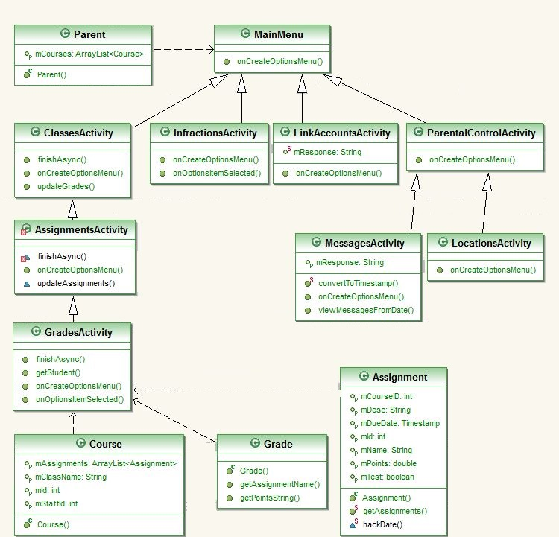

Slide 11
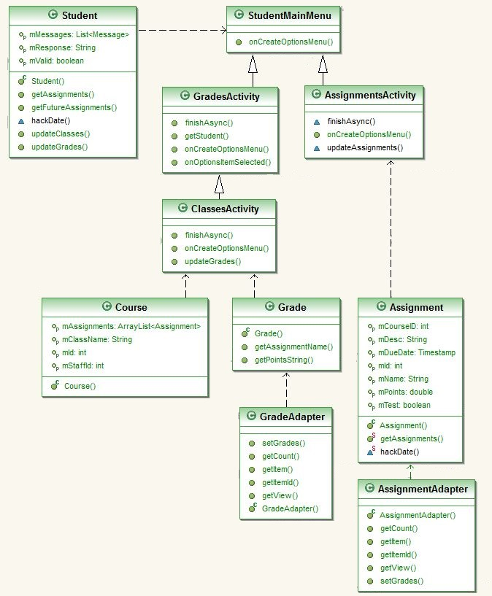

Slide 12
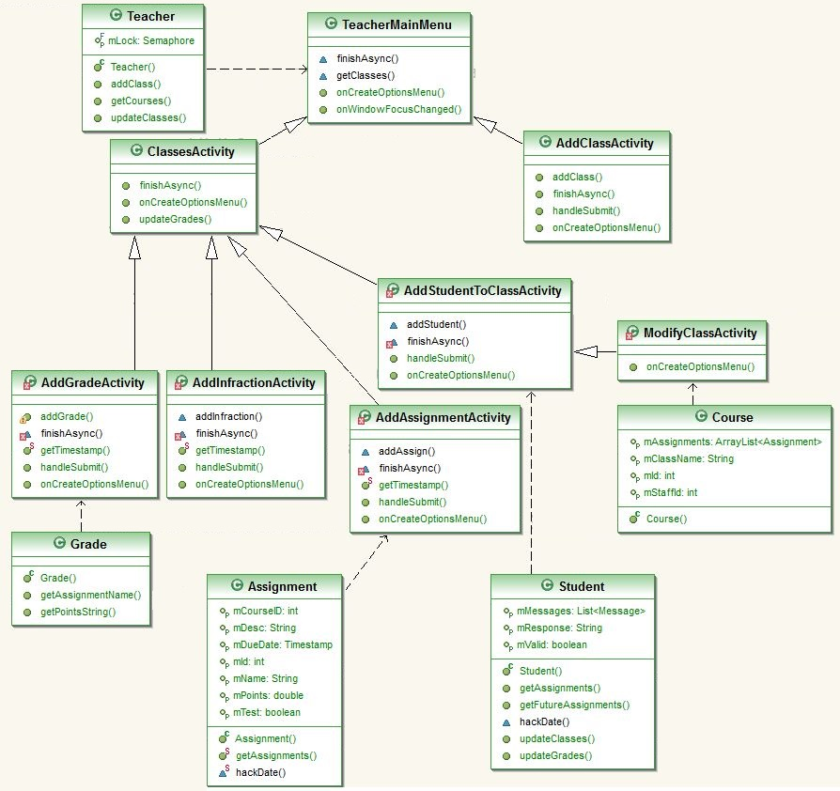

Slide 13
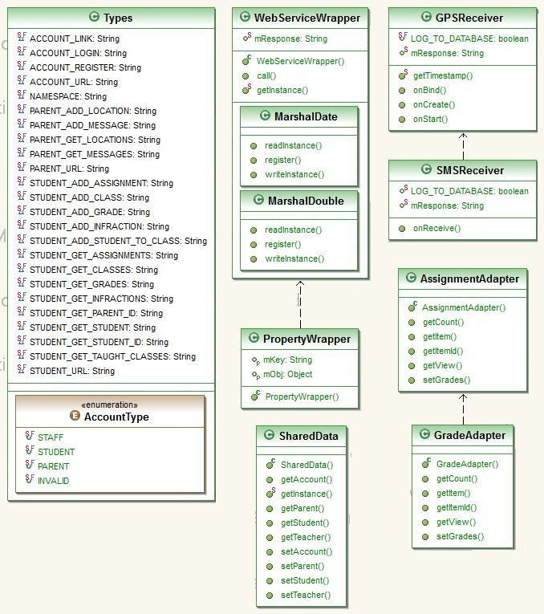

Slide 14
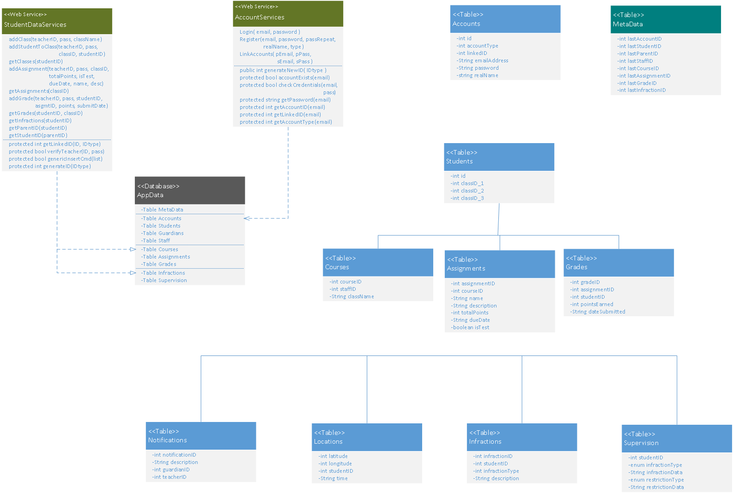

Slide 15
Evaluation
SternerLearn is unique in combining all of these features into one application
It provides parents with in-depth knowledge of their student’s school activities
In cases of misbehaving children, the extra parental control features will be invaluable in monitoring their child’s safety

Slide 16
Limitations
Children can uninstall the application to prevent texts and locations from being logged. For future work this would be prevented
Parents can view a large amount of information about a potentially innocent child. For future work we would have “levels” to only unlock certain parental controls with amounts of infractions

Slide 17
Video Demonstration
Youtube link

Slide 18
Questions?

