Slide 1
Applied Case Studies of Machine Learning and Deep Learning in Key Areas
Introduction to Transformers and LLMs Fundamentals
Marco Maccarini
Angelo Moroncelli
Loris Roveda

Slide 2
2. The Transformer: a bit of history ...
Before the Transformer architecture, language models were typically based on recurrent neural networks (RNNs). RNNs are good at learning long-range dependencies in sequential data, such as text. However, they can be slow to train and prone to overfitting. -> They struggle to recognize the context of words in a long sequence.
Credit: Intro to Large Language Models

Slide 3
2. The Transformer: a bit of history ...
Before the Transformer architecture, language models were typically based on recurrent neural networks (RNNs). RNNs are good at learning long-range dependencies in sequential data, such as text. However, they can be slow to train and prone to overfitting. -> They struggle to recognize the context of words in a long sequence.
Long Short-Term Memory (LSTM) networks are a special kind of RNN-based sequence model that addresses the issues of vanishing/exploding gradients and captures long-range dependencies. (Schmidhuber et al., 1997) -> Sequential data elaboration problem.
Credit: Intro to Large Language Models

Slide 4
2. The Transformer: a bit of history ...
Before the Transformer architecture, language models were typically based on recurrent neural networks (RNNs). RNNs are good at learning long-range dependencies in sequential data, such as text. However, they can be slow to train and prone to overfitting. -> They struggle to recognize the context of words in a long sequence.
Long Short-Term Memory (LSTM) networks are a special kind of RNN-based sequence model that addresses the issues of vanishing/exploding gradients and captures long-range dependencies. (Schmidhuber et al., 1997) -> Sequential data elaboration problem.
A Neural Probabilistic Language Model (Yoshua Bengio et al., 2003) -> One of the first attempts to model a language with a neural way.
Credit: Intro to Large Language Models

Slide 5
2. The Transformer: a bit of history ...
Before the Transformer architecture, language models were typically based on recurrent neural networks (RNNs). RNNs are good at learning long-range dependencies in sequential data, such as text. However, they can be slow to train and prone to overfitting. -> They struggle to recognize the context of words in a long sequence.
Long Short-Term Memory (LSTM) networks are a special kind of RNN-based sequence model that addresses the issues of vanishing/exploding gradients and captures long-range dependencies. (Schmidhuber et al., 1997) -> Sequential data elaboration problem.
A Neural Probabilistic Language Model (Yoshua Bengio et al., 2003) -> One of the first attempts to model a language with a neural way.
Seq-to-Seq Learning with Neural Networks (Ilya Sutskever et al., 2014) -> Two LSTMs were combined in the encoder and decoder structures for translation (sequential elaboration and bottleneck problems).
Credit: Intro to Large Language Models

Slide 6
2. The Transformer: a bit of history ...
Before the Transformer architecture, language models were typically based on recurrent neural networks (RNNs). RNNs are good at learning long-range dependencies in sequential data, such as text. However, they can be slow to train and prone to overfitting. -> They struggle to recognize the context of words in a long sequence.
Long Short-Term Memory (LSTM) networks are a special kind of RNN-based sequence model that addresses the issues of vanishing/exploding gradients and captures long-range dependencies. (Schmidhuber et al., 1997) -> Sequential data elaboration problem.
A Neural Probabilistic Language Model (Yoshua Bengio et al., 2003) -> One of the first attempts to model a language with a neural way.
Seq-to-Seq Learning with Neural Networks (Ilya Sutskever et al., 2014) -> Two LSTMs were combined in the encoder and decoder structures for translation (sequential elaboration and bottleneck problems).
Neural Machine Translation by Jointly Learning to Align and Translate (Dzmitry Bahdanau et al., 2014) -> Introduced the concept of attention (removed bottleneck problem).
Credit: Intro to Large Language Models

Slide 7
2. The Transformer: a bit of history ...
Before the Transformer architecture, language models were typically based on recurrent neural networks (RNNs). RNNs are good at learning long-range dependencies in sequential data, such as text. However, they can be slow to train and prone to overfitting. -> They struggle to recognize the context of words in a long sequence.
Long Short-Term Memory (LSTM) networks are a special kind of RNN-based sequence model that addresses the issues of vanishing/exploding gradients and captures long-range dependencies. (Schmidhuber et al., 1997) -> Sequential data elaboration problem.
A Neural Probabilistic Language Model (Yoshua Bengio et al., 2003) -> One of the first attempts to model a language with a neural way.
Seq-to-Seq Learning with Neural Networks (Ilya Sutskever et al., 2014) -> Two LSTMs were combined in the encoder and decoder structures for translation (sequential elaboration and bottleneck problems).
Neural Machine Translation by Jointly Learning to Align and Translate (Dzmitry Bahdanau et al., 2014) -> Introduced the concept of attention (removed bottleneck problem).
Attention is all you need (A Team at Google, 2017) -> Removed LSTMs (parallelization and efficiency).
Credit: Intro to Large Language Models

Slide 8
2. The Transformer: more on the preliminary Dzmitry Bahdanau's Attention Mechanism
The Challenge Without Attention: If translation were simple—where each word in the source language directly maps to one word in the target language (e.g., "the dog runs" → “il cane corre")—models without attention would suffice. They could rely on a fixed memory of the input and translate word by word in sequence. However, real translation is rarely so straightforward. Word order and meaning depend on context—both before and after the word being translated.
Credit: Intro to Large Language Models

Slide 9
2. The Transformer: more on the preliminary Dzmitry Bahdanau's Attention Mechanism
The Challenge Without Attention: If translation were simple—where each word in the source language directly maps to one word in the target language (e.g., "the dog runs" → “il cane corre")—models without attention would suffice. They could rely on a fixed memory of the input and translate word by word in sequence. However, real translation is rarely so straightforward. Word order and meaning depend on context—both before and after the word being translated.
What Attention Does: Attention bridges this gap by allowing the model to consider the entire input context dynamically, not just the words before or after. For example, when translating the seventh word, the model can "look back" at earlier words and even anticipate upcoming ones to produce the correct translation, removing the need to process all the input context in one single vector (bottleneck problem).
Credit: Intro to Large Language Models

Slide 10
2. The Transformer: more on the preliminary Dzmitry Bahdanau's Attention Mechanism
The Challenge Without Attention: If translation were simple—where each word in the source language directly maps to one word in the target language (e.g., "the dog runs" → “il cane corre")—models without attention would suffice. They could rely on a fixed memory of the input and translate word by word in sequence. However, real translation is rarely so straightforward. Word order and meaning depend on context—both before and after the word being translated.
What Attention Does: Attention bridges this gap by allowing the model to consider the entire input context dynamically, not just the words before or after. For example, when translating the seventh word, the model can "look back" at earlier words and even anticipate upcoming ones to produce the correct translation, removing the need to process all the input context in one single vector (bottleneck problem).
Why It Matters: This flexibility makes translation far more accurate, especially for complex languages or phrases where the relationship between words isn’t strictly linear.
Credit: Intro to Large Language Models

Slide 11
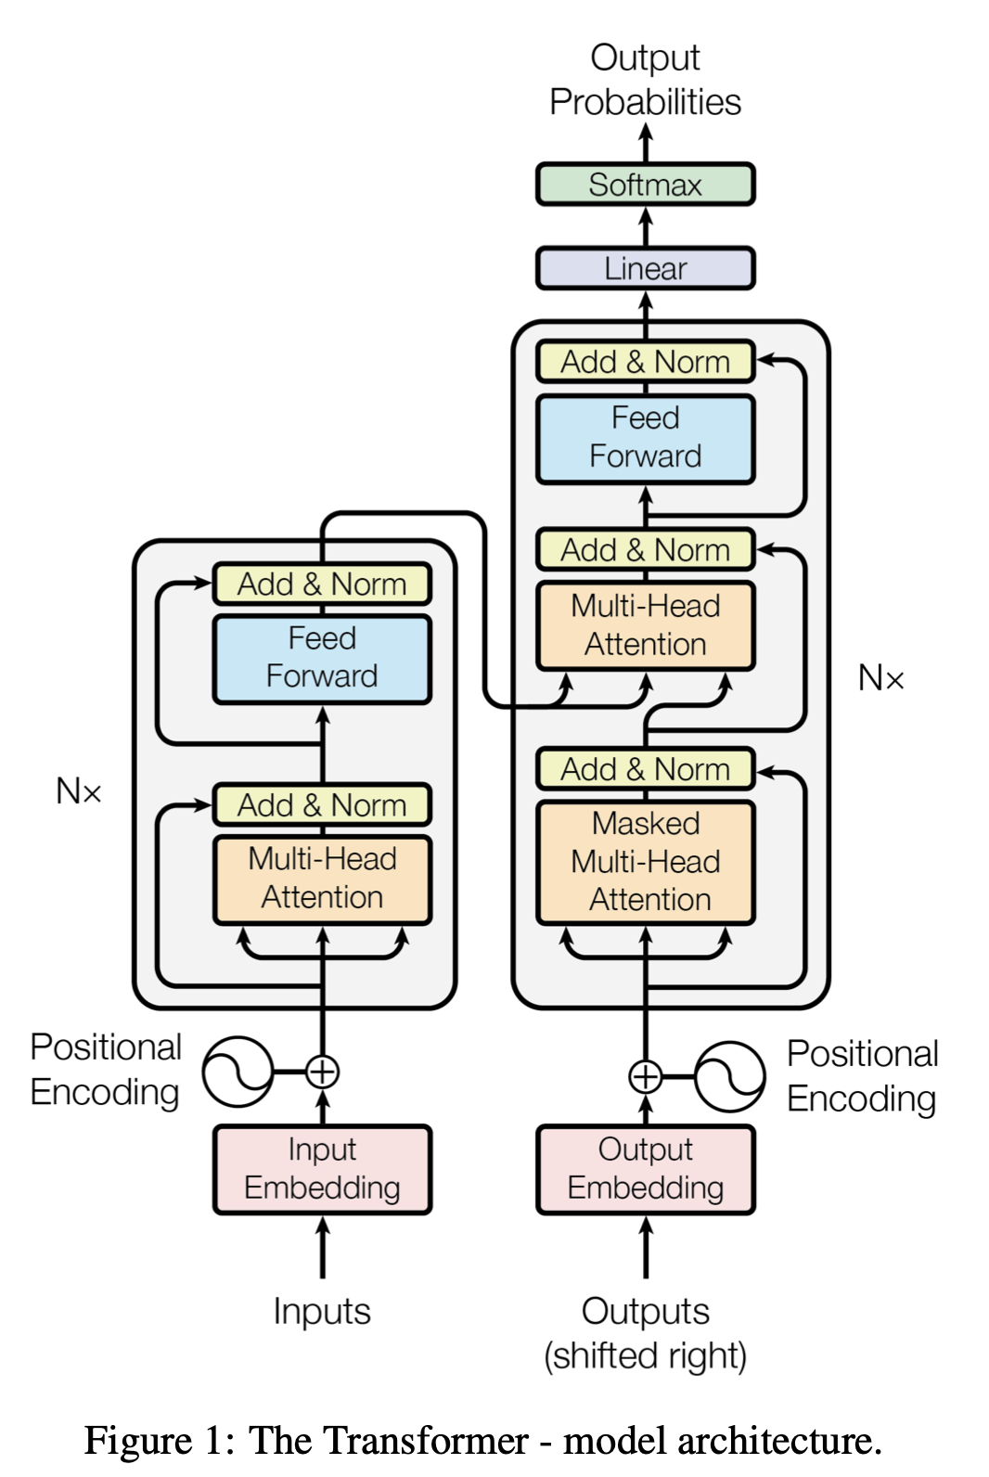
2. The Transformer
The invention of the transformer architecture has greatly improved performance in processing natural language.
Credit: attention is all you need, transformer explainer.

Slide 12
2. The Transformer
The invention of the transformer architecture has greatly improved performance in processing natural language.
The transformer has a remarkable ability at learning
the relevance and the context of all the words in a sentence.
Credit: attention is all you need, transformer explainer.

Slide 13
2. The Transformer
The invention of the transformer architecture has greatly improved performance in processing natural language.
The transformer has a remarkable ability at learning
the relevance and the context of all the words in a sentence.
Transformer was first introduced in the seminal paper “Attention is All You Need ” in 2017 and has since become the go-to architecture for deep learning models, powering text-generative models like OpenAI's GPT, Meta's Llama, and Google's Gemini.
Credit: attention is all you need, transformer explainer.

Slide 14
2. The Transformer
Transformer models operate on the principle of next-word prediction:
given a text prompt from the user, what is the most probable next word that will follow this input?
Credit: attention is all you need, transformer explainer.

Slide 15
2. The Transformer
Transformer models operate on the principle of next-word prediction:
given a text prompt from the user, what is the most probable next word that will follow this input?
The core innovation and power of Transformers lie in their use of self-attention mechanism, which allows them to process entire sequences and capture long-range dependencies more effectively than previous architectures.
Credit: attention is all you need, transformer explainer.

Slide 16
2. The Transformer
Every text-generative Transformer consists of these three key components:
Embedding: Text input is divided into smaller units called tokens, which can be words or sub-words. These tokens are converted into numerical vectors called embeddings, which capture the semantic meaning of words.
Credit: attention is all you need, transformer explainer.

Slide 17
2. The Transformer
Every text-generative Transformer consists of these three key components:
Embedding: Text input is divided into smaller units called tokens, which can be words or sub-words. These tokens are converted into numerical vectors called embeddings, which capture the semantic meaning of words.
Transformer Block: it is the fundamental building block of the model that processes and transforms the input data. Each block includes:
Attention Mechanism, the core component of the Transformer block. It allows tokens to communicate with other tokens, capturing contextual information and relationships between words.
MLP (Multilayer Perceptron) Layer, a feed-forward network that operates on each token independently. While the goal of the attention layer is to route information between tokens, the goal of the MLP is to refine each token's representation.
Credit: attention is all you need, transformer explainer.

Slide 18
2. The Transformer
Every text-generative Transformer consists of these three key components:
Embedding: Text input is divided into smaller units called tokens, which can be words or sub-words. These tokens are converted into numerical vectors called embeddings, which capture the semantic meaning of words.
Transformer Block: it is the fundamental building block of the model that processes and transforms the input data. Each block includes:
Attention Mechanism, the core component of the Transformer block. It allows tokens to communicate with other tokens, capturing contextual information and relationships between words.
MLP (Multilayer Perceptron) Layer, a feed-forward network that operates on each token independently. While the goal of the attention layer is to route information between tokens, the goal of the MLP is to refine each token's representation.
Output Probabilities: The final linear and softmax layers transform the processed embeddings into probabilities, enabling the model to make predictions about the next token in a sequence.
Credit: attention is all you need, transformer explainer.

Slide 19
2. The Transformer: basic elements
The transformer block is composed of two distinct parts:

Slide 20
2. The Transformer: basic elements
The transformer block is composed of two distinct parts:
Encoder
Encoder
Embedding
Input
Credit: attention is all you need

Slide 21
2. The Transformer: basic elements
The transformer block is composed of two distinct parts:
Encoder Decoder
Softmax
Decoder
Encoder
Embedding
Embedding
Input
Credit: attention is all you need

Slide 22
2. The Transformer: basic elements
The transformer block is composed of two distinct parts:
Encoder Decoder
These two elements work in combination with each other and have a number of characteristics in common;
Softmax
Decoder
Encoder
Embedding
Embedding
Input
Credit: attention is all you need

Slide 23
2. The Transformer: basic elements
The transformer block is composed of two distinct parts:
Encoder Decoder
These two elements work in combination with each other and have a number of characteristics in common; Like any machine learning model, the transformer also requires numbers as input, and not words, and outputs words back.
Softmax
Decoder
Encoder
Embedding
Embedding
Input
Credit: attention is all you need

Slide 24
2. The Transformer: basic elements
The transformer block is composed of two distinct parts:
Encoder Decoder
These two elements work in combination with each other and have a number of characteristics in common; Like any machine learning model, the transformer also requires numbers as input, and not words, and outputs words back.
We have to turn words into numbers:
Tokenization and embedding
Softmax
Decoder
Encoder
Embedding
Embedding
Input
Credit: attention is all you need

Slide 25
2. The Transformer: basic elements
The transformer block is composed of two distinct parts:
Encoder Decoder
These two elements work in combination with each other and have a number of characteristics in common; Like any machine learning model, the transformer also requires numbers as input, and not words, and outputs words back.
We have to turn words into numbers:
Tokenization and embedding
We need a probability distribution that gives the most probable next world as output:
Output probabilities (Logit)
Softmax
Decoder
Encoder
Embedding
Embedding
Input
Credit: attention is all you need

Slide 26
2.1. Tokenization and embedding: sentences representation
For example, in this sentence:
Hello
I
am
studying
generative
AI

Slide 27
2.1. Tokenization and embedding: sentences representation
For example, in this sentence:
The transformer doesn't just learn the relationship between one word and the next;
Hello
AI
I
generative
am
studying

Slide 28
2.1. Tokenization and embedding: sentences representation
For example, in this sentence
The transformer doesn't just learn the relationship between one word and the next; It learns ALL relationships!
Hello
AI
I
generative
am
studying

Slide 29
2.1. Tokenization and embedding
Step 1: Tokenization
Tokenization is the process of breaking down the input text into smaller, more manageable pieces called tokens. These tokens can be a word or a sub-word.
Softmax
Decoder
Encoder
Embedding
Embedding
Input
Credit: attention is all you need

Slide 30
2.1. Tokenization and embedding
Step 1: Tokenization
Tokenization is the process of breaking down the input text into smaller, more manageable pieces called tokens. These tokens can be a word or a sub-word.
Step 2. Token Embedding
Each token in the vocabulary has a n-dimensional vector; the dimension of the vector depends on the model. These embedding vectors are stored in a matrix of shape (# tokens, # dimensions).
Softmax
Decoder
Encoder
Embedding
Embedding
Input
Credit: attention is all you need

Slide 31
2.1. Tokenization and embedding
Step 1: Tokenization
Tokenization is the process of breaking down the input text into smaller, more manageable pieces called tokens. These tokens can be a word or a sub-word.
Step 2. Token Embedding
Each token in the vocabulary has a n-dimensional vector; the dimension of the vector depends on the model. These embedding vectors are stored in a matrix of shape (# tokens, # dimensions).
Step 3. Positional Encoding
The Embedding layer also encodes information about each token's position in the input prompt.
Softmax
Decoder
Encoder
Embedding
Embedding
Input
Credit: attention is all you need

Slide 32
2.1. Tokenization and embedding
Step 1: Tokenization
Tokenization is the process of breaking down the input text into smaller, more manageable pieces called tokens. These tokens can be a word or a sub-word.
Step 2. Token Embedding
Each token in the vocabulary has a n-dimensional vector; the dimension of the vector depends on the model. These embedding vectors are stored in a matrix of shape (# tokens, # dimensions).
Step 3. Positional Encoding
The Embedding layer also encodes information about each token's position in the input prompt.
Step 4. Final Embedding
The sum of the token and the positional embedding captures both the semantic meaning of the tokens and their position in the input sequence.
Softmax
Decoder
Encoder
Embedding
Embedding
Input
Credit: attention is all you need

Slide 33
2.1. Tokenization and embedding: words tokenization
We can see tokenization as a function that:
tokenizer

Slide 34
2.1. Tokenization and embedding: words tokenization
We can see tokenization as a function that:
Receives a word as input
Hello
I
am
studyng
generative
AI
tokenizer

Slide 35
2.1. Tokenization and embedding: words tokenization
We can see tokenization as a function that:
Receives a word as input
Outputs the «number» associated with that word
Specifically, the associated number represents the position of that word in a dictionary
Hello
I
am
studyng
generative
AI
tokenizer
0
1
2
3
4
5

Slide 36
2.1. Tokenization and embedding: words tokenization
We can see tokenization as a function that:
Receives a word as input
Outputs the «number» associated with that word
Specifically, the associated number represents the position of that word in a dictionary
There are many ways to tokenize:
Hello
I
am
studyng
generative
AI
tokenizer
0
1
2
3
4
5

Slide 37
2.1. Tokenization and embedding: words tokenization
We can see tokenization as a function that:
Receives a word as input
Outputs the «number» associated with that word
Specifically, the associated number represents the position of that word in a dictionary
There are many ways to tokenize:
We can tokenize words
Hello
I
am
studyng
generative
AI
tokenizer
0
1
2
3
4
5

Slide 38
2.1. Tokenization and embedding: words tokenization
We can see tokenization as a function that:
Receives a word as input
Outputs the «number» associated with that word
Specifically, the associated number represents the position of that word in a dictionary
There are many ways to tokenize:
We can tokenize words We can tokenize the breakdown of a word
Hello
I
am
studyng
generative
AI
tokenizer
0
1
2
3
4
5

Slide 39
2.1. Tokenization and embedding: words tokenization
We can see tokenization as a function that:
Receives a word as input
Outputs the «number» associated with that word
Specifically, the associated number represents the position of that word in a dictionary
There are many ways to tokenize:
We can tokenize words We can tokenize the breakdown of a word
The full vocabulary of tokens is decided before training the model.
Hello
I
am
studyng
generative
AI
tokenizer
0
1
2
3
4
5

Slide 40
2.1. Tokenization and embedding: the dictionary
ID | Associated word
1 | Word1
2 | Word2
3 | Word3
4 | Word4
5 | Word5
6 | Word6
7 | Word7
8 | Word8
9 | Word9
10 | Word10
11 | Word11
12 | Word12
13 | Word13
14 | Word14
15 | Word15
16 | Word16
17 | Word17
18 | Word18
19 | Word19
20 | Word20
21 | Word21
22 | Word22
23 | Word23
24 | Word24
25 | Word25
26 | Word26
27 | Word27
28 | Word28
29 | Word29
30 | Word30
31 | Word31
32 | Word32
33 | Word33
34 | Word34
35 | Word35
36 | Word36
37 | Word37
38 | Word38
39 | Word39
40 | Word40
41 | Word41
42 | Word42
43 | Word43
44 | Word44
45 | Word45
46 | Word46
47 | Word47
48 | Word48
49 | Word49
50 | Word50
51 | Word51
52 | Word52
53 | Word53
54 | Word54
55 | Word55
56 | Word56
57 | Word57
58 | Word58
59 | Word59
60 | Word60
61 | Word61
62 | Word62
63 | Word63
64 | Word64
65 | Word65
66 | Word66
67 | Word67
68 | Word68
69 | Word69
70 | Word70
71 | Word71
72 | Word72
73 | Word73
74 | Word74
75 | Word75
76 | Word76
77 | Word77
78 | Word78
79 | Word79

Slide 41
2.1. Tokenization and embedding: embedding
Now let's move on to the next layer: the embedding.
This layer is a trainable vector space where each token:
is represented by a multidimensional vector;
occupies a unique position in space.
These vectors learn to encode the meaning and context of individual tokens in the input sequence!
Softmax
Decoder
Encoder
Embedding
Embedding
Input
Credit: attention is all you need

Slide 42






2.1. Tokenization and embedding: embedding
In the original architecture of the transformer, the multidimensional vector has dimension 512
Embedding
$$x_{0}$$
$$x_{1}$$
$$x_{2}$$
$$x_{3}$$
$$x_{4}$$
$$x_{5}$$
512
0
1
2
3
4
5

Slide 43






2.1. Tokenization and embedding: embedding
In the original architecture of the transformer, the multidimensional vector has dimension 512.
Question: If this vector were of dimension 2, what would its representation look like?
Embedding
$$x_{0}$$
$$x_{1}$$
$$x_{2}$$
$$x_{3}$$
$$x_{4}$$
$$x_{5}$$
2
0
1
2
3
4
5

Slide 44
2.1. Tokenization and embedding: embedding
In the original architecture of the transformer, the multidimensional vector has dimension 512.
Question: If this vector were of dimension 2, what would its representation look like?
… see the next slide.
Embedding
$$x_{0}$$
$$x_{1}$$
$$x_{2}$$
$$x_{3}$$
$$x_{4}$$
$$x_{5}$$
2
0
1
2
3
4
5

Slide 45

2.1. Tokenization and embedding: vector space representation
In the original architecture of the transformer, the multidimensional vector has dimension 512.
In case the vector has only 2 dimensions, it would be possible to represent the embedding through the graph on the left.
The degree of relationship between the words is equivalent to the angle that forms between the two tokens (the closer the two vectors are in the vector space, the stronger the relationship between the two words in that context).
AI
generative
$$α$$

Slide 46
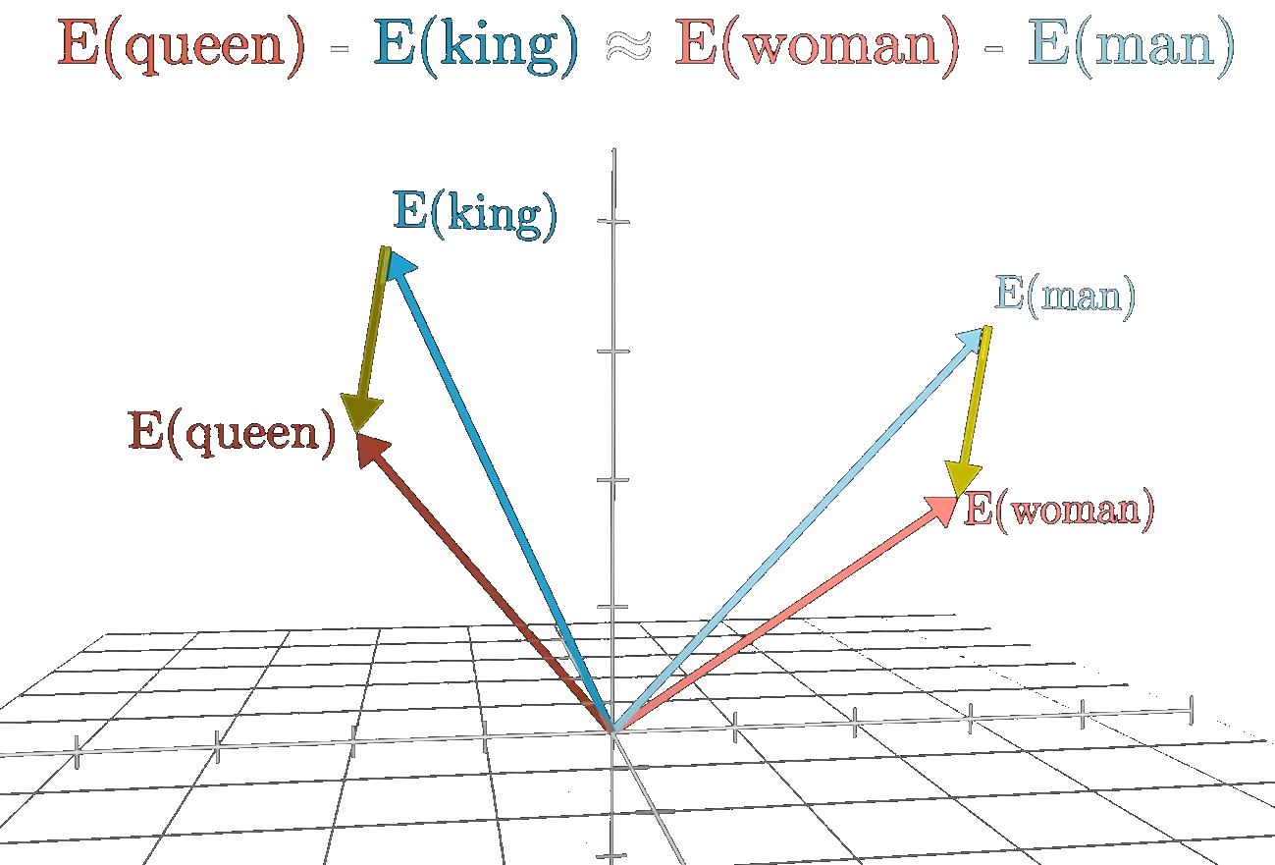
More examples 3blue1brown
Credit: Transformers explained visually

Slide 47
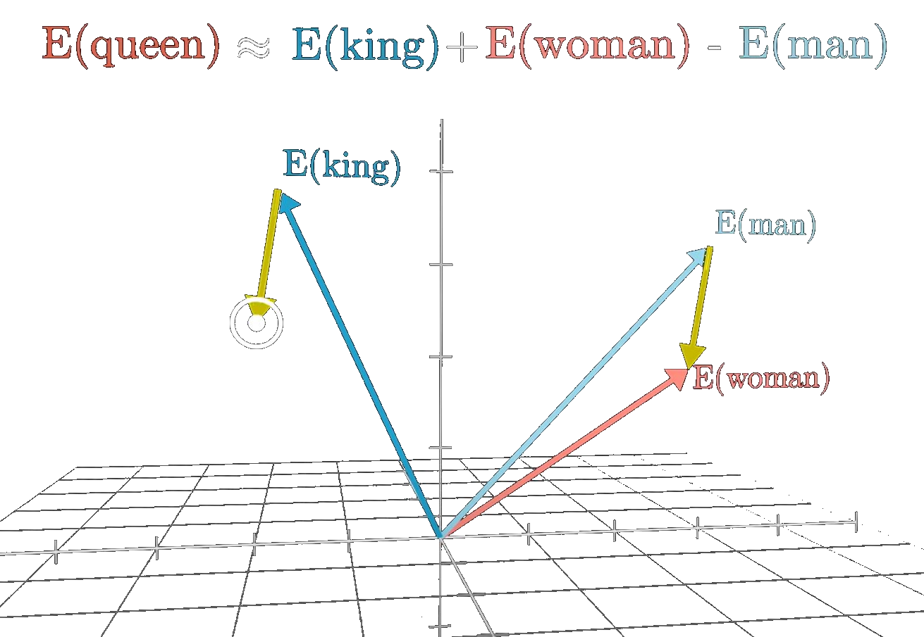
More examples 3blue1brown
Credit: Transformers explained visually

Slide 48
2.2. Transformer block: encoder and decoder
After the embedding layer, the information passes through the self-attention layers and an MLP layers in both the encoder and the decoder, stacked sequentially one after the other.
Softmax
Decoder
Encoder
Embedding
Embedding
Input
Notes:
Ogni persona intuisce/ da importanza a parti divere della conversazione.

Slide 49
2.2. Transformer block: encoder and decoder
After the embedding layer, the information passes through the self-attention layers and an MLP layers in both the encoder and the decoder, stacked sequentially one after the other.
In this layer, the relationships between the tokens received as input are analyzed, this layered approach leads to higher-order representations of the input;
Softmax
Decoder
Encoder
Embedding
Embedding
Input
Notes:
Ogni persona intuisce/ da importanza a parti divere della conversazione.

Slide 50
2.2. Transformer block: encoder and decoder
After the embedding layer, the information passes through the self-attention layers and an MLP layers in both the encoder and the decoder, stacked sequentially one after the other.
In this layer, the relationships between the tokens received as input are analyzed, this layered approach leads to higher-order representations of the input;
It is where the computation of contextual dependencies between tokens actually takes place;
Softmax
Decoder
Encoder
Embedding
Embedding
Input
Notes:
Ogni persona intuisce/ da importanza a parti divere della conversazione.

Slide 51
2.2. Transformer block: encoder and decoder
After the embedding layer, the information passes through the self-attention layers and an MLP layers in both the encoder and the decoder, stacked sequentially one after the other.
In this layer, the relationships between the tokens received as input are analyzed, this layered approach leads to higher-order representations of the input;
It is where the computation of contextual dependencies between tokens actually takes place;
Each relationship will be assigned a weight (calculated during training and different for each attention layer due to initial conditions randomization);
Softmax
Decoder
Encoder
Embedding
Embedding
Input
Notes:
Ogni persona intuisce/ da importanza a parti divere della conversazione.

Slide 52
2.2. Transformer block: encoder and decoder
After the embedding layer, the information passes through the self-attention layers and an MLP layers in both the encoder and the decoder, stacked sequentially one after the other.
In this layer, the relationships between the tokens received as input are analyzed, this layered approach leads to higher-order representations of the input;
It is where the computation of contextual dependencies between tokens actually takes place;
Each relationship will be assigned a weight (calculated during training and different for each attention layer due to initial conditions randomization);
They reflect the importance of each word compared to all the other words in the sequence.
Softmax
Decoder
Encoder
Embedding
Embedding
Input
Notes:
Ogni persona intuisce/ da importanza a parti divere della conversazione.

Slide 53
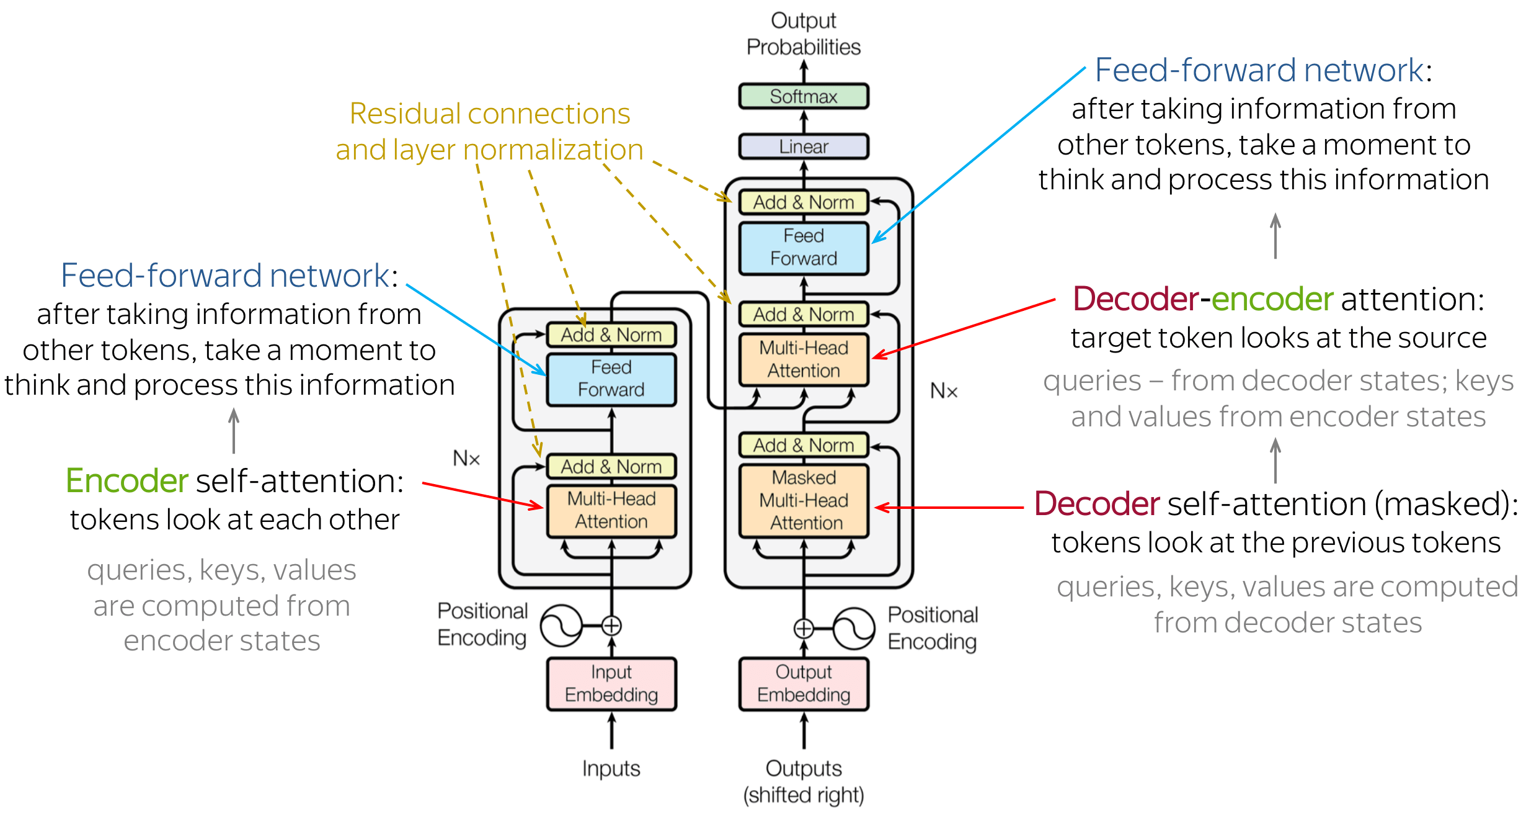
2.2. Transformer block: encoder and decoder
Credit: https://www.youtube.com/watch?v=XDK3OYpxmuY&t=1025s

Slide 54
2.2. Transformer block: encoder and decoder
Warning: there is not just one self-attention layer + MLP.
Softmax
Decoder
Encoder
Embedding
Embedding
Input
Notes:
Ogni persona intuisce/ da importanza a parti divere della conversazione.

Slide 55
2.2. Transformer block: encoder and decoder
Warning: there is not just one self-attention layer + MLP.
Multiple layers of self-attention are trained in parallel independently of the others, leveraging high-performance parallel computation on modern GPUs.
Softmax
Decoder
Encoder
Embedding
Embedding
Input
Notes:
Ogni persona intuisce/ da importanza a parti divere della conversazione.

Slide 56
2.2. Transformer block: encoder and decoder
Warning: there is not just one self-attention layer + MLP.
Multiple layers of self-attention are trained in parallel independently of the others, leveraging high-performance parallel computation on modern GPUs.
The self-attention layers depend on the model, they can vary (a standard number of layers in basic architectures like GPT2 was 12).
Softmax
Decoder
Encoder
Embedding
Embedding
Input
Notes:
Ogni persona intuisce/ da importanza a parti divere della conversazione.

Slide 57
2.2.1. Why attention is all you need?
What does the word it mean?
“The animal did not cross the street because it was too tired.”
Example from: Transformers from Google
Notes:
Ogni persona intuisce/ da importanza a parti divere della conversazione.

Slide 58
2.2.1. Why attention is all you need?
What does the word it mean?
“The animal did not cross the street because it was too tired.”
And now?
“The animal did not cross the street because it was too wide.”
It depends on the context!
Example from: Transformers from Google
Notes:
Ogni persona intuisce/ da importanza a parti divere della conversazione.

Slide 59
2.2.1. Why attention is all you need?
The self-attention mechanism enables the model to focus on relevant parts of the input sequence, allowing it to capture complex relationships and dependencies within the data. We will go through the following concepts:
Queries, Keys and Values;
Notes:
Ogni persona intuisce/ da importanza a parti divere della conversazione.

Slide 60
2.2.1. Why attention is all you need?
The self-attention mechanism enables the model to focus on relevant parts of the input sequence, allowing it to capture complex relationships and dependencies within the data. We will go through the following concepts:
Queries, Keys and Values;
Scaling the dot product;
Notes:
Ogni persona intuisce/ da importanza a parti divere della conversazione.

Slide 61
2.2.1. Why attention is all you need?
The self-attention mechanism enables the model to focus on relevant parts of the input sequence, allowing it to capture complex relationships and dependencies within the data. We will go through the following concepts:
Queries, Keys and Values;
Scaling the dot product;
Multi-head attention;
Notes:
Ogni persona intuisce/ da importanza a parti divere della conversazione.

Slide 62
2.2.1. Why attention is all you need?
The self-attention mechanism enables the model to focus on relevant parts of the input sequence, allowing it to capture complex relationships and dependencies within the data. We will go through the following concepts:
Queries, Keys and Values;
Scaling the dot product;
Multi-head attention;
Output of self-attention layers.
Notes:
Ogni persona intuisce/ da importanza a parti divere della conversazione.

Slide 63
2.2.1. Why attention is all you need?
The self-attention mechanism enables the model to focus on relevant parts of the input sequence, allowing it to capture complex relationships and dependencies within the data. We will go through the following concepts:
Queries, Keys and Values;
Scaling the dot product;
Multi-head attention;
Output of self-attention layers.
Note: We’ll aim to keep things simple, using just essential mathematics to provide an idea of what’s really happening inside the transformer during an attention step computation. Some minor details will be skipped in this introduction.
Additional suggested reading with Pytorch examples: https://peterbloem.nl/blog/transformers
Notes:
Ogni persona intuisce/ da importanza a parti divere della conversazione.

Slide 64
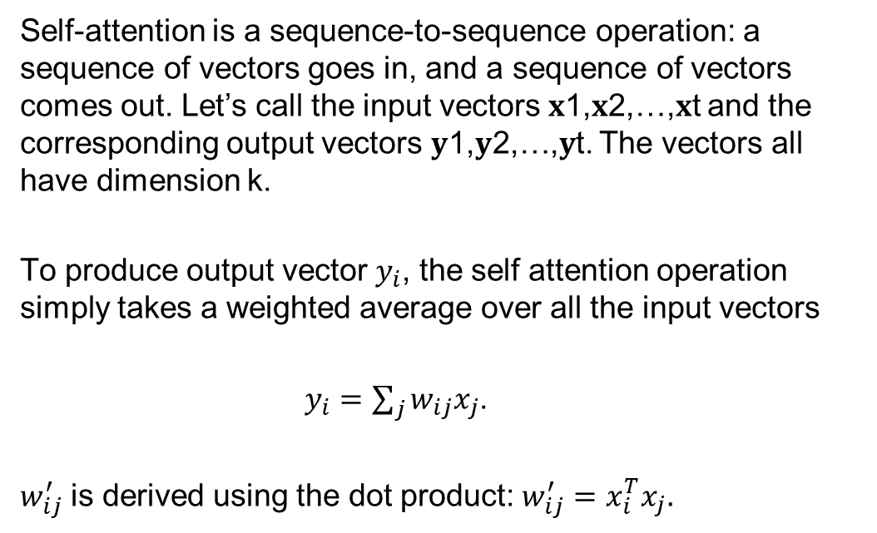
2.2.1. Self-attention layer: token's embedding vector
Self-attention is a sequence-to-sequence operation: a sequence of vectors goes in, and a sequence of vectors comes out. Let’s call the input vectors 𝐱1,𝐱2,…,𝐱t and the corresponding output vectors 𝐲1,𝐲2,…,𝐲t. The vectors all have dimension k.
To produce output vector $y_{i}$, the self attention operation simply takes a weighted average over all the input vectors
$y_{i}=\sum_{j}{w_{ij}x_{j}}$.
$w_{ij}^{′}$ is derived using the dot product: $w_{ij}^{′}=x_{i}^{T}x_{j}.$
Notes:
Ogni persona intuisce/ da importanza a parti divere della conversazione.

Slide 65
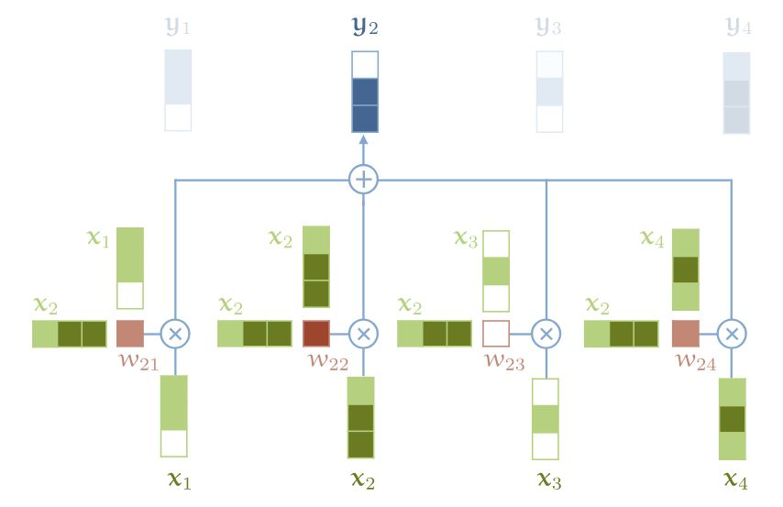
2.2.1. Self-attention layer: token's embedding vector
Self-attention is a sequence-to-sequence operation: a sequence of vectors goes in, and a sequence of vectors comes out. Let’s call the input vectors 𝐱1,𝐱2,…,𝐱t and the corresponding output vectors 𝐲1,𝐲2,…,𝐲t. The vectors all have dimension k.
To produce output vector $y_{i}$, the self attention operation simply takes a weighted average over all the input vectors
$y_{i}=\sum_{j}{w_{ij}x_{j}}$.
$w_{ij}^{′}$ is derived using the dot product: $w_{ij}^{′}=x_{i}^{T}x_{j}.$
This is the only operation that involves interaction between vectors in the transformer.
Images and examples from: https://peterbloem.nl/blog/transformers and https://poloclub.github.io/transformer-explainer/
Notes:
Ogni persona intuisce/ da importanza a parti divere della conversazione.

Slide 66
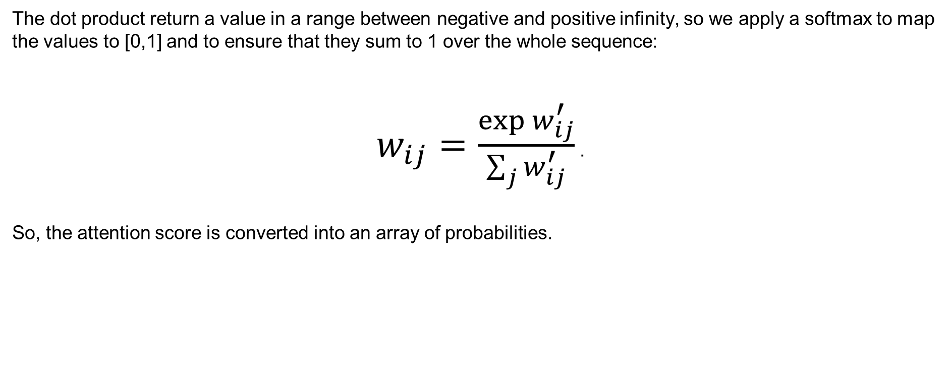
2.2.1. Self-attention layer: softmax operation
The dot product return a value in a range between negative and positive infinity, so we apply a softmax to map the values to [0,1] and to ensure that they sum to 1 over the whole sequence:
$w_{ij}=\frac{\exp{w_{ij}^{′}}}{\sum_{j}{w_{ij}^{′}}}$ .
So, the attention score is converted into an array of probabilities.
Notes:
Ogni persona intuisce/ da importanza a parti divere della conversazione.

Slide 67
2.2.1. Self-attention layer: token's embedding vector
Now, suppose that we have a sequence of words:
the, cat, walks, on, the, street (words sequence)
Notes:
Ogni persona intuisce/ da importanza a parti divere della conversazione.

Slide 68

2.2.1. Self-attention layer: token's embedding vector
Now, suppose that we have a sequence of words:
the, cat, walks, on, the, street (words sequence)
We apply an embedding vector $e_{t}$ to every word (or token) in our dictionary. We have:
$e_{the}$, $e_{cat}$, $e_{walks}$, $e_{on}$, $e_{the}$, $e_{street}$ (vector sequence)
Notes:
Ogni persona intuisce/ da importanza a parti divere della conversazione.

Slide 69
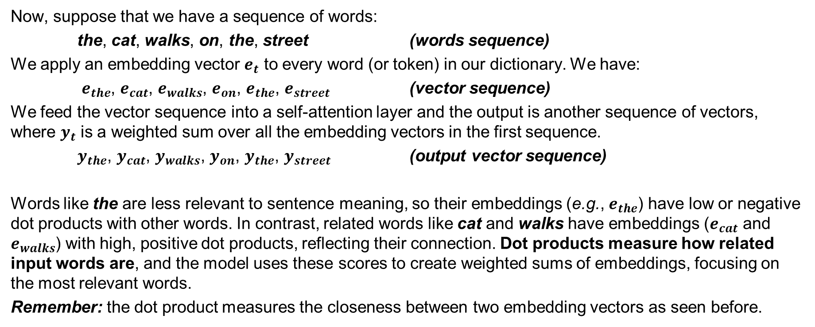
2.2.1. Self-attention layer: token's embedding vector
Now, suppose that we have a sequence of words:
the, cat, walks, on, the, street (words sequence)
We apply an embedding vector $e_{t}$ to every word (or token) in our dictionary. We have:
$e_{the}$, $e_{cat}$, $e_{walks}$, $e_{on}$, $e_{the}$, $e_{street}$ (vector sequence)
We feed the vector sequence into a self-attention layer and the output is another sequence of vectors, where $y_{t}$ is a weighted sum over all the embedding vectors in the first sequence.
$y_{the}$, $y_{cat}$, $y_{walks}$, $y_{on}$, $y_{the}$, $y_{street}$ (output vector sequence)
Words like the are less relevant to sentence meaning, so their embeddings (e.g., $e_{the}$​) have low or negative dot products with other words. In contrast, related words like cat and walks have embeddings ($e_{cat}$​ and $e_{walks}$) with high, positive dot products, reflecting their connection. Dot products measure how related input words are, and the model uses these scores to create weighted sums of embeddings, focusing on the most relevant words.
Remember: the dot product measures the closeness between two embedding vectors as seen before.
Notes:
Ogni persona intuisce/ da importanza a parti divere della conversazione.

Slide 70

2.2.1. Self-attention layer: queries, keys and values
Each token's embedding vector is mapped to three distinct vectors: Query (Q), Key (K), and Value (V). This means that each input vector $x_{i}$is used in three distinct ways:
Notes:
Ogni persona intuisce/ da importanza a parti divere della conversazione.

Slide 71

2.2.1. Self-attention layer: queries, keys and values
Each token's embedding vector is mapped to three distinct vectors: Query (Q), Key (K), and Value (V). This means that each input vector $x_{i}$is used in three distinct ways:
Query: The vector $x_{i}$ is used to compute a query that will be compared with all other vectors to determine the importance (weight) of each vector in the context of the current vector.
Notes:
Ogni persona intuisce/ da importanza a parti divere della conversazione.

Slide 72

2.2.1. Self-attention layer: queries, keys and values
Each token's embedding vector is mapped to three distinct vectors: Query (Q), Key (K), and Value (V). This means that each input vector $x_{i}$is used in three distinct ways:
Query: The vector $x_{i}$ is used to compute a query that will be compared with all other vectors to determine the importance (weight) of each vector in the context of the current vector.
Key: The same vector $x_{i}$​ is also used to form a key that will be compared against the queries of all other vectors to assess how much influence each vector should have over others.
Notes:
Ogni persona intuisce/ da importanza a parti divere della conversazione.

Slide 73
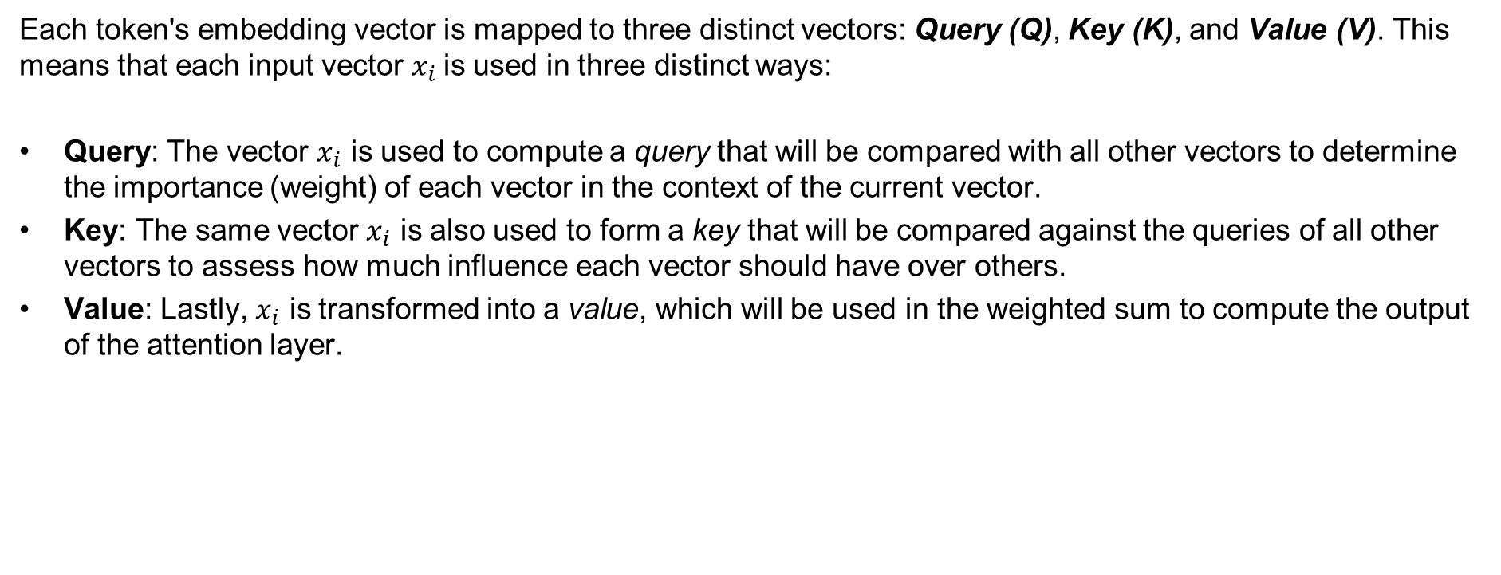
2.2.1. Self-attention layer: queries, keys and values
Each token's embedding vector is mapped to three distinct vectors: Query (Q), Key (K), and Value (V). This means that each input vector $x_{i}$is used in three distinct ways:
Query: The vector $x_{i}$ is used to compute a query that will be compared with all other vectors to determine the importance (weight) of each vector in the context of the current vector.
Key: The same vector $x_{i}$​ is also used to form a key that will be compared against the queries of all other vectors to assess how much influence each vector should have over others.
Value: Lastly, $x_{i}$​ is transformed into a value, which will be used in the weighted sum to compute the output of the attention layer.
Notes:
Ogni persona intuisce/ da importanza a parti divere della conversazione.

Slide 74
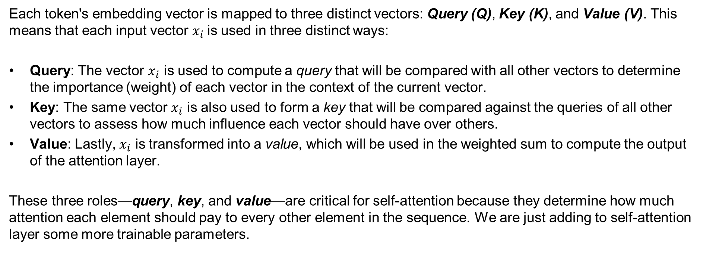
2.2.1. Self-attention layer: queries, keys and values
Each token's embedding vector is mapped to three distinct vectors: Query (Q), Key (K), and Value (V). This means that each input vector $x_{i}$is used in three distinct ways:
Query: The vector $x_{i}$ is used to compute a query that will be compared with all other vectors to determine the importance (weight) of each vector in the context of the current vector.
Key: The same vector $x_{i}$​ is also used to form a key that will be compared against the queries of all other vectors to assess how much influence each vector should have over others.
Value: Lastly, $x_{i}$​ is transformed into a value, which will be used in the weighted sum to compute the output of the attention layer.
These three roles—query, key, and value—are critical for self-attention because they determine how much attention each element should pay to every other element in the sequence. We are just adding to self-attention layer some more trainable parameters.
Notes:
Ogni persona intuisce/ da importanza a parti divere della conversazione.

Slide 75
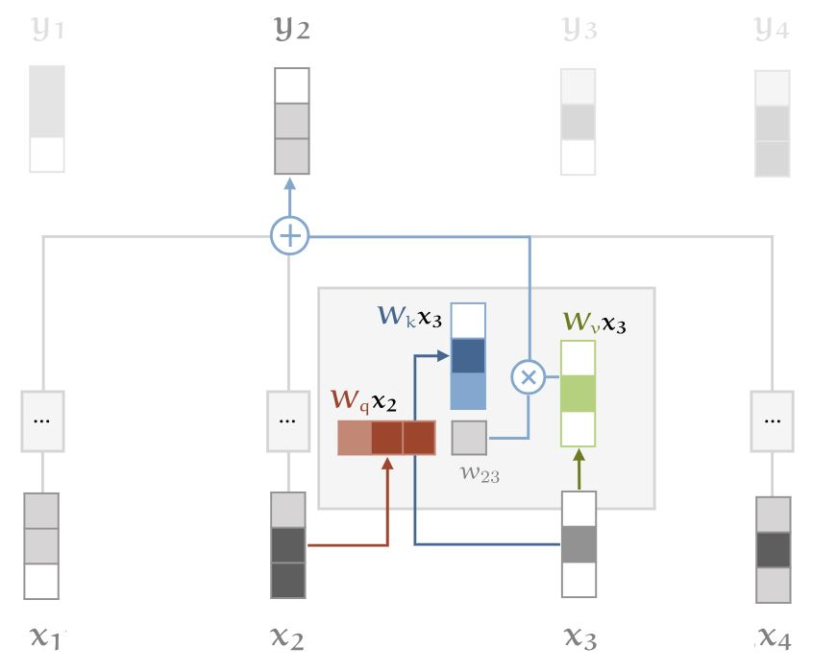
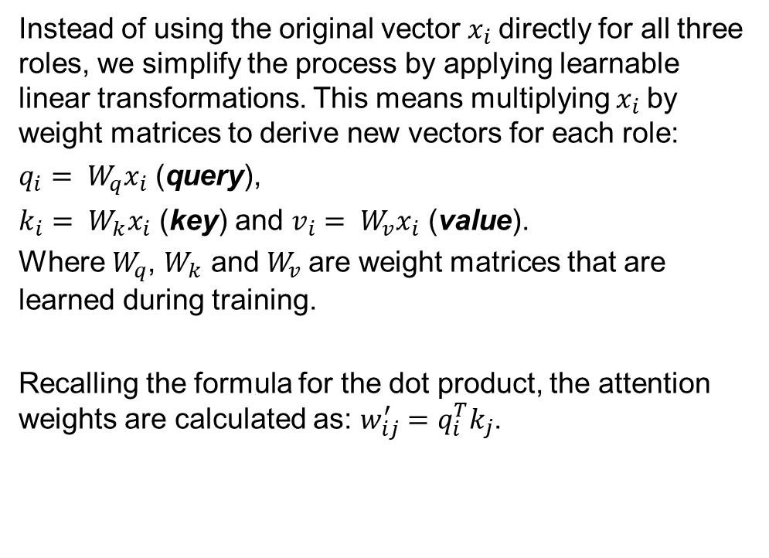
2.2.1. Self-attention layer: queries, keys and values
Instead of using the original vector $x_{i}$directly for all three roles, we simplify the process by applying learnable linear transformations. This means multiplying $x_{i}$by weight matrices to derive new vectors for each role:
$q_{i}= W_{q}x_{i}$ (query),
$k_{i}= W_{k}x_{i}$ (key) and $v_{i}= W_{v}x_{i}$ (value).
Where $W_{q}$, $W_{k}$ and $W_{v}$are weight matrices that are learned during training.
Recalling the formula for the dot product, the attention weights are calculated as: $w_{ij}^{′}=q_{i}^{T}k_{j}$.
Images and examples from: https://peterbloem.nl/blog/transformers and https://poloclub.github.io/transformer-explainer/
Notes:
Ogni persona intuisce/ da importanza a parti divere della conversazione.

Slide 76

2.2.1. Self-attention layer: scaling the dot product
The softmax function can be sensitive to large input values, which can saturate the gradients or slow down learning. Since the average value of the dot product increases with the embedding dimension k, it’s useful to scale the dot product to prevent the inputs to the softmax from becoming too large. This is done by dividing the dot product by the square root of k:
$w_{ij}^{′}=\frac{q_{i}^{T}k_{j}}{\sqrt{k}}$ .
Notes:
Ogni persona intuisce/ da importanza a parti divere della conversazione.

Slide 77
2.2.1. Self-attention layer: multi-head attention
What if we consider the case in which a word can mean different things to different neighbours in the text?
We take the example:
“Mary gave the roses to Susan.”
Notes:
Ogni persona intuisce/ da importanza a parti divere della conversazione.

Slide 78
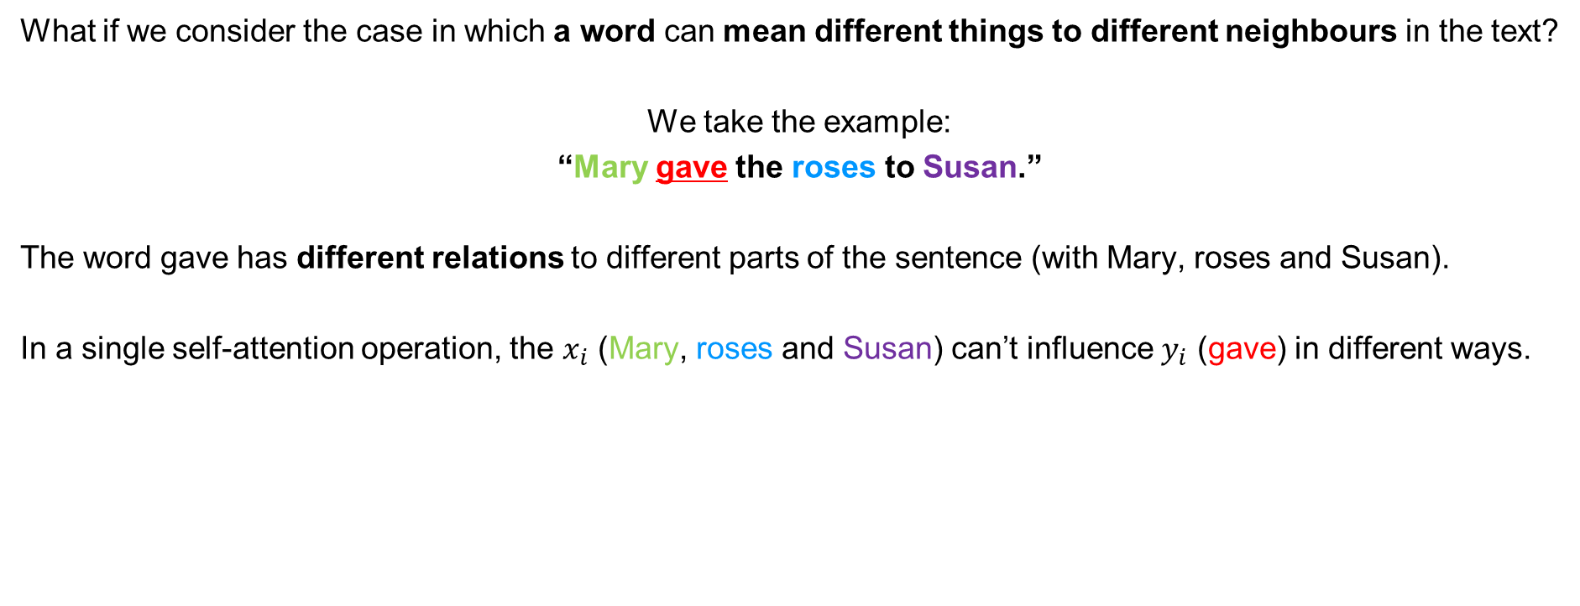
2.2.1. Self-attention layer: multi-head attention
What if we consider the case in which a word can mean different things to different neighbours in the text?
We take the example:
“Mary gave the roses to Susan.”
The word gave has different relations to different parts of the sentence (with Mary, roses and Susan).
In a single self-attention operation, the $x_{i}$ (Mary, roses and Susan) can’t influence $y_{i}$ (gave) in different ways.
Notes:
Ogni persona intuisce/ da importanza a parti divere della conversazione.

Slide 79
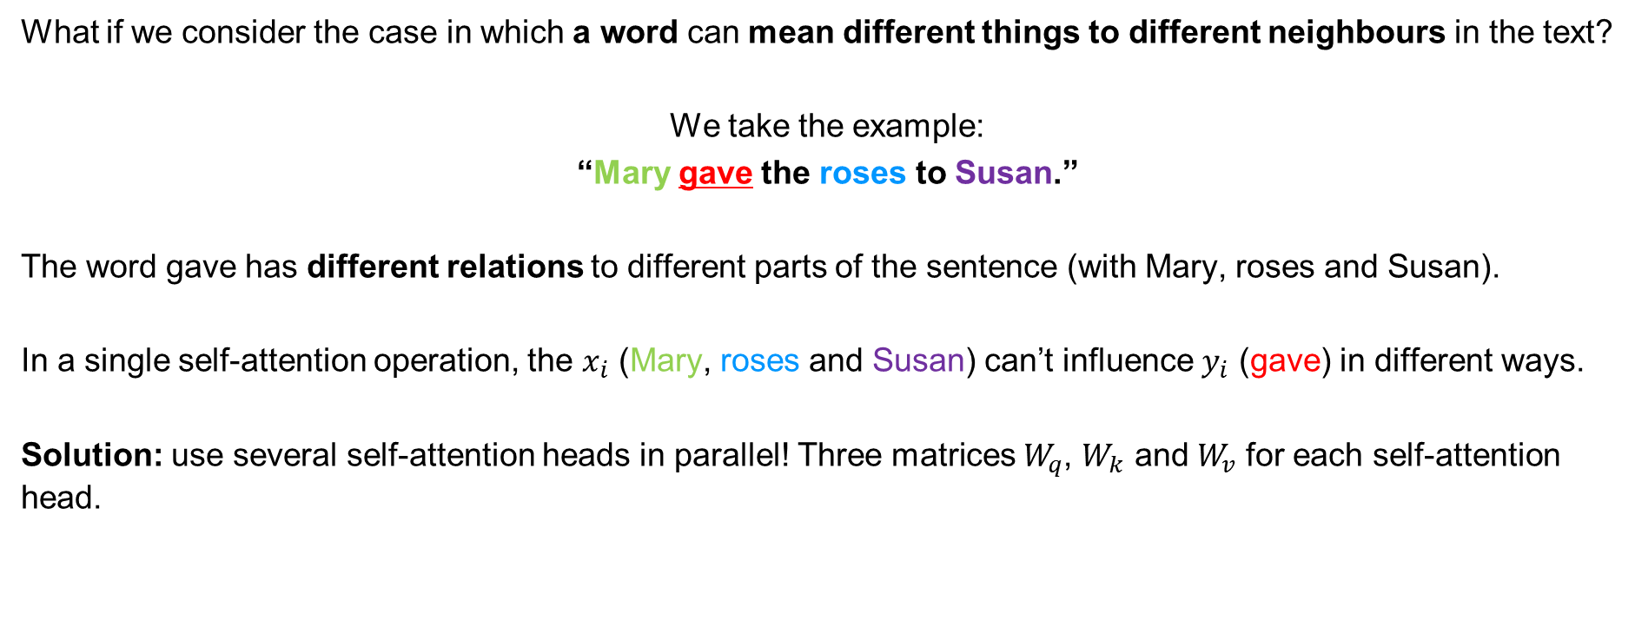
2.2.1. Self-attention layer: multi-head attention
What if we consider the case in which a word can mean different things to different neighbours in the text?
We take the example:
“Mary gave the roses to Susan.”
The word gave has different relations to different parts of the sentence (with Mary, roses and Susan).
In a single self-attention operation, the $x_{i}$ (Mary, roses and Susan) can’t influence $y_{i}$ (gave) in different ways.
Solution: use several self-attention heads in parallel! Three matrices $W_{q}$, $W_{k}$ and $W_{v}$ for each self-attention head.
Notes:
Ogni persona intuisce/ da importanza a parti divere della conversazione.

Slide 80
2.2.1. Self-attention layer: output of self-attention layers
ID | z
1 | 0.1
2 | 1.1
3 | 1.1
4 | 1.3
5 | 1.5
6 | 2
7 | 1.1
8 | 0.7
9 | 1.6
10 | 0.6
11 | 0.9
12 | 0.2
13 | 0.1
14 | 2
15 | 1.7
16 | 1.4
17 | 0.8
18 | 0.4
19 | 0.3
20 | 0.5
21 | 1.1
22 | 1.5
23 | 1.3
24 | 0.6
25 | 1.9
26 | 1.5
27 | 1.1
28 | 1.2
29 | 0.9
30 | 0.5
31 | 0.7
32 | 1.5
33 | 0
34 | 0.2
35 | 0.1
36 | 0.1
37 | 1.7
38 | 1.4
39 | 1
40 | 0.2
41 | 1
42 | 1
43 | 0.4
44 | 0.9
45 | 0.8
46 | 1.3
47 | 1.3
48 | 0.1
49 | 0.8
50 | 1.3
51 | 1
52 | 1.7
53 | 1.3
54 | 0.3
55 | 0.1
56 | 1.3
57 | 0.1
58 | 1.2
59 | 1.9
60 | 1.2
61 | 0.8
62 | 1.3
63 | 0.9
64 | 1.1
65 | 1.9
66 | 0.8
67 | 2
68 | 1.8
69 | 0.4
70 | 0.1
71 | 0.2
72 | 0
73 | 0.2
74 | 1.4
75 | 0.1
76 | 0.6
77 | 1.7
78 | 0
79 | 1.7

Slide 81
2.2.1. Self-attention layer: masked self-attention
Since the Transformer we are introducing is tailored for text generation, two important details must be considered:
Decoder only architecture: usually Transformers such as GPT are Decoder only due to the fact that the goal is to perform next token prediction for generation, no need of an encoder (everything presented until here remains valid).

Slide 82
2.2.1. Self-attention layer: masked self-attention
Since the Transformer we are introducing is tailored for text generation, two important details must be considered:
Decoder only architecture: usually Transformers such as GPT are Decoder only due to the fact that the goal is to perform next token prediction for generation, no need of an encoder (everything presented until here remains valid).
Masked self-attention: we want a character-level transformer to predict autoregressively the next character in a sequence given the previous ones (context). We repeat the procedure taking as new context the old one plus the predicted character, until a stop signal is triggered. Transformers that we saw can access the entire sequence, making prediction “using the future”. To use self-attention autoregressively, we need to mask the attention matrix to prevent the model from "seeing" future characters. This is done by setting elements above the diagonal to −∞ before applying softmax, ensuring attention is restricted to preceding elements only. This masking enforces the sequential dependency required for autoregressive modeling.

Slide 83
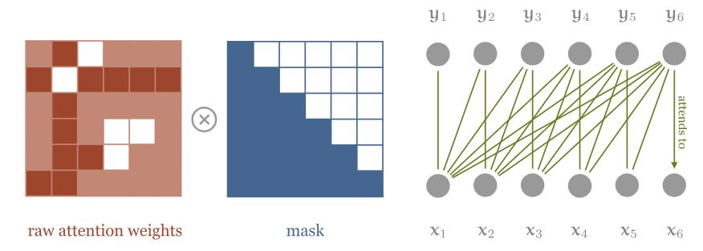
2.2.1. Self-attention layer: masked self-attention
All the elements above the diagonal of the matrix are deactivated.
Cannot look into the future.

Slide 84
2.2.1. Self-attention layer
The following is a possible definition of what is a Transformer architecture:
Any architecture designed to process a connected set of units—such as the tokens in a sequence or the pixels in an image—where the only interaction between units is through self-attention.
It is a pretty general definition, that highlights the fact that a Transformer does not just implement the self-attention operation. In particular, in the Transformer block we have also a Multi-Layer Perceptron layer ...
Notes:
Ogni persona intuisce/ da importanza a parti divere della conversazione.

Slide 85
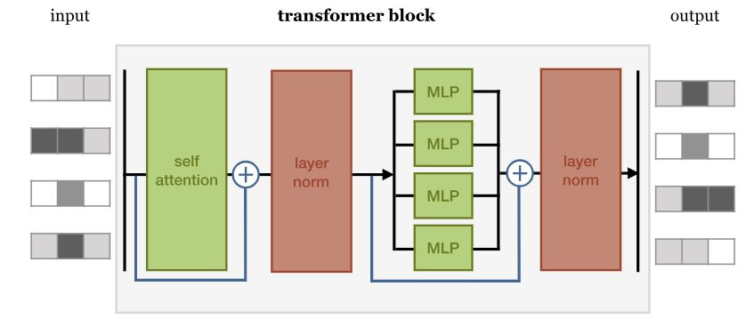
2.2.2. Multi-Layer Perceptron layer
Feed forward layer
It enhances the model's representational capacity;
Notes:
Ogni persona intuisce/ da importanza a parti divere della conversazione.

Slide 86
2.2.2. Multi-Layer Perceptron layer
Feed forward layer
It enhances the model's representational capacity;
The only part of the Transformer with activation functions;
Notes:
Ogni persona intuisce/ da importanza a parti divere della conversazione.

Slide 87
2.2.2. Multi-Layer Perceptron layer
Feed forward layer
It enhances the model's representational capacity;
The only part of the Transformer with activation functions;
It processes tokens independently and simply map them from one representation to another;
Notes:
Ogni persona intuisce/ da importanza a parti divere della conversazione.

Slide 88
2.2.2. Multi-Layer Perceptron layer
Feed forward layer
It enhances the model's representational capacity;
The only part of the Transformer with activation functions;
It processes tokens independently and simply map them from one representation to another;
No interaction between units;
Notes:
Ogni persona intuisce/ da importanza a parti divere della conversazione.

Slide 89
2.2.2. Multi-Layer Perceptron layer
Feed forward layer
It enhances the model's representational capacity;
The only part of the Transformer with activation functions;
It processes tokens independently and simply map them from one representation to another;
No interaction between units;
Where the biggest portion of learnable parameters are.
Notes:
Ogni persona intuisce/ da importanza a parti divere della conversazione.

Slide 90
2.3. Output probabilities: logits, predictions and temperature control
Final Output Layer: Transforms representations from Transformer blocks into a n-dimensional space (vocabulary size). Each token gets a logit.
Softmax
Decoder
Encoder
Embedding
Embedding
Input

Slide 91
2.3. Output probabilities: logits, predictions and temperature control
Final Output Layer: Transforms representations from Transformer blocks into a n-dimensional space (vocabulary size). Each token gets a logit.
Softmax Function: Converts logits into a probability distribution for token prediction.
Softmax
Decoder
Encoder
Embedding
Embedding
Input

Slide 92
2.3. Output probabilities: logits, predictions and temperature control
Final Output Layer: Transforms representations from Transformer blocks into a n-dimensional space (vocabulary size). Each token gets a logit.
Softmax Function: Converts logits into a probability distribution for token prediction.
Sampling: Next token is generated by sampling from this distribution (usually the one with the highest probability).
Softmax
Decoder
Encoder
Embedding
Embedding
Input

Slide 93
2.3. Output probabilities: logits, predictions and temperature control
Final Output Layer: Transforms representations from Transformer blocks into a n-dimensional space (vocabulary size). Each token gets a logit.
Softmax Function: Converts logits into a probability distribution for token prediction.
Sampling: Next token is generated by sampling from this distribution (usually the one with the highest probability).
Temperature Hyperparameter:
1 (default): No change; normal softmax outputs.
< 1: Sharper distribution; more deterministic and predictable outputs.
> 1: Softer distribution; increases randomness and diversity, enhancing “creativity.”
Softmax
Decoder
Encoder
Embedding
Embedding
Input

Slide 94
2.3. Output probabilities: logits, predictions and temperature control
ID | softmax(z)
1 | 0.003
2 | 0.009
3 | 0.009
4 | 0.011
5 | 0.014
6 | 0.023
7 | 0.009
8 | 0.006
9 | 0.015
10 | 0.006
11 | 0.008
12 | 0.004
13 | 0.003
14 | 0.023
15 | 0.017
16 | 0.013
17 | 0.007
18 | 0.005
19 | 0.004
20 | 0.005
21 | 0.009
22 | 0.014
23 | 0.011
24 | 0.006
25 | 0.021
26 | 0.014
27 | 0.009
28 | 0.01
29 | 0.008
30 | 0.005
31 | 0.006
32 | 0.014
33 | 0.003
34 | 0.004
35 | 0.003
36 | 0.003
37 | 0.017
38 | 0.013
39 | 0.008
40 | 0.004
41 | 0.008
42 | 0.008
43 | 0.005
44 | 0.008
45 | 0.007
46 | 0.011
47 | 0.011
48 | 0.003
49 | 0.007
50 | 0.011
51 | 0.008
52 | 0.017
53 | 0.011
54 | 0.004
55 | 0.003
56 | 0.011
57 | 0.003
58 | 0.01
59 | 0.021
60 | 0.01
61 | 0.007
62 | 0.011
63 | 0.008
64 | 0.009
65 | 0.021
66 | 0.007
67 | 0.023
68 | 0.019
69 | 0.005
70 | 0.003
71 | 0.004
72 | 0.003
73 | 0.004
74 | 0.013
75 | 0.003
76 | 0.006
77 | 0.017
78 | 0.003
79 | 0.017

Slide 95
2.3. Output probabilities: logits, predictions and temperature control
ID | softmax(z)
1 | 0.003
2 | 0.009
3 | 0.009
4 | 0.011
5 | 0.014
6 | 0.023
7 | 0.009
8 | 0.006
9 | 0.015
10 | 0.006
11 | 0.008
12 | 0.004
13 | 0.003
14 | 0.023
15 | 0.017
16 | 0.013
17 | 0.007
18 | 0.005
19 | 0.004
20 | 0.005
21 | 0.009
22 | 0.014
23 | 0.011
24 | 0.006
25 | 0.021
26 | 0.014
27 | 0.009
28 | 0.01
29 | 0.008
30 | 0.005
31 | 0.006
32 | 0.014
33 | 0.003
34 | 0.004
35 | 0.003
36 | 0.003
37 | 0.017
38 | 0.013
39 | 0.008
40 | 0.004
41 | 0.008
42 | 0.008
43 | 0.005
44 | 0.008
45 | 0.007
46 | 0.011
47 | 0.011
48 | 0.003
49 | 0.007
50 | 0.011
51 | 0.008
52 | 0.017
53 | 0.011
54 | 0.004
55 | 0.003
56 | 0.011
57 | 0.003
58 | 0.01
59 | 0.021
60 | 0.01
61 | 0.007
62 | 0.011
63 | 0.008
64 | 0.009
65 | 0.021
66 | 0.007
67 | 0.023
68 | 0.019
69 | 0.005
70 | 0.003
71 | 0.004
72 | 0.003
73 | 0.004
74 | 0.013
75 | 0.003
76 | 0.006
77 | 0.017
78 | 0.003
79 | 0.017

Slide 96
3. Different types of LLMs
Modern Large Language Models are usually trained on trillions of tokens for many weeks/months and using a lot of computational power (clusters of GPUs);
BERT
GPT
PaLM
Llama
BLOOM
FLAN-T5

Slide 97
3. Different types of LLMs
Modern Large Language Models are usually trained on trillions of tokens for many weeks/months and using a lot of computational power (clusters of GPUs);
Goal of current research: to make LLMs perform complex tasks and to increase reliability of such models;
BERT
GPT
PaLM
Llama
BLOOM
FLAN-T5

Slide 98
3. Different types of LLMs
Modern Large Language Models are usually trained on trillions of tokens for many weeks/months and using a lot of computational power (clusters of GPUs);
Goal of current research: to make LLMs perform complex tasks and to increase reliability of such models;
The more parameters a network has, the higher the chance that it will be able to learn complex representations and to solve difficult tasks.
BERT
GPT
PaLM
Llama
BLOOM
FLAN-T5

Slide 99
3.1. Prompt and context window
The "text" that receives the model as input is known as a prompt;
Prompt
Context
window
LLM
Inference
Completion

Slide 100
3.1. Prompt and context window
The "text" that receives the model as input is known as a prompt;
The maximum available size of the prompt is called the context window:
It changes from model to model;
Prompt
Context
window
LLM
Inference
Completion

Slide 101
3.1. Prompt and context window
The "text" that receives the model as input is known as a prompt;
The maximum available size of the prompt is called the context window:
It changes from model to model;
The output of the model is called completion;
Prompt
Context
window
LLM
Inference
Completion

Slide 102
3.1. Prompt and context window
The "text" that receives the model as input is known as a prompt;
The maximum available size of the prompt is called the context window:
It changes from model to model;
The output of the model is called completion;
The operation to generate the completion from inputs by passing tokens through the modelis called inference.
Prompt
Context
window
LLM
Inference
Completion

Slide 103
4.1. Practical example: translation from Italian to English
Objective: to translate a sentence from Italian to English.
1. Input phrase: «Ciao come stai?»;
Ciao | come | stai | ?

Slide 104
4.1. Practical example: translation from Italian to English
Objective: to translate a sentence from Italian to English.
1. Input phrase: «Ciao come stai?»;
2. Phrase tokenization: - Each word is looked up in the dictionary and it is transformed into the associated token;
Embedding
Input:
453 | 23 | 11 | 739
Ciao | come | stai | ?

Slide 105
4.1. Practical example: translation from Italian to English
Objective: to translate a sentence from Italian to English.
1. Input phrase: «Ciao come stai?»;
2. Phrase tokenization: - Each word is looked up in the dictionary and it is transformed into the associated token;
- Embedding.
Embedding
Input:
453 | 23 | 11 | 739
Ciao | come | stai | ?

Slide 106
4.1. Practical example: translation from Italian to English
Objective: to translate a sentence from Italian to English.
1. Input phrase: «Ciao come stai?»;
2. Phrase tokenization: - Each word is looked up in the dictionary and it is transformed into the associated token;
- Embedding.
3. The input is received by the encoder: - In this phase the deep representation of the structure of the input takes place; - The output of this phase is used by the decoder to influence its attention mechanism;
Encoder
Embedding
Input:
453 | 23 | 11 | 739
Ciao | come | stai | ?

Slide 107

4.1. Practical example: translation from Italian to English
Objective: to translate a sentence from Italian to English.
1. Input phrase: «Ciao come stai?»;
2. Phrase tokenization: - Each word is looked up in the dictionary and it is transformed into the associated token;
- Embedding.
3. The input is received by the encoder: - In this phase the deep representation of the structure of the input takes place; - The output of this phase is used by the decoder to influence its attention mechanism;
4. An initial token sequence is created r;
Encoder
Embedding
Input:
453 | 23 | 11 | 739
$$r$$
.. | .. | .. | ..
Ciao | come | stai | ?

Slide 108

4.1. Practical example: translation from Italian to English
Vector $r$ enters the decoder, which produces the next token. It does so based on the contextualized representation learned through the self-attention mechanism.
$$z$$
Decoder
Encoder
Embedding
Embedding
Input:
453 | 23 | 11 | 739
$$r$$
.. | .. | .. | ..
Ciao | come | stai | ?

Slide 109
4.1. Practical example: translation from Italian to English
Softmax is applied to the output z of the decoder (logits) and a probability distribution associated to the tokens is generated.
Softmax
$$z$$
Decoder
Encoder
Embedding
Embedding
Input:
453 | 23 | 11 | 739
$$r$$
.. | .. | .. | ..
Ciao | come | stai | ?

Slide 110
4.1. Practical example: translation from Italian to English
234 | .. | .. | ..
Softmax is applied to the output z of the decoder (logits) and a probability distribution associated to the tokens is generated.
The generated token will be the one with highest probability;
Softmax
$$z$$
Decoder
Encoder
Embedding
Embedding
Input:
453 | 23 | 11 | 739
$$r$$
.. | .. | .. | ..
Ciao | come | stai | ?

Slide 111

4.1. Practical example: translation from Italian to English
234 | .. | .. | ..
Softmax is applied to the output z of the decoder (logits) and a probability distribution associated to the tokens is generated.
The generated token will be the one with highest probability;
$r$ is updated with the new prediction;
Softmax
$$z$$
Decoder
Encoder
Embedding
Embedding
Input:
453 | 23 | 11 | 739
$$r$$
234 | .. | .. | ..
Ciao | come | stai | ?

Slide 112
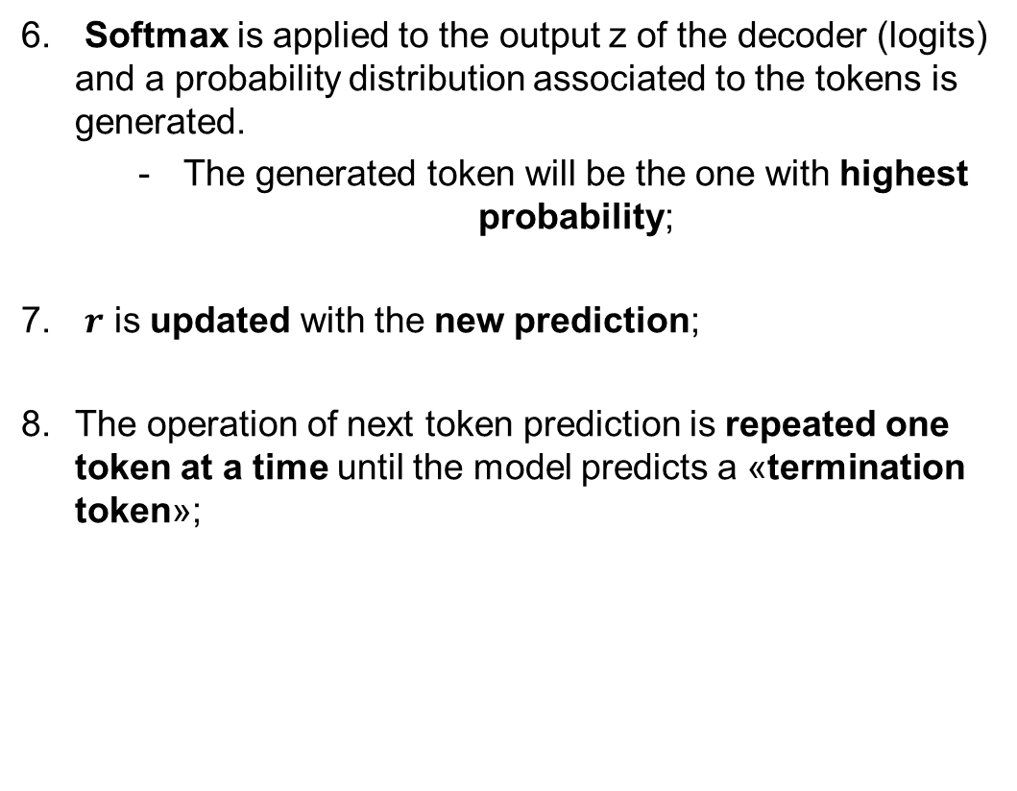
4.1. Practical example: translation from Italian to English
234 | 453 | .. | ..
Softmax is applied to the output z of the decoder (logits) and a probability distribution associated to the tokens is generated.
The generated token will be the one with highest probability;
$r$ is updated with the new prediction;
The operation of next token prediction is repeated one token at a time until the model predicts a «termination token»;
Softmax
$$z$$
Decoder
Encoder
Embedding
Embedding
Input:
453 | 23 | 11 | 739
$$r$$
234 | 453 | .. | ..
Ciao | come | stai | ?

Slide 113
4.1. Practical example: translation from Italian to English
234 | 453 | 122 | ..
Softmax is applied to the output z of the decoder (logits) and a probability distribution associated to the tokens is generated.
The generated token will be the one with highest probability;
$r$ is updated with the new prediction;
The operation of next token prediction is repeated one token at a time until the model predicts a «termination token»;
Softmax
$$z$$
Decoder
Encoder
Embedding
Embedding
Input:
453 | 23 | 11 | 739
$$r$$
234 | 453 | 122 | ..
Ciao | come | stai | ?

Slide 114
4.1. Practical example: translation from Italian to English
234 | 453 | 122 | 19
Softmax is applied to the output z of the decoder (logits) and a probability distribution associated to the tokens is generated.
The generated token will be the one with highest probability;
$r$ is updated with the new prediction;
The operation of next token prediction is repeated one token at a time until the model predicts a «termination token»;
Softmax
$$z$$
Decoder
Encoder
Embedding
Embedding
Input:
453 | 23 | 11 | 739
$$r$$
234 | 453 | 122 | 19
Ciao | come | stai | ?

Slide 115
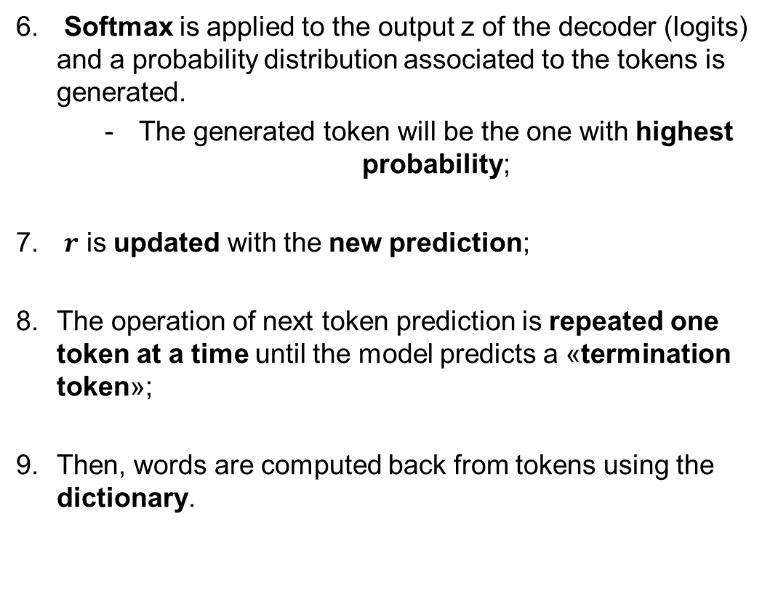
4.1. Practical example: translation from Italian to English
234 | 453 | 122 | 19
Softmax is applied to the output z of the decoder (logits) and a probability distribution associated to the tokens is generated.
The generated token will be the one with highest probability;
$r$ is updated with the new prediction;
The operation of next token prediction is repeated one token at a time until the model predicts a «termination token»;
Then, words are computed back from tokens using the dictionary.
Softmax
$$z$$
Decoder
Encoder
Embedding
Embedding
Input:
453 | 23 | 11 | 739
$$r$$
234 | 453 | 122 | 19
Hi | how | are | you
Ciao | come | stai | ?

Slide 116
4.2. Encoder, decoder, or both? It depends on the task to be solved
Encoder-only Models
Softmax
Encoder
Embedding
Classification problems:
Sentiment analysis
Example: BERT

Slide 117
4.2. Encoder, decoder, or both? It depends on the task to be solved
Encoder-only Models
Econder-Decoder-Models
Softmax
Softmax
Decoder
Encoder
Encoder
Embedding
Embedding
Embedding
Classification problems:
Sentiment analysis
Example: BERT
«Sequence-to-sequence» problems:
Translation, text generation
Esempio: BART, T5

Slide 118
4.2. Encoder, decoder, or both? It depends on the task to be solved
Encoder-only Models
Econder-Decoder-Models
Decoder-only Models
Softmax
Softmax
Softmax
Decoder
Decoder
Encoder
Encoder
Embedding
Embedding
Embedding
Embedding
Classification problems:
Sentiment analysis
Example: BERT
«Sequence-to-sequence» problems:
Translation, text generation
Esempio: BART, T5
Generation problems:
Text generation, chat
Esempio: GPT, LLama

Slide 119



4.2.1 Model training
The model receives GB, TB, PB of data:
From many and diverse sources:
Internet
Ad-hoc documents
Pre-defined datasets
$$D_{1}$$
$$D_{..}$$
$$D_{n}$$
Train
LLM

Slide 120
4.2.1 Model training
The model receives GB, TB, PB of data:
From many and diverse sources:
Internet
Ad-hoc documents
Pre-defined datasets
During training, the model learns the relationships between the data and their representations:
The encoder/decoder generates embedded representations for every token;
$$D_{1}$$
$$D_{..}$$
$$D_{n}$$
Train
LLM

Slide 121
4.2.1 Model training
The model receives GB, TB, PB of data:
From many and diverse sources:
Internet
Ad-hoc documents
Pre-defined datasets
During training, the model learns the relationships between the data and their representations:
The encoder/decoder generates embedded representations for every token;
The weights of the Transformer are calculated.
$$D_{1}$$
$$D_{..}$$
$$D_{n}$$
Train
LLM

Slide 122
4.2.2. Encoder-only models
Known as auto-encoding models.
Lo | Studente | ?? | Matematica
Encoder-only
LLM
Lo | Studente | Studia | Matematica

Slide 123
4.2.2. Encoder-only models
Known as auto-encoding models.
These models are trained using «masked language modeling»:
The inputs are randomly masked or hidden.
The model is then trained to predict these masked elements using the context provided by the surrounding words.
Lo | Studente | ?? | Matematica
Encoder-only
LLM
Lo | Studente | Studia | Matematica

Slide 124
4.2.2. Encoder-only models
Known as auto-encoding models.
These models are trained using «masked language modeling»:
The inputs are randomly masked or hidden.
The model is then trained to predict these masked elements using the context provided by the surrounding words.
Typical use:
Sentiment analysis
Word classification
Lo | Studente | ?? | Matematica
Encoder-only
LLM
Lo | Studente | Studia | Matematica

Slide 125
4.2.2. Encoder-only models
Known as auto-encoding models.
These models are trained using «masked language modeling»:
The inputs are randomly masked or hidden.
The model is then trained to predict these masked elements using the context provided by the surrounding words.
Typical use:
Sentiment analysis
Word classification
Models:
BERT
ROBERTA
Lo | Studente | ?? | Matematica
Encoder-only
LLM
Lo | Studente | Studia | Matematica

Slide 126
4.2.3. Decoder-only models
Known as auto-regressive models.
Lo | ?? | ?? | ??
Decoder-only
LLM
Lo | Studente | ?? | ??

Slide 127
4.2.3. Decoder-only models
Known as auto-regressive models.
These models are trained using «causal language modeling»:
The model is trained to predict the next token in a sequence given the previous tokens.
The model has no knowledge of how the sentence ends.
Lo | ?? | ?? | ??
Decoder-only
LLM
Lo | Studente | ?? | ??

Slide 128
4.2.3. Decoder-only models
Known as auto-regressive models.
These models are trained using «causal language modeling»:
The model is trained to predict the next token in a sequence given the previous tokens.
The model has no knowledge of how the sentence ends.
Typical use:
Text generation
Lo | ?? | ?? | ??
Decoder-only
LLM
Lo | Studente | ?? | ??

Slide 129
4.2.3. Decoder-only models
Known as auto-regressive models.
These models are trained using «causal language modeling»:
The model is trained to predict the next token in a sequence given the previous tokens.
The model has no knowledge of how the sentence ends.
Typical use:
Text generation
Models:
GPT
BLOOM
Lo | ?? | ?? | ??
Decoder-only
LLM
Lo | Studente | ?? | ??

Slide 130
4.2.4. Encoder-decoder models
They use both encoder and decoder.
Lo | ?? | ?? | Matematica
Lo | <<Sentinel token>> | Matematica
Encoder-Decoder
LLM
<<Sentinel token>> | Studente | Studia

Slide 131
4.2.4. Encoder-decoder models
They use both encoder and decoder.
These models are trained using «Span corruption»:
Input sequences are randomly masked or hidden.
These masked sequences are replaced with a single token, which is called «sentinel token».
The sentinel token is a special token that is added to the vocabulary. It does not correspond to any particular word.
The decoder's task is to reconstruct the special tokens in an autoregressive manner.
Lo | ?? | ?? | Matematica
Lo | <<Sentinel token>> | Matematica
Encoder-Decoder
LLM
<<Sentinel token>> | Studente | Studia

Slide 132
4.2.4. Encoder-decoder models
They use both encoder and decoder.
These models are trained using «Span corruption»:
Input sequences are randomly masked or hidden.
These masked sequences are replaced with a single token, which is called «sentinel token».
The sentinel token is a special token that is added to the vocabulary. It does not correspond to any particular word.
The decoder's task is to reconstruct the special tokens in an autoregressive manner.
Typical use:
Text translation, text summarization, question answering
Lo | ?? | ?? | Matematica
Lo | <<Sentinel token>> | Matematica
Encoder-Decoder
LLM
<<Sentinel token>> | Studente | Studia

Slide 133
4.2.4. Encoder-decoder models
They use both encoder and decoder.
These models are trained using «Span corruption»:
Input sequences are randomly masked or hidden.
These masked sequences are replaced with a single token, which is called «sentinel token».
The sentinel token is a special token that is added to the vocabulary. It does not correspond to any particular word.
The decoder's task is to reconstruct the special tokens in an autoregressive manner.
Typical use:
Text translation, text summarization, question answering
Models:
T5, BART
Lo | ?? | ?? | Matematica
Lo | <<Sentinel token>> | Matematica
Encoder-Decoder
LLM
<<Sentinel token>> | Studente | Studia

Slide 134
4.2.5. Summary
Encoder-only
LLM

Slide 135
4.2.5. Summary
Encoder-only
LLM
masked language modeling

Slide 136
4.2.5. Summary
Encoder-only
LLM
masked language modeling
The student «??» math

Slide 137
4.2.5. Summary
Encoder-only
LLM
masked language modeling
The student «??» math
The student studies math

Slide 138
4.2.5. Summary
Encoder-only
LLM
masked language modeling
The student «??» math
The student studies math
Decoder-only
LLM

Slide 139
4.2.5. Summary
Encoder-only
LLM
masked language modeling
The student «??» math
The student studies math
Decoder-only
LLM
causal language modeling

Slide 140
4.2.5. Summary
Encoder-only
LLM
masked language modeling
The student «??» math
The student studies math
Decoder-only
LLM
causal language modeling
The «??» «??» «??»

Slide 141
4.2.5. Summary
Encoder-only
LLM
masked language modeling
The student «??» math
The student studies math
Decoder-only
LLM
causal language modeling
The «??» «??» «??»
The student

Slide 142
4.2.5. Summary
Encoder-only
LLM
masked language modeling
The student «??» math
The student studies math
Decoder-only
LLM
causal language modeling
The «??» «??» «??»
The student
Encoder-Decoder
LLM

Slide 143
4.2.5. Summary
Encoder-only
LLM
masked language modeling
The student «??» math
The student studies math
Decoder-only
LLM
causal language modeling
The «??» «??» «??»
The student
Encoder-Decoder
LLM
span corruption

Slide 144
4.2.5. Summary
Encoder-only
LLM
masked language modeling
The student «??» math
The student studies math
Decoder-only
LLM
causal language modeling
The «??» «??» «??»
The student
Encoder-Decoder
LLM
span corruption
The «??» «??»
math

Slide 145
4.2.5. Summary
Encoder-only
LLM
masked language modeling
The student «??» math
The student studies math
Decoder-only
LLM
causal language modeling
The «??» «??» «??»
The student
Encoder-Decoder
LLM
span corruption
The «??» «??»
math
«??» student studies

Slide 146
5.0 Models dimensions over the years
BERT-L
340M

Slide 147
5.0 Models dimensions over the years
GPT-2
1.5B
BERT-L
340M

Slide 148
5.0 Models dimensions over the years
GPT-3
175B
GPT-2
1.5B
BERT-L
340M

Slide 149
5.0 Models dimensions over the years
PaLM
540B
GPT-3
175B
GPT-2
1.5B
BERT-L
340M

Slide 150
5.0 Models dimensions over the years
GPT-4
~1000B
PaLM
540B
GPT-3
175B
GPT-2
1.5B
BERT-L
340M

Slide 151
5.0 Models dimensions over the years
GEMINI
~1650B
GPT-4
~1000B
PaLM
540B
GPT-3
175B
GPT-2
1.5B
BERT-L
340M

Slide 152

5.1. Loading weights of an LLM
Model
1B
Load a pre-trained model with 1 billion parameters into memory
Weights
loading

Slide 153
5.1. Loading weights of an LLM
Model
1B
Load a pre-trained model with 1 billion parameters into memory
1 parameter = 4 bytes = 32 bit (FP32)
Weights
loading

Slide 154

5.1. Loading weights of an LLM
Model
1B
Load a pre-trained model with 1 billion parameters into memory
1 parameter = 4 bytes = 32 bit (FP32)
To store 1B parameters:
$4∗{10}^{9}=4$ GB
Weights
loading

Slide 155
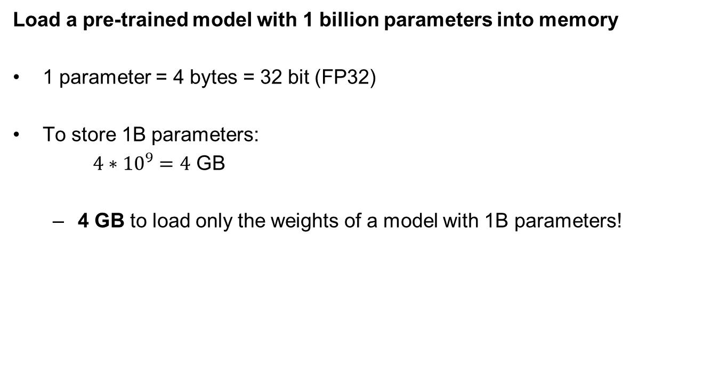
5.1. Loading weights of an LLM
Model
1B
Load a pre-trained model with 1 billion parameters into memory
1 parameter = 4 bytes = 32 bit (FP32)
To store 1B parameters:
$4∗{10}^{9}=4$ GB
4 GB to load only the weights of a model with 1B parameters!
Weights
loading

Slide 156
5.2. Training of an LLM
Model
1B
To train a model with 1B parameters
Training
Credit: huggingface

Slide 157
5.2. Training of an LLM
Model
1B
To train a model with 1B parameters
1 parameter: 4 bytes
Training
Credit: huggingface

Slide 158
5.2. Training of an LLM
Model
1B
To train a model with 1B parameters
1 parameter: 4 bytes
2 optimizators: 8 bytes
Training
Credit: huggingface

Slide 159
5.2. Training of an LLM
Model
1B
To train a model with 1B parameters
1 parameter: 4 bytes
2 optimizators: 8 bytes
Gradients: 4 bytes
Training
Credit: huggingface

Slide 160
5.2. Training of an LLM
Model
1B
To train a model with 1B parameters
1 parameter: 4 bytes
2 optimizators: 8 bytes
Gradients: 4 bytes
Activation functions and temporary variables : 8 bytes
Training
Credit: huggingface

Slide 161
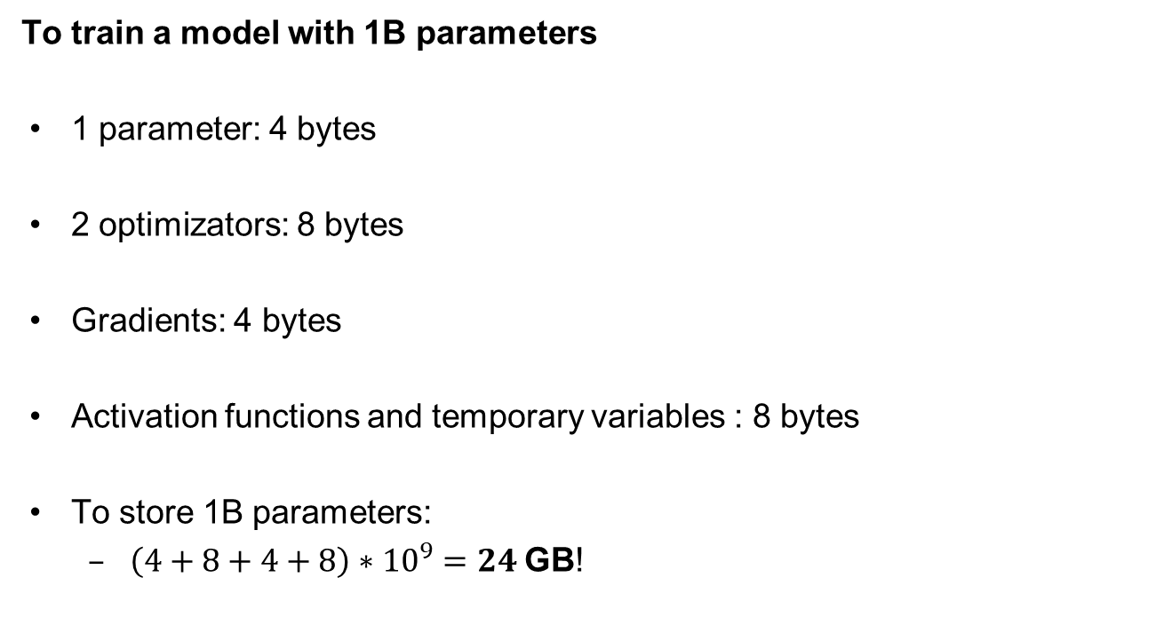
5.2. Training of an LLM
Model
1B
To train a model with 1B parameters
1 parameter: 4 bytes
2 optimizators: 8 bytes
Gradients: 4 bytes
Activation functions and temporary variables : 8 bytes
To store 1B parameters:
$\left(4+8+4+8\right)∗{10}^{9}=24$GB!
Training
Credit: huggingface

Slide 162
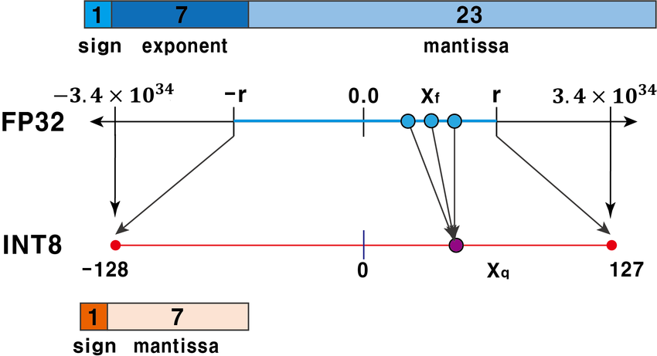

5.3. How to reduce the weight of a model? Reduce the weight of the variables
Idea: represent data with a different data type
Float (FP32): $[−3e^{38},$ $e^{38}]$, 4 bytes
Credit: research gate

Slide 163
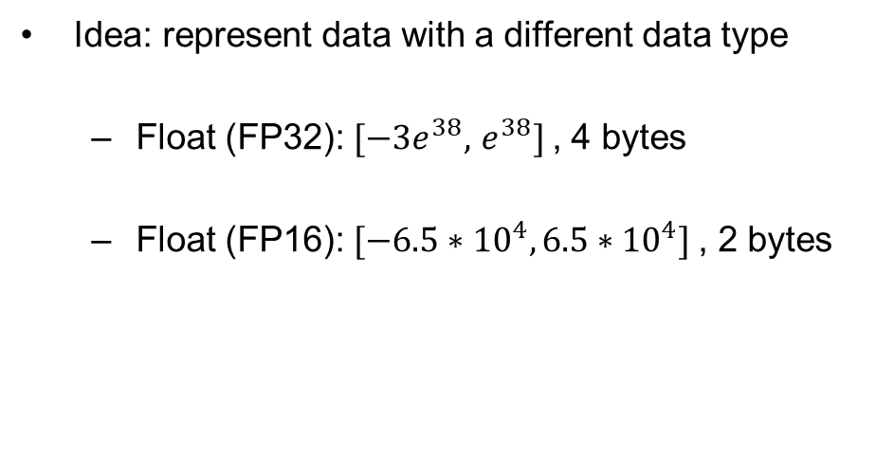
5.3. How to reduce the weight of a model? Reduce the weight of the variables
Idea: represent data with a different data type
Float (FP32): $[−3e^{38},$ $e^{38}]$, 4 bytes
Float (FP16): $[−6.5{∗10}^{4},6.5{∗10}^{4}]$, 2 bytes
Credit: research gate

Slide 164
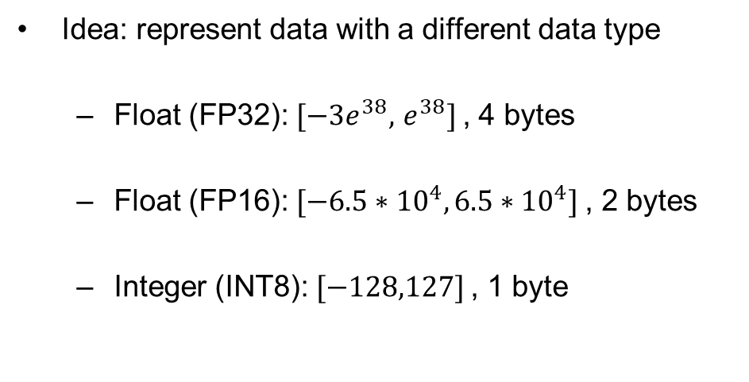
5.3. How to reduce the weight of a model? Reduce the weight of the variables
Idea: represent data with a different data type
Float (FP32): $[−3e^{38},$ $e^{38}]$, 4 bytes
Float (FP16): $[−6.5{∗10}^{4},6.5{∗10}^{4}]$, 2 bytes
Integer (INT8): $[−128,127]$, 1 byte
This is called quantization!
Credit: research gate

Slide 165
5.4. FP16
Model
1B
Load a pre-trained model with 1 billion parameters into memory
Weights
loading

Slide 166
5.4. FP16
Model
1B
Load a pre-trained model with 1 billion parameters into memory
1 parameter = 2 bytes = 16 bit (FP16)
Weights
loading

Slide 167

5.4. FP16
Model
1B
Load a pre-trained model with 1 billion parameters into memory
1 parameter = 2 bytes = 16 bit (FP16)
To store 1B parameters:
$2∗{10}^{9}=2$ GB
Weights
loading

Slide 168
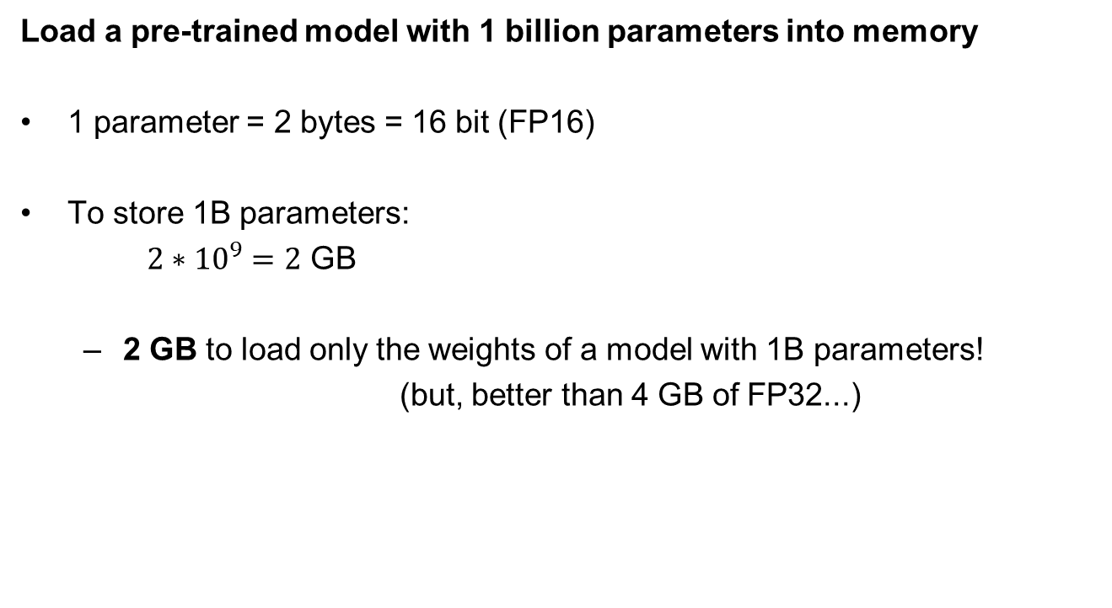
5.4. FP16
Model
1B
Load a pre-trained model with 1 billion parameters into memory
1 parameter = 2 bytes = 16 bit (FP16)
To store 1B parameters:
$2∗{10}^{9}=2$ GB
2 GB to load only the weights of a model with 1B parameters!
(but, better than 4 GB of FP32...)
Weights
loading

Slide 169
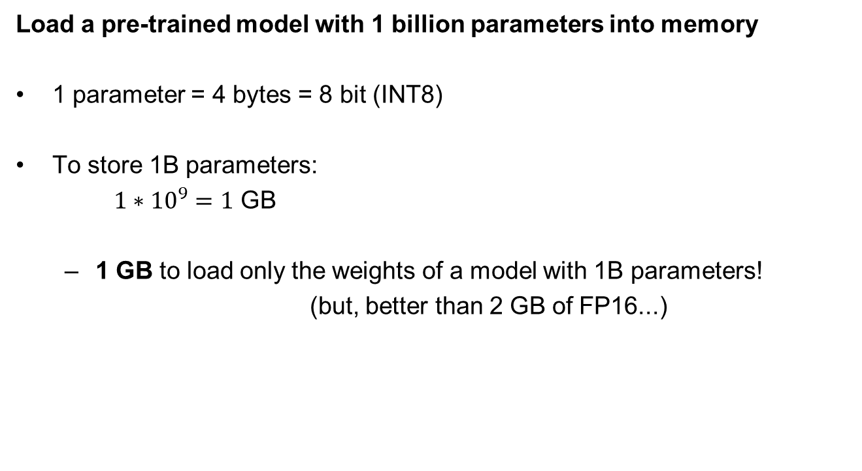
5.5. INT8
Model
1B
Load a pre-trained model with 1 billion parameters into memory
1 parameter = 4 bytes = 8 bit (INT8)
To store 1B parameters:
$1∗{10}^{9}=1$ GB
1 GB to load only the weights of a model with 1B parameters!
(but, better than 2 GB of FP16...)
Weights
loading

Slide 170
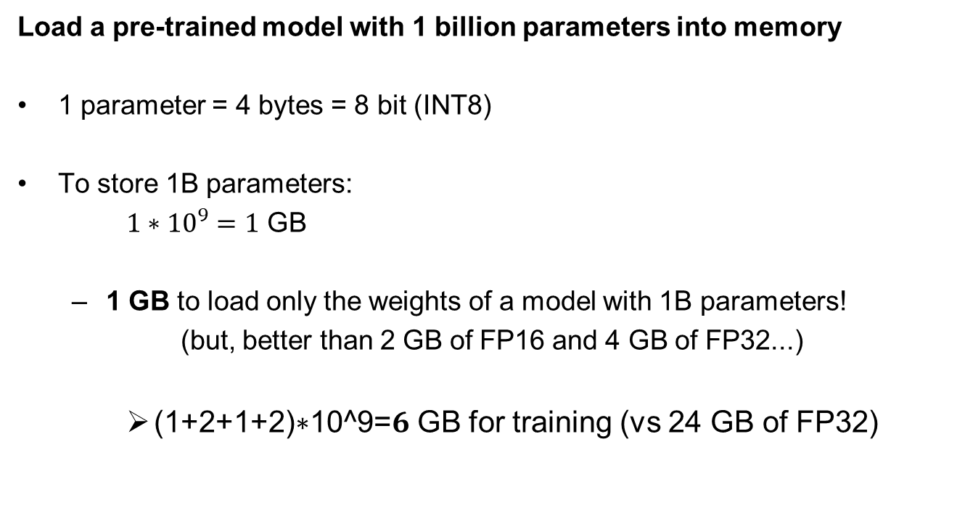
5.5. INT8
Model
1B
Load a pre-trained model with 1 billion parameters into memory
1 parameter = 4 bytes = 8 bit (INT8)
To store 1B parameters:
$1∗{10}^{9}=1$ GB
1 GB to load only the weights of a model with 1B parameters!
(but, better than 2 GB of FP16 and 4 GB of FP32...)
(1+2+1+2)∗10^9=𝟔 GB for training (vs 24 GB of FP32)
Train

Slide 171
5.6. Model training
Model
1B
Training a model that competes with the state-of-the-art is practically unfeasible for end users or small companies and research institutes;
Fine-tuning

Slide 172
5.6. Model training
Model
1B
Training a model that competes with the state-of-the-art is practically unfeasible for end users or small companies and research institutes;
It would imply the use of too many resources:
Ekectric energy;
GPUs;
Very high costs
Fine-tuning

Slide 173
5.6. Model training
Model
1B
Training a model that competes with the state-of-the-art is practically unfeasible for end users or small companies and research institutes;
It would imply the use of too many resources:
Ekectric energy;
GPUs;
Very high costs
Idea: we can add information about our downstream tasks to pretrained models:
Fine-tuning! (we focus on this)
Retrieval Augmented Generation (RAG)!
Fine-tuning

Slide 174
6. Fine tuning
Challenges with LLMs solvable with fine-tuning:
High computational cost: Billions of parameters require significant resources for training and deployment.

Slide 175
6. Fine tuning
Challenges with LLMs solvable with fine-tuning:
High computational cost: Billions of parameters require significant resources for training and deployment.
Memory constraints: Large model size makes it hard to deploy on devices with limited resources.

Slide 176
6. Fine tuning
Challenges with LLMs solvable with fine-tuning:
High computational cost: Billions of parameters require significant resources for training and deployment.
Memory constraints: Large model size makes it hard to deploy on devices with limited resources.
Adaptation to specific tasks: Pretrained LLMs may need fine-tuning to perform well on specialized tasks.

Slide 177
6. Fine tuning
Traditional fine-tuning:
Fine-tune all model parameters on a task-specific dataset.
Requires extensive computational resources and time.
Potential overfitting if the fine-tuning dataset is too small.
Full model fine-tuning can be a slow process, especially for new tasks or datasets.

Slide 178
6. Fine tuning
Traditional fine-tuning:
Fine-tune all model parameters on a task-specific dataset.
Requires extensive computational resources and time.
Potential overfitting if the fine-tuning dataset is too small.
Full model fine-tuning can be a slow process, especially for new tasks or datasets.
Keep frozen most of the layers of the model and fine-tune a small number of weights on a task-specific dataset.
How to select the layers to fine-tune?

Slide 179
6. Parameter-Efficient Fine-Tuning (PEFT)
Solution: Parameter-Efficient Fine-Tuning (PEFT)

Slide 180
6. Parameter-Efficient Fine-Tuning (PEFT)
Solution: Parameter-Efficient Fine-Tuning (PEFT)
A strategy for fine-tuning that focuses on optimizing only a small subset of model parameters.

Slide 181
6. Parameter-Efficient Fine-Tuning (PEFT)
Solution: Parameter-Efficient Fine-Tuning (PEFT)
A strategy for fine-tuning that focuses on optimizing only a small subset of model parameters.
Minimizes resource consumption while maintaining model performance.

Slide 182
6. Parameter-Efficient Fine-Tuning (PEFT)
Solution: Parameter-Efficient Fine-Tuning (PEFT)
A strategy for fine-tuning that focuses on optimizing only a small subset of model parameters.
Minimizes resource consumption while maintaining model performance.
Lower memory usage: Fine-tunes only a small number of parameters.

Slide 183
6. Parameter-Efficient Fine-Tuning (PEFT)
Solution: Parameter-Efficient Fine-Tuning (PEFT)
A strategy for fine-tuning that focuses on optimizing only a small subset of model parameters.
Minimizes resource consumption while maintaining model performance.
Lower memory usage: Fine-tunes only a small number of parameters.
Faster adaptation: Reduced fine-tuning time.

Slide 184
6. Parameter-Efficient Fine-Tuning (PEFT)
Solution: Parameter-Efficient Fine-Tuning (PEFT)
A strategy for fine-tuning that focuses on optimizing only a small subset of model parameters.
Minimizes resource consumption while maintaining model performance.
Lower memory usage: Fine-tunes only a small number of parameters.
Faster adaptation: Reduced fine-tuning time.
Preserves pretrained knowledge: Only minor adjustments are made to the model.

Slide 185
6. Parameter-Efficient Fine-Tuning (PEFT): LoRA
The method we will use in practice is Low-Rank Adaptation (LoRA):
Introduces low-rank matrices into the model’s weight matrices.
Fine-tunes just the low-rank components rather than the full weight matrices.
Advantage: Efficient use of parameters and less resource-intensive.
Fine-tunes the model by making minimal changes to the pretrained weights, allowing the model to retain its general-purpose knowledge from pretraining while adapting to task-specific requirements.
Credit: https://github.com/huggingface/peft

Slide 186
6. Parameter-Efficient Fine-Tuning (PEFT): LoRA
The method we will use in practice is Low-Rank Adaptation (LoRA):
Introduces low-rank matrices into the model’s weight matrices.
Fine-tunes just the low-rank components rather than the full weight matrices.
Advantage: Efficient use of parameters and less resource-intensive.
Fine-tunes the model by making minimal changes to the pretrained weights, allowing the model to retain its general-purpose knowledge from pretraining while adapting to task-specific requirements.
Requirement: we need a dataset for our specific downstream task (more insights in the exercise session...).
Credit: https://github.com/huggingface/peft

Slide 187
LLMs lessons recap
Definition of Generative Artificial Intelligence.
What are the main differences between a discriminative model and a generative model?
What are the main features of the Transformer architecture?
What are the types of LLM and how they differ?
Considerations on running inference and training of LLMs.

