Slide 1
Applied Case Studies of Machine Learning and Deep Learning in Key Areas
Marco Maccarini, Researcher at IDSIA USI/SUPSI
Notes:
this is a short lesson to introduce to you generative artificial intelligence.

Slide 2
What will we do today?
Test one GPT model
Create a HuggingFace token
Download a model from HuggingFace
Use the correct tokenizer
Play with the model
Create a synthetic dataset using python
Choose a use-case
What the model has to learn?
Upload the dataset on HuggingFace
Train the model using Axolotl
Modify the existing yml file in the examples
Launch the train
Once the train has been completed:
Merge the trained model with the HuggingFace model
Test the model
Upload the model to HuggingFace

Slide 3
What will we do today?
Test one GPT model
Create a HuggingFace token
Download a model from HuggingFace
Use the correct tokenizer
Play with the model
Create a synthetic dataset using python
Choose a use-case
What the model has to learn?
Upload the dataset on HuggingFace
Train the model using Axolotl
Modify the existing yml file in the examples
Launch the train
Once the train has been completed:
Merge the trained model with the HuggingFace model
Test the model
Upload the model to HuggingFace

Slide 4
1. Testing one GPT model
There are more than 1 millions of available models on HuggingFace
Mostly are open weights, sometimes you need to ask the access to the model
Here you can find all the models in HuggingFace
Let’s see a model: llama3 8B

Slide 5
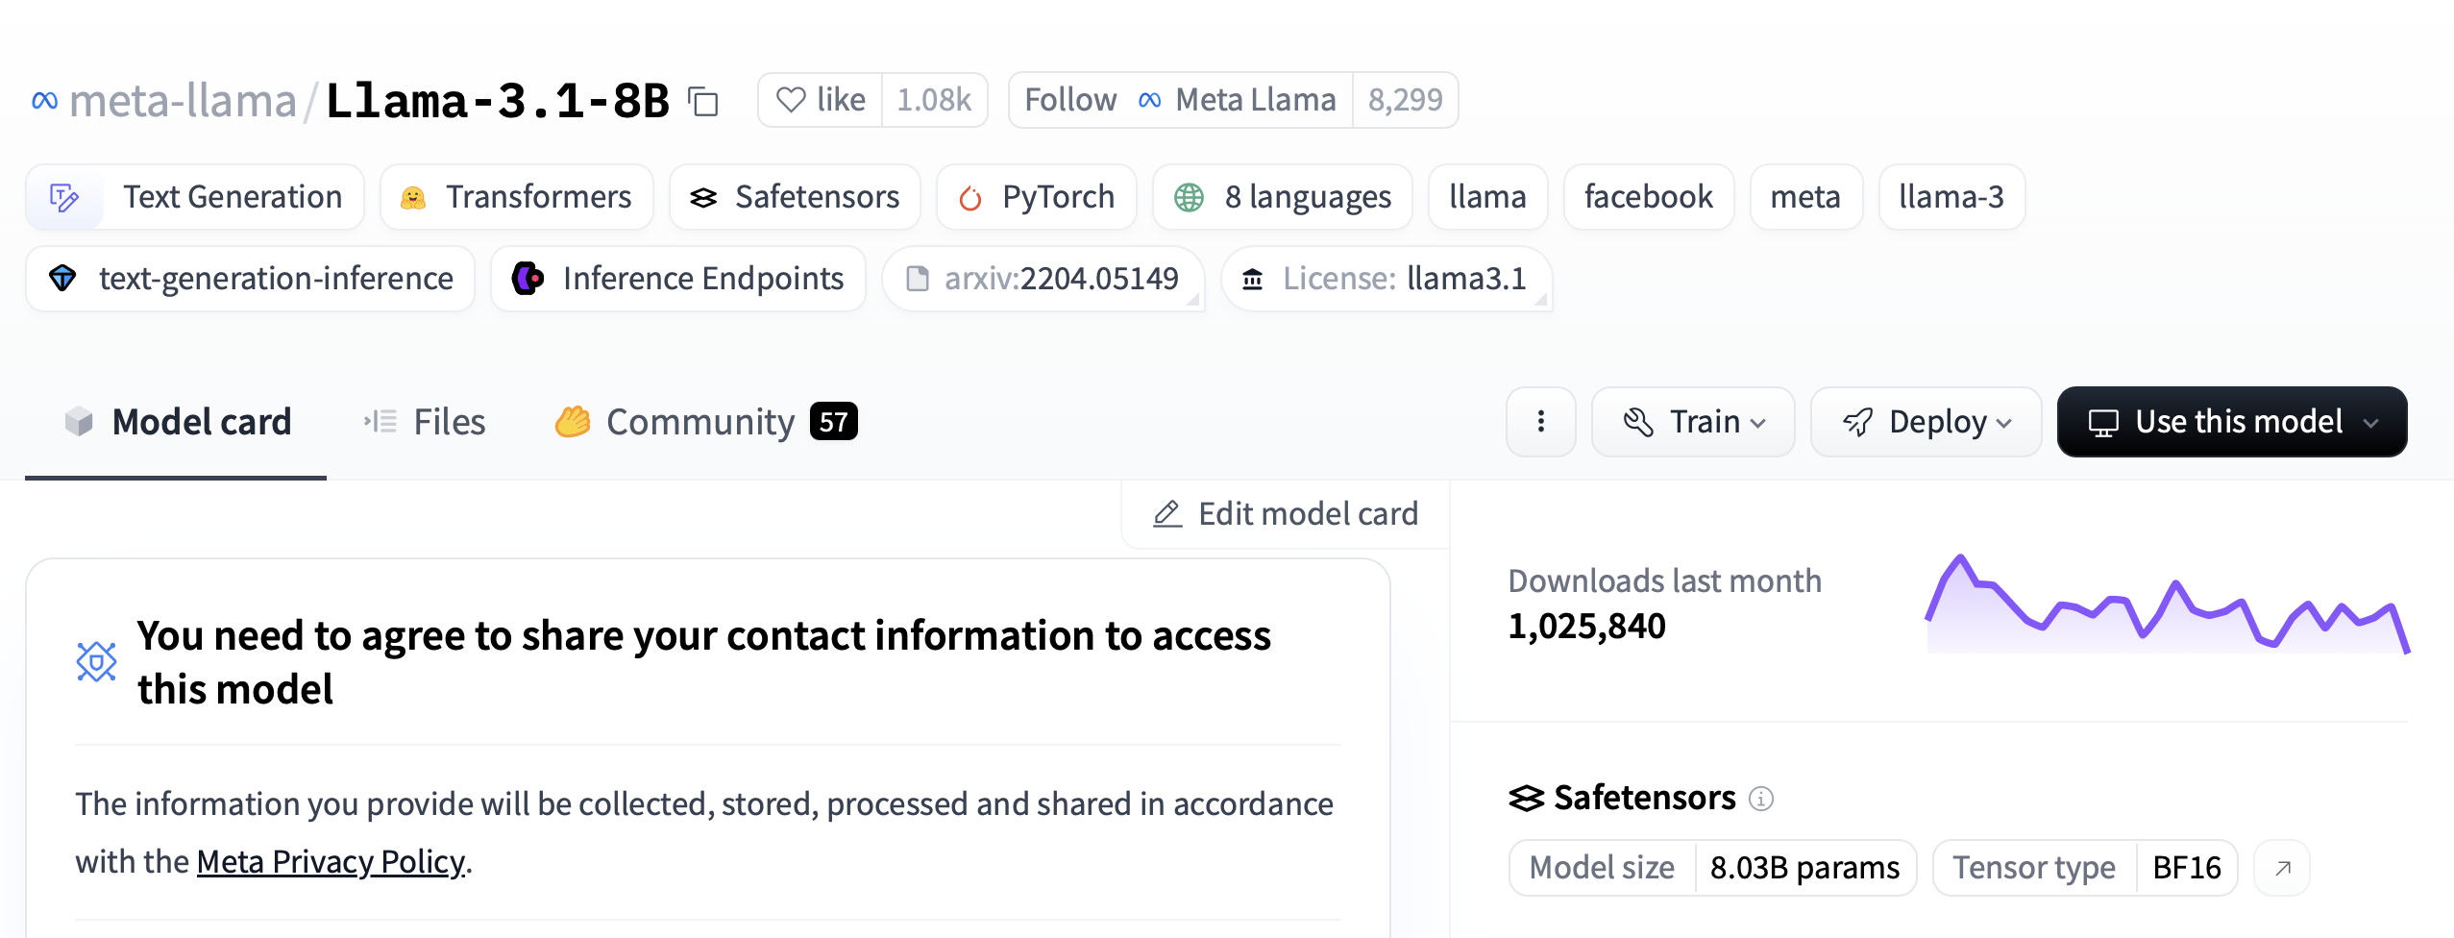
1.1. Llama3 8B

Slide 6
1.2. Creating a token
To create a token, go to HuggingFace
Create an account
Once the account is created you can go to menu → access tokens
Click on create new token, set the token name (i.e. “test1”) and mark all boxes
Then click on create token
Remember: save this token somewhere, if you lost it you have to repeat this operation

Slide 7
1.3. Play on jupyter lab
Fundamental steps on jupyter lab:
Import HuggingFace library and access with the token
Set the gpu (optionally)
Choose the model
Choose the tokenizer
Test the tokenizer
Download the model
Set the prompt
Do some tests (inference)
Let’s move on jupyter lab! (1_play_with_models)

Slide 8
What will we do today?
Test one GPT model
Create a HuggingFace token
Download a model from HuggingFace
Use the correct tokenizer
Play with the model
Create a synthetic dataset using python
Choose a use-case
What the model has to learn?
Upload the dataset on HuggingFace
Train the model using Axolotl
Modify the existing yml file in the examples
Launch the train
Once the train has been completed:
Merge the trained model with the HuggingFace model
Test the model
Upload the model to HuggingFace

Slide 9
2. Synthetic data generation
First, let’s define a use case: the model has to learn the pick and place
How to teach this skill to the model? Same idea of our brain: dividet et impera.
If I have to pick an apple and place to the cup, i have to split this action in several sub-action:
Go above the apple
Go close to it
Pick it
Go above the cup
Go close to it
Open the gripper
Go home
Let’s move on jupyter lab! (2_synth_dataset)

Slide 10
What will we do today?
Test one GPT model
Create a HuggingFace token
Download a model from HuggingFace
Use the correct tokenizer
Play with the model
Create a synthetic dataset using python
Choose a use-case
What the model has to learn?
Upload the dataset on HuggingFace
Train the model using Axolotl
Modify the existing yml file in the examples
Launch the train
Once the train has been completed:
Merge the trained model with the HuggingFace model
Test the model
Upload the model to HuggingFace

Slide 11
3. Train with axolotl (1)
Several option to train the model, one of this is axolotl
Different example of config file present in the “example folder” in github
Copy this config file into your project directory, then change
base_model: meta-llama/Meta-Llama-3-8B
datasets:
- path: your dataset
- type: context_qa.load_v

Slide 12
3. Train with axolotl (2)
Run axolotl’s docker
docker run --name test_1 --gpus '"all"' -v ${PWD}:/workspace/axolotl/my_vol --rm -it winglian/axolotl:main-latest
-v option is to mount the current directory inside “my_vol” folder in the docker
Go inside “my_vol”, it should appear your project directory
Let’s start the training:
huggingface-cli login --token <<your token>>
CUDA_VISIBLE_DEVICES="0" python -m axolotl.cli.preprocess 3_1_test.yml
CUDA_VISIBLE_DEVICES="0" python -m axolotl.cli.train 3_1_test.yml
During the training a folder named “qlora-out” should appear

Slide 13
What will we do today?
Test one GPT model
Create a HuggingFace token
Download a model from HuggingFace
Use the correct tokenizer
Play with the model
Create a synthetic dataset using python
Choose a use-case
What the model has to learn?
Upload the dataset on HuggingFace
Train the model using Axolotl
Modify the existing yml file in the examples
Launch the train
Once the train has been completed:
Merge the trained model with the HuggingFace model
Test the model
Upload the model to HuggingFace

Slide 14
4. Merging the fine-tuned model with the GPT
Basically, what we have to do is
Import the fine-tuned model
Import the GPT model
Merge them together
Test the merged model
Upload to HuggingFace
Let’s move on jupyter lab! (3_merging_models)

