Slide 1
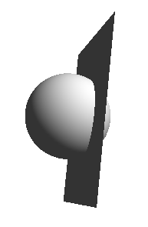
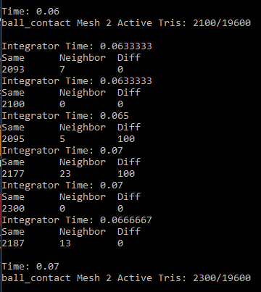
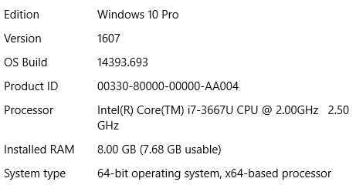
testContactBallFloor
1 second forward simulation, ball motion is prescribed to penetrate floor.
Verify:
Depth of penetration (ball radius = 0.05 m)
Contact detection speed
Mesh 1:
floor (coarse) = 1000 triangles
floor = 20000 triangles
Mesh 2:
ball = 19600 triangles
Colin’s X1-Carbon Laptop
Coarse
Contact Algorithm
Debug
Release
Release
No recheck:
1989s
46.0s
64.6s
Recheck same triangle:
1163s
29.0s
43.5s
Recheck same triangle+neighbors:
1141s
28.9s
41.2s

