Slide 1
A brief introduction to R and Rstudio
Cristian Villegas (clobos@usp.br)

Slide 2
What is R?
R is a language and environment for statistical computing and graphics. It is a GNU project which is similar to the S language and environment which was developed at Bell Laboratories (formerly AT&T, now Lucent Technologies) by John Chambers and colleagues. R can be considered as a different implementation of S. There are some important differences, but much code written for S runs unaltered under R.

Slide 3
What is R?
R provides a wide variety of statistical (linear and nonlinear modelling, classical statistical tests, time-series analysis, classification, clustering, …) and graphical techniques, and is highly extensible. The S language is often the vehicle of choice for research in statistical methodology, and R provides an Open Source route to participation in that activity.

Slide 4
What is R?
One of R’s strengths is the ease with which well-designed publication-quality plots can be produced, including mathematical symbols and formulae where needed. Great care has been taken over the defaults for the minor design choices in graphics, but the user retains full control.

Slide 5
What is R?
R is available as Free Software under the terms of the Free Software Foundation’s GNU General Public License in source code form. It compiles and runs on a wide variety of UNIX platforms and similar systems (including FreeBSD and Linux), Windows and MacOS.

Slide 6
The R environment
R is an integrated suite of software facilities for data manipulation, calculation and graphical display. It includes
an effective data handling and storage facility,
a suite of operators for calculations on arrays, in particular matrices,
a large, coherent, integrated collection of intermediate tools for data analysis,

Slide 7
The R environment
graphical facilities for data analysis and display either on-screen or on hardcopy, and
a well-developed, simple and effective programming language which includes conditionals, loops, user-defined recursive functions and input and output facilities.

Slide 8
The R environment
The term “environment” is intended to characterize it as a fully planned and coherent system, rather than an incremental accretion of very specific and inflexible tools, as is frequently the case with other data analysis software.

Slide 9
The R environment
R, like S, is designed around a true computer language, and it allows users to add additional functionality by defining new functions. Much of the system is itself written in the R dialect of S, which makes it easy for users to follow the algorithmic choices made. For computationally-intensive tasks, C, C++ and Fortran code can be linked and called at run time. Advanced users can write C code to manipulate R objects directly.

Slide 10
The R environment
Many users think of R as a statistics system. We prefer to think of it as an environment within which statistical techniques are implemented. R can be extended (easily) via packages. There are about eight packages supplied with the R distribution and many more are available through the CRAN family of Internet sites covering a very wide range of modern statistics.

Slide 11
The R environment
R has its own LaTeX-like documentation format, which is used to supply comprehensive documentation, both on-line in a number of formats and in hardcopy.
Link for more information https://www.r-project.org/about.html

Slide 12
Download and Install R
Precompiled binary distributions of the base system and contributed packages, Windows and Mac users most likely want one of these versions of R: - Download R for Linux (Debian, Fedora/Redhat, Ubuntu) - Download R for macOS - Download R for Windows R is part of many Linux distributions, you should check with your Linux package management system in addition to the link above.
Link: The Comprehensive R Archive Network

Slide 13
RStudio
Used by millions of people weekly, the RStudio integrated development environment (IDE) is a set of tools built to help you be more productive with R and Python.
Download RStudio Desktop Link: RStudio Desktop

Slide 14
Install Packages from Repositories or Local Files
install.packages("tidyverse")

Slide 15
Loading/Attaching and Listing of Packages
library(tidyverse) citation("tidyverse")

Slide 16
List Objects (ggplot2 example)
ls("package:ggplot2") citation("ggplot2")

Slide 17
Example of dplyr R package
library(dplyr) starwars %>% select(homeworld, height, mass)

Slide 18
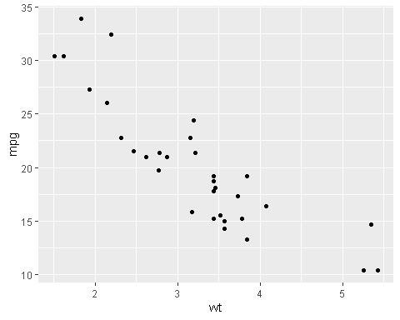
Example of ggplot2 R package
library(ggplot2) ggplot(mtcars, aes(wt, mpg)) + geom_point()

Slide 19
Rmarkdown from Rstudio
Documents
Interactive Documents
Dashboards
Presentations
Books
Websites
Templates
Package Vignettes

Slide 20
Rmarkdown from Rstudio: Examples
Check out the range of outputs and formats you can create using R Markdown https://rmarkdown.rstudio.com/gallery

Slide 21
Citation R
To cite R in publications use:
R Core Team (2022). R: A language and environment for statistical computing. R Foundation for Statistical Computing, Vienna, Austria. URL https://www.R-project.org/.

Slide 22
References: Books
Link: ggplot2: elegant graphics for data analysis, Hadley Wickham
Link: R Programming for Data Science, Roger D. Peng
Link: R for Data Science, Hadley Wickham e Garrett Grolemund.
Link: R Graphics Cookbook, Winston Chang

Slide 23
References (links of dplyr, ggplot2 and magrittr)
Link: dplyr of tidyverse
Link: ggplot2 of tidyverse
Link: magrittr of tidyverse?

Slide 24
Reference: cheat sheet
Link: Data visualization with ggplot2
Link: Data transformation with dplyr
Link: Rmarkdown
Link: Rstudio IDE

