Slide 1
CS499 - Open Source software development
Lecture #05: Licenses and copyright
Dr. Igor Steinmacher
e-mail: Igor.Steinmacher@nau.edu
Twitter: @igorsteinmacher

Slide 2
Before Anything
I am not a lawyer, so, this is not a legal advice
Actually, far from being it

Slide 3
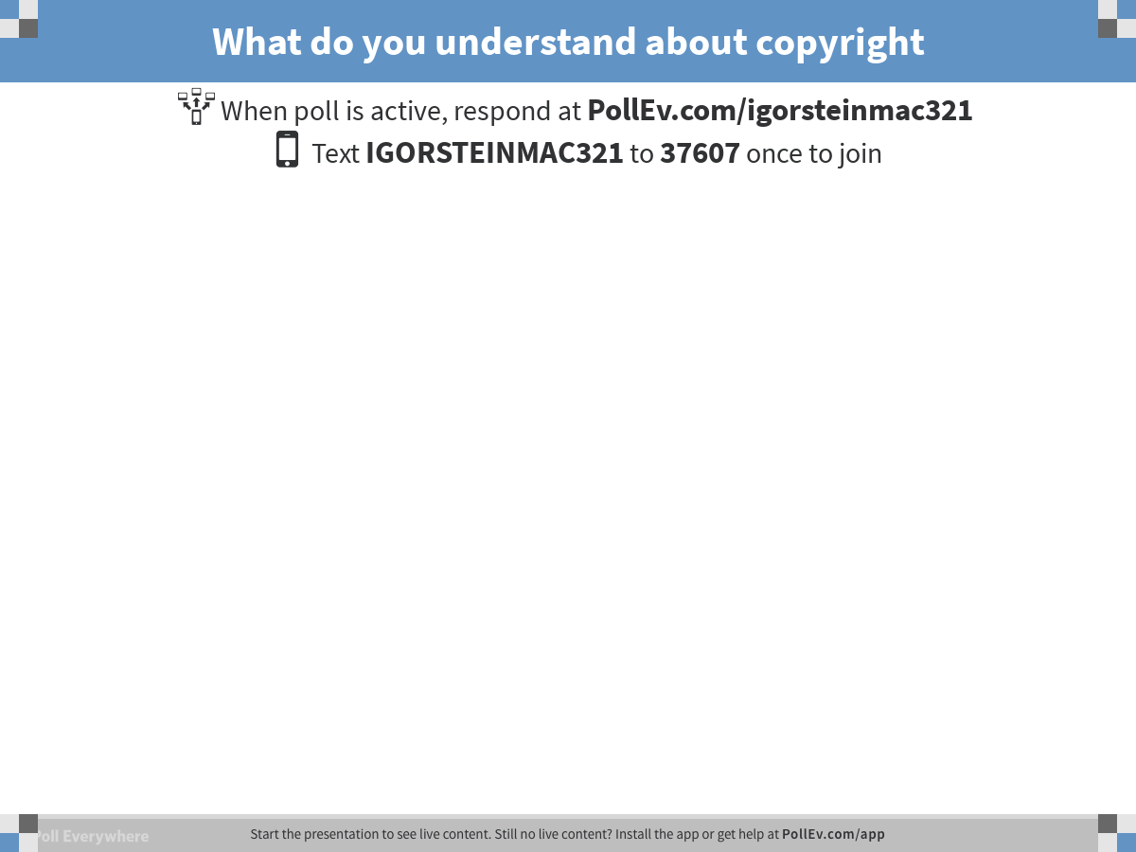
Notes:
What do you understand about copyright
https://www.polleverywhere.com/free_text_polls/zHi1SoFGMOYH72t

Slide 4
Basics
Copyright
Copies
Derivative work
Patent law
New and useful process, machine, manufacture, composition of matter, or any new and useful improvement thereof
Ownership
Licenses
permission to use a copyrighted work
Can impose other restrictions
Do not transfer ownership

Slide 5

Open Source Software
Software that is subject to an open source license
The author decides (it is copyright, right?)
Give the licensee certain rights

Slide 6
Open Source Licenses
Developers vs. legal background?
Who would have know-how to write a license from scratch?
Open source = sharing
What about common licenses and building upon them?
100+ licenses commonly used!!!

Slide 7
Open Source Licenses
Broader classification:
Copyleft or “strong reciprocal”
GPL, AGPL, and family
“Weak copyleft”
LGPL, MPL, etc.
Permissive
Apache, BSD, etc.

Slide 8
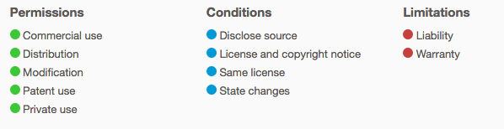
Copyleft Licenses
Four Freedoms are guaranteed
Any changes you make must also be licensed under the same license.
You have to give everyone else the same rights as you got
Related work must be licensed in some way under the same license as the original work
The most common is the GNU General Public License (GPL)
GPLv3:
https://choosealicense.com/licenses/gpl-3.0/

Slide 9
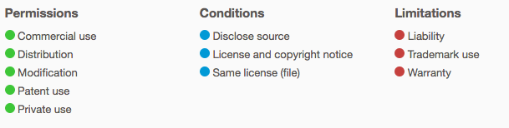
Weak Copyleft Licenses
The code and modifications that are directly related must also be licensed under the same license
Licensee may include unmodified code in an independent work without being required to license the work under any OSS license
I can use a function! Libraries usually use these licenses
Lesser General Public License (LGPL), Mozilla Public License, Eclipse Public License
https://choosealicense.com/licenses/mpl-2.0/

Slide 10
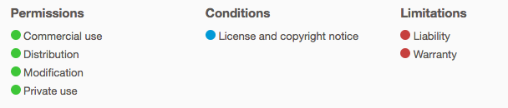
Permissive Licenses
Few restrictions
No requirement to allow copies of the work or modified work
It is possible to create closed source derivatives
Berkeley Software Distribution (BSD), Apache 2.0, MIT License
https://choosealicense.com/licenses/mit/

Slide 11
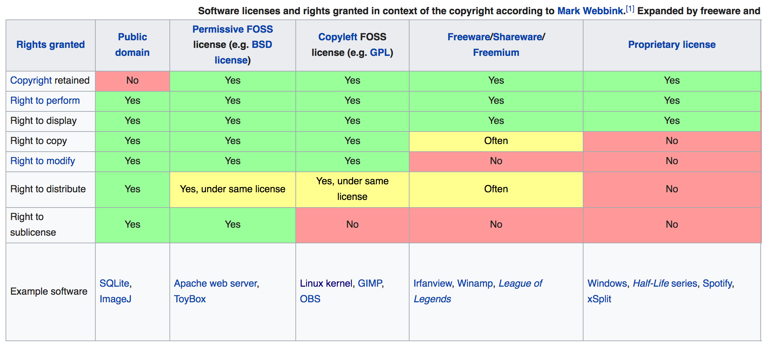
Comparison
https://en.wikipedia.org/wiki/Software_license#Proprietary_software_licenses

Slide 12
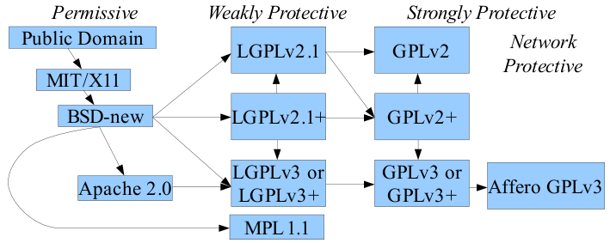
License Compatibility
By David A. Wheeler - http://www.dwheeler.com/essays/floss-license-slide.html, CC BY-SA 3.0, https://commons.wikimedia.org/w/index.php?curid=41060008

Slide 13
How to choose
Tips here and there:
https://choosealicense.com/
http://oss-watch.ac.uk/apps/licdiff/

