Slide 1
Recursive Methods 12.06
Christian Lockley

Slide 2
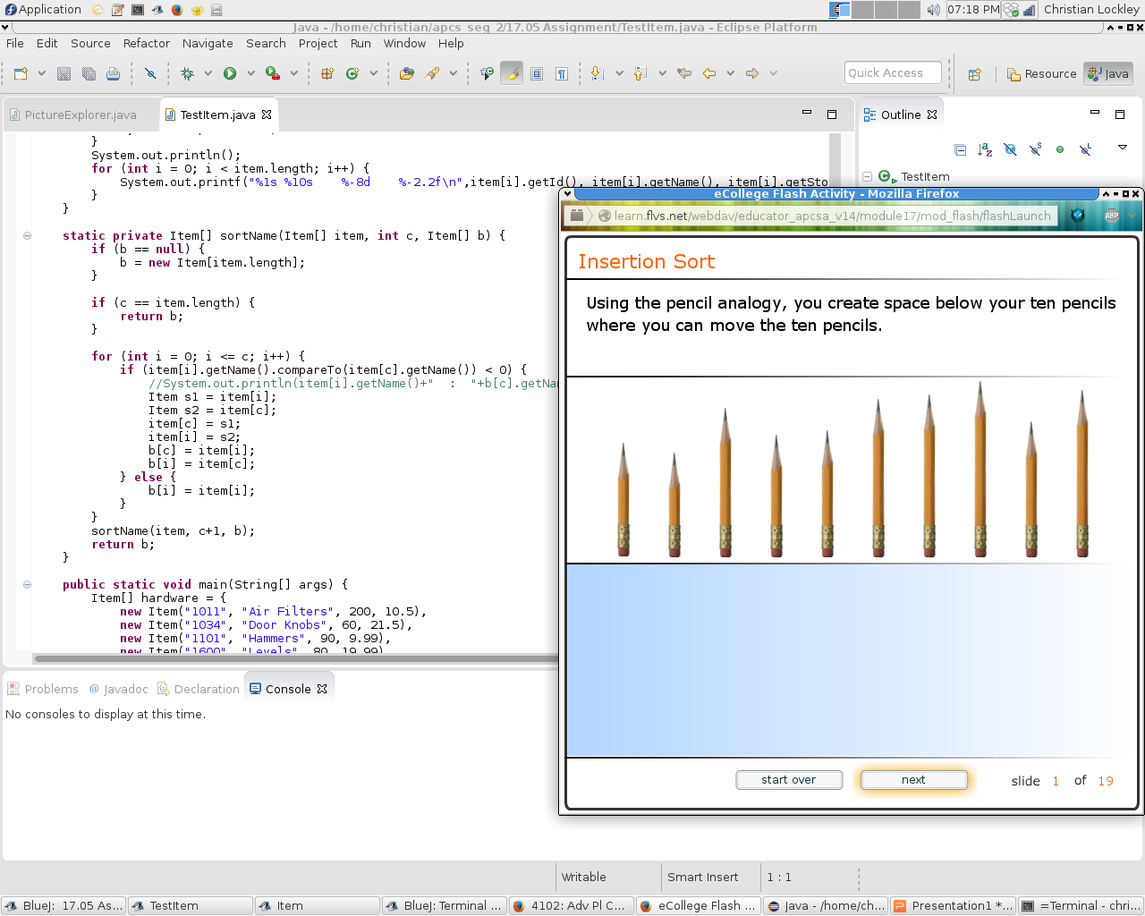
Recursive methods are functions that call themselves until a condition is met.
I will demonstrate a recursive search method.
(Resizable picture)

Slide 3
Sort Name 17.05
static private Item[] sortName(Item[] item, int c, Item[] b) {
if (b == null) {
b = new Item[item.length];
}
if (c == item.length) {
return null;
}
for (int i = 0; i <= c; i++) {
if (item[i].getName().compareTo(item[c].getName()) < 0) {
//System.out.println(item[i].getName()+" : "+b[c].getName());
Item s1 = item[i];
Item s2 = item[c];
item[c] = s1;
item[i] = s2;
b[c] = item[i];
b[i] = item[c];
} else {
b[i] = item[i];
}
}
sortName(item, c+1, b);
return b;
}

Slide 4

Almost any algorithm can be implemented as a recursive method.
Recursive methods divide a problem in to smaller until the base condition is met then function returns.
To to return a set of Russian dolls to a
nested state the smallest doll is placed
in the next largest until
all the dolls larger than the smallest
the at least one doll inside.

Slide 5
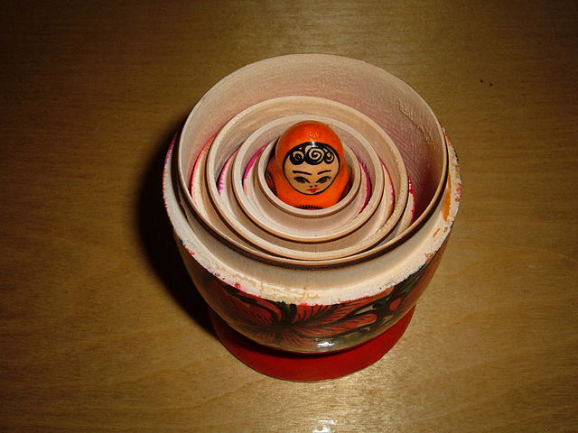
After the base condition is true the last called function(smallest doll) returns to the function that called it until the “largest doll”/method returns.

Slide 6
Recursive vs Loops
All loops must have a stopping condition for example in the for loop below
v must be greater than 2015 for the loop to end
for (int v = 2015; v != 0; v-=1) ;
if the condition is never met, the program will never end.
for (int v = 0; v > 2015;) ;
In a loop the stopping condition is an expression in the parameter of the loop.
Computer will not run out of memory unless there is a memory leak.
void r(int v) {if (v == 0) { return;}r(v-1);}
void r(int v) {if (v == 0) { return;}r(v);}
The base condition cursive method is the body of the method with the other statements.
Program can use all system memory if base condition is not met.

Slide 7
The code
Item[] sortName(Item[] item, int c, Item[] b) {
//If passed a null pointer allocate memory.
if (b == null) { b = new Item[item.length]; }
//When count equals original array length return buffer return buffer.
if (c == item.length) { return null; }
//This loop compares the current object (index c) to object in array upto c
for (int i = 0; i <= c; i++) {
if (item[i].getName().compareTo(item[c].getName()) > 0) {
Item s1 = item[i];
Item s2 = item[c];
item[c] = s1;
item[i] = s2;
b[c] = item[i]; //swap
b[i] = item[c];
} else {
b[i] = item[i]; //Item is already in corect place.
}
}
sortName(item, c+1, b); //Compare next object
return b;

Slide 8
Notes
Each recursive compares one object every other object in the array before calling itself.
To sort backwards I would need to start at the end of the array and compare the last object to the first, or use a simple loop to reverse the array at the end of the recursive calls.
Images from http://en.wikipedia.org/wiki/Matryoshka_doll
if (b == null) { b = new Item[item.length];}
if (c == item.length) {
for (int i = 0, j = item.length - 1; i < item.length - 1; i++,j--) {
Item tmp = b[j];
b[j] = b[i];
b[i] = tmp;
}
return null;
}
for (int i = 0; i <= c; i++) {
if (item[i].getName().compareTo(item[c].getName()) > 0) {
Item s1 = item[i];
Item s2 = item[c];
item[c] = s1;
item[i] = s2;
b[c] = item[i];
b[i] = item[c];
} else { b[i] = item[i];}
}
sortName(item, c+1, b);
return b

