Slide 2
Client
Server
Request
Rendering
User Interface
Response
Business Logic
Storage

Slide 3
Client
Server
User Interface
Business Logic
Sync
API
Storage
Business Logic
Storage

Slide 4
Client
Server
Request
Router
Controller
Model
Database
Data Formatting
View Rendering
(Templates)
Response
Assets (JS+CSS+media)
JS Processing

Slide 5
Client
Server
Request
Router
Controller
Model
Database
Response
Render Main View
JS Template
JS Template
Assets
Assets
JS Processing
Data Response

Slide 6
Client
Server
View
Router
Controller
Controller
Model
Model
JSON
localStorage
Database

Slide 7
Client
Server
Backbone.Model
Backbone.sync
RESTful JSON Interface
get(attribute)
set(attributes)
JSON
POST (create)
GET (read)
PUT (update)
DELETE (delete)
id
url
urlRoot
save
fetch
destroy
validate
Model endpoints:
/[collection.url]/[id] (if in a collection)
/[urlRoot.url]/[id] (if not in a collection)

Slide 8
Client
sync
Server
Backbone.Collection
RESTful JSON Interface
add
remove
set
at
reset
models
/[collection.url]/[id]
GET (read)
PUT (update)
DELETE (delete)
Backbone.Model
Backbone.Model
…
/[collection.url]
POST (create)
GET (read)
url
create
fetch
save

Slide 9
Notify via a callback
Register / Unregister
on
off
Register / Unregister
on
off
Backbone.Model
Backbone.Collection
Events:
change
change:[attribute]
Events:
change
change:[attribute]
add
remove

Slide 10
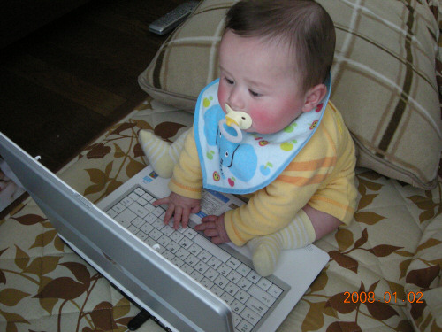
Events: update, click, input
render
Backbone.View
update
DOM
update
inject
…
<div id=“list”>
Hello
</div>
…
notify
Backbone.Model

Slide 11
Events: update, click, input
render
render
View1
View2
notify
update
Model
Server
update

Slide 12
render
DOM
View1
…
<div id=“list”>
Hello
</div>
…
render
update
View2
notify
fetch
Model
Server
json

Slide 13
render
OptionsView
render
DOM
ListView
…
<div id=“list”>
Hello
</div>
…
reset, all
ItemView
ItemView
NewView
save
save
create
change
change
Articles (Collection)
Article (Model)
Article (Model)
…
fetch
sync
Server

