Slide 2























UI
Elements
forms
2d Canvas
Svg
Webgl
Styling
Transformations
Animations
Transitions
Notifications (alert, sound, vibration)
Backend
Logic
Touch events
Orientation
Notifications
Web Workers XHR 2
File API
Contacts API
Data
Database
Offline usage
Storage
IndexDB
Web sockets
Server-sent events
File API
Accelerometer
Media
Camera
Compass
Network
Device
Accelerometer
Geolocation
Media Capture API
Multimedia

Slide 3
Client
Server
Request
Rendering
User Interface
Response
Business Logic
Storage

Slide 4
Client
Server
User Interface
Business Logic
Sync
API
Storage
Business Logic
Storage

Slide 6
Client
REST Interface
Server
Mobile Browser
GET ‘/’
Render main page
Index.html
POST ‘/articles’
Save entry
title
content
email
List of articles
M
V
C

Slide 7
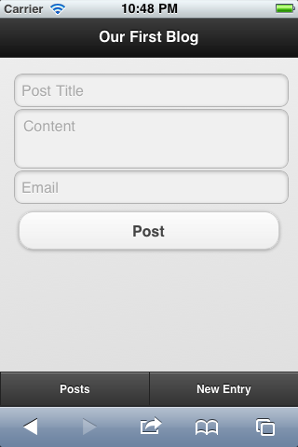
%div(data-role="page" id="home")
%div(data-role="header")
%h1 Our First Blog
%div(data-role="content")
= yield
%div(data-role="footer”)
%div(data-role="navbar")
JQM
Page
Chrome

Slide 8
Client
REST Interface
Server
Mobile Browser
GET ‘/’
Render main page
index
GET ‘/new’
layout
Render new form
new
POST ‘/new’
Save entry
title
content
email
List of articles
M
V
C

Slide 9
Client
REST Interface
Server
Mobile Browser
GET ‘/’
Render main page
index
GET ‘/new’
layout
Render new form
new
POST ‘/new’
Save entry
List of articles
POST ‘/update’
Update entry
title
content
email
M
V
C

Slide 10
Client
REST Interface
Server
Mobile Browser
GET ‘/’
posts
Render main page
index
layout
new
POST ‘/new’
Save entry
List of articles
POST ‘/update’
Update entry
title
content
email
M
V
C

Slide 11
Client
REST Interface
Server
Mobile Browser
posts
Options Page
GET ‘/’
Render main page
index
layout
new
New
Page
options
localStorage
nickname
email
POST ‘/new’
Save entry
List of articles
POST ‘/update’
Update entry
title
content
email
M
V
C

Slide 12
Client
REST Interface
Server
Mobile Browser
templates
GET ‘/’
home
Home Page
New
Page
Render main page
layout
index
new
Options Page
options
GET ‘/articles’
Fetch all
List of articles
Templates
articles
localStorage
nickname
email
POST ‘/new’
Save entry
POST ‘/update’
Update entry
title
content
email
M
V
C

Slide 14
Client
User Interface
Server
Async Request
jQuery Mobile
Templates
Response
Business Logic
Storage

Slide 15
Client
User Interface
Server
Async Request
jQuery Mobile
Templates
Response
Business Logic
localStorage
Storage

Slide 16
Client
HTML+
CSS+
JS
User Interface
Server
Async Request
jQuery Mobile
Templates
Haml
Response
Business Logic
Sinatra
localStorage
Storage

Slide 17
Client
Server
Request
Router
Controller
Model
Database
Data Formatting
View Rendering
(Templates)
Response
Assets (JS+CSS+media)
JS Processing

Slide 18
Client
Server
Request
Router
Controller
Model
Database
Response
Render Main View
JS Template
JS Template
Assets
Assets
JS Processing
Data Response

Slide 19
Client
Server
View
Router
Controller
Controller
Model
Model
JSON
localStorage
Database

Slide 20
Client
Server
Backbone.Model
Backbone.sync
RESTful JSON Interface
get(attribute)
set(attributes)
JSON
POST (create)
GET (read)
PUT (update)
DELETE (delete)
id
url
urlRoot
save
fetch
destroy
validate
Model endpoints:
/[collection.url]/[id] (if in a collection)
/[urlRoot.url]/[id] (if not in a collection)

Slide 21
Client
sync
Server
Backbone.Collection
RESTful JSON Interface
add
remove
set
at
reset
models
/[collection.url]/[id]
GET (read)
PUT (update)
DELETE (delete)
Backbone.Model
Backbone.Model
…
/[collection.url]
POST (create)
GET (read)
url
create
fetch
save

Slide 22
Notify via a callback
Register / Unregister
on
off
Register / Unregister
on
off
Backbone.Model
Backbone.Collection
Events:
change
change:[attribute]
Events:
change
change:[attribute]
add
remove

Slide 23

Events: update, click, input
render
Backbone.View
update
DOM
update
inject
…
<div id=“list”>
Hello
</div>
…
notify
Backbone.Model

Slide 24
Events: update, click, input
render
render
View1
View2
notify
update
Model
Server
update

Slide 25
render
DOM
View1
…
<div id=“list”>
Hello
</div>
…
render
update
View2
notify
fetch
Model
Server
json

Slide 26
render
OptionsView
render
DOM
ListView
…
<div id=“list”>
Hello
</div>
…
reset, all
ItemView
ItemView
NewView
save
save
create
change
change
Articles (Collection)
Article (Model)
Article (Model)
…
fetch
sync
Server

Slide 28
Single Thread
Events
Event Queue
Event Loop
Callbacks
DOM

Slide 29
Web Worker Thread
Main Thread
Events
Events
Event Queue
Event Queue
Event Loop
Callbacks
Event Loop
Callbacks
DOM

Slide 30
 | Firefox Android 11 | Opera Mobile 11.50 | Android 4 | iOS 5 | N9 | Chrome 17 | Firefox 11
XHR 2
Upload Files | Yes | No | Yes | No | Yes | Yes | Yes
Text response type | Yes | No | Yes | Yes | No | Yes | Yes
Document response type | No | No | No | No | No | No | No
Array buffer response type | Yes | No | Yes | Yes | No | Yes | Yes
Blob response type | Yes | No | No | No | No | No | Yes
Files API
FileReader API | Yes | Partial | Yes | No | No | Yes | Yes
FileSystem API | No | No | No | No | No | Yes | No
WebGL
Native binary data | Partial (all but DataView) | No | Partial all but Float64Array) | Partial all but Float64Array) | No | Yes | Partial (all but DataView)
Opera doesn't support createObjectURL, revokeObjectURL, BlobBuilder, readAsArrayBuffer

Slide 31
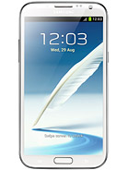
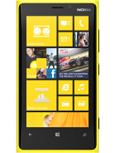
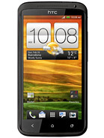
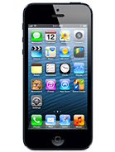
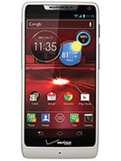
 |  | Apple iPhone 5 | Motorola RAZR M | Nokia Lumia 920 | HTC One X | Samsung Galaxy Note
Size | 4.0” | 4.0” | 4.3” | 4.5” | 4.7” | 5.5”
Width |  | 640 | 540 | 768 | 720 | 720
Height |  | 1136 | 960 | 1280 | 1280 | 1280
PPI |  | 326 | 256 | 332 | 312 | 267
Device-width |  | 320 | 360 |  | 360
Device-height |  | 568 | 563 |  | 640
Pixel-ratio |  | 2 | 1.5 |  | 2 | 2

Slide 32
