Slide 1
F5 Active-Active Kubernetes Cluster – Lab Guide
Chapter 6

Slide 2
Lab Architecture
10.1.1.10
10.1.1.4
Management (10.1.1.0/24)
Client
F5 BIG-IP
LTM+GTM VE
DC1
K8s Master
External (10.1.10.0/24)
Internal (10.1.20.0/24)
10.1.10.10
10.1.10.4
10.1.20.4
10.1.20.6
10.1.1.6
10.1.110.10
DC1
K8s Worker
10.1.20.7
10.1.1.7
10.1.1.5
F5 BIG-IP
LTM+GTM VE
DC2
K8s Master
10.1.110.5
10.1.120.5
10.1.120.8
10.1.1.8
DC2
K8s Worker
10.1.120.9
10.1.1.9

Slide 3
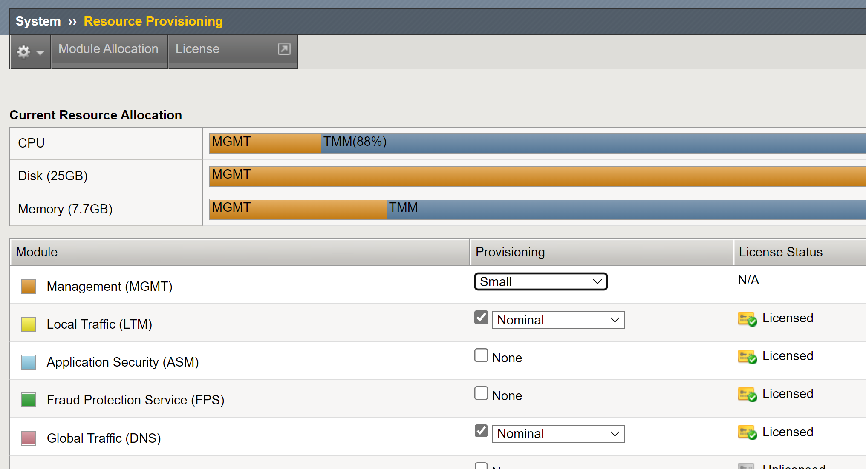
F5 BIG-IP Requirements
Ensure that LTM and DNS/GTM are provisioned.

Slide 4
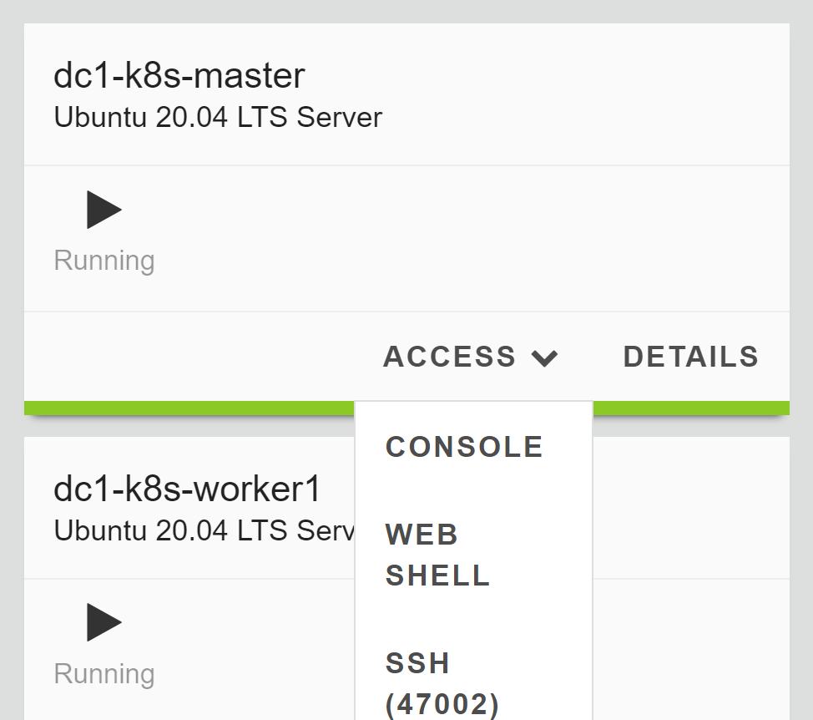
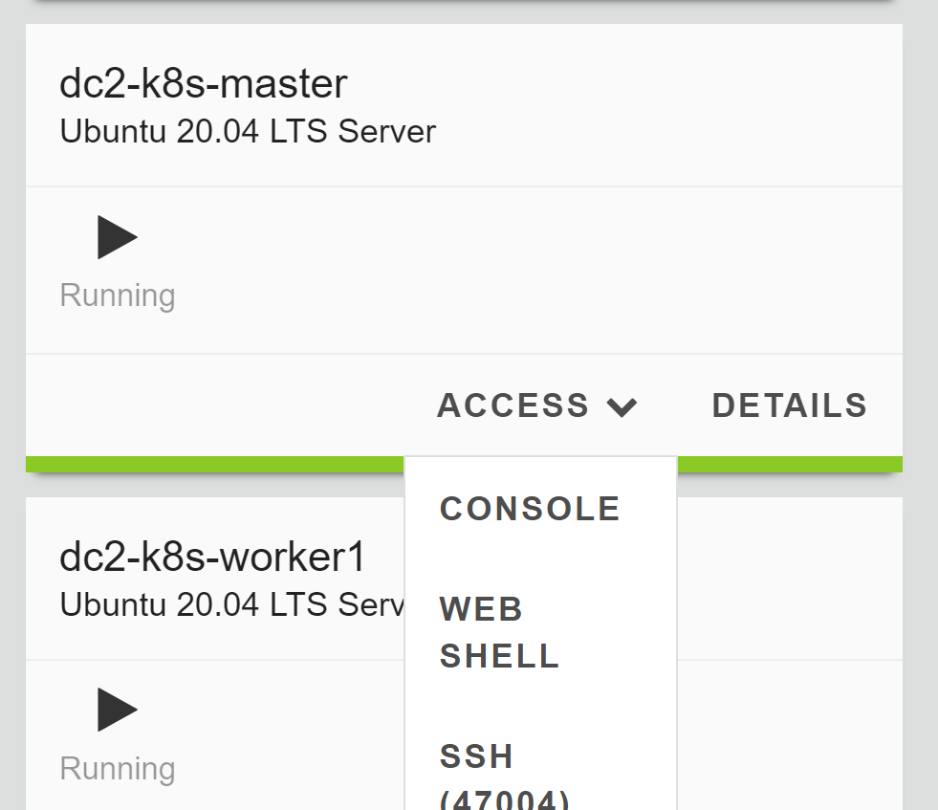
Access to Master Node Directly
In this lab, you have to connect to master node directly.

Slide 5
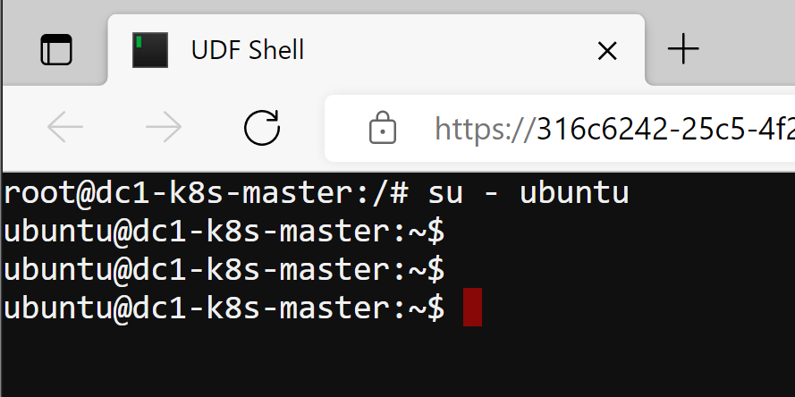
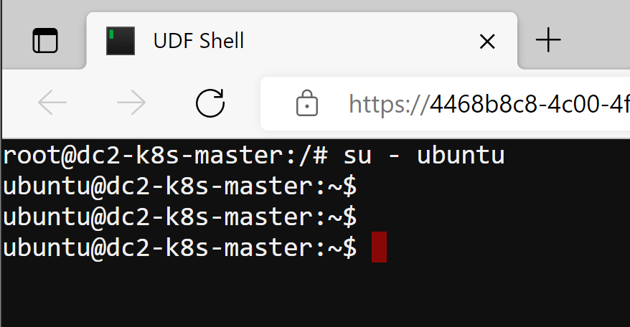
Access to Master Node Directly
Run the following command to login to "ubuntu" account from the web shell from each cluster.
su - ubuntu
You should see "ubuntu@dc1-k8s-master:~$" prompt and "ubuntu@dc2-k8s-master:~$" prompt.

Slide 6
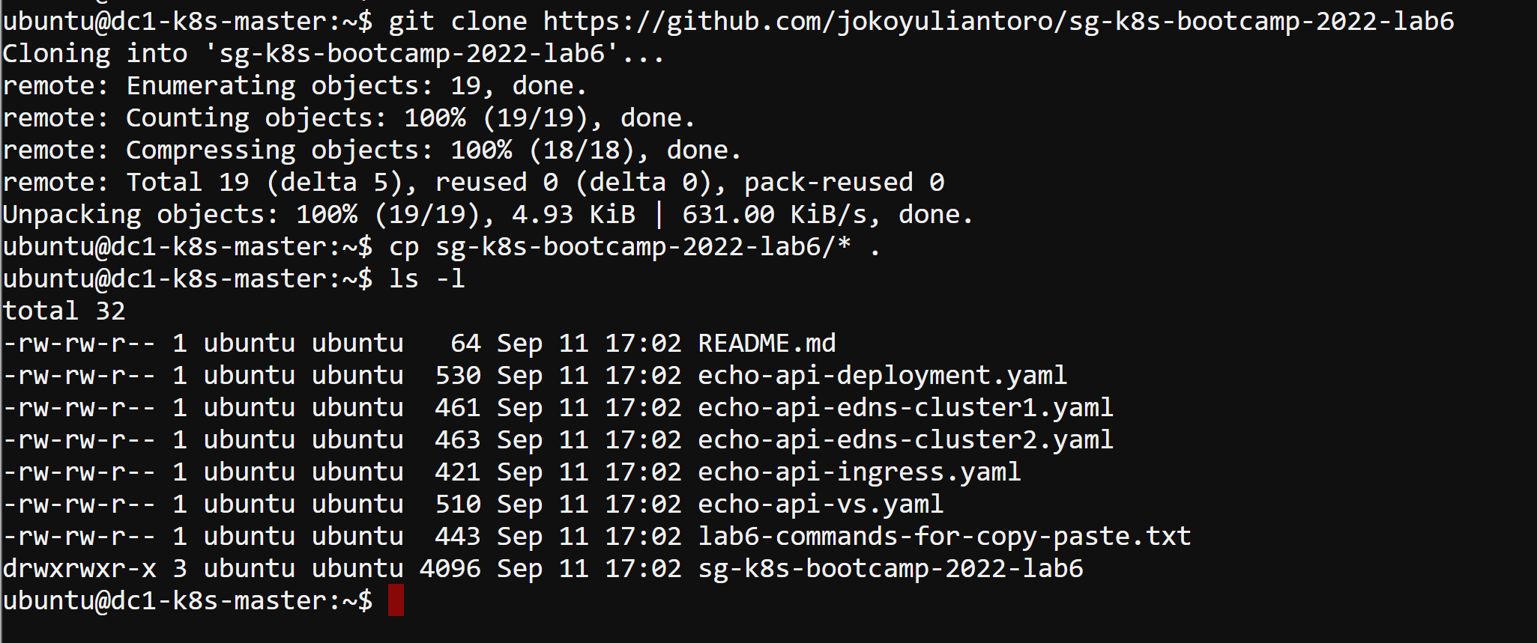
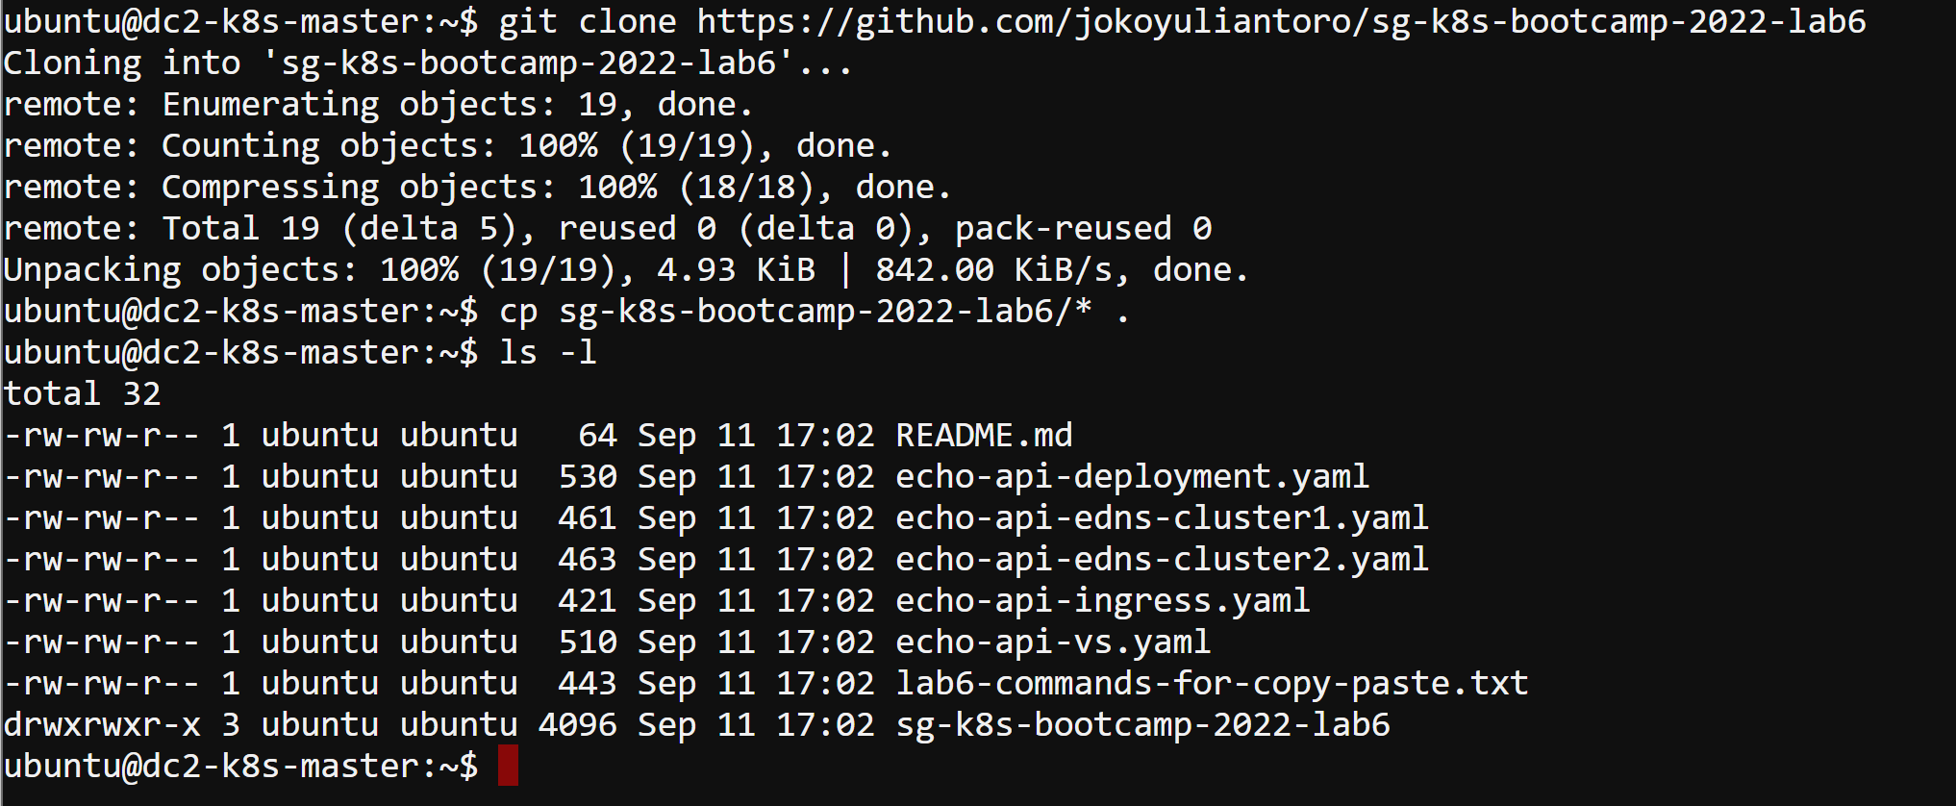
Download YAML Files to Local
Use "git clone" to download the YAML files to local storage inside the master node and copy all cloned YAML files to the home directory.
dc1-k8s-master
git clone https://github.com/jokoyuliantoro/sg-k8s-bootcamp-2022-lab6
cp sg-k8s-bootcamp-2022-lab6/* .
dc2-k8s-master
git clone https://github.com/jokoyuliantoro/sg-k8s-bootcamp-2022-lab6
cp sg-k8s-bootcamp-2022-lab6/* .

Slide 7
Lab 6 – AAKC

Slide 8
Lab 6 – AAKC
Lab Tasks
6.1) Confirm the CIS deployment in 2 K8s clusters.
6.2) Deploy the application in both K8s clusters.
6.3) Test the HA scenarios.

Slide 9
Task 6.1) Confirm the CIS Deployment in 2 K8s Clusters

Slide 10
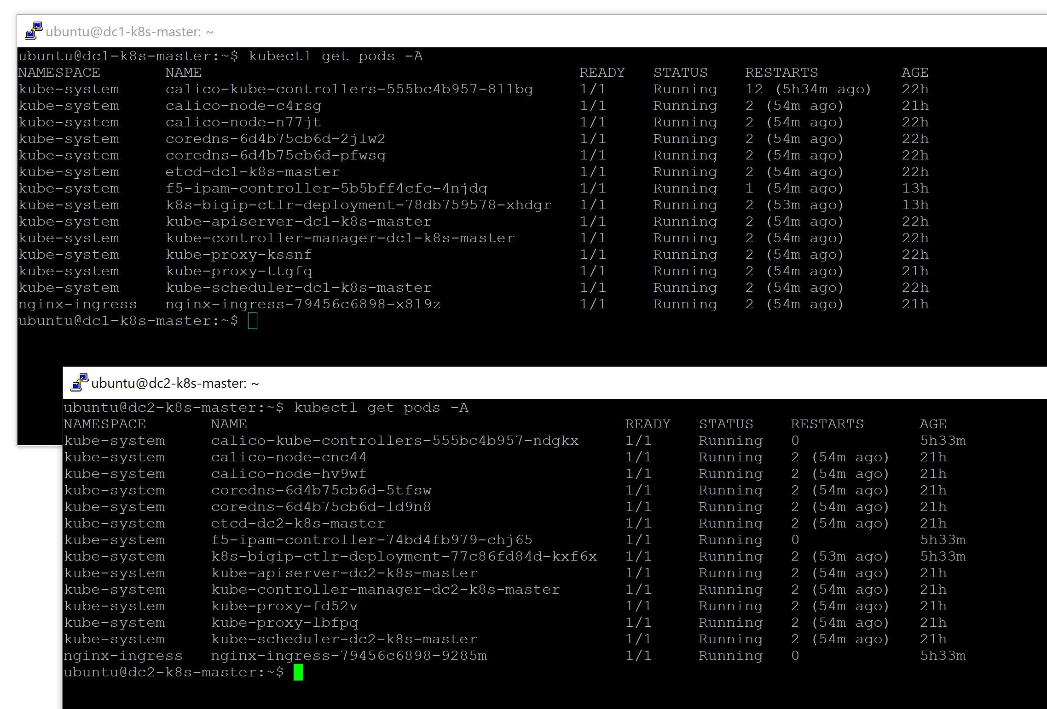
Task 6.1) Confirm the CIS Deployment in 2 K8s Clusters
Login to dc1-K8s-master and dc2-k8s-master using PuTTY, run the command below, and ensure all status show Running.
kubectl get pods -A

Slide 11
Task 6.2) Deploy the Application in Both K8s Clusters

Slide 12
Task 6.2) Deploy the Application in Both K8s Clusters
Deploy the Echo API application in both K8s cluster:
dc1-k8s-master
kubectl create -f echo-api-deployment.yaml
kubectl create -f echo-api-ingress.yaml
kubectl create -f echo-api-vs.yaml
kubectl create -f echo-api-edns-cluster1.yaml
dc2-k8s-master
kubectl create -f echo-api-deployment.yaml
kubectl create -f echo-api-ingress.yaml
kubectl create -f echo-api-vs.yaml
kubectl create -f echo-api-edns-cluster2.yaml

Slide 13
Task 6.3) Test the HA Scenarios

Slide 14
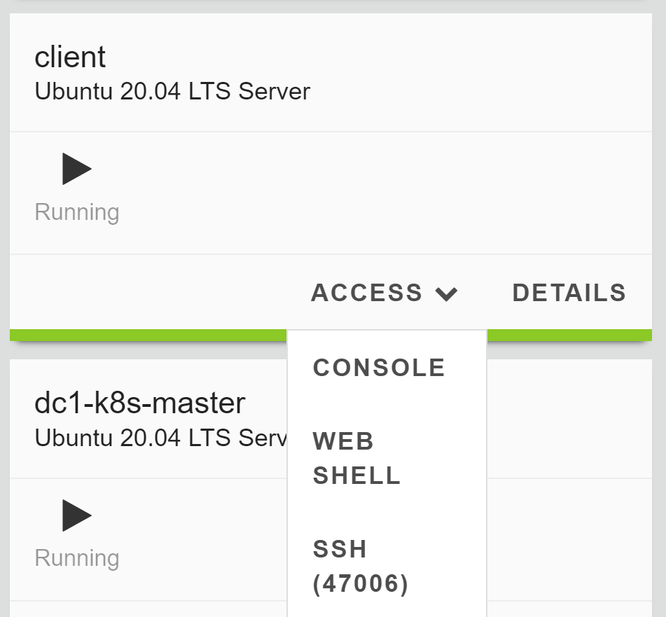
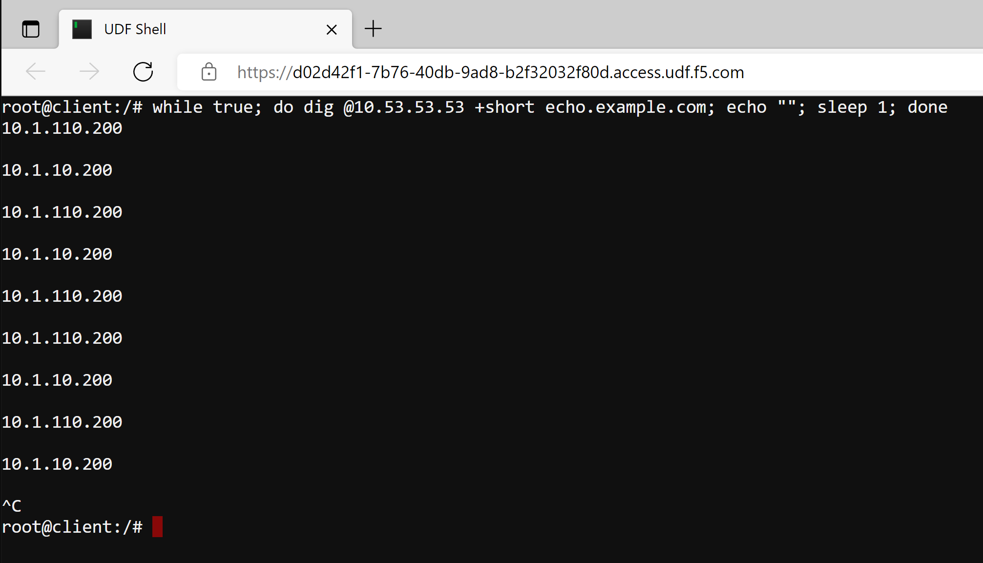
Task 6.3) Test the HA Scenarios
Login to the client CLI and run below command to trigger the DNS query multiple times:
while true; do dig @10.53.53.53 +short echo.example.com; echo ""; sleep 1; done
Observe that the return IP keeps changing for every query.
Press Ctrl+C to stop the command.

Slide 15
Task 6.3) Test the HA Scenarios
On dc1-k8s-master CLI, scale down the Echo API deployment to 0 to simulate unavailability event.
kubectl scale deployment echo-api --replicas=0
Repeat the DNS query and observe the result.

Slide 16
Task 6.3) Test the HA Scenarios
On dc1-k8s-master CLI, scale down the Echo API deployment to 0 to simulate unavailability event.
kubectl scale deployment echo-api --replicas=0
Repeat the DNS query and observe the result.
Scale up the deployment to simulate the comeback of the deployment.
kubectl scale deployment echo-api --replicas=2
Repeat the DNS query and observe the result.

Slide 17
Summary

Slide 18
What We Have Learned in This Chapter
Real live scenario requires 2 data centers and minimum a K8s cluster in each data center.
Active-Active Data Center concept has been providing great benefit in DC resilience.
Active-Active Kubernetes Cluster using F5 solutions enhance the K8s cluster's resilience.

