Slide 1
Wii Educational Tools
Kyle Shepard
Seth Daugherty
Gilliane Oswald
Chris Loew
Joseph Cirone

Slide 2
Outline
Project Description
Wii Event Parser
Game Event Parser
Demos

Slide 3
Project Details
Build a Wiimote framework for future games
Develop two games using our framework
  Binary Tree Game
  Network Routing Game
These games will be used in CSCI 101

Slide 4
Wiimote Framework

Slide 5
Wiimote Manager
Controls the actual Wiimotes
cwiid library creates Wiimote objects
Callback function sends raw data over dedicated socket to Wii Event Parser

Slide 6
Wii Event Parser
Reads raw data down from socket
Data is checked to see if a Wii Event needs to be sent to Game Event Parser
  Accelerometer
  RollPitch
  ButtonControl

Slide 7
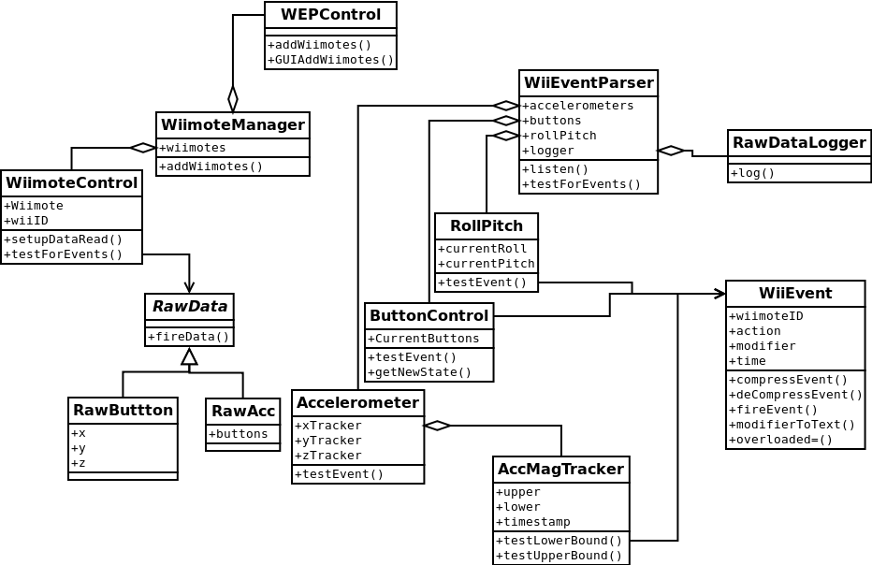
Wii Event Parser

Slide 8
Game Event Parser

Slide 9
Game Event Parser
Game developer supplies a list of “Game Events” and corresponding game functions
bind_functionA = [‘ButtonAPress’, ‘ButtonARelease’]
bind_functionB = [‘ButtonBPress’, ‘FlickX’, ‘ButtonBRelease’]
bind_functionC = [ set((‘ButtonAPress’, ‘ButtonBPress’)), ‘FlickX’, set((‘ButtonARelease’, ‘ButtonBRelease’)) ]

Slide 10
Game Event Parser
Listens for Wii Events from Wii Event Parser
Looks for bindings that match sequences of received Wii Events
Calls the corresponding function in the game logic

Slide 11
It’s DEMO TIME!!!

Slide 12

Questions?

