Slide 1


Clojure
Sneaking parens into your enterprise build

Slide 2
Agenda
Gradle Intro
History
Features
Demo
Gradle and Clojure
History
Features
Demo

Slide 3
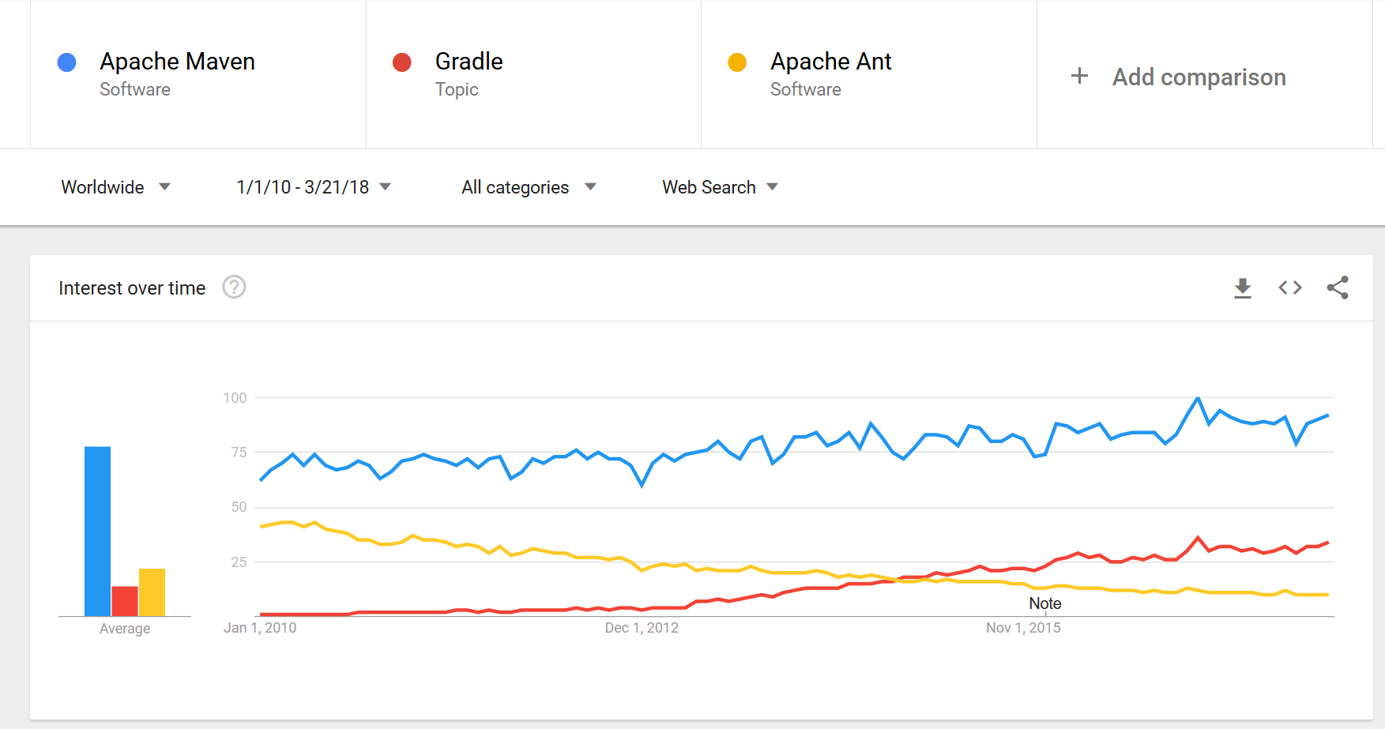
Gradle Trends

Slide 4
History of Gradle
Started in 2007
Built on Ant and Ivy (originally)
Scripts written in a Groovy DSL
Work in progress on a Kotlin DSL
Kotlin DSL will likely be preferred over Groovy at some point
Focus on flexibility and performance
Often leverages domain modelling for configuration
Supports convention-based builds
Official build tool for Android

Slide 5
Gradle Flexibility
Most needs can be met declaratively
Declare plugins
Declare dependencies
Declare project information
Can program the configuration for further needs
You have full Groovy capabilities in build
Custom tasks and plugins can be:
Inline in build script
In buildSrc/ within project
From external plugins (e.g. Plugin Portal)

Slide 6
Gradle Performance
A key focus of Gradle
Often achieved through work avoidance:
Reuse build JVM via Gradle daemon
Fast Maven dependency cache
Task dependencies only run the tasks you need
Incremental build only reruns tasks whose inputs changed
Reuse task worker JVMs when JVM settings are compatible
Incremental tasks only redo work for inputs that change
Task results can be cached and shared across machines

Slide 7
My Background with Gradle
Writing Gradle plugins since 2011 (pre 1.0)
Some plugins contributed to Gradle core
Primary plugin is gradle-git (and its descendants) since 2012

Slide 8
Demo: Gradle Intro

Slide 9
History of Clojure on Gradle
Clojuresque by Meikel Brandmeyer (2009 to 2015)
Hard to get started as a user, documentation was fragmented
Graclj by me (2015 to 2016)
Never got beyond PoC
Built on Gradle’s new “model space” feature, since deprecated
cursive.clojure by Colin Fleming (2016 to 2017)
Minimal plugin for Clojure compilation
Met Colin’s needs for building Cursive IDE (Kotlin + Clojure)

Slide 10
History of gradle-clojure
John Szakmeister (motivated individual) reached out to Colin and I
Organized call with Gradle to get momentum
New plugin started from cursive.clojure’s codebase
Goals:
Support polyglot development
Feel native to Gradle
Provide creature comforts Clojure devs are used to

Slide 11
Current Features
Clojure code packaging into JAR
Clojure AOT compilation
clojure.test runner (through Gradle’s JUnit support)
Clojure nREPL (headless only)
Maven dependencies and publishing (including Clojars)
Just native Gradle features, nothing added by us

Slide 12
Future Features
ClojureScript support
Compilation
Figwheel
nREPL middleware (e.g. CIDER)
deps.edn

Slide 13
Demo: gradle-clojure

Slide 14
Links
https://gradle-clojure.github.io
https://github.com/gradle-clojure/gradle-clojure/

