Slide 1
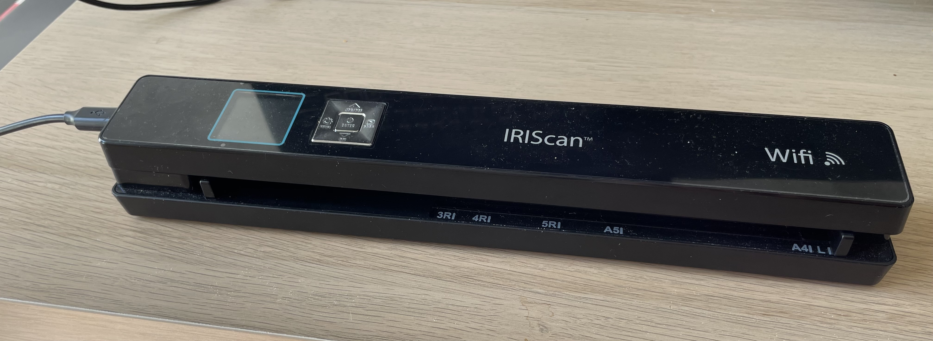
Bouton
JPG/PDF
USB
Ecran
JPG/PDF
Bouton
On/Off/Enter
Enter
Bouton
DPI
DPI

Slide 2
