Slide 1

Automated aCRF Annotation Engine
Automating aCRF Annotations and Bookmarks

Slide 2

The Problem: Manual aCRF Annotation Bottleneck
Around 500 pages of blank CRF need to be manually annotated following AZ standard documents and processes making it a repetitive task.
Multiple sources of information must be referenced and cross-checked to produce the first draft of the annotated CRF.
Significant rework is required on the first draft, so a tool that generates a reliable first draft reduces this rework and shortens the overall turnaround time.

Slide 3
Objective
Automation of Annotated CRFs
The engine automates the production of annotated Case Report Forms, reducing turnaround time from weeks to hours with standard-acceptable accuracy.
2. Standards-Based SDTM Mapping
It incorporates intelligent SDTM mapping grounded in AZ corporate SDTM standards
AZ RAW-to-SDTM Specification Template
AZ Corporate SDTM Standards
AZ SDTM Controlled Terminology
3. Technical and Practical Solution
The system offers an integrated, modular architecture with a clear roadmap for future enhancements.

Slide 4
Approaches evaluated
Rave Export CRF Mapping (Direct Lookup)
The RAW-to-SDTM specification already contains complete mappings (RAW variable → SDTM variable), so attempted to transfer these directly onto the blank CRF.
However, the spec is built against the non-unique pages CRF, while annotations are done on the unique pages CRF (each form appears once with unique page numbers)
Structural mismatch makes direct overlay impractical without manual reconciliation
2. Direct Prompting with LLMs
Fed CRF labels directly to a large language model (Qwen 0.6B from Artifactory-Prod-Cluster) and asked it to return the corresponding SDTM variable, achieving low accuracy
The model hallucinated plausible-sounding variables that don't exist in the specification (e.g., returned DM.DOB for "Birth date" instead of the correct DM.BRTHDTC), gave different answers on repeated runs, and provided no traceability to source documentation.
For regulatory submissions, every annotation must trace back to a standard; a system that invents answers isn't viable regardless of how convincing they sound.

Slide 5
Approaches evaluated
3. Vector Similarity Matching
Converted every CRF label and SDTM variable label into numerical vectors (using BGE-small-en embeddings + FAISS search from Artifactory-Prod-Cluster). Each phrase gets a position in space where similar meanings sit close together, and the system finds the nearest SDTM match mathematically. Achieved low accuracy with no hallucinations.
Noticeable Limitation: labels like "Result" appear on VS, LB, and EG forms, so the vector is identical regardless of which form it's on, so the system can't distinguish whether it should map to VS.VSORRES, LB.LBORRES, or EG.EGORRES. It lacks form-level context.
Some R&I Use Cases for this technology:
Document retrieval — finding relevant protocols or SAPs from a library
Auto-coding — matching verbatim AE terms to MedDRA preferred terms
Similar study identification — finding trials with comparable endpoints

Slide 6
Approaches evaluated
4. Specification-Driven Resolution (Chosen)
Parsed AZ SDTM specifications into structured JSON knowledge bases, each form gets its own scoped set of valid mappings, mirroring how a human annotator works: read the spec, know the form, apply the mapping
PDF parsed using PyMuPDF to extract field labels, positions, form context, and codelist values — enabling form-aware resolution where "Result" on VS → VS.VSORRES and same label on LB → LB.LBORRES
Fully traceable and auditable; every annotation points back to a specific line in the specification; nothing is generated without source evidence, and same input always produces same output
Output includes PDF bookmarks for each form (navigable table of contents), colour-coded domain boxes, codelist codes, and dataset headers, structured for efficient programmer review

Slide 7
High-Level Architecture
Input Layer
Blank CRF PDF, AZ RAW-to-SDTM specification, AZ SDTM standards, AZ controlled terminology which are essential for processing
Cache & Index Builder
Parses Excel specifications into structured JSON knowledge bases (openpyxl, json, pathlib). This module builds structured registries, and lookup tables to optimize performance and indexing
PDF Parsing Engine
Extracts form structure, field labels, positions, and codelist values using PyMuPDF — applies regex normalization and noise filtering to remove instructional text and system helper fields.

Slide 8
High-Level Architecture
Multi-Tier Resolution Engine
Fields first attempt spec-pattern matching within their form scope, then cross-module fuzzy matching, then NOT SUBMITTED inference. Each tier assigns a confidence score; fields escalate to the next tier only if unresolved by the previous.
PDF Annotation Writer
Generates the annotated CRF using PyMuPDF — colour-coded domain boxes, dataset headers, codelist codes, overlap avoidance, and PDF bookmarks for navigation.

Slide 9
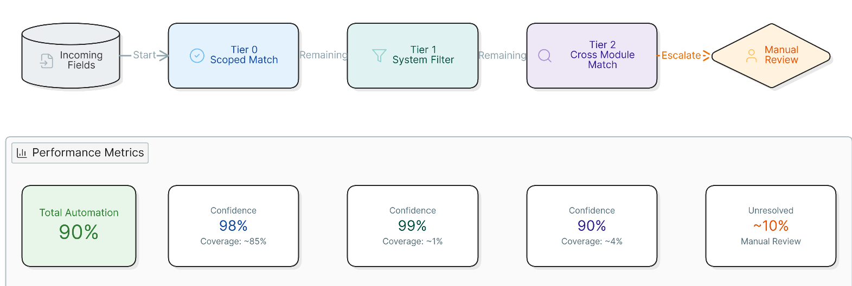
Resolution Engine

Slide 10
Tier 0- Form-Scoped Match
The engine reads the form code from the PDF page header, scopes down to only that form's valid mappings from the knowledge base and matches the field label.
Tier 1- NOT SUBMITTED Classification
Catches fields that should never map to SDTM — e.g., "Field created for RSG to calculate height" → marked NOT SUBMITTED instead of forcing a wrong mapping.
not_submitted_tree .png
Tier 2- Cross-Module Fuzzy Match
For fields unresolved within their form scope, searches broadly across all spec modules. Only accepts matches above confidence threshold — if uncertain, leaves it unannotated so the programmer knows exactly what needs manual attention.
az_spec_tree.png

Slide 11
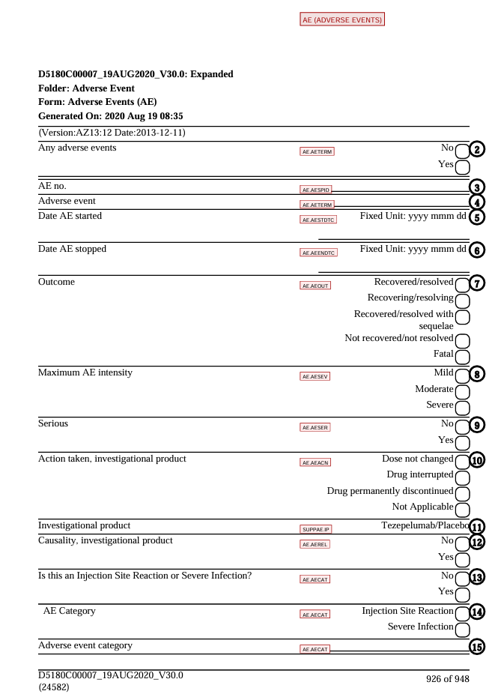
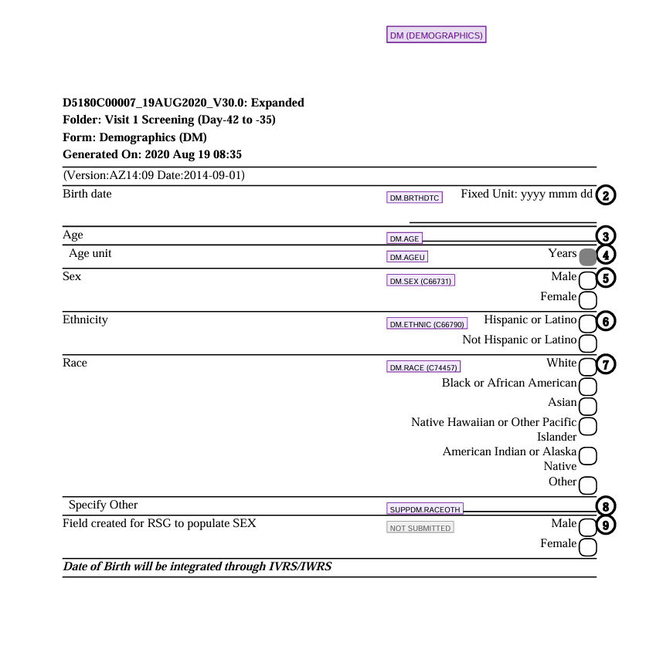
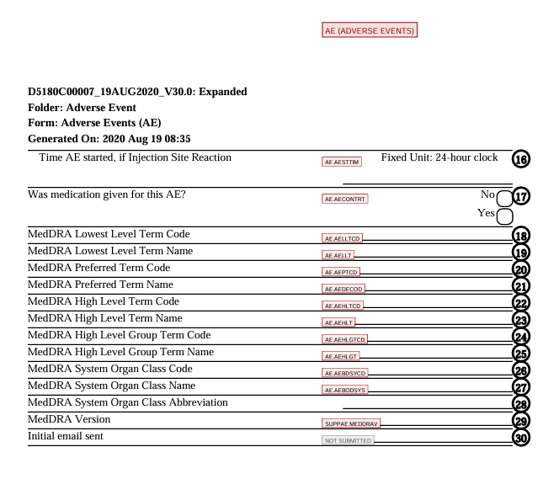
Resolution in Forms

Slide 12
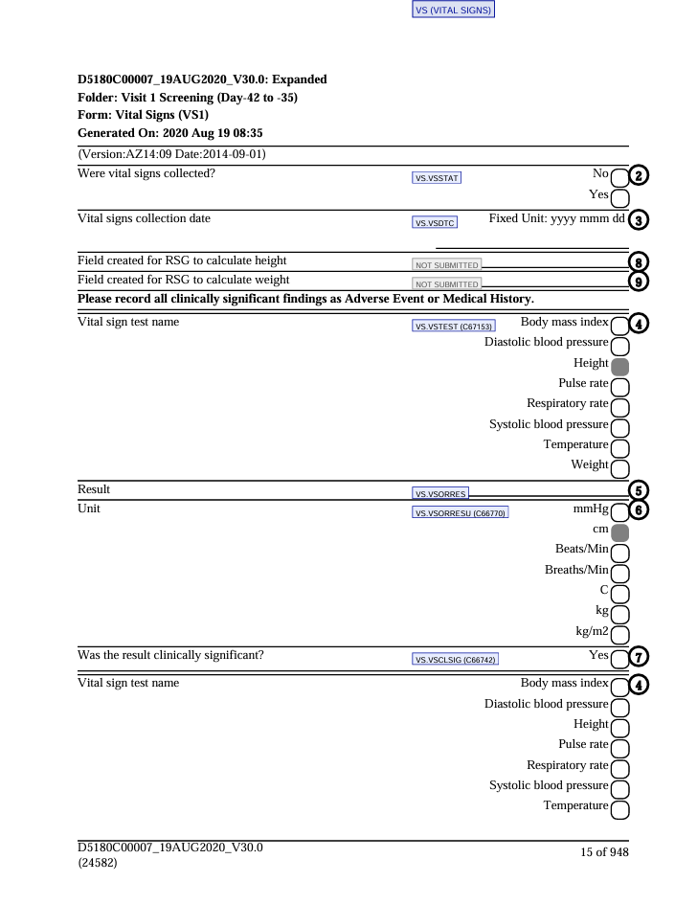
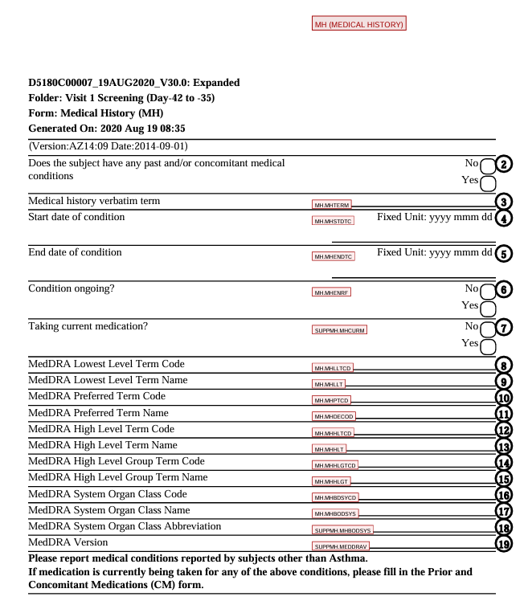
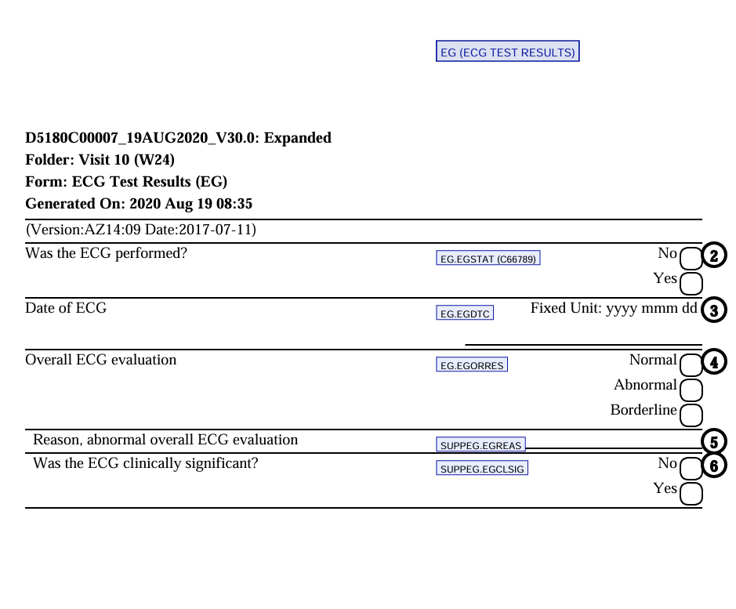
Resolution in Forms

Slide 13
Technical Stack
PDF Processing — PyMuPDF Reads and writes PDFs programmatically — extracts text with exact page coordinates, writes annotation boxes at precise positions. Same library handles both input parsing and output generation.
Text Patterns — regex, difflib, functools Pattern recognition and fuzzy string matching for field label normalization, form detection, and cross-module resolution. Cached lookups for performance.
Knowledge Base — openpyxl, json, pathlib Parses Excel specifications into structured JSON files indexed by form code — converts static documents into queryable knowledge that the resolver can search instantly.
Vector Search — BGE-small-en, FAISS Sentence embeddings and similarity search — explored for semantic matching, retained in architecture for future enhancement.
LLM — Qwen 0.6B via AZ Artifactory Locally-hosted language model from AZ-approved repository — explored for direct prompting, retained in architecture for future LLM-augmented disambiguation of complex fields.
Runtime — Python 3.11+ Runs fully offline, no external API dependencies at runtime. Structured logging and full traceability for regulated environments.

Slide 14
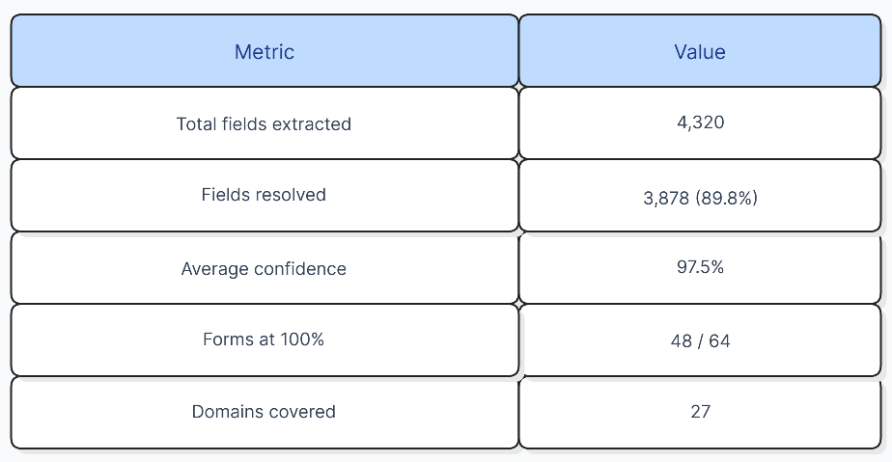
Output Quality and Metrics
Visual Output Colour-coded annotation boxes by domain class, dataset headers per page, codelist codes in parentheses, PDF bookmarks for navigation – acceptable first draft quality
How confidence is assigned
Tier 0 (form-scoped spec match): 0.98 — field label matched directly against a spec entry within the correct form scope. High confidence because the match is exact and context-verified.
Tier 1 (NOT SUBMITTED): 0.99 — field matched a known system/helper pattern. Near-certain because these patterns are explicit and unambiguous.
Tier 2 (cross-module): Variable (0.85–0.95) — based on string similarity ratio between CRF label and best matching spec label. Higher similarity = higher confidence. Only accepted above threshold.
How metrics are calculated
Resolution rate: fields that received an annotation ÷ total data-carrying fields
Confidence: score assigned by the tier that resolved it — averaged across all resolved fields
Form coverage: forms where every field was resolved ÷ total forms

Slide 15
Summary and Next Steps
Strongest performing domains AE, VS, PR, LB, CM, EG, MH, DM, IE, SV — all at 98% confidence, covering the bulk of standard clinical trial forms
Refinement areas
Gating questions (Yes/No fields that trigger a form section) occasionally map to the topic variable instead of being marked NOT SUBMITTED — requires study-level context to distinguish
Supplemental qualifier assignments (SUPP-- variables) need additional specification detail for fields like "Reason not performed" and processing date/time fields
Duplicate variable assignments on forms where one label serves two purposes (e.g., coded result vs free-text reason) — resolvable with field-type awareness
Multi-domain forms (EXACATE, INFSS, LIVERSS) where the same field could belong to CE, FA, or MH — needs protocol context to disambiguate

Slide 16
Future Enhancements
LLMs will serve as a supplementary tier for the ~10% of fields the specification-driven engine leaves unresolved — complex multi-domain forms (EXACATE, INFSS) where disambiguation requires study protocol context. The current resolution core remains unchanged; LLM only handles what specification matching cannot.
Planned Use Cases
Disambiguation of fields spanning multiple domains (e.g., "Shortness of Breath" → CE or FA?)
MedDRA dictionary field resolution using contextual inference
Quality check — LLM as a second opinion on low-confidence Tier 2 matches
Broader Roadmap
Multi-study pattern learning — as more studies run through the tool, the knowledge base grows
Direct integration with EDC system exports for streamlined input
Architecture ready to connect to AZ-approved LLM API endpoint when access is available
Projected resolution: 97–99% with LLM handling remaining edge cases

