Slide 1
Automated aCRF Annotation Engine
Generating a first-draft annotated CRF from a blank CRF PDF
Does the repetitive ~80% automatically — the SDTM programmer reviews & finalises
Proof of concept · Intern project · June 2026
Notes:
I'm an intern; this is a proof-of-concept tool I built that generates a first-draft annotated CRF from a blank CRF PDF. It does the repetitive ~80%; the SDTM programmer reviews and finalises. A helpful first draft and a starting point, not a replacement for our process.

Slide 2
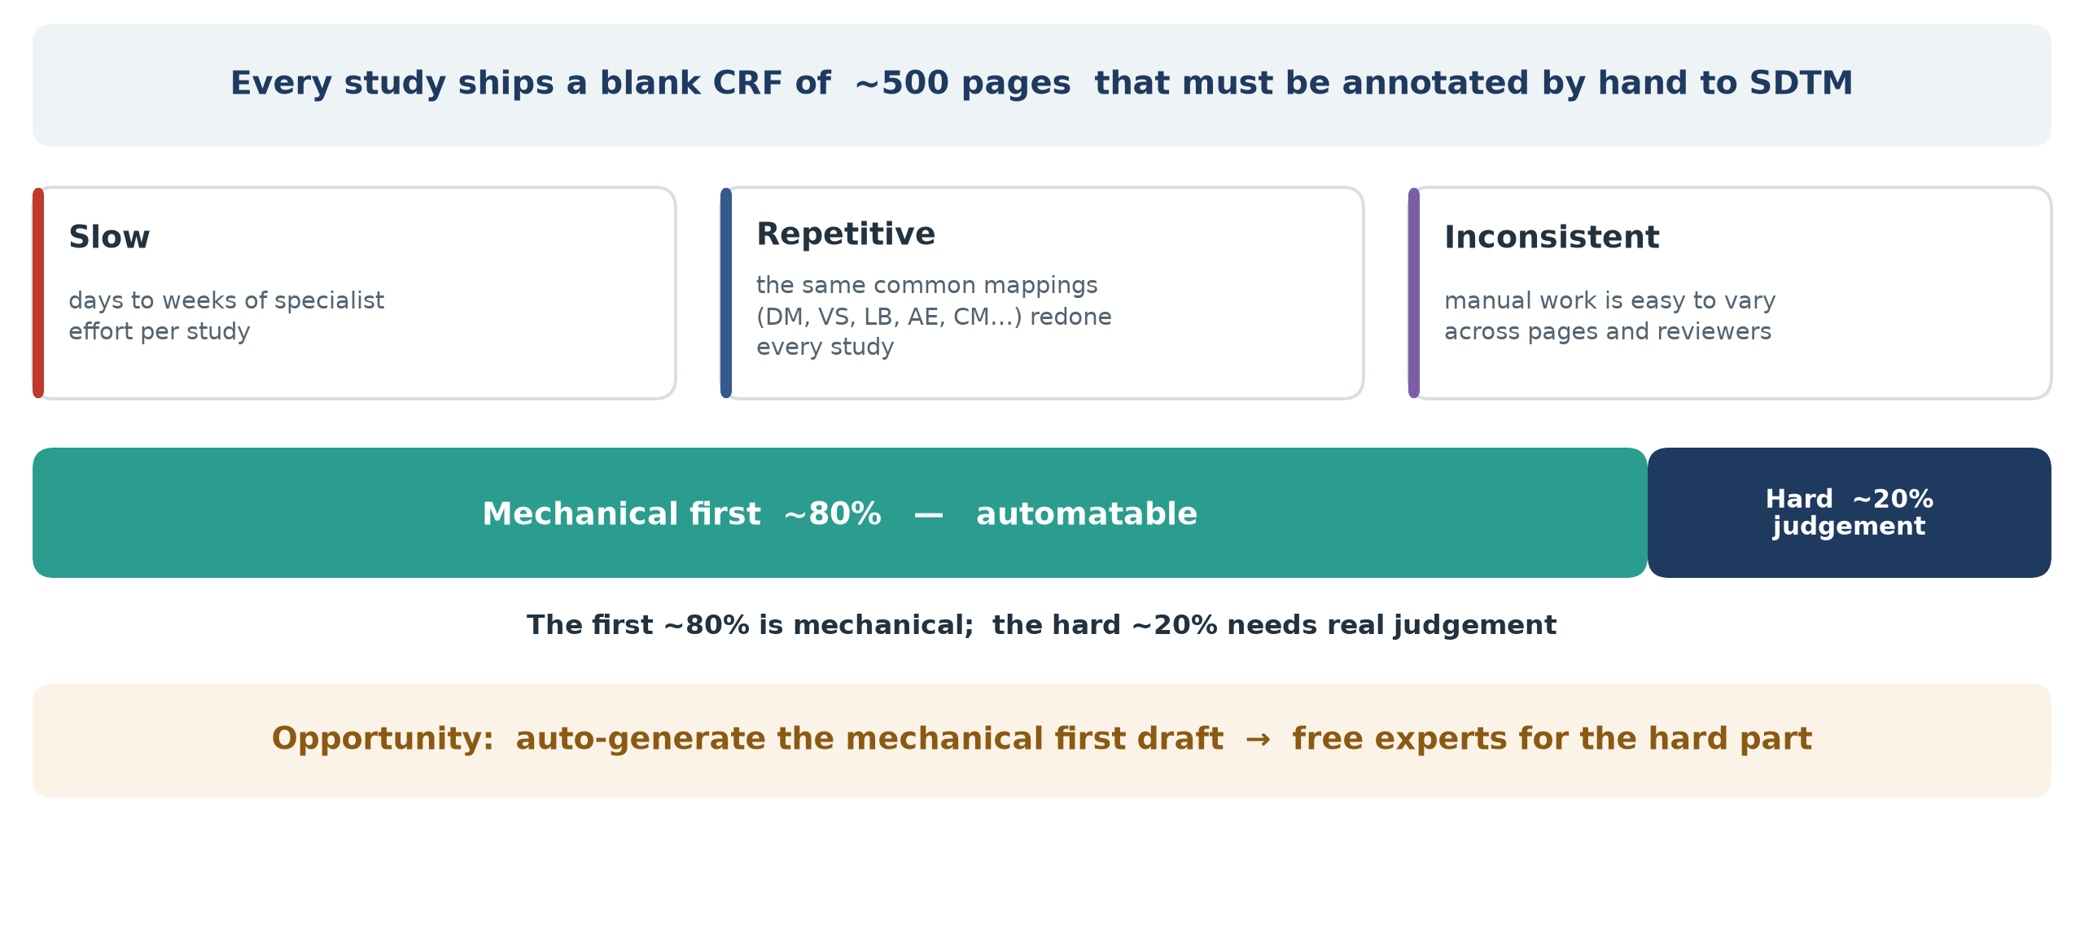
The problem: aCRF annotation is a manual bottleneck
First-draft aCRF · Proof of concept · Human-in-the-loop
2
Notes:
Blank CRF ~500 pages annotated by hand to SDTM: slow (days-weeks), repetitive (same DM/VS/LB/AE/CM mappings each study), and manual work varies across pages/reviewers. First ~80% mechanical, hard ~20% needs judgement. Auto-generate the first draft, free experts for the hard part.

Slide 3
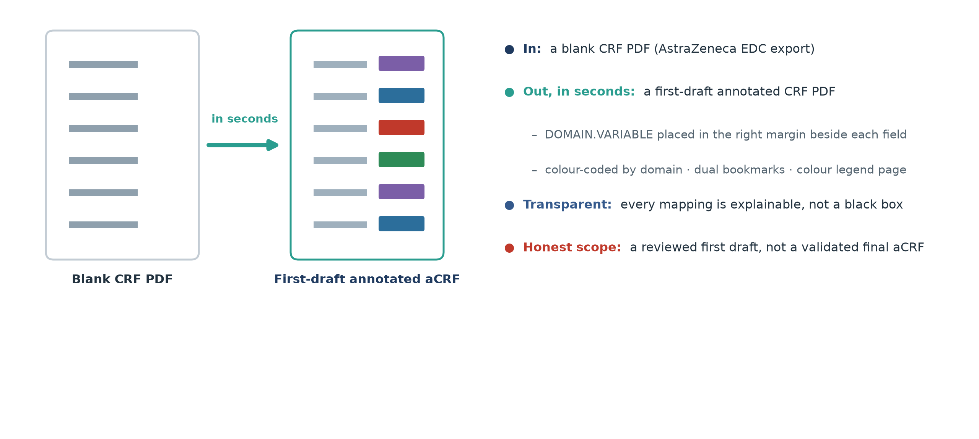
What the tool does
First-draft aCRF · Proof of concept · Human-in-the-loop
3
Notes:
In: a blank CRF PDF (AZ EDC export). Out in seconds: a first-draft annotated CRF - DOMAIN.VARIABLE in the right margin by each field, colour-coded by domain, dual bookmarks, legend page. Transparent: every mapping is explainable. Honest scope: a reviewed first draft, not a validated final aCRF.

Slide 4
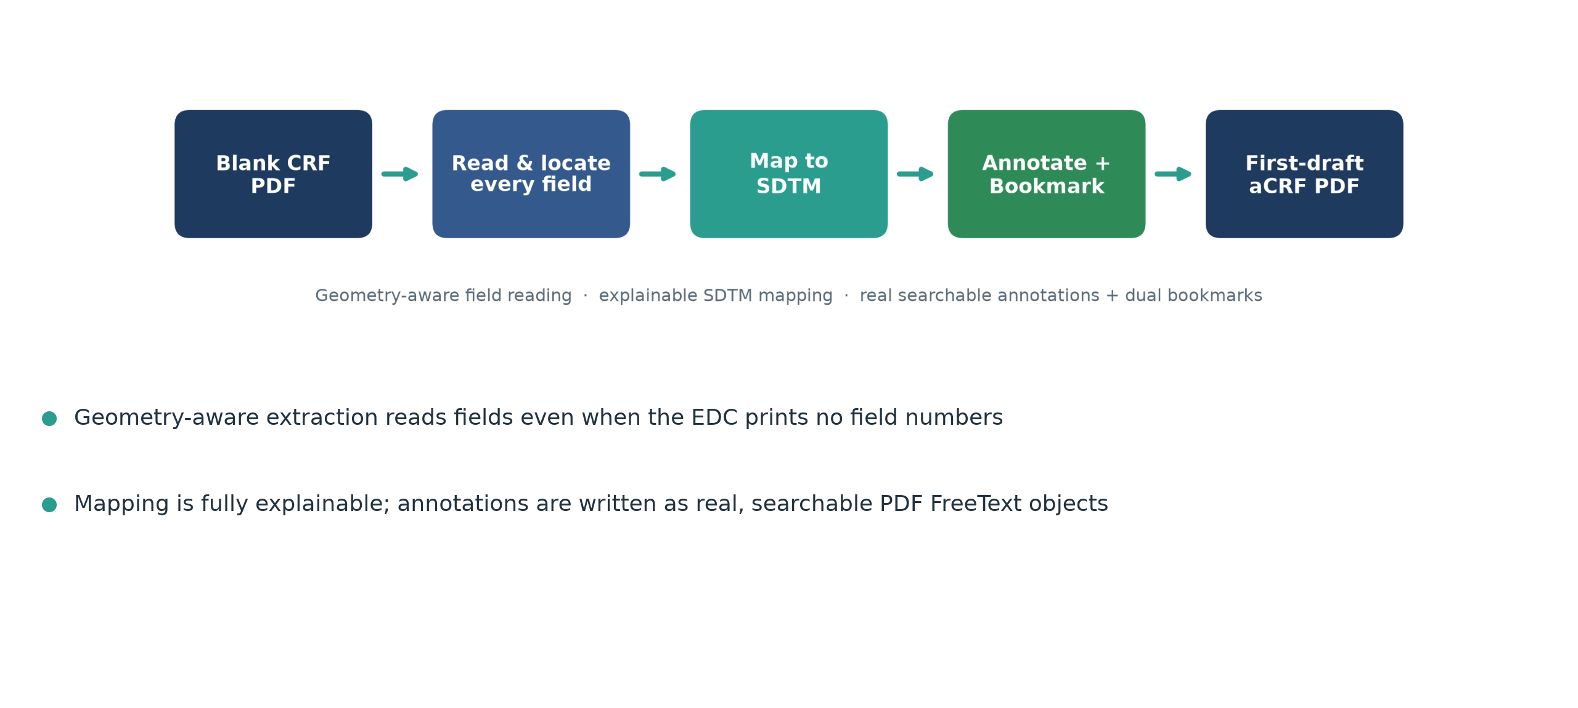
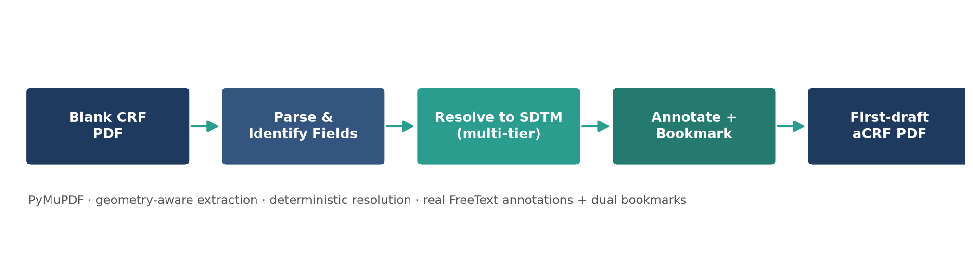
How it works
First-draft aCRF · Proof of concept · Human-in-the-loop
4
Notes:
Pipeline: read the blank CRF, locate every field (geometry-aware, works even with no field numbers), map to SDTM, annotate and bookmark. Mapping is fully explainable; annotations are real searchable PDF text.

Slide 5
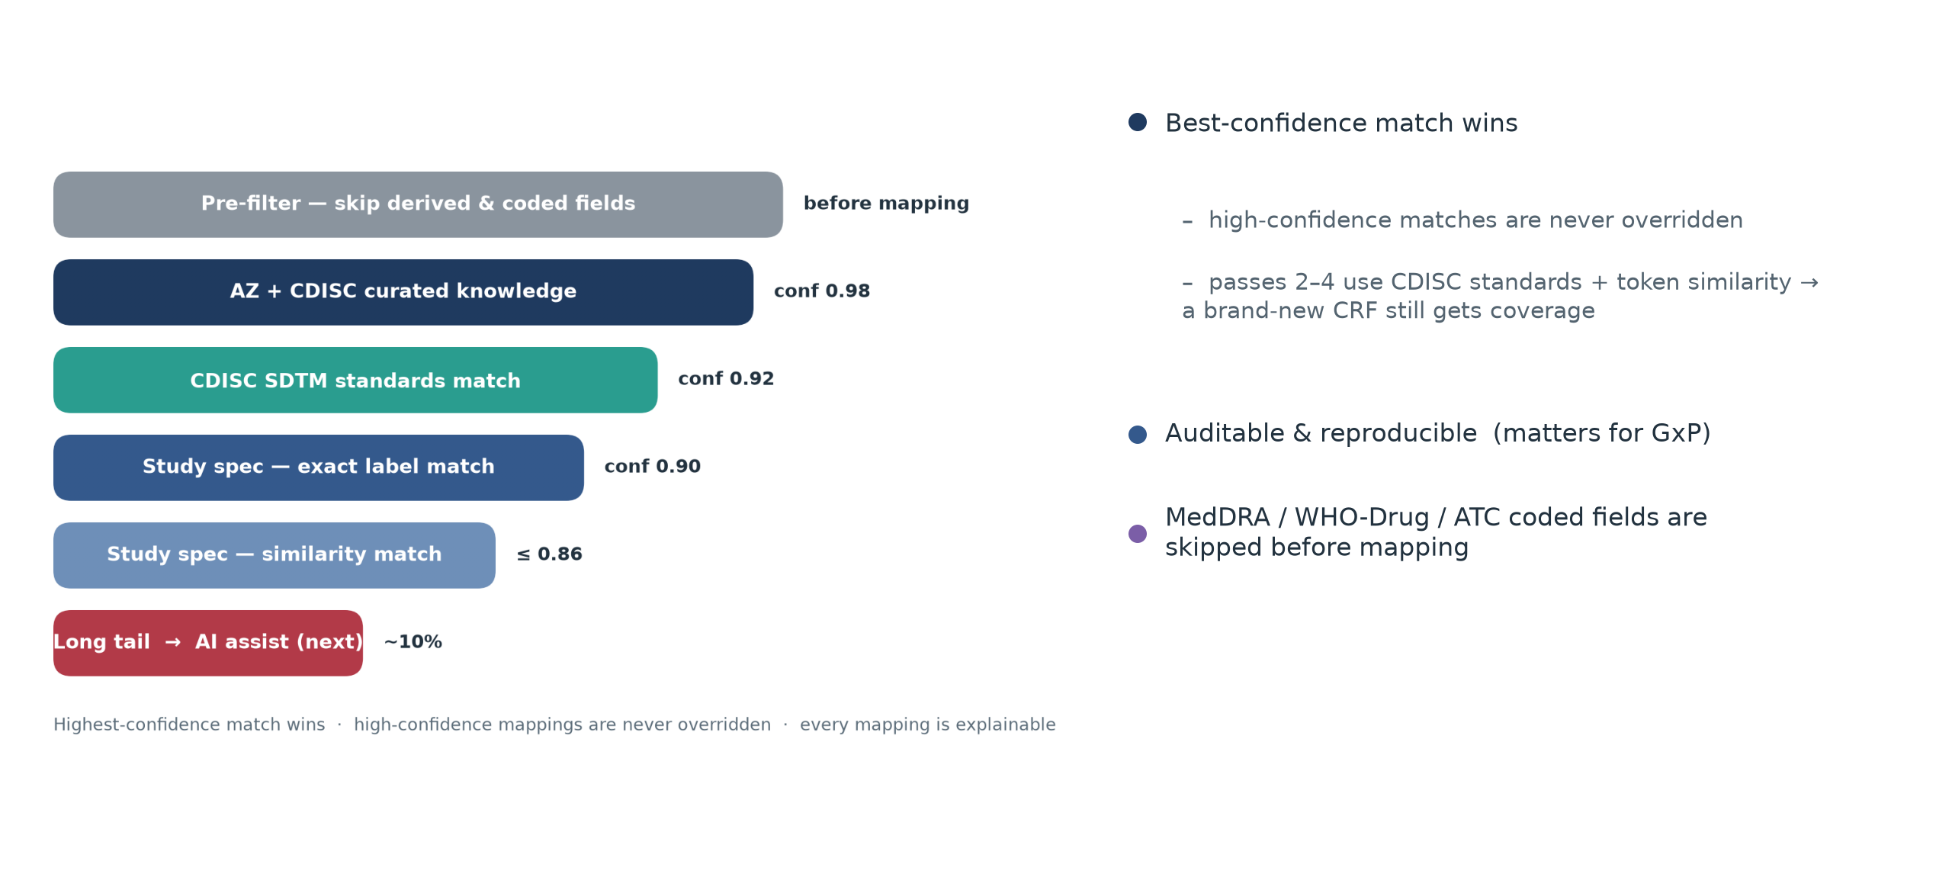
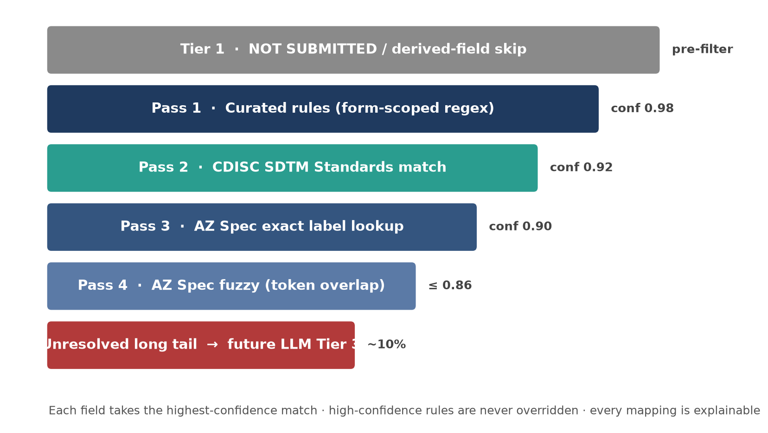
SDTM mapping engine — a confidence-ranked cascade
First-draft aCRF · Proof of concept · Human-in-the-loop
5
Notes:
Confidence-ranked cascade, best match wins. Pre-filter skips derived/coded fields, then AZ+CDISC curated knowledge (~0.98), CDISC standards (~0.92), study-spec exact (~0.90), study-spec similarity (<=0.86). High-confidence matches never overridden; standards+similarity give a new CRF coverage. MedDRA/WHO-Drug/ATC skipped before mapping. Auditable and reproducible - matters for GxP.

Slide 6
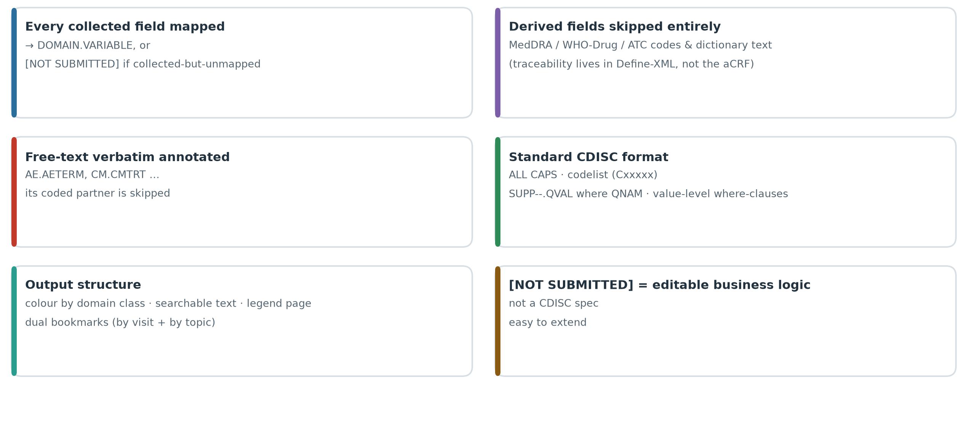
Conventions we engineered to (CDISC aCRF)
First-draft aCRF · Proof of concept · Human-in-the-loop
6
Notes:
CDISC aCRF conventions: every collected field gets DOMAIN.VARIABLE or [NOT SUBMITTED]. Derived/coded fields (MedDRA/WHO-Drug/ATC) skipped - traceability in Define-XML. Verbatim annotated (AE.AETERM, CM.CMTRT), coded partner skipped. Format ALL CAPS, (Cxxxxx), SUPP--.QVAL where QNAM, where-clauses. Colour by class, dual bookmarks, searchable, legend. [NOT SUBMITTED] is editable business logic.

Slide 7
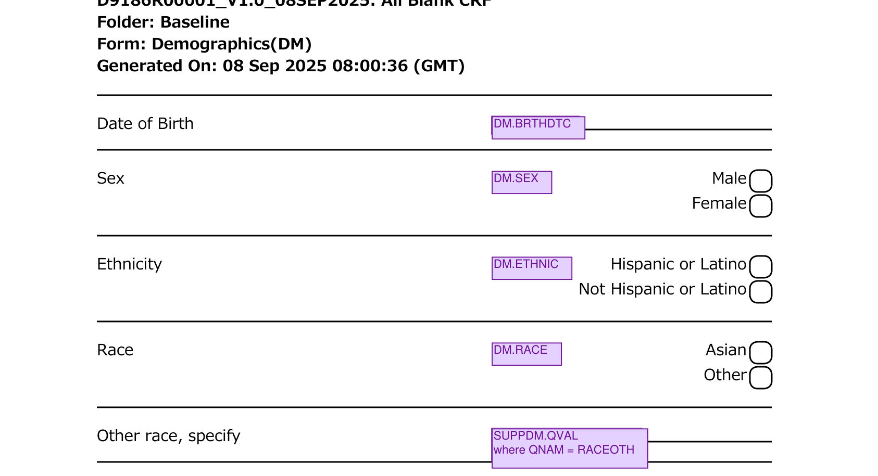
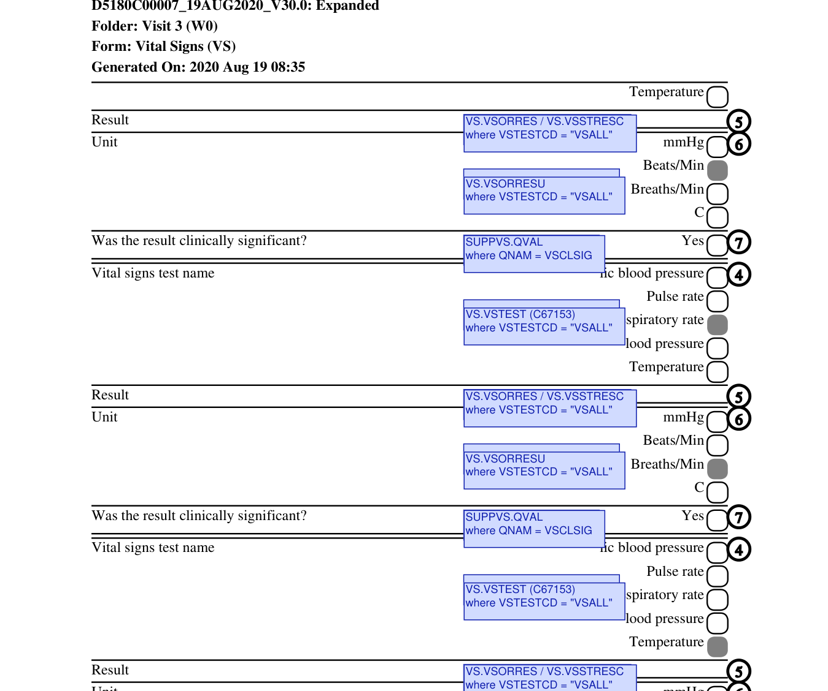
Real output — generated, not mocked
Demographics — DM.SEX / DM.RACE / DM.ETHNIC + SUPPDM.QVAL
Findings — VS.VSORRES / SUPPVS.QVAL where VSTESTCD = … (value-level)
First-draft aCRF · Proof of concept · Human-in-the-loop
7
Notes:
Real generated pages, not mockups. Left: Demographics - DM.SEX/RACE/ETHNIC + SUPPDM.QVAL. Right: a Findings page - VS.VSORRES with value-level where VSTESTCD per test.

Slide 8
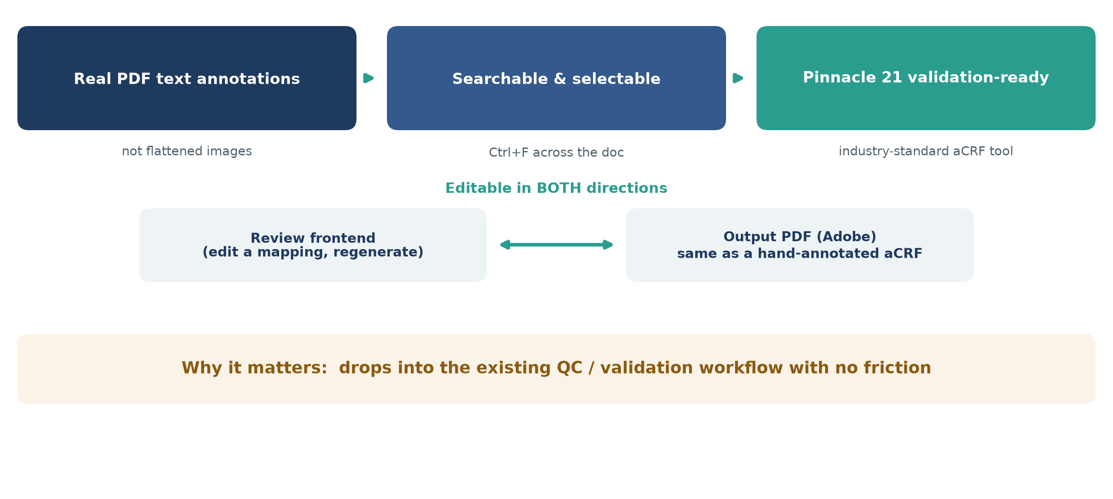
FreeText annotations → Pinnacle 21 ready & editable
First-draft aCRF · Proof of concept · Human-in-the-loop
8
Notes:
Annotations are real PDF FreeText, not images - searchable (Ctrl+F), selectable, extractable by Pinnacle 21 (industry-standard validation). Editable both ways: review frontend (edit + regenerate) and in the output PDF (Adobe). Drops into the existing QC/validation workflow with no friction.

Slide 9
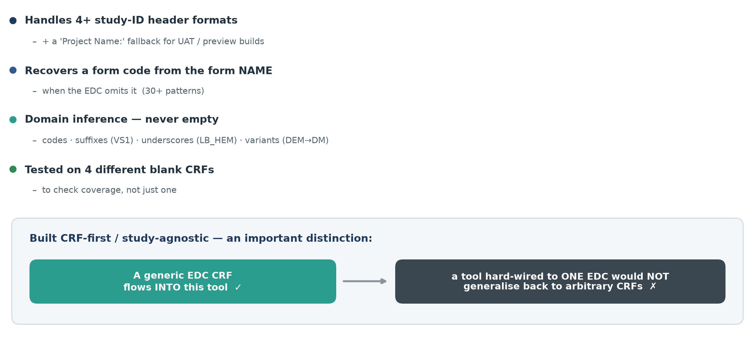
Works across different EDC export styles
First-draft aCRF · Proof of concept · Human-in-the-loop
9
Notes:
CRF-first/study-agnostic: 4+ study-ID header formats + Project Name fallback, recovers form code from form name (30+ patterns), domain inference (codes, suffixes, underscores, variants) - never empty. Any CRF flows in, but a tool hard-wired to one EDC wouldn't generalise back. Tested on 4 different CRFs.

Slide 10
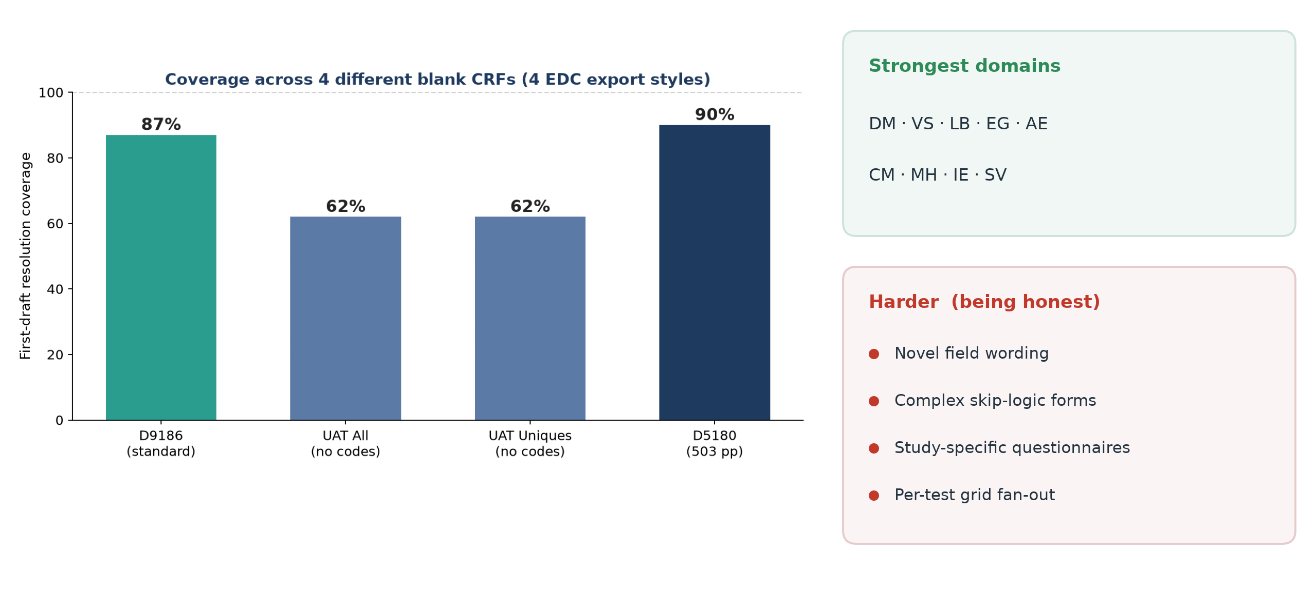
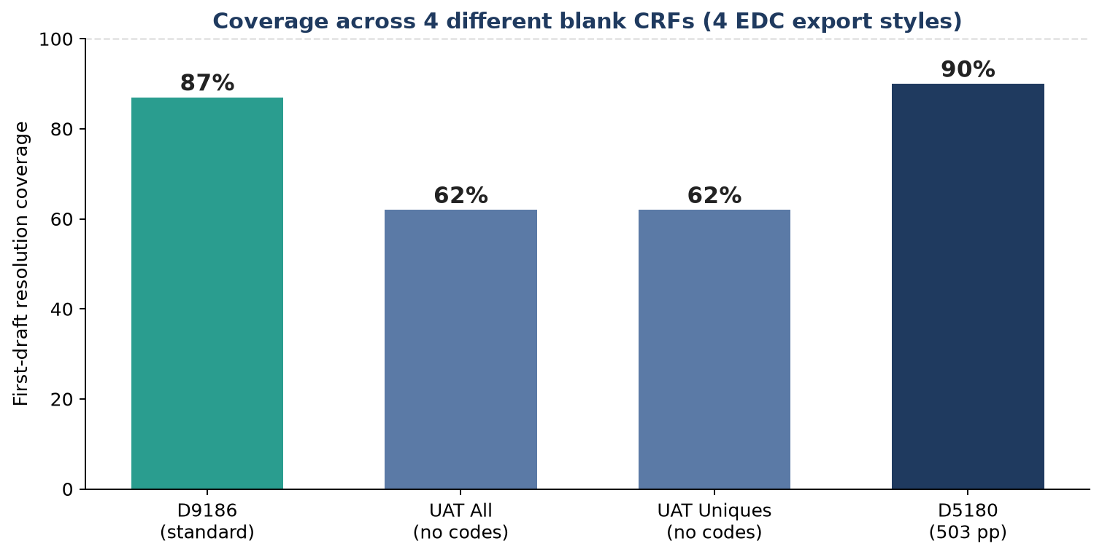
Coverage & honest metrics
First-draft aCRF · Proof of concept · Human-in-the-loop
10
Notes:
Coverage across 4 CRFs/export styles: 87% (D9186), 62% and 62% (UAT, codes stripped), 90% (D5180, 503pp). Strongest: DM, VS, LB, EG, AE, CM, MH, IE, SV. Harder: novel wording, skip-logic forms, study-specific questionnaires, per-test grid fan-out.

Slide 11
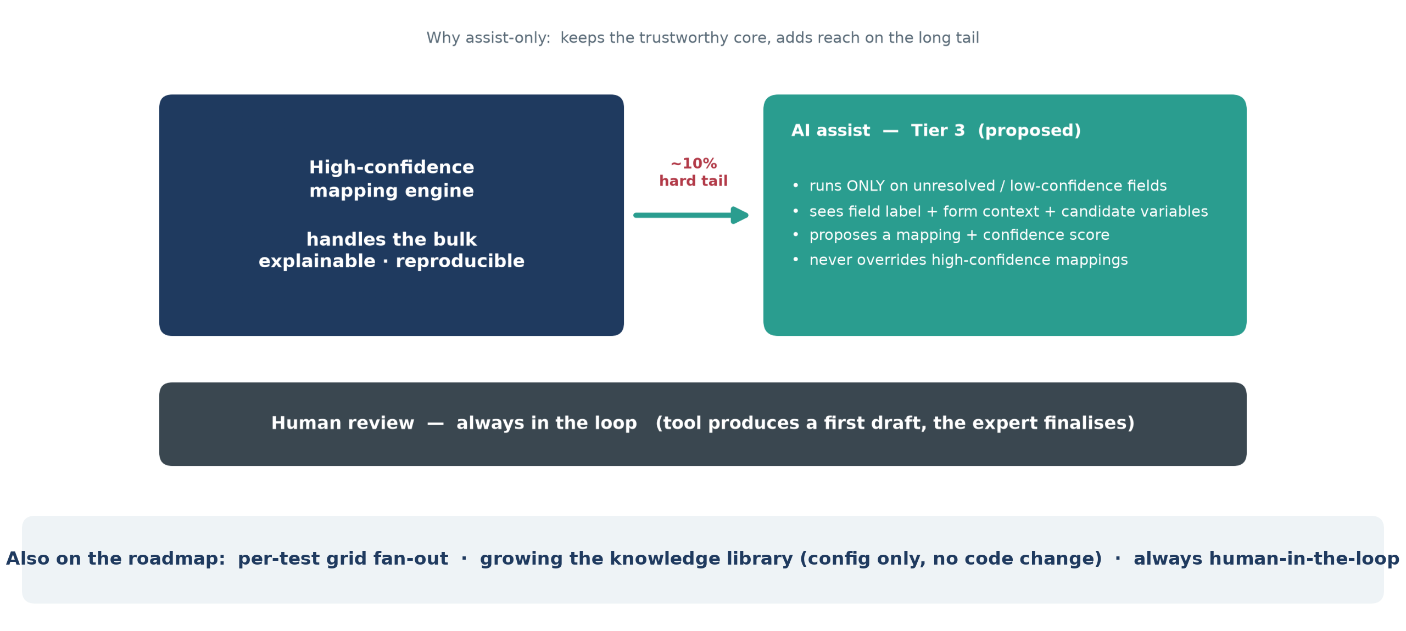
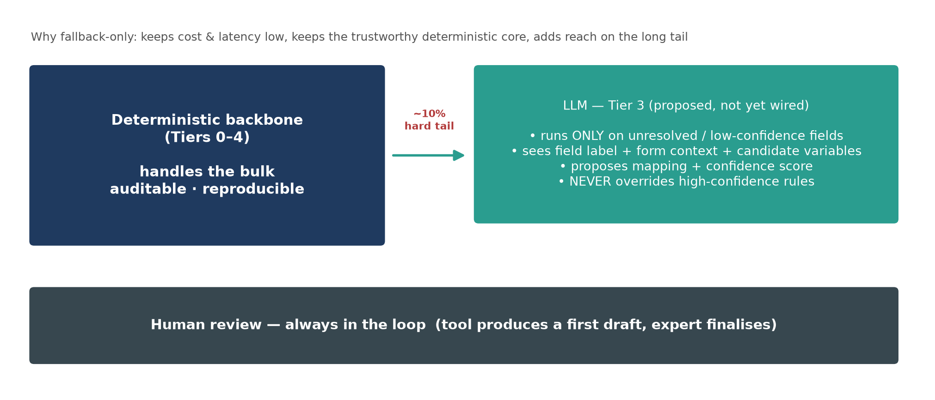
What's next — LLM as a Tier-3 fallback
First-draft aCRF · Proof of concept · Human-in-the-loop
11
Notes:
Highest-leverage next step: LLM as a Tier-3 fallback for the ~10% hard tail - runs only on unresolved/low-confidence fields, sees label + form context + candidate variables, proposes a mapping + confidence, never overrides high-confidence matches. Roadmap: per-test grid fan-out, growing the knowledge library (config only). Human review always in the loop.

Slide 12
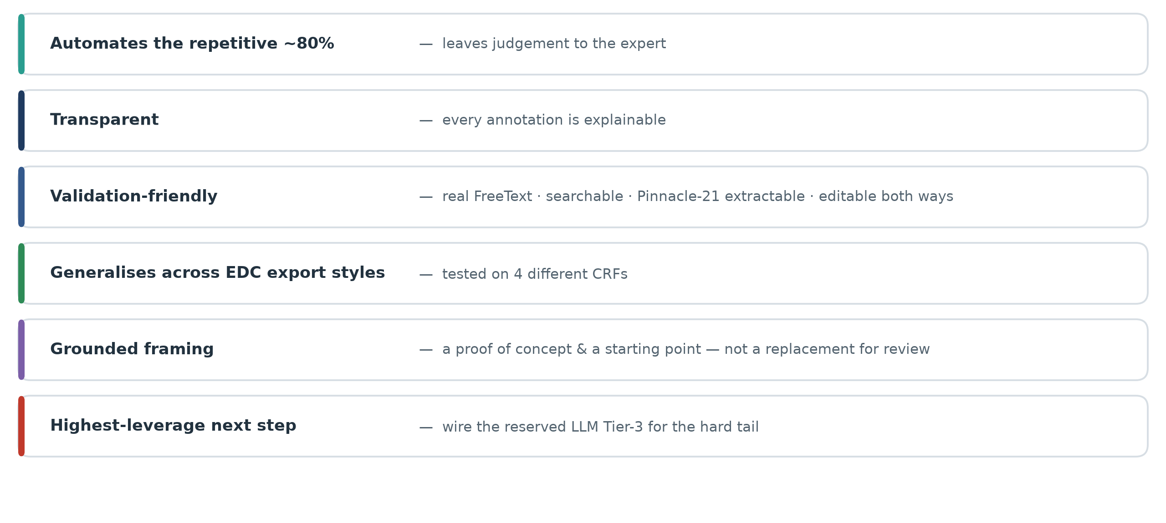
Summary
First-draft aCRF · Proof of concept · Human-in-the-loop
12
Notes:
Recap: automates the repetitive ~80%; transparent and explainable; validation-friendly (real FreeText, searchable, Pinnacle-21, editable both ways); generalises across EDC styles, tested on 4 CRFs; a proof of concept and starting point, not a replacement for review. Next: wire the reserved LLM Tier-3. Thank you.

