Slide 1


工程化专题之git
咕泡学院-James

Slide 2
Agenda
什么是git
世纪难题：git和svn的区别
安装 ssh
基本命令
git-flow
gitlab
git hooks

Slide 3
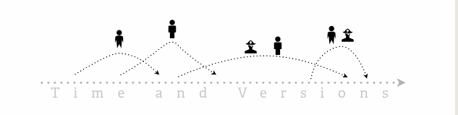
什么是git
谁会用到git
怎么用

Slide 4
世纪难题：git和svn的区别

Slide 5
安装 ssh
https://git-scm.com/book/en/v2/Getting-Started-Installing-Git
http://windows.github.com
http://mac.github.com
http://git-scm.com/download/linux
sudo yum install git-all
生成SSH KEY ssh-keygen -t rsa -C 'james@gupaoedu.com'

Slide 6
常用命令
remote
fetch/pull/push
log
stash
merge/rebase
tag

Slide 7
git-flow
团队管理

Slide 8
gitlabs
https://bitnami.com/stack/gitlab/virtual-machine
https://github.com/gitlabhq/gitlabhq
https://about.gitlab.com/downloads/#centos7

Slide 9
git hooks
Client side
Server side

Slide 10
git hooks
Client side
Server side

Slide 11

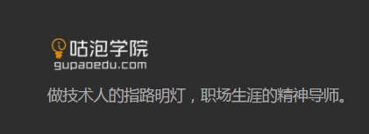
谢谢
咕泡学院-James

