Slide 1
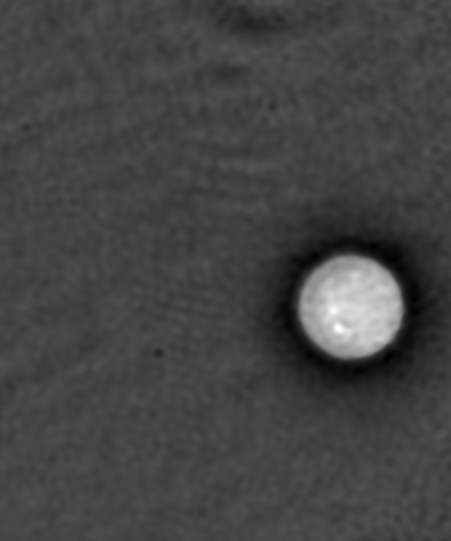
One microscopy image, one linked pixel summary
A · Quantitative phase image
B · Raw 8-bit pixel histogram
10 µm
0
64
128
192
255
Full field · 550 × 660 px · 0.107 µm/px
Pixel intensity (0–255, arbitrary image units)
No crop, stitch, LUT or intensity adjustment
Pixels ≥128: 11,570 / 363,000 (3.2%)
Descriptive threshold only; no cell segmentation or biological replicate.

