Slide 1
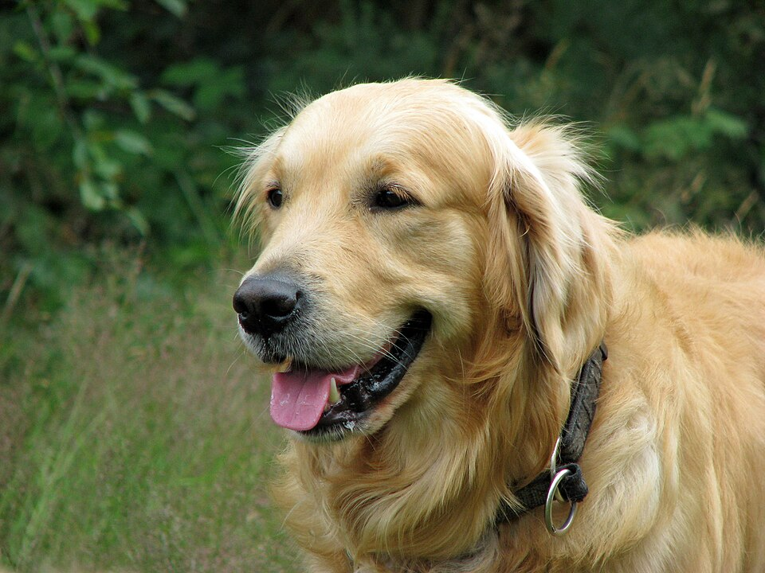
(1) Contrastive pre-training
(2) Create dataset classifier from label text
plane
A golden
retriever
Text
Encoder
car
Text
Encoder
A photo of
a {object}.
dog
⋮
T₁
T₂
T₃
···
Tₙ
bird
I₁
I₁·T₁
I₁·T₂
I₁·T₃
···
I₁·Tₙ
(3) Use for zero-shot prediction
I₂
I₂·T₁
I₂·T₂
I₂·T₃
···
I₂·Tₙ
I₃
T₁
T₂
T₃
···
Tₙ
I₃·T₁
I₃·T₂
I₃·T₃
···
I₃·Tₙ
Image
Encoder
Image
Encoder
⋮
⋮
⋮
⋮
⋱
⋮
I₁
I₁·T₁
I₁·T₂
I₁·T₃
···
I₁·Tₙ
Iₙ
Iₙ·T₁
Iₙ·T₂
Iₙ·T₃
···
Iₙ·Tₙ
A photo of
a dog.

