Slide 1
Software-Project Scientific Computing
Frank Noé
frank.noe@fu-berlin.de

Slide 2
Learning Aims
Learned to conduct a scientific software development project
Be able to acquired information of the numerical methods to be implemented
Understand a few important algorithms for analyzing high-dimensional scientific data
Collaborate in a small group (<10)
Be familiar with: source code repository management, public development platform, source code testing, continuous integration
Have a rough idea of software architecture design
Improve programming skills, in particular python, C(++), CUDA.

Slide 3
Rules
If you are in, stay in.
We are one team, everyone helps the others
The project is finished when the features are functional, or at the end of the semester. We all finish together.
Nobody does something and then leans back for the second half of the semester.
If you are done with something, regroup
Everyone has to present and contribute

Slide 4
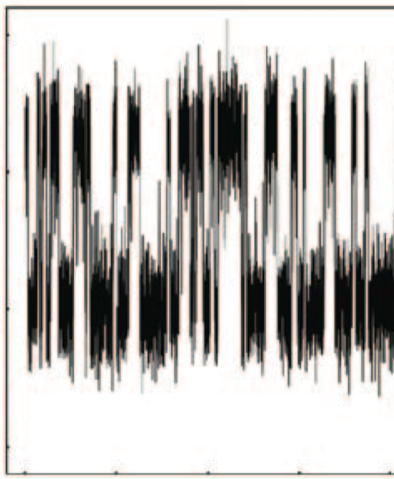
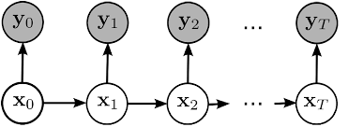
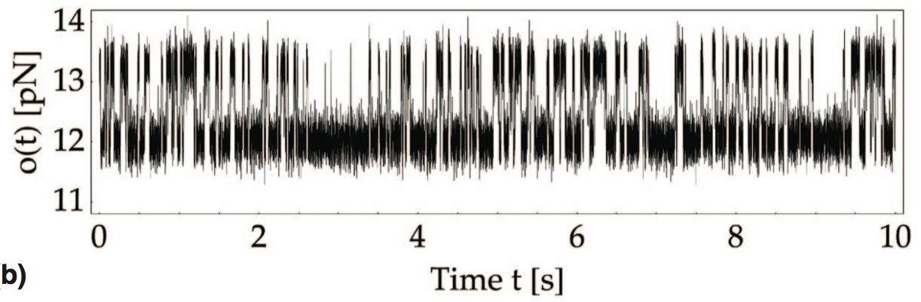
Data processing algorithms
3. Hidden Markov model
Observed states
Hidden states
discretize data without suffering from curse of dimensions
works well in a few dimensions (typically <10)

Slide 5
Data processing algorithms
2. k-means clustering
discretize data without suffering from curse of dimensions
works well in a few dimensions (typically <10)

Slide 6
Data processing algorithms
1. time-lagged independent component analysis
high-dimensional space
dimension reduction (TICA)

Slide 7
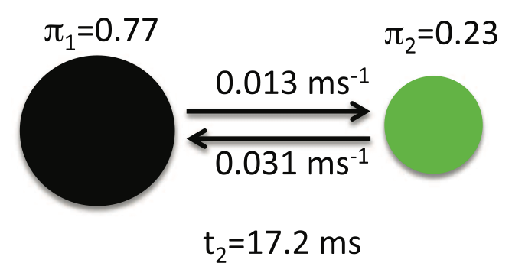
Pipeline:
high-dimensional data stream
TICA
k-means
HMM

Slide 8
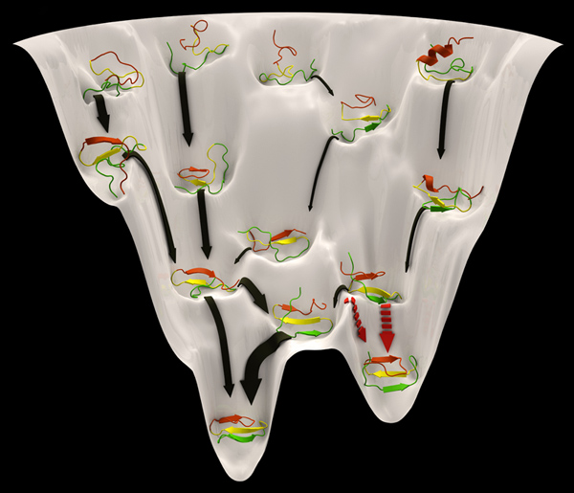
Application: molecular dynamics

Slide 9
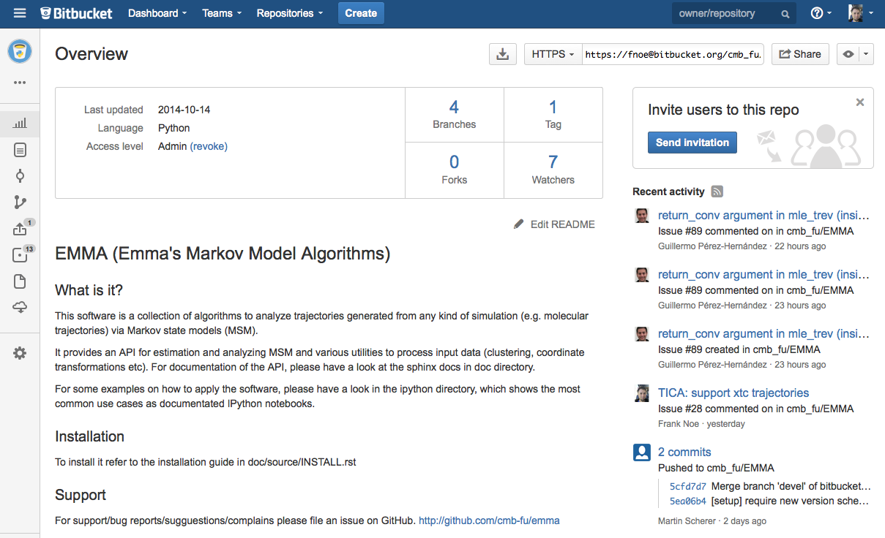
Our software library: EMMA

Slide 10
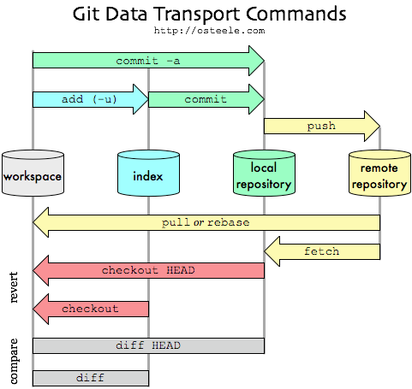
source code repository: git
You‘ll need a repository whenever you are not working alone.
But even when you work alone it has many advantages.

Slide 11
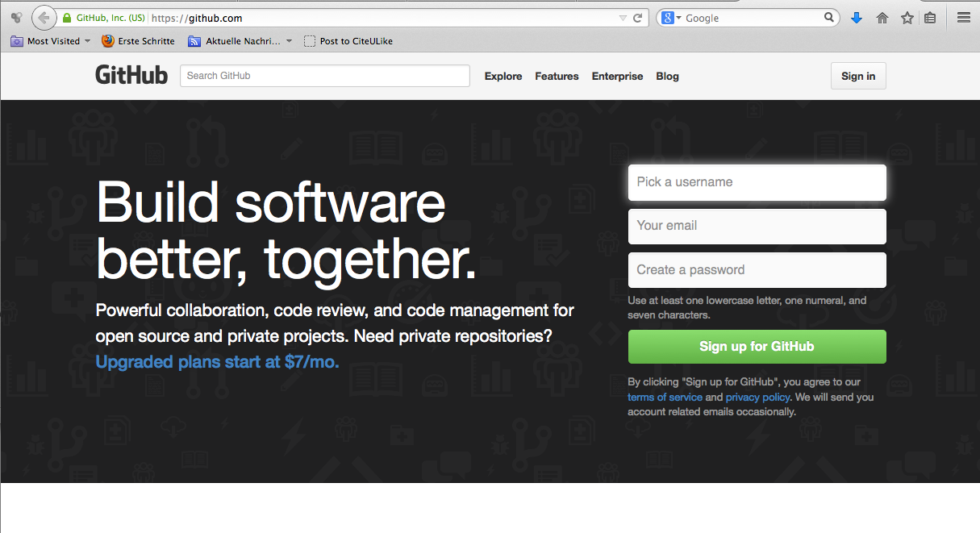
public development site: www.github.com
Github offers you free git repositories, combined with issue management and other features in a nice website.
„Github is like facebook for coding“

Slide 12
software design / continuous integration
run_tica
run_kmeans
run_hmm
shell scripts
Python packages
tica
kmeans
hmm

Slide 13
software design / continuous integration
integration test
run_tica
run_kmeans
run_hmm
shell scripts
unit test
unit test
unit test
Python packages
tica
kmeans
hmm

Slide 14
software design / continuous integration
integration test
run_tica
run_kmeans
run_hmm
shell scripts
unit test
unit test
unit test
Python packages
tica
kmeans
hmm
C
CUDA
C
CUDA
C
CUDA
platform-specific
implementation

Slide 15
Meetings
Suggestion: Every two weeks, roughly for 2 hours

Slide 16
Assignments for next meeting (Oct 31st)
All: Decide if you are in!
Form teams: TICA (2+), k-means (2+), HMM (3+)
Every team should have at least one person designing and implementing tests
Every team should have one representative
Elect one or two project leaders.
Project leader(s) are github administrators and create a repository
I upload three papers to the repository (theory)
Make sure all project members can communicate and get technical help from others (mailing list)
All: Get github accounts, make sure you have push+pull rights in the project
Read and understand theory
Whenever possible, start with python prototypes (you can use any availble code or package for the prototype!)

