Slide 1
Audio/Voice Recognition
Team Members:
Chris Loo and Andrew Steinbergs

Slide 2
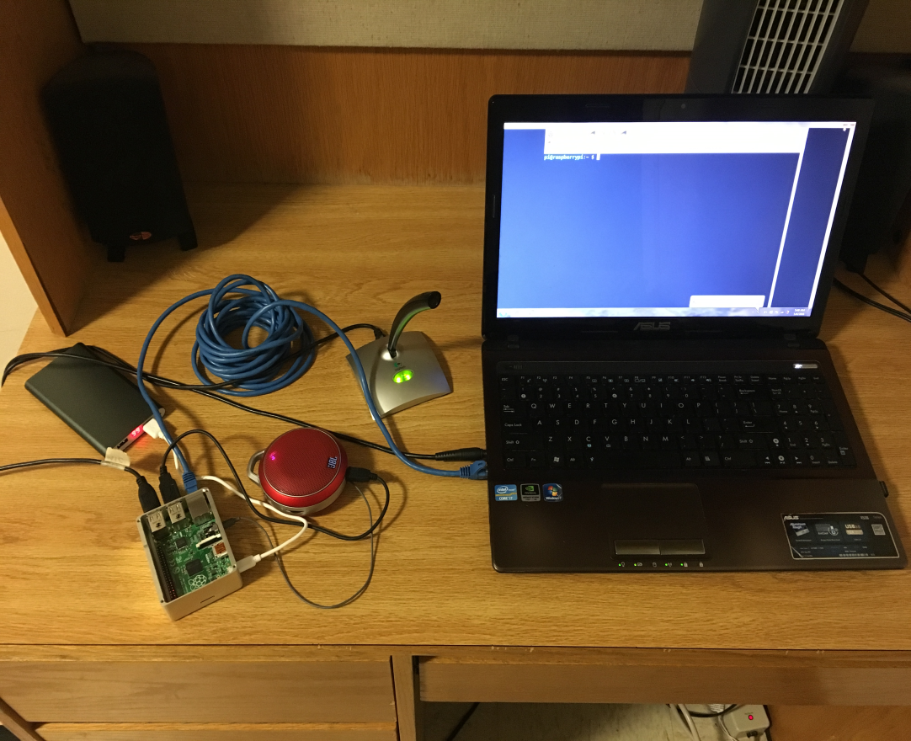
OBJECTIVES
Build a system that can translate speech to text and recognize voice commands
System should also be able to listen to and identify songs
Original plan was to recognize, at a minimum, 4-5 songs
Final iteration of the project, called Rosie, expands on the original idea

Slide 3
OBJECTIVES
Final iteration of the project is able to recognize speech, respond audibly, and execute voice commands
Rosie, our name for the system, is able to accept a voice command to identify a song and respond with the title and artist
Additional information such as album, year, and Spotify ID is available
Rosie is also able to answer a broad range of questions by using the Wolfram Alpha API

Slide 4
BACKGROUND
We wanted a project that would incorporate both software and hardware components
Inspired by voice recognition/personal assistant systems such as Apple’s Siri, Microsoft Cortana and Amazon Alexa
Wanted to incorporate a music identification functionality, idea came from Shazam and other similar music ID software
Hands-free assistant has been shown to be useful in many different contexts – benefits for the disabled, hearing impaired, or users simply looking for convenience
Further developments on the project would include more features and a wider range of uses – could incorporate with a more general home automation system

Slide 5
APPROACH
Initial plans were made without knowing the exact difficulty of implementing this type of system
For this reason, our approach was to propose an idea we were confident we could execute, then expand on it as time allowed
We came up with two similar but separate timelines, each implementing our original project plan with different ideas for expansion

Slide 6
VOICE RECOGNITION
Voice recognition for this project was done through PiAUISuite, which uses Google Voice API to translate speech to text
In addition to the PiAUISuite interface, we further customized the project by implementing Wolfram Alpha API and Python Weather API
Rosie uses these APIs to recognize and execute commands
Commands can be given as a word or phrase, and Rosie can be customized to give responses ranging from prewritten speech answers to executing a shell script
PiAUISuite allows Rosie to be highly customizable, as any word or phrase and the appropriate response can be programmed in

Slide 7
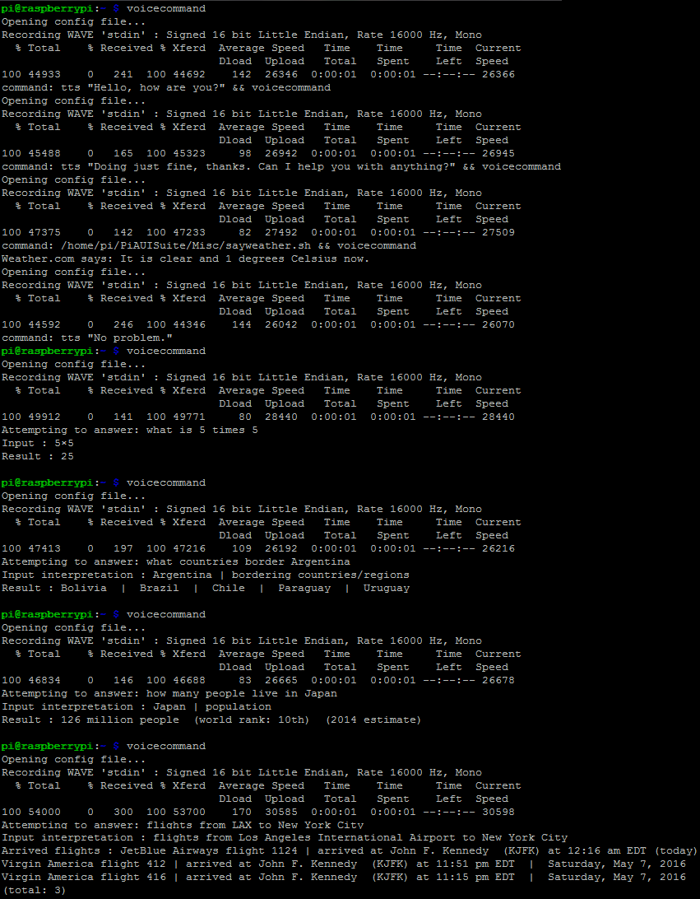
VOICE RECOGNITION
Examples of voice commands and responses

Slide 8
MUSIC RECOGNITION
Music recognition was implemented through ACRCloud
ACRCloud is a powerful acoustic fingerprinting service with a recognition rate greater than 98% and over 40 million songs in its database
Provides extensive information about recognized songs such as artist, title, album, and year
Also provides Spotify and iTunes IDs which could be used in the future to provide access to these services through Rosie
Functions by recording a 10 second audio file and running fingerprint algorithms on this file, then communicating with the ACRCloud database to identify the song and return information about it

Slide 9
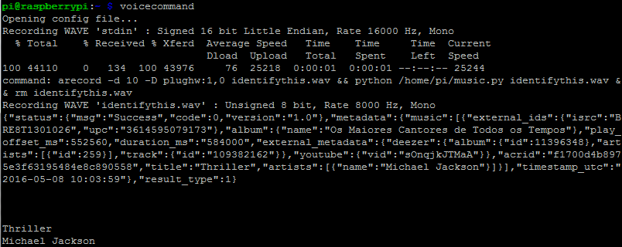
MUSIC RECOGNITION
Example of a song being identified

Slide 10
CHALLENGES
Inexperience with working with audio or writing algorithms based on processing audio files – presented potential issues such as handling noise filtering
Initial idea was to use an Arduino, but concerns over data format and possible memory issues caused us to switch to Raspberry Pi
Had issues with recording audio at first, solved by switching to another microphone
Originally planned to use the Jasper Project for voice recognition, but found that the code was written for the original Pi instead of our B+ model
These platform issues led us to switch to PiAUISuite, which worked well after solving some minor problems

Slide 11
CHALLENGES
Tried a few different options for music fingerprinting
Original idea was to use Echoprint, an open source music fingerprinting software, but the software was purchased by Spotify so API keys were no longer available
Switched to Chromaprint, a similar software, but had issues getting the code to compile
Final option that we ended up using was ACRCloud

Slide 12
CHALLENGES
Ran into a few issues we were unable to resolve before the deadline
Attempted to implement a “continuous mode” similar to Amazon Alexa where Rosie could always be listening and would respond to its name, as opposed to the project requiring user intervention to accept voice commands
Couldn’t resolve an issue where continuous mode wouldn’t work when Rosie executed another API call
Also wanted to make the system portable and independent from external power sources and displays, but we were unable to get all the project components working before the deadline

Slide 13
Project Timeline
Mar. 3 – Received parts and began initial setup of system
Mar. 10 – Successfully able to record and play audio through the Pi using the microphone
Mar. 17 – Completed research on voice recognition capabilities
Apr. 5 – Basic voice recognition system working
Apr. 12 – Weather and Wolfram Alpha APIs implemented and more voice commands programmed
Apr. 14 – Completed research on music recognition capabilities
Apr. 24 – Music recognition system working
Apr. 27 – Integrated music and voice recognition together, so that a voice command could be given to initiate the music recognition code
Apr. 29 – Presented project to the class

Slide 14
Resources Used
To complete this project, we used the following components:
Raspberry Pi Model B+
USB microphone
USB speaker
Battery power source
Ethernet cable
Laptop

