Slide 1
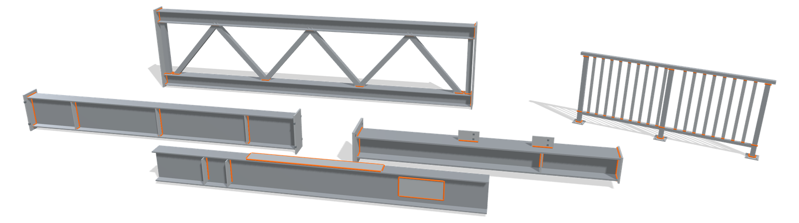
Structural steel welding with RoboScan
Beams, columns, lattice girders and railings. Scanned and welded by a CLOOS robot.
CLOOS Americas

Slide 2
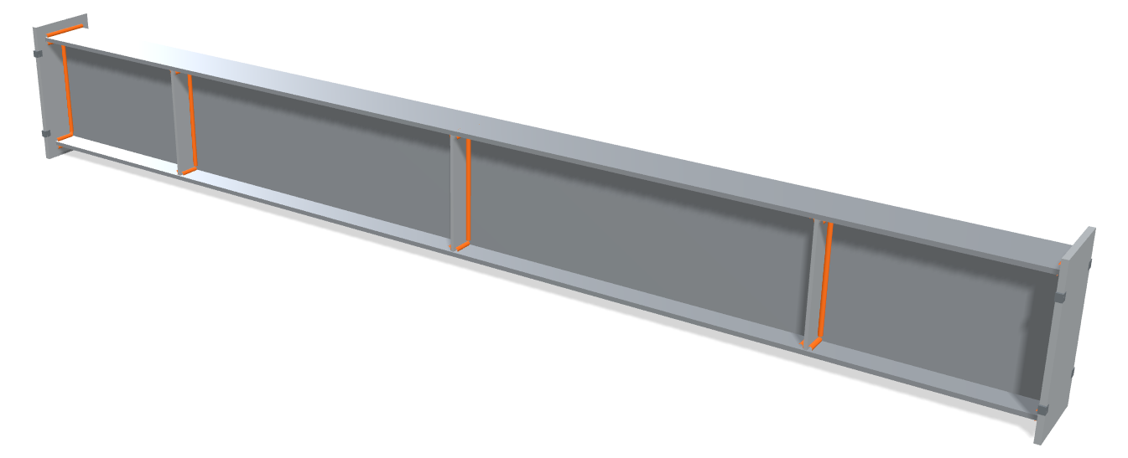
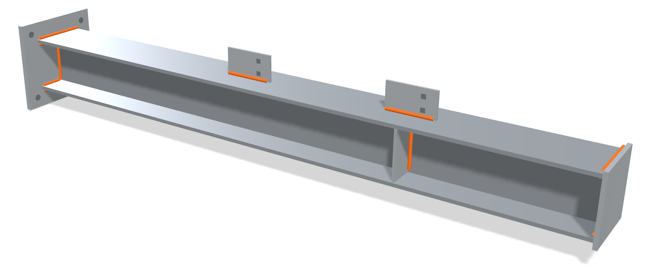
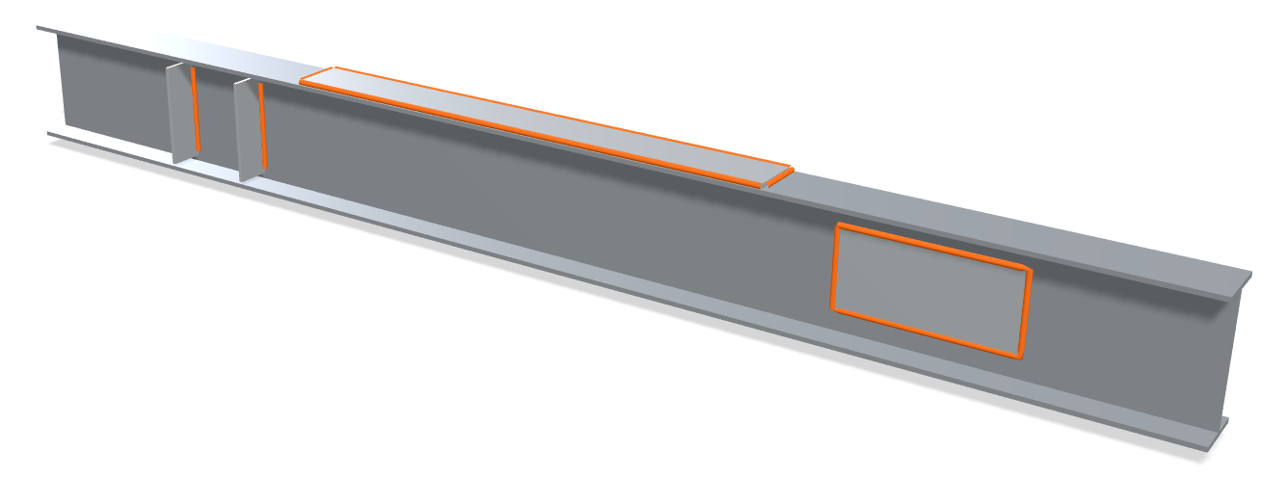
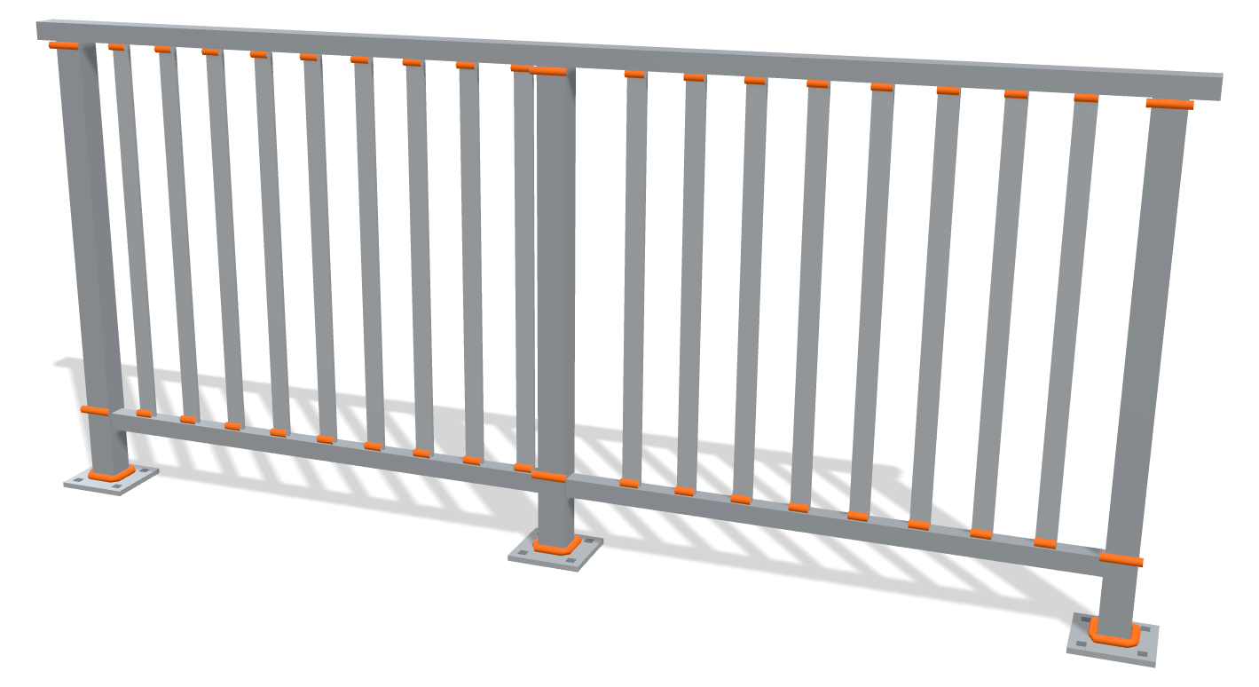
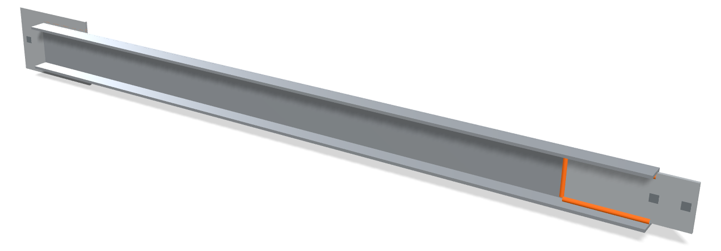
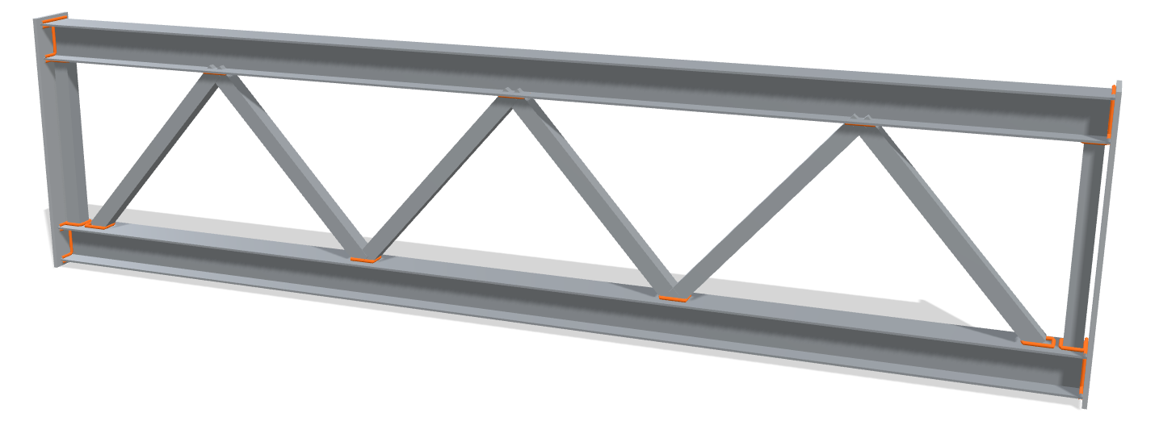
Your parts, welded by RoboScan
Beam with stiffeners and end plates
C3 stiffener, A1 head plate
Column with base plate and shear tabs
A2 column base, A1 head plate, C2 shear tab
Beam with plates on web and flange
B1 reinforcing plate, C1 plate on web, C2 shear tab
Channel brace with gusset plates
D1 plate on profile, D2 plate in profile
Lattice girder
Its own connection library
Railing section
Its own connection library
Typical parts, shown as 3D illustrations. Every real part goes through the fit check.

Slide 3
RoboScan: the robot writes the program
Teaching by hand, point by point
180 min
RoboScan: one scan, program generated
15 s
720x less programming time per part
Same part, measured by CLOOS.

Slide 4
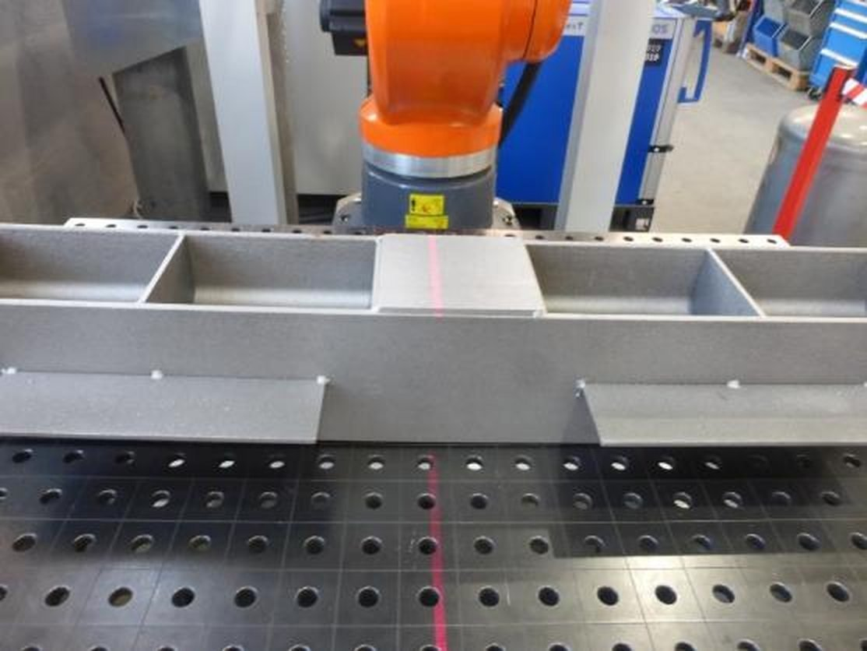
Place. Scan. Verify. Weld.
Place. Lay the tacked part on the table or trestles. No fixture.
Scan. One pass measures the real part.
Verify. Check every seam on the touchscreen.
Weld. One tap. The robot welds every seam.

Slide 5
What it can't do
Single wire only. No tandem, no TANDEM+, no torch change, no two-robot master and slave.
One robot per scanner.
It does not detect bevels, grooves or root gaps.
Clean steel: no scale, rust, grease or oil. Ground or polished surfaces are excluded.
The track must be longer than your longest part.
Standard connections only. Combinations are confirmed case by case.
Full fit check: see the kit.

Slide 6
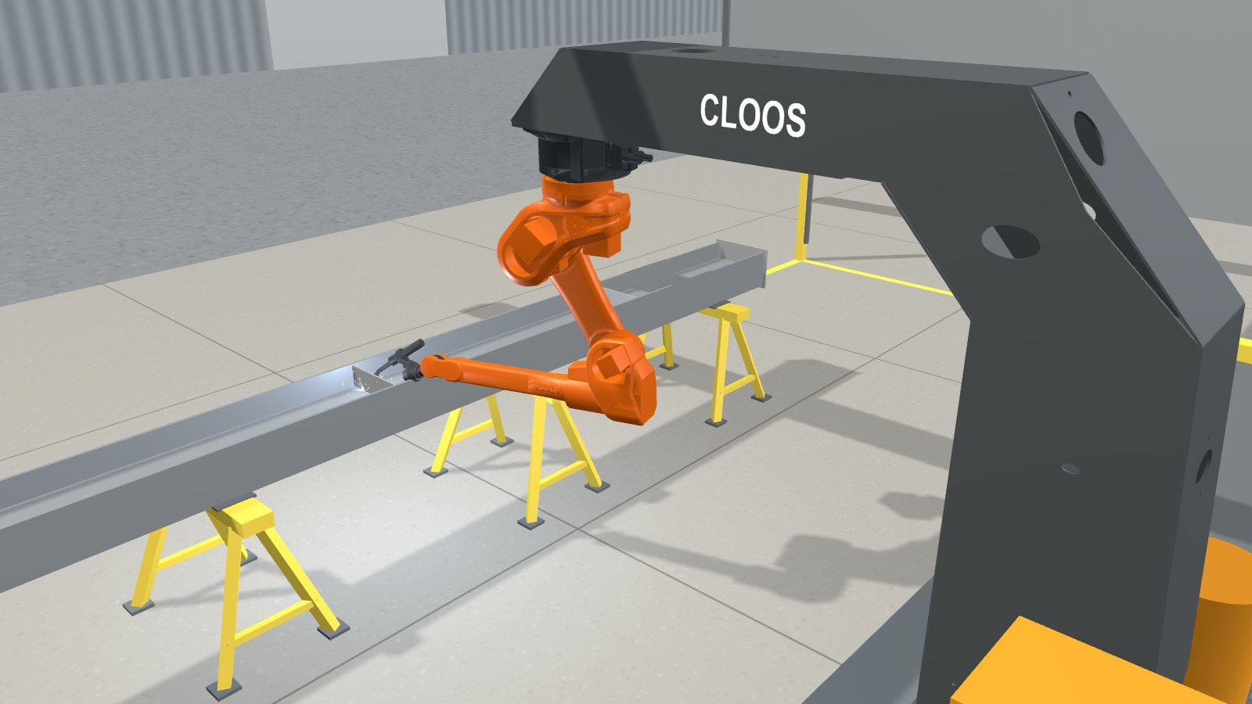
What a RoboScan steel cell looks like
A robot on a C-frame. The beam lies on steel stands inside the shop.
Walk through it in 3D:
cloos-americas.github.io/roboscan-kit/cell/
Every layout is drawn to your building before any quote.
3D illustration, not to scale

Slide 7
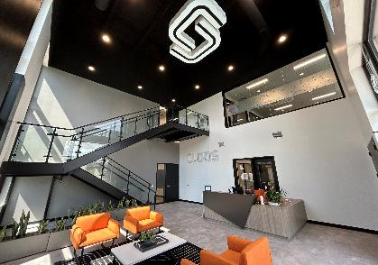
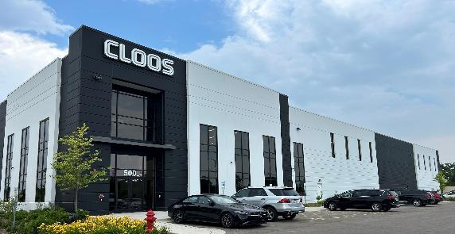
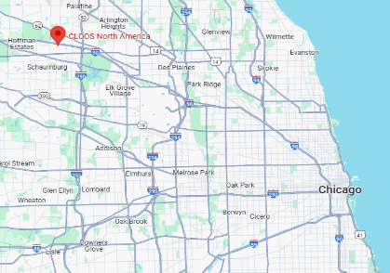
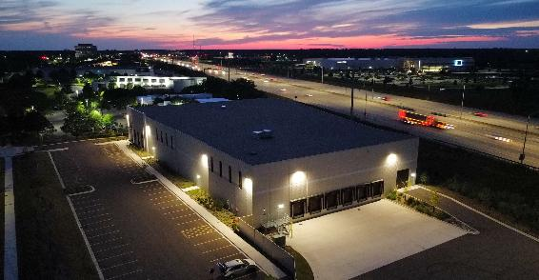

CLOOS AMERICAS:
AT A GLANCE
CLOOS Americas founded in 1985
Schaumburg, IL opened in 2024
45,000 square foot facility
$15 M investment
100% subsidiary of Cloos Germany.
15 miles to O´Hare Airport
CLOOS Americas

Slide 8


YOUR ONE-STOP WELDING SOLUTION
WELDING PROCESS
POWER SOURCES
CLOOS develop welding processes
MIG/MAG, TIG, Laser Hybrid
Single, Tandem, Tandem+ wire
For manual & robotic welding
CLOOS develop and produce welding power sources
MIG/MAG, TIG, Laser Hybrid
For manual & robotic welding
SERVICE SUPPORT
WELDING ROBOTS
CLOOS provide global service for:
Commissioning & programming
Training & supervision
Preventive maintenance, TPM
CLOOS develop and produce
Robots & cobots
Controllers & sensors
Manipulators, fixtures & tooling

Slide 9
Next step
Send us a drawing or a photo.
https://cloos-americas.github.io/roboscan-kit/
JPS International: Casey Janes, cjj@jpsint.com
CLOOS Americas: Cameron Montbriand, cmontbriand@cloosrobot.com, 847.908.2233

