Slide 1
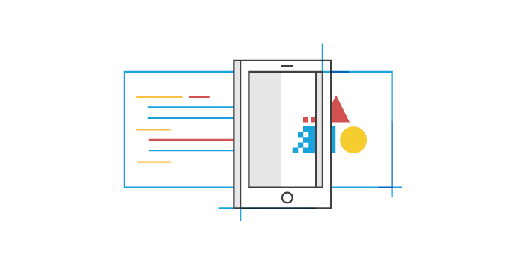
Responsive Design
& SASS

Slide 2
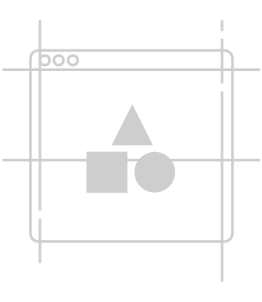

Viewport Meta Tag
<meta name="viewport" content="width=device-width,initial-scale=1">

Slide 3
Viewport Height | Width

Slide 4
Percentages

Slide 5
Element Relative (em)
Root EM (rem)

Slide 6
Max-Width | Min-Width

Slide 7
Box-Sizing: Border-Box;

Slide 8
Box Model

Slide 9
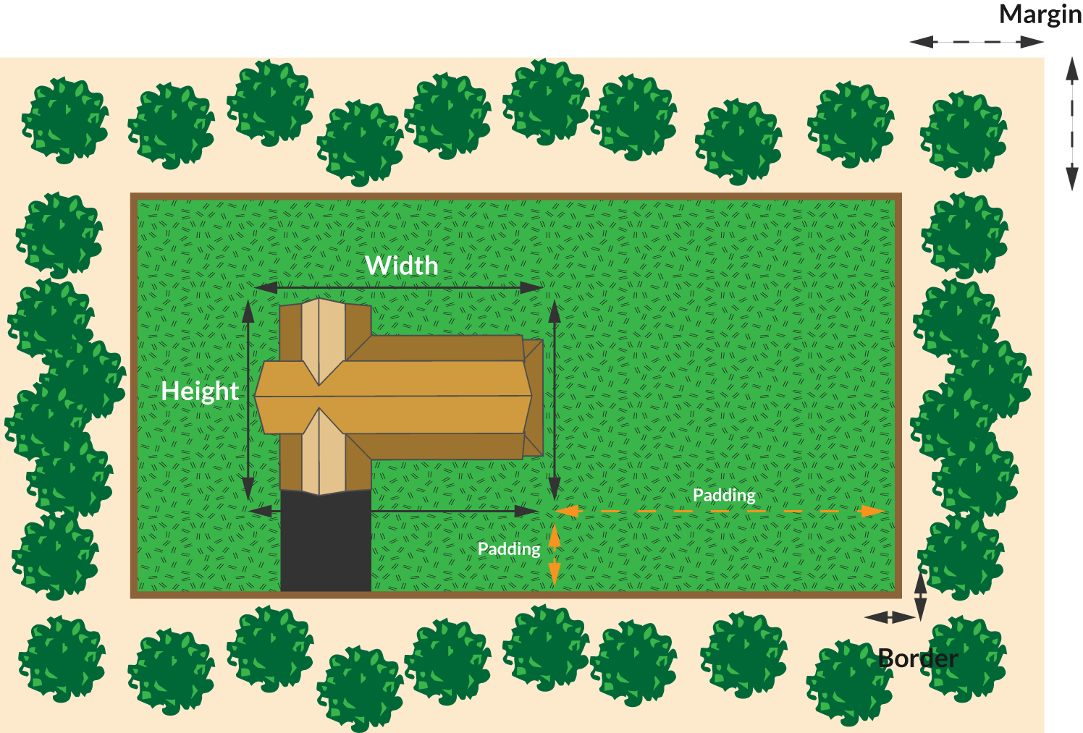
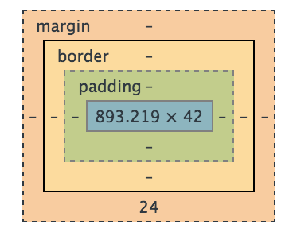
The Box Model

Slide 10
The Display Property
block
inline
inline-block

Slide 11
Flex Box

Slide 12
display: flex;
HTML
<article>
<h2>I’m a title</h2>
<p>I’m a paragraph tag</p>
</article>
CSS
article {
display: flex;
}

Slide 13
Demo: Flex Box

Slide 14
MEDIA QUERIES

Slide 15
Breakpoints
Large Screens:
min-width: 1024px;
Medium Screens:
max-width: 768px;
Small Screens:
max-width: 480px;

Slide 16
Syntax
@media [media-type] and (expression) { div { /* styles to be applied */ } }
Notes:
Breakdown the following media query piece by piece including:
@media: the keyword which indicates we are applying responsive styles;
[media-type]: the screen type with screen, print or speech. We will be using only ‘screen’ for our webpages. Print is for printers and speech is used for screen readers.
(expression): the size of screen we will apply styles to. Often ‘max-width’ and ‘min-width’ values. These values give us the breakpoints for various standard screen sizes. An iPad is min-width: 768px and an iPhone has a min-width: 375px;
css selections: target the elements you want to style in the usual ways

Slide 17
Stretch: SASS

Slide 18
Demo: SASS

Slide 19
Advanced: Architecture, Tool & Performance

Slide 20
THANK YOU!

