Slide 1


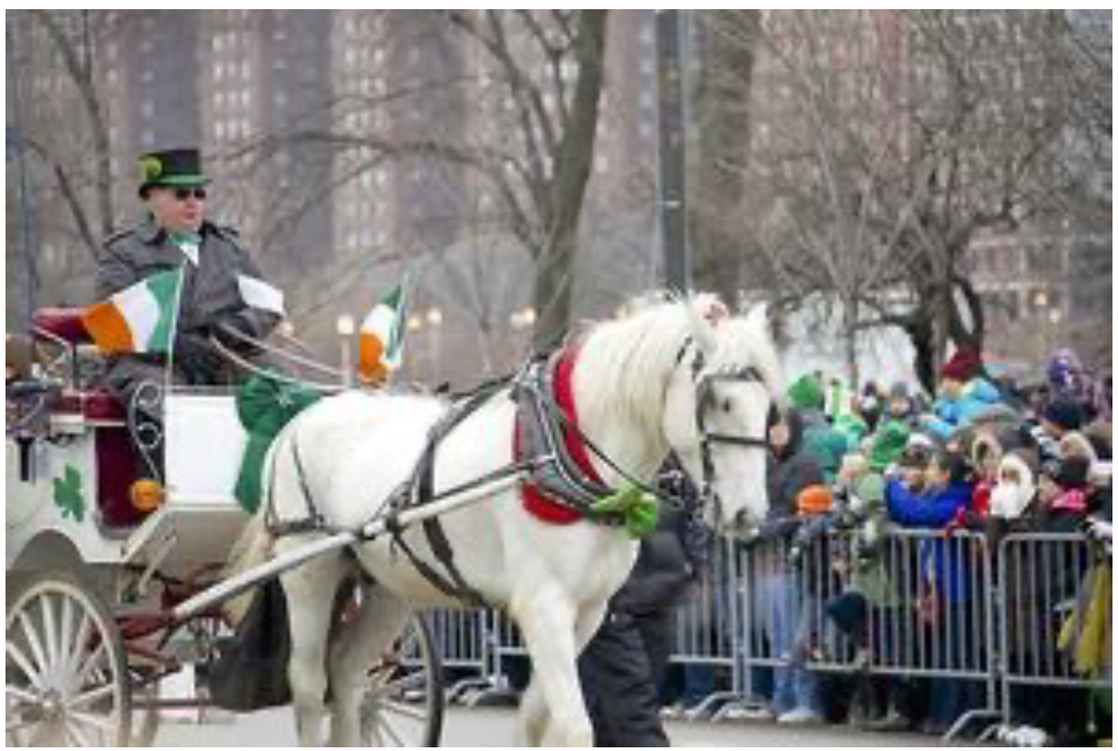





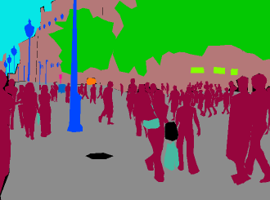
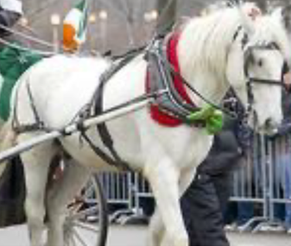
Demonstration Pool
Plan
Prompt
1. LOC horse
2. CROP
3. VQA color
4. EVAL via python
Instruction: Is there a horse that is not white?
Retrieval
1. Correct examples
2. Incorrect examples
3. Instruction
Plan generation
Demonstration Pool
Prompt
Program
1. Correct examples
2. Incorrect examples
3. Instruction
4. Plan
B=LOC(IMABE, ‘horse’)
I’=CROP(IMAGE,B)
A=VQA(I’, ‘what color..’)
F_A=EVAL(‘yes’ if {A}=‘yes’)
Retrieval
Program generation
Toolkit
Program
interpreter module
CROP
VQA
EVAL
LOC
CROP
REPLACE
LOC
Tool execution
Gray
No
VQA
EVAL
SEG

