Slide 1

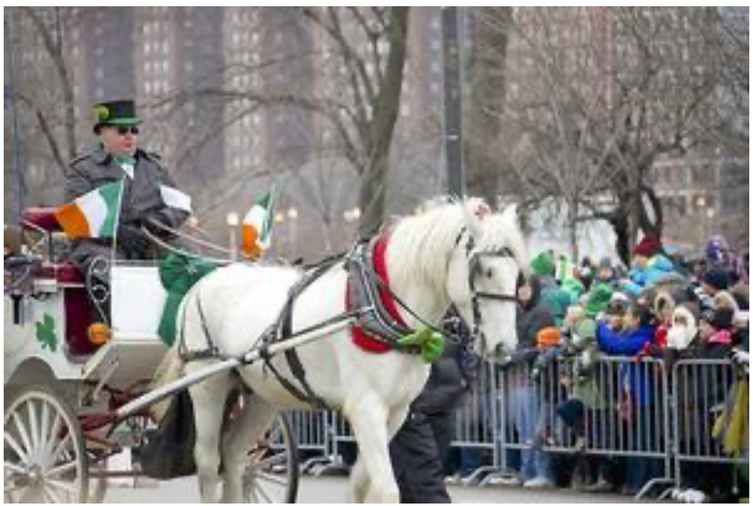


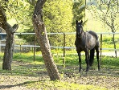
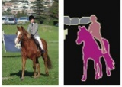
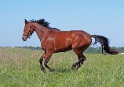

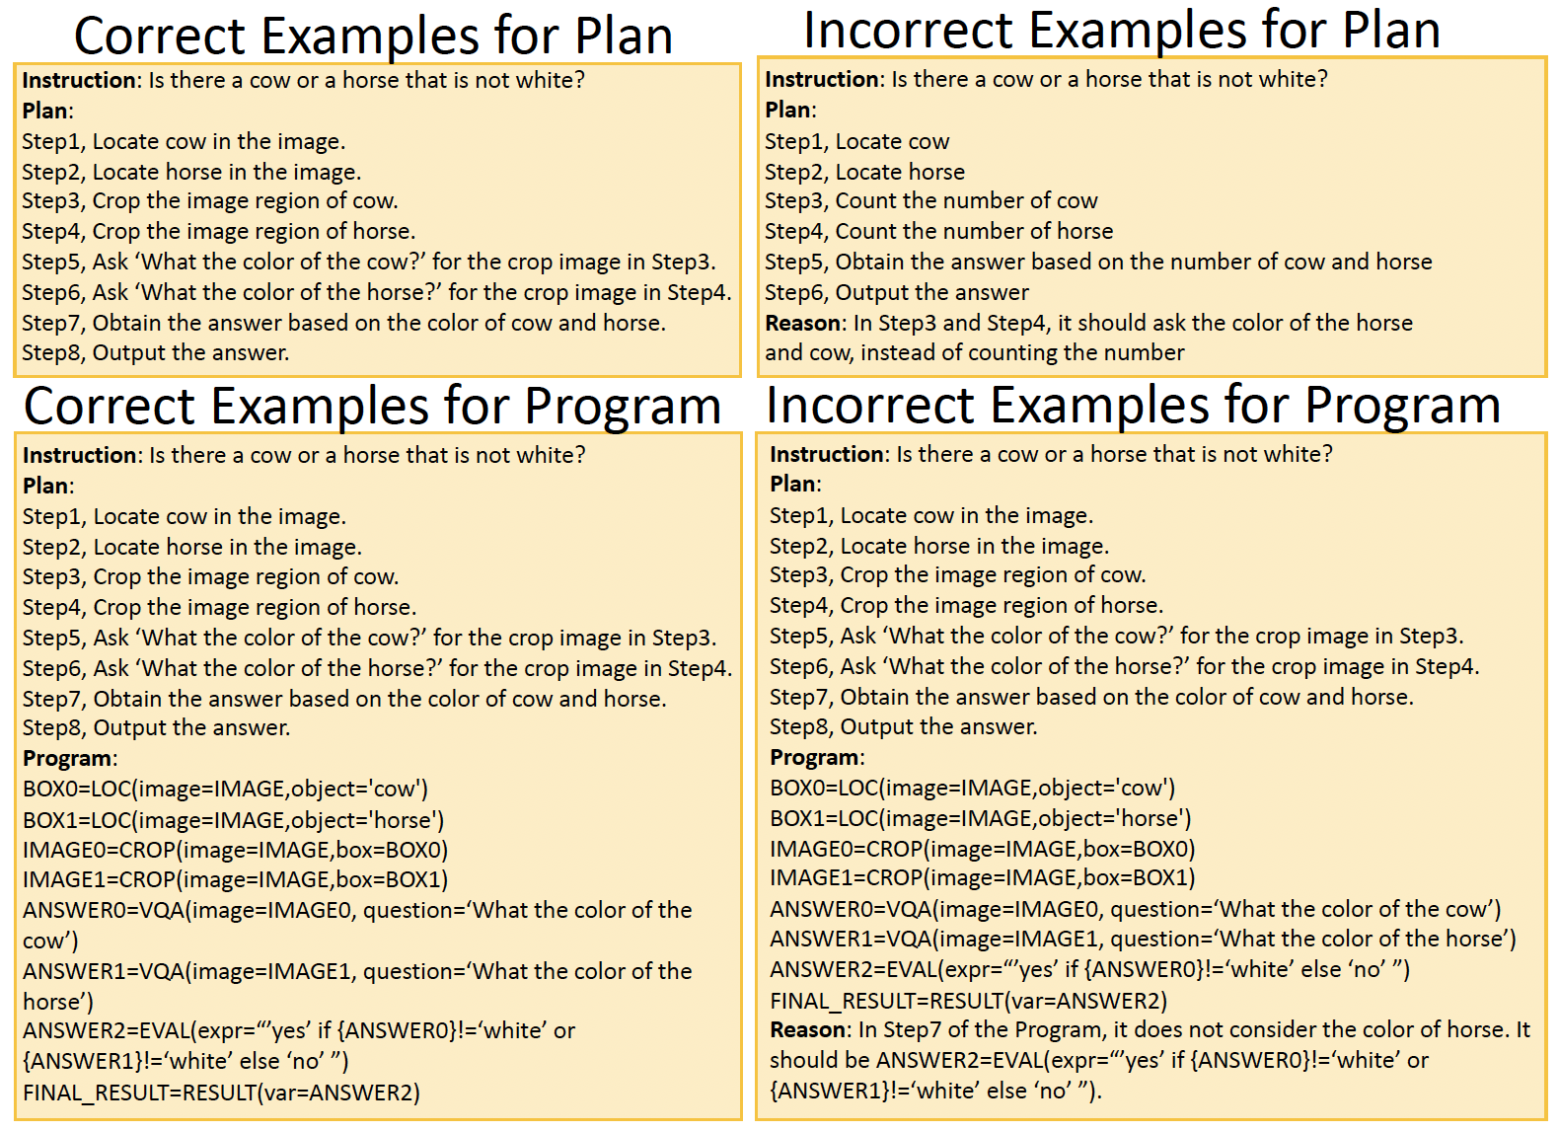




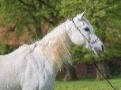

① LLM inference for VQA model
Data collection
③ Search on the Internet for the SELECT, REPLACE, and CLASSIFY models
From reflection: in solving the compositional question ‘Is there a horse that is not white?’, the VQA model in step3 incorrectly answer the subquestion ‘What color of the horse?’
② Collect data from open-vocabulary dataset for the LOC and SEG models
From reflection: the SELECT/REPLACE/CLASSIFY models fails for the object ‘horse’
From reflection: the LOC/SEG model in step3 fails for the object ‘horse’
Prompt
Instruction
Desirable answer
Program of all steps
Intermediate result of all steps
Correct answer is white.
‘horse’
‘horse’
Training
Prompt Pool
① Prompt tuning for LLMs
② Prompt tuning for VFMs
prompt
+
CLIP
Loss
Horse:
Demosntration Pool
BP
prompt
+
Maskerformer
Loss
Horse:
BP
prompt
+
OWL
Loss
Horse:
BP
① Prompt validation for LLMs
Validation
Demosntration
pool
Is there a horse that is not white?
Prompt Pool
② Prompt validation for VFMs
Keep the prompt
Keep the prompt
prompt
or
Model
or
Remove the prompt
Remove the prompt
Validation data

