Slide 1
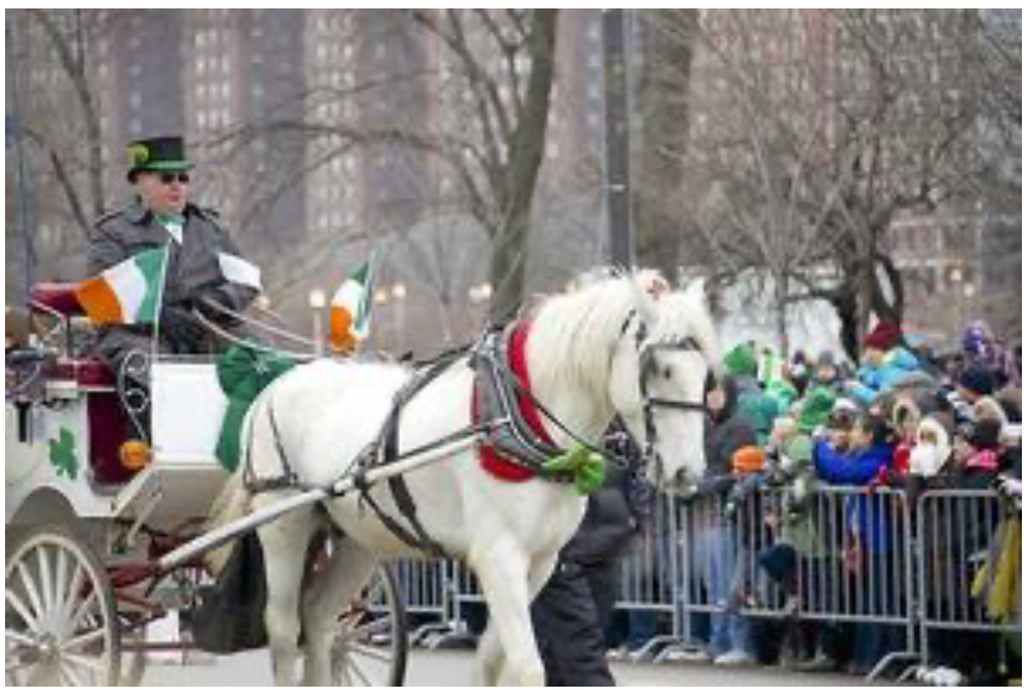
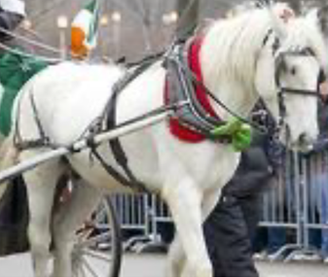

Intermediate results
Intermediate results in the language modality
IMAGE:
B:
I’:
The description of input image …
The coordinate of B is
The description of I’ …
The result of Ain Step3 is gray
The final answer is Yes.
[119,150,210,298]
Result conversion
gary
yes
A:
F_A:
Prompt
Global reflection
Learning phase
to update
the model
The updated
models still fail
1. Instruction
2. Plan of all steps
3. Program of all steps
4. Intermediate result of all steps
The error is caused by the program/LOC/VQA of step ..
no
end
yes
plan, program, and results of Step1
Prompt for reflection of Step1
Learning phase
to update
the model
1. Instruction
2. Steps have been checked (None)
3. Step now need to be checked
(plan, program, and results of Step1)
The error is in the program/LOC/VQA of this step
end
or
Do not find the error in this step.
Prompt for reflection of Step i
1. Instruction
2. Steps have been checked
(plan, program, and results of Step1-Step(i-1))
3. Step now need to be checked
(plan, program, and results of Step i)
Local reflection
plan, program, and results of Step i

