Slide 1

ClosetU
By Manny Nunez and Claudia Sychev

Slide 2
Recap
ClosetU is a single cloud solution that lets you store images of your clothing to build a virtual closet
Assemble outfits based on the items located in your virtual closet
Able to save outfits
Compare outfits to a reference outfit or even other outfits you have created
Budgeting assistance
Environmental advantages
Consuming less
Easier to figure out what you’re going to wear any given day

Slide 3
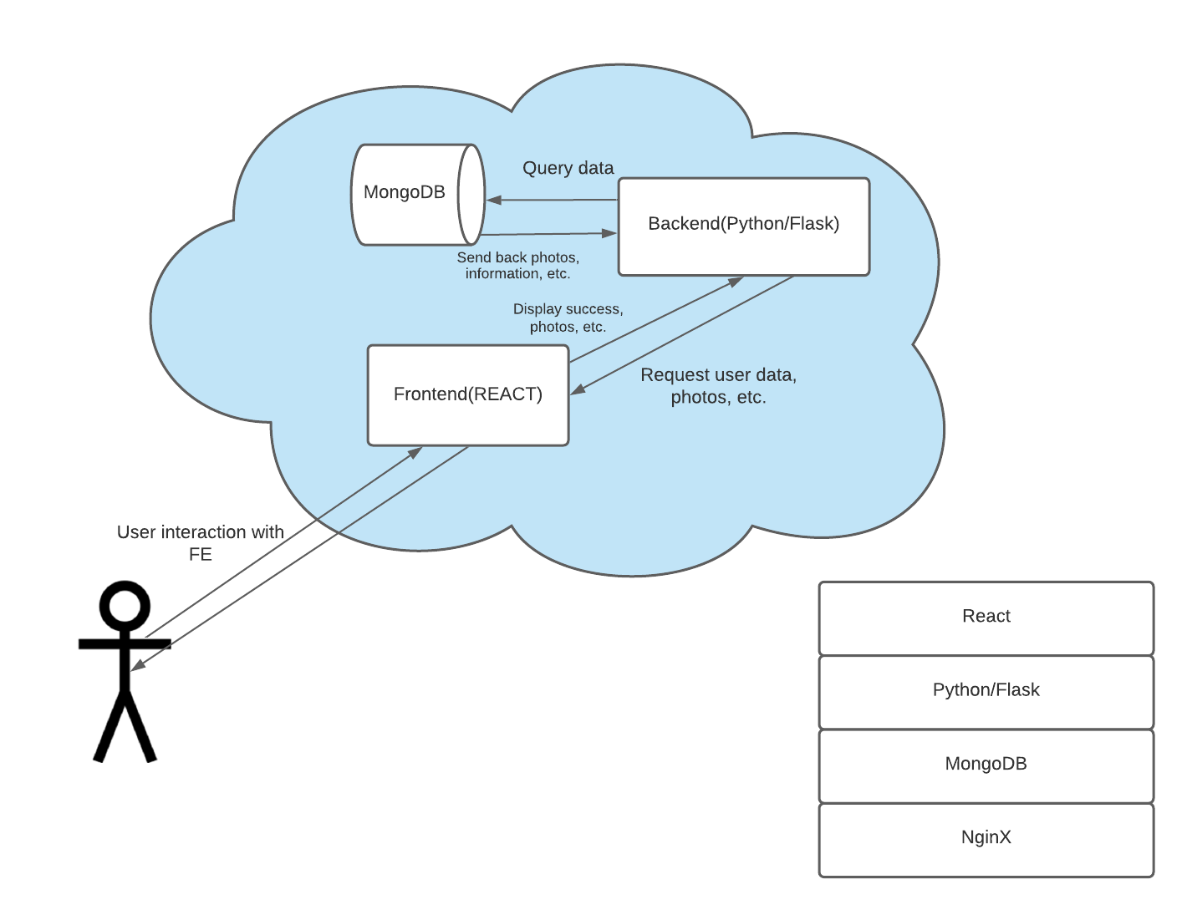
System
Diagram
User interaction successful

Slide 4
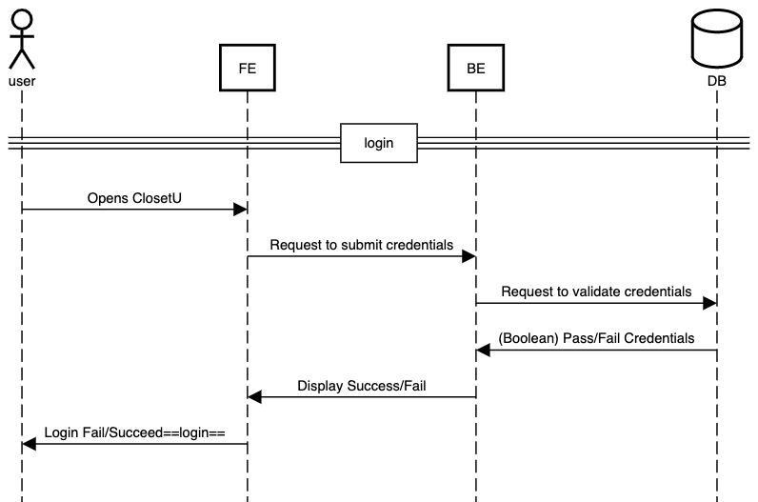
Sequence
Diagram

Slide 5
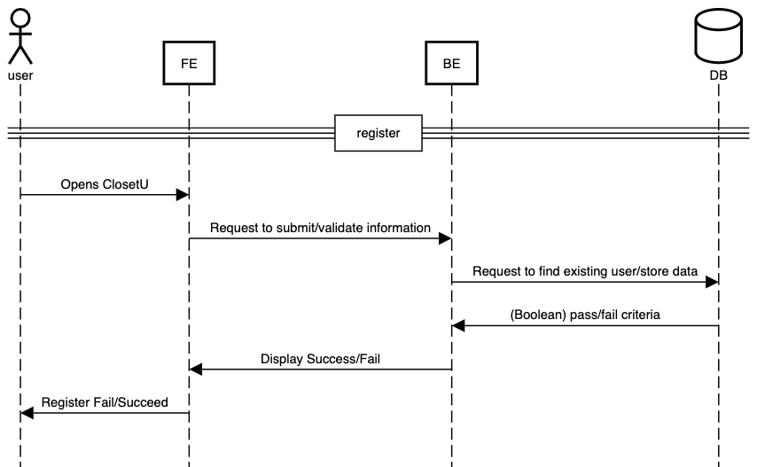

Slide 6
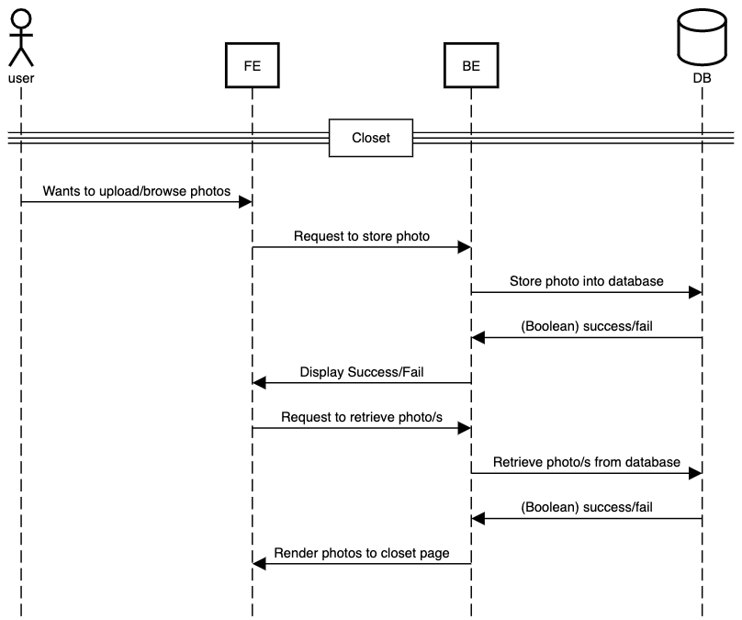

Slide 7
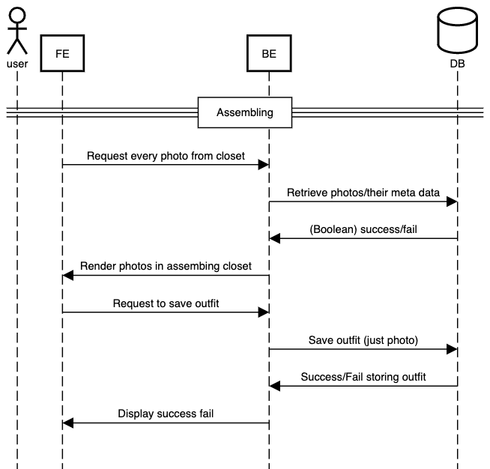

Slide 8
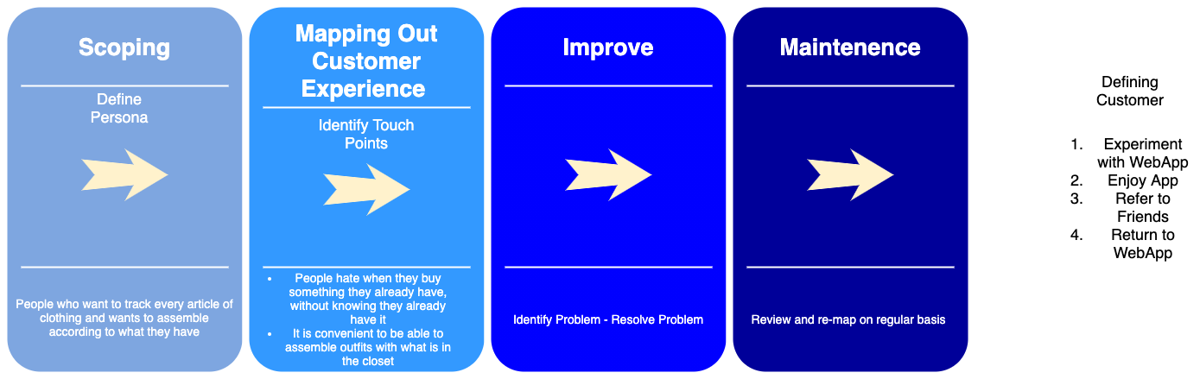
Design map

Slide 9
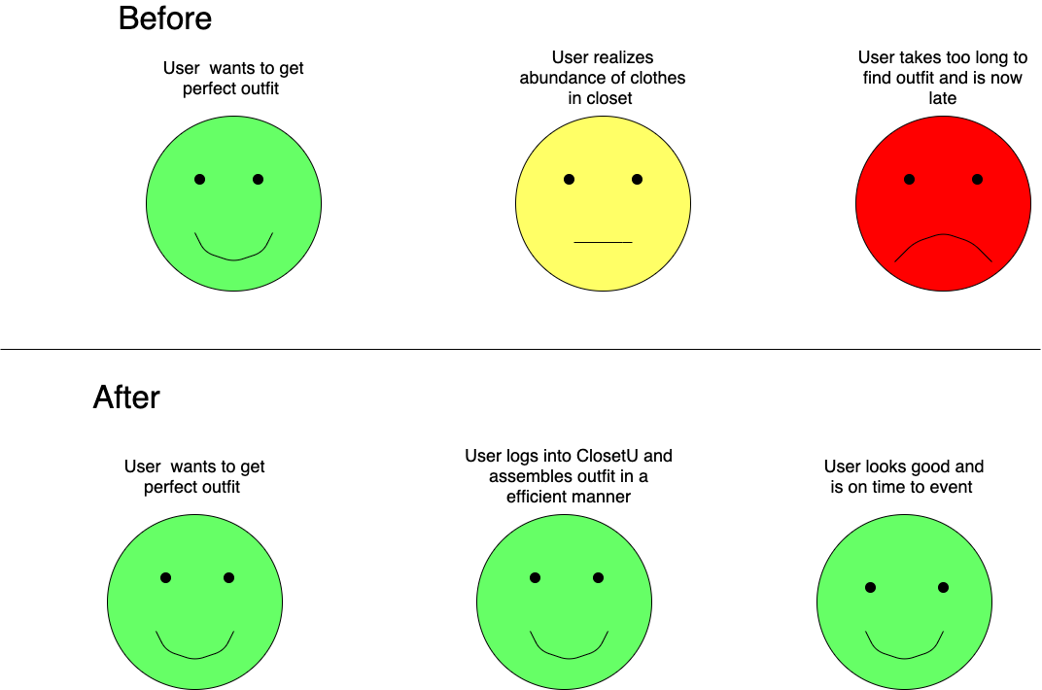

Slide 10
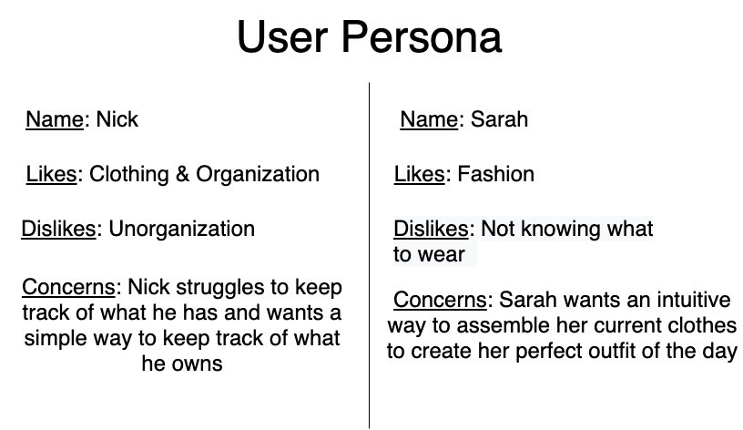

Slide 11
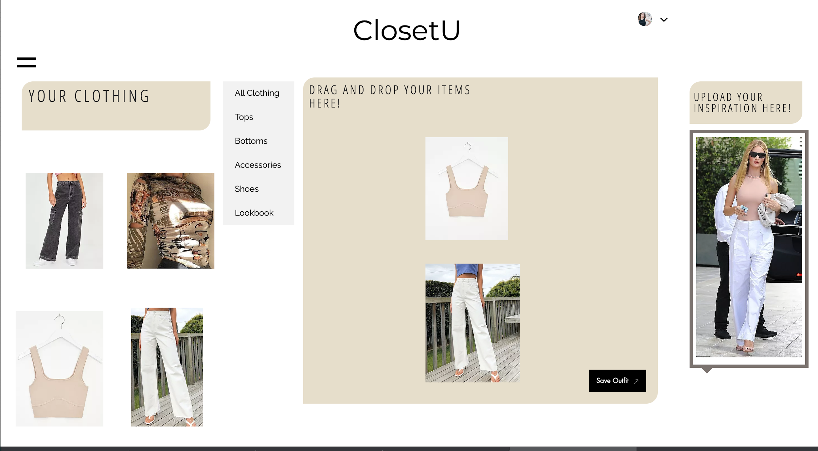
Mock
outfit
assembler

