Slide 1
Computer Vision Final Project
An Experiment on the Properties of Guided Filter
( Implement & Experiment on Matlab 2015R , without CV toolboxes)
102062209邱政凱

Slide 2

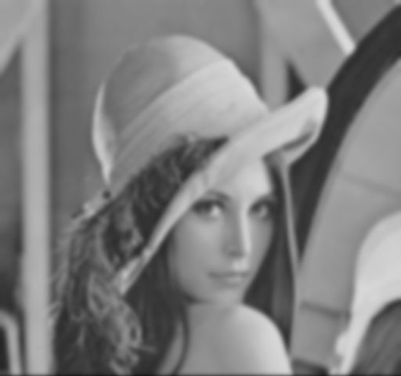
We Want to smooth or denoise an image….
Using Gaussian Blur?
We might lose some detail (contour…)

Slide 3

Edge-Preserving Filtering
Details are saved after filtering

Slide 4
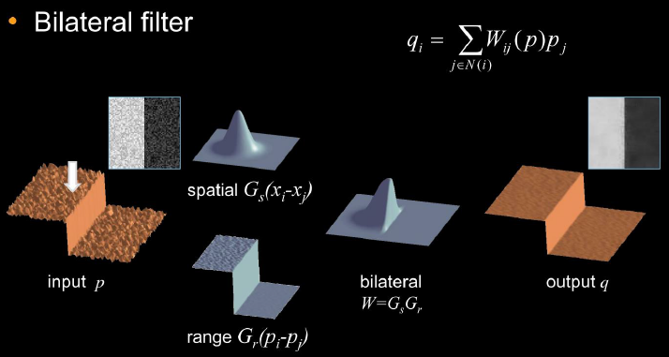
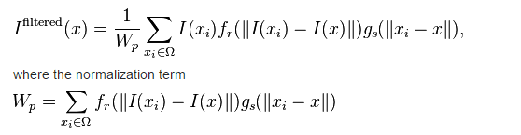
Bilateral Filtering

Slide 5
Bilateral Filtering
Some Problems associated with bilateral filtering:
˙Naïve O(N^2) Time complexity
˙Gradient Reversal

Slide 6
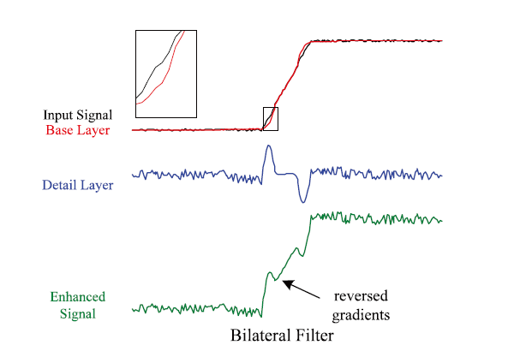
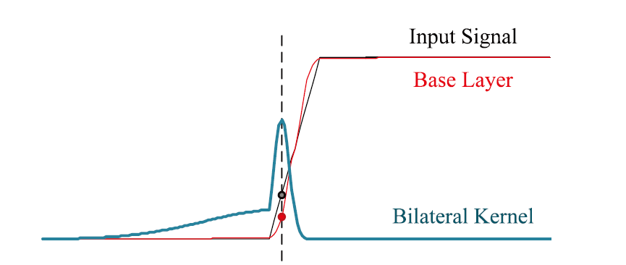
Gradient Reversal

Slide 7
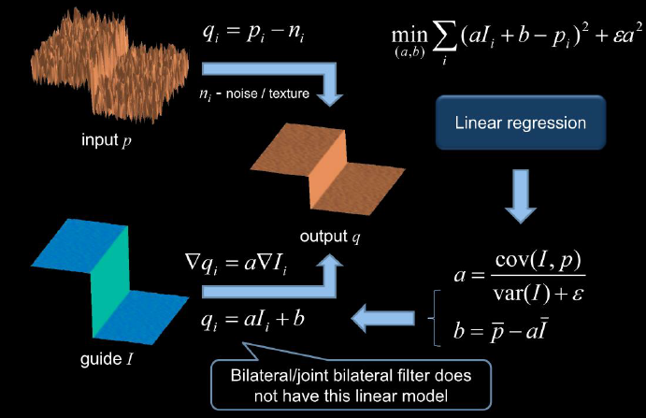


Guided Filter

Slide 8
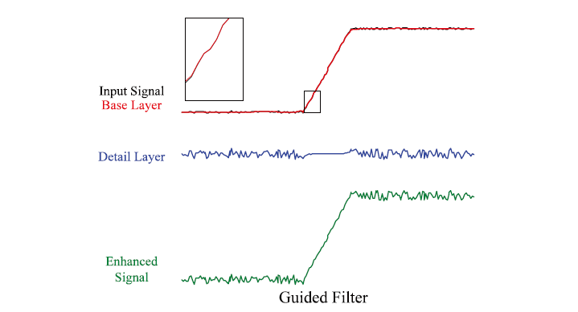
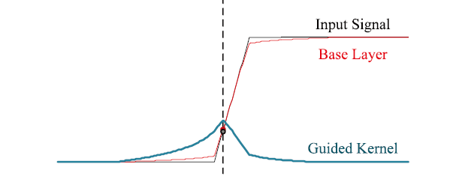
Guided Filter

Slide 9
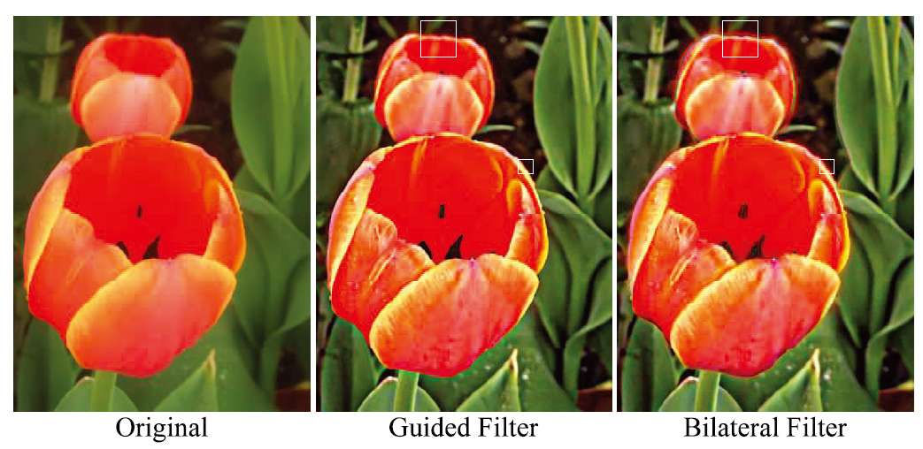
Gradient Reversal in Detail Enhancement

Slide 10
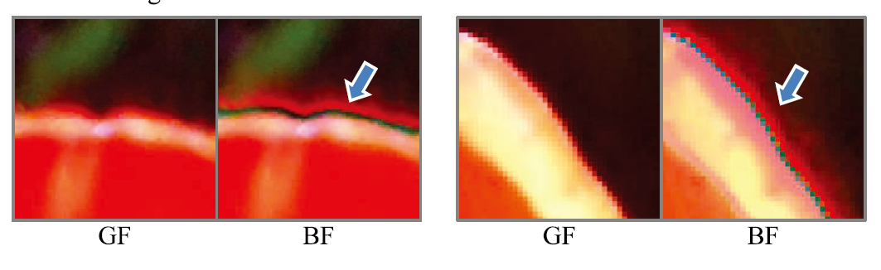

Slide 11
Guided Filter
Also has lots of other applications:
˙Structure Transferring (Image Feathering)
˙Flash / no Flash Denoising
˙HDR Compression
˙Image Matting

