Slide 1
CS340400 Compiler Design Homework Introduction
Spring 2017
Notes:
各位同學大家好，
我是這堂課其中一個助教于琳雅，于美人的于，因為于長得很像豆干的干，
被叫錯過（像國罵XD），所以綽號叫小干，也可以叫我小干
如果有課堂相關的問題，或是對清大的研究所有想知道的，
或上完課很喜歡 compiler，對我們實驗室有興趣的，
都歡迎隨時找我☺
今天我們會說明三份投影片，
會先簡介本學期三次作業的內容和一些通用的作業規定，
再來是簡介三次作業都會用到的lex工具，
最後是作業一的詳細說明
投影片內有些內容等等會由學長 demo 給大家看

Slide 2
Outline
The Structure of a Modern Compiler
What will we do in the Homework
Grading Policies
How to Connect to our Server
Tutorials
FAQ

Slide 3
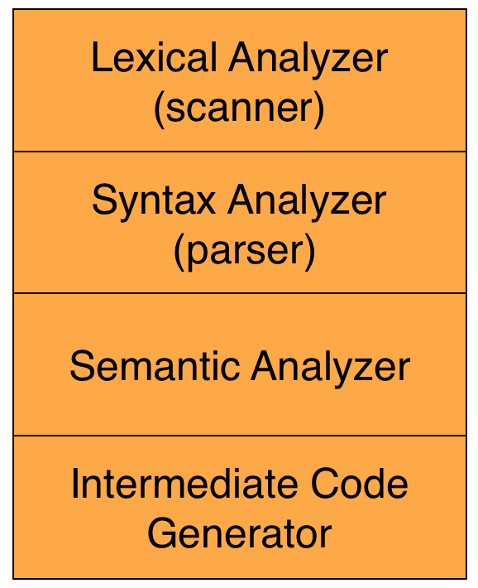
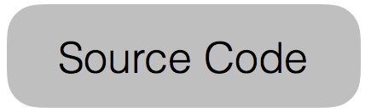
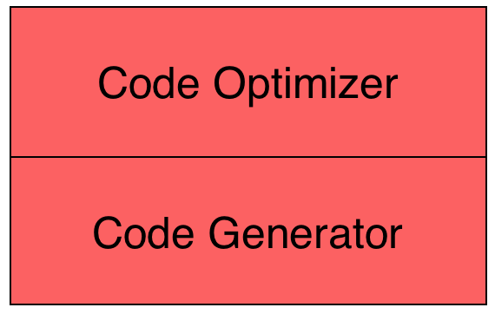
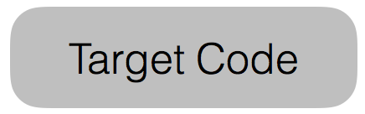
The Structure of a Modern Compiler
Front End
Back End

Slide 4
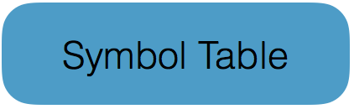
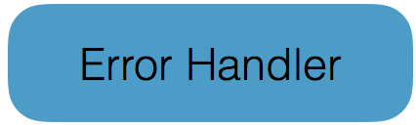
The Structure of a Modern Compiler
*
Notes:
Token: A token is a pair a token name and an optional attribute value
Pattern: A pattern is a description of the form that the lexemes of a token may take
Lexeme: A lexeme is a sequence of characters in the source program that matches the pattern for a token

Slide 5
What will we do in the Homework?
Homework 1
(Lex)
Homework 2
(Lex, Yacc)
Homework 3
(SW:Lex, Yacc)
(HW: Andes Andino )

Slide 6
Grading Policies
Homework 1: 10%
3 unique test cases (90%)
One will release before grading for you to validate your program. The others will release after grading.
Pass 1 test case: get 60; Pass 2 test cases: get 75; Pass 3 test cases: get 90
Report (10%)
Homework 2: 10%
TBA.
Homework 3: 10%
Demo
We will ask you some questions about the homework and lectures.
TBA.

Slide 7
Grading Policies
For all the homework,
Warning messages: minus 20 points
Late homework: minus 10 points per day
Not executable (include not following the output format and not following the submission rules): You can still get 50 points if you turn in your codes and the report.
Cheating: You will receive zero credit!

Slide 8
How to Connect to our Server?
PieTTY
https://sites.google.com/view/pietty-project/download
MobaXterm
http://mobaxterm.mobatek.net/download.html
Terminal : for MAC OS/ Linux-based
ssh –p 7878 your_account@140.114.88.219
Notes:
有要用 scp 上傳檔案的話，請注意 pietty 的版本

Slide 9
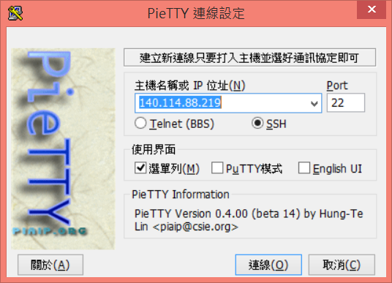
PieTTY
SSH
IP: 140.114.88.219 Port: 7878
7878

Slide 10
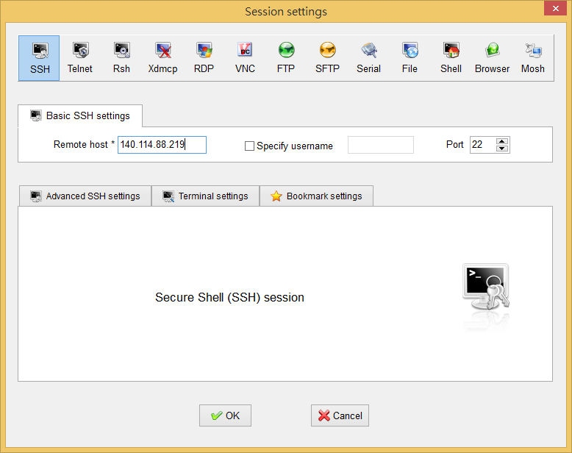
MobaXTerm
Toolbar > Session > SSH
Remote host: 140.114.88.219 Port: 7878
7878

Slide 11
Account
Account: student ID (lowercase letter)
Password: same as account
Please change the password when you first login!
Steps:
Enter old password
Enter new password
Enter new password again
Connect to our server again
If you want to change your password afterwards,
$ passwd

Slide 12
Tutorials
Linux command
http://linux.vbird.org/linux_basic/0220filemanager.php
Vim
http://linux.vbird.org/linux_basic/0310vi.php
Shell script
http://linux.vbird.org/linux_basic/0320bash.php
Makefile
http://www.csie.nuk.edu.tw/…/Embedded%20Syst…/8-Makefile.pdf
http://www.cprogramming.com/tutorial/makefiles.html
http://jimmynuts.blogspot.tw/2010/12/gnu-makefile.html

Slide 13
FAQ
Q: What should you do if you can not login or can not connect to our server?
Please contact us directly.
Q: Do TAs help debug my programs?
No. We can only discuss the program concept with you; however, you can still show your error messages in the course FB group and discuss with the classmates and us.
Q: Some seniors want to get their course grades earlier.
Hand in homework 3 and demo it earlier.
Notes:
(tyler: 這部分應該沒問題，學生在家應可作業，這點建議先不要提。只要無法連線，就請他們直接聯絡我們即可)
Q: What should you do if you can not connect to our server?
Our server can not be accessed over private network. While located outside the school, use VPN service. For more VPN information, please visit https://net.nthu.edu.tw/2009/sslvpn:info. If you still can not connect to our server, Please contact us directly.

Slide 14
Contact Us
Facebook Group
If you have any questions, feel free to discuss with everyone in class.
TAs
于琳雅 lyyu@pllab.cs.nthu.edu.tw
陳泰良 tlchen@pllab.cs.nthu.edu.tw

