Slide 1
CS340400 Compiler Design Lex: A Lexical Analyzer Generator
Spring 2017

Slide 2
What are we Going to do?
HW1
a = b + c * d
source code
Lexical Analyzer
tokens
id = id + id * id
HW2
Syntax Analyzer
syntax tree
=
id
+
id
*
id
id
HW3
Code Generator
generated code
mul $r1, $r2, $r3
add $r0, $r1, $r4 …

Slide 3
The Structure of Compiler
HW1
a = b + c * d
source code
Lexical Analyzer
tokens
id = id + id * id
HW2
Syntax Analyzer
syntax tree
=
id
+
id
*
id
id
HW3
Code Generator
generated code
mul $r1, $r2, $r3
add $r0, $r1, $r4 …

Slide 4
Why we Need Lex and Yacc?
a
start
3
1
a
2
b
one or more copies of ab
Notes:
RE-(E-NFA)-NFA-DFA-MINIMAL DFA

Slide 5
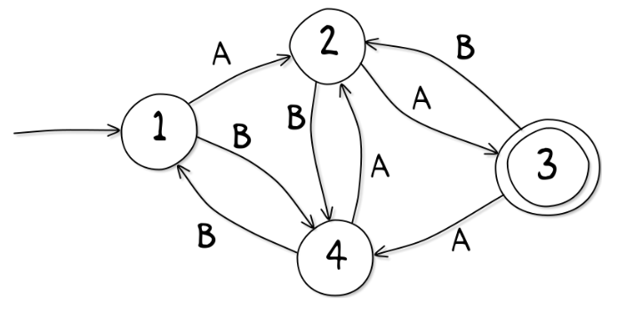
Why we Need Lex and Yacc?
City Mall Station

Slide 6

Why we Need Lex and Yacc?
City Mall Station

Slide 7
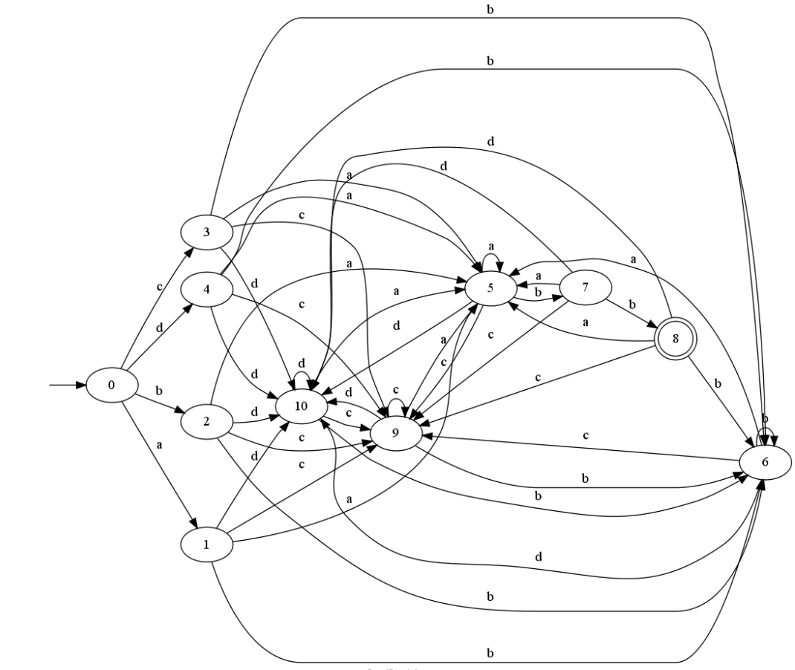
[a-d]+abb

Slide 8



[a-d]+abb

Slide 9

Lex & Yacc

Slide 10
Outline
What is Lex?
How to Write Lex?
Flex: the Fast Lexical Analyser Generator
Regular Expressions
Start Condition
Lex Predefined Variables
Reference

Slide 11
What is Lex?
Lex is a program generator designed for lexical processing of character input streams. It accepts a high-level, problem oriented specification for character string matching, and produces a program in a general purpose language which recognizes regular expressions.
The regular expressions are specified by the user in the source specifications given to Lex.
Lex generates a deterministic finite automaton (DFA) from the regular expressions in the source.
The Lex written code recognizes these expressions in an input stream and partitions the input stream into strings matching the expressions.
From http://dinosaur.compilertools.net/lex/
Notes:
RE-(E-NFA)-NFA-DFA-MINIMAL DFA
Table maintain MINIMAL DFA

Slide 12
What is Lex?
The benefit is you do not have to write the whole C program by yourself.
You just need to learn the simpler language Lex.
C
Lex
a
start
(ab)+
3
1
a
2
b
Notes:
優點同樣也是缺點
像是個黑盒子，無法掌控更細節的部分，只能交由 Lex 去做處理

Slide 13
Lex with Yacc
HW1
HW2
Lex source
(Lexical Rules)
Yacc source
(Grammar Rules)
Lex
Yacc
lex.yy.c
y.tab.c
call
yylex()
yyparse()
Parsed
Input
Input
return token

Slide 14
How to Write Lex?
Definition Section
%%
Rules Section
%%
C Code Section
(required)
(required)
(optional)

Slide 15
How to Write Lex?
%{
#include <stdio.h>
int lineCount=0;
%}
Definition Section
%%
Rules Section
%%
C Code Section
The Definition Section will be copied to the top of generated C program. Include header files, declare variables.

Slide 16
How to Write Lex?
\n { lineCount++;
printf(“line:%d\n”, lineCount); }
Definition Section
%%
Rules Section
%%
C Code Section
The Rules Section is for writing regular expression to recognize tokens. When pattern is matched, then execute action
[Regular expression rule] { The things you want to do; }

Slide 17
How to Write Lex?
int main(void) {
yylex();
return 0;
}
int yywrap() {
return 1;
}
// Other function you defined.
Definition Section
%%
Rules Section
%%
C Code Section
The C Code Section will be copied to the bottom of generated C program.

Slide 18
How to Write Lex?
%{
#include <stdio.h>
int lineCount=0;
%}
%%
\n { lineCount++;
printf(“line:%d\n”, lineCount); }
%%
int main(void){
yylex();
return 0;
} ……
Definition Section
%%
Rules Section
%%
C Code Section
A completed Lex program.

Slide 19
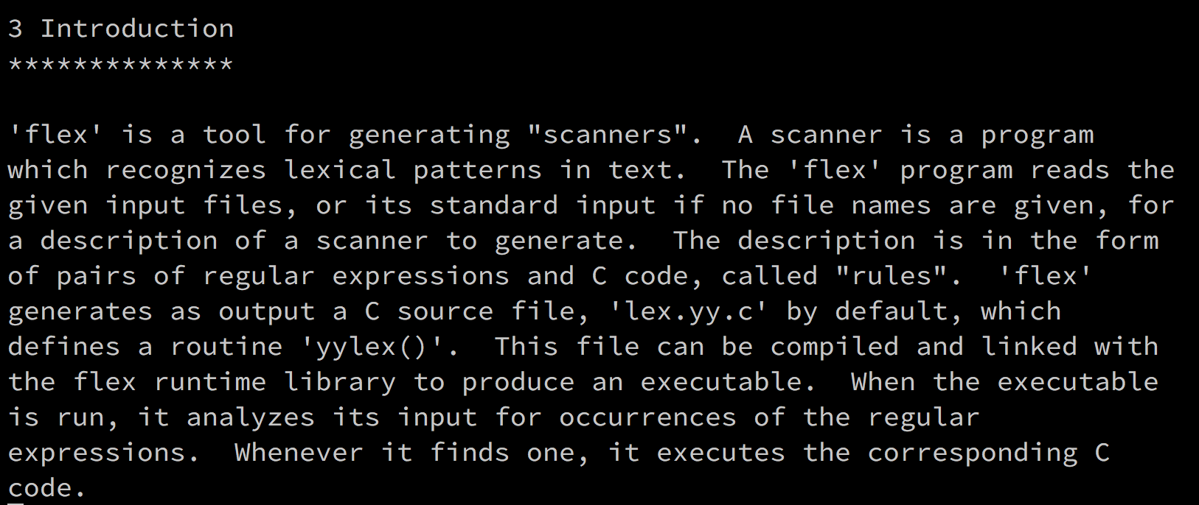
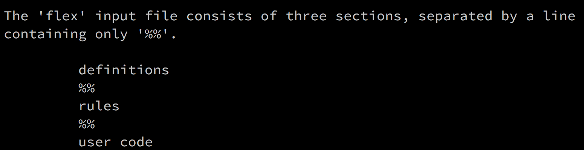
Flex: the Fast Lexical Analyser Generator
Link with library libfl.a

Slide 20
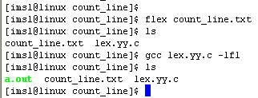

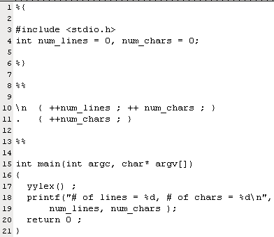
From: http://oz.nthu.edu.tw/~d947207/chap10_lex.ppt
Flex Example:
Count Number of Lines and Number of Characters
count_line.l
Press Enter
Press Ctrl+D
1
2
3
4
5
6
7
8
9
10
11
12
13
14
15
T
h
i
s
i
s
a
b
o
o
k
\n
b
y
e
b
y
e
\n
.l
Generate source C-code lex.yy.c
l
l
Library libfl.a
Notes:
Control-D: handle "end of file”

Slide 21
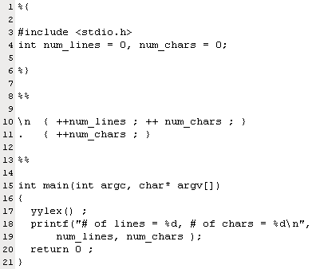
From: http://oz.nthu.edu.tw/~d947207/chap10_lex.ppt
Grammar of Input file of Flex
Lex copy data enclosed by %{ and %} into C source file
pattern
action
\n
{ ++num_lines ; ++ num_chars ; }
.
{ ++ num_chars ; }
wild card character, represent any character expect line feed \n
User code
grammar of input file
definition section
%%
rule section
%%
user code
pattern action
When pattern is matched, then execute action

Slide 22

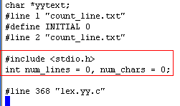
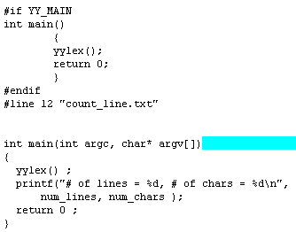
Grammar of Input file of Flex
lex.yy.c
default main
From: http://oz.nthu.edu.tw/~d947207/chap10_lex.ppt

Slide 23
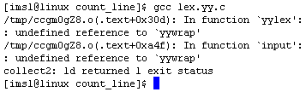
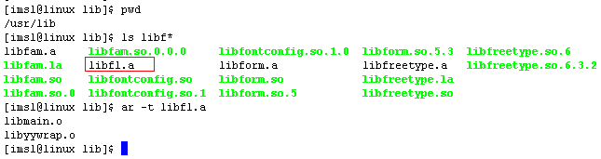
Can we Compile lex.yy.c without –lfl ?
We want to use lex.yy.c on different platforms (Linux and windows), to avoid specific library is lesson one.
Library libfl.a contains function yywrap()
-lfl means “include library libfl.a”, this library locates in /usr/lib
contains function mian() and yywrap()
From: http://oz.nthu.edu.tw/~d947207/chap10_lex.ppt

Slide 24
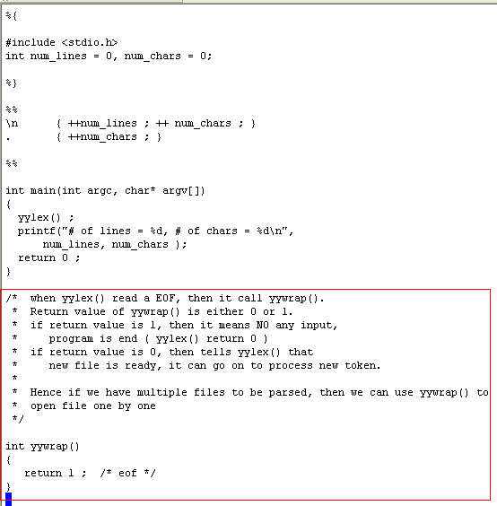
From: http://oz.nthu.edu.tw/~d947207/chap10_lex.ppt
Can we Compile lex.yy.c without –lfl ?
count_line.l
Implement function yywrap explicitly
Notes:
不用 –lfl ，一定要給定main及yywrap

Slide 25
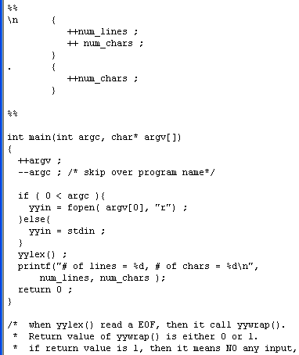
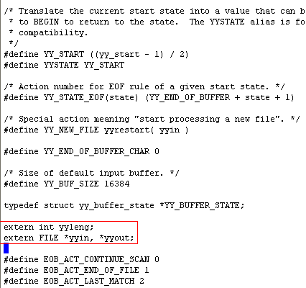
How to Process a file?
count_line.l
lex.yy.c
yyin is a file pointer in lex, function yylex() read characters from yyin
From: http://oz.nthu.edu.tw/~d947207/chap10_lex.ppt

Slide 26
Regular Expressions
. | Any character excepts ‘\n’. | . = {a, b, c, d, ……}
* | Zero or more. | ab* = {a, ab, abb, abbb, ……}
+ | One or more. | ab+ = {ab, abb, abbb, ……}
? | Zero or one. | a? = {ԑ, a}
| | Or. | a|b = {a, b}
[] | Any character of the character set. | [abc] = {a, b, c}
() | To group characters. | (ab)* = {ԑ, ab, abab, ……}
\ | For escape character. | \* = {*}, \\ = {\}
“…” | Literally. | “a*” = {a*}
{} | Repeat. Substitution. | a{1,3} = {a, aa, aaa}
^ | Head of line. Exclude. | [^a] = {b, c, d, e, ……}
$ | End of line.
/ | Followed with specific character. | a/b = {ab}

Slide 27
Regular Expressions
Input
String
she
%%
she { printf(“she\t”); }
[sS]he { printf(“another she\t”); }
he { printf(“he\t”); }
s { printf(“s\t”); }
%%
Rule
Section
The output result is “she”.
Always choose the longest matching pattern.
If the length are the same, choose the first met rule.

Slide 28
More Elegant Way to Write Regular Expressions
%{
#include <stdio.h>
int lineCount=0;
%}
ch [a-z]
%%
\n { lineCount++;
printf(“line:%d\n”, lineCount) ;}
{ch}+ { ECHO; }

Slide 29
More Elegant Way to Write Regular Expressions
%{
#include <stdio.h>
int lineCount=0;
%}
%%
\n { lineCount++;
printf(“line:%d\n”, lineCount); }
[[:alpha:]]+ { ECHO; }

Slide 30
Regular Expressions
Regular Expression | Meaning
[a-zA-Z] | Any character of a ~ z and A ~ Z.
[0-9] | Any character of 0 ~ 9.
[:lower:] | [[:lower:]] = [a-z]
[:upper:] | [[:upper:]] = [A-Z]
[:alpha:] | [[:alpha:]] = [a-zA-Z]
[:digit:] | [[:digit:]] = [0-9]
[:alnum:] | [[:alnum:]] = [a-zA-Z0-9]
Notes:
report

Slide 31
Start Condition
What if you encounter the string like this?
/* int count
is for counting line number */
Input
String
printf( “int is 32-bit” );
Input
String

Slide 32
Start Condition
Declare at Definition Section.
%x STATE_NAME - exclusive
%s STATE_NAME - inclusive
%{
…
%}
%x COMMENT
%%
Notes:
flex provides a mechanism for conditionally activating rules. Any rule whose pattern is prefixed with "<sc>" will only be active when the scanner is in the start condition named "sc".
• Start conditions are declared in the definitions (first) section of the input using unindented lines beginning with either `%s' (inclusive start conditions) or `%x' (exclusive start conditions)
• Initial starting condition of flex is 0 (INITIAL)
• A start condition is activated using the BEGIN action. Until the next BEGIN action is executed, rules with the given start condition will be active and rules with other start conditions will be inactive.
• If the start condition is inclusive, then rules with no start conditions at all will also be active.
• If it is exclusive, then only rules qualified with the start condition will be active.

Slide 33
Start Condition
Input
String
/*int
%{
…
%}
%x COMMENT
/* Exclusive */
%%
“/*” { BEGIN COMMENT; }
int { printf(“normal\n”);
BEGIN 0; }
<COMMENT>int { printf(“special\n”);
BEGIN 0; }
%%
Notes:
只選擇前面有對應 condition 的規則

Slide 34
Start Condition
Input
String
/*int
%{
…
%}
%s COMMENT
/* Inclusive */
%%
“/*” { BEGIN COMMENT; }
int { printf(“normal\n”);
BEGIN 0; }
<COMMENT>int { printf(“special\n”);
BEGIN 0; }
%%
Notes:
所有規則都可以選擇，最先碰到的優先

Slide 35
Compilation flow
We use Flex(Fast Lex) instead of Lex.
Output
Input
$ lex scanner.l
Lex program
scanner.l
Flex
lex.yy.c
1
$ gcc -o scanner lex.yy.c
lex.yy.c
GCC compiler
scanner
2
$ ./scanner < test.c
C program
test.c
scanner
tokens
3

Slide 36
Lex Predefined Variables
Name | Function
char *yytext | Pointer to matched string.
int yyleng | Length of matched string.
int yylex(void) | Function call to invoke lexer and return token.
int yywrap(void) | Return 1 if no more files to be read.
char *yymore(void) | Return the next token.
int yyless(int n) | Retain token except the first n characters in yytext.
FILE *yyin | Input stream pointer.
FILE *yyout | Output stream pointer.
ECHO | Print out the yytext.
BEGIN | Condition switch.
REJECT | Go to the next alternative rule.
man flex or info flex to get more info

Slide 37
Versions of Lex
AT&T: lex
http://www.combo.org/lex_yacc_page/lex.html
GNU: flex
http://www.gnu.org/manual/flex-2.5.4/flex.html
a Win32 version of flex
http://www.monmouth.com/~wstreett/lex-yacc/lex-yacc.html
or Cygwin
http://sources.redhat.com/cygwin/
Lex on different machines is not created equal.

Slide 38
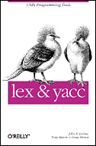
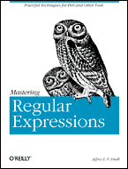
Reference
lex & yacc
by John R.Levine, Tony Mason & Doug Brown
O’Reilly
ISBN: 1-56592-000-7
Mastering Regular Expressions
by Jeffrey E.F. Friedl
O’Reilly
ISBN: 1-56592-257-3

