Slide 1
Project3
102062209 邱政凱

Slide 2
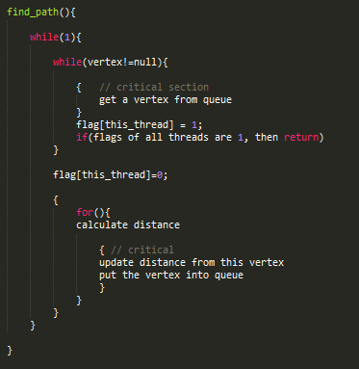
SSSP_Pthread
˙ Moore’s algorithm
˙ Working queue is protected by mutex
˙ 每次更新節點距離時，先把所有要更新的節點和距離都算好，再取得mutex (避免太頻繁)
˙ 用Adjacancy List取代Adjacancy matrix
˙在密集的圖可以達到較好的平行度

Slide 3
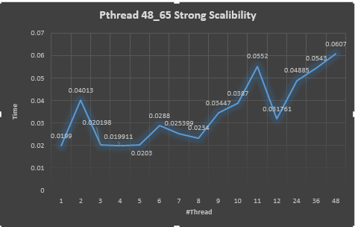
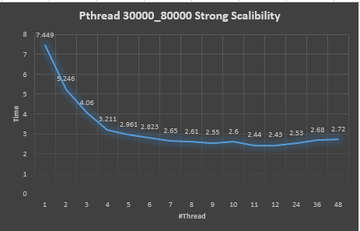

Slide 4
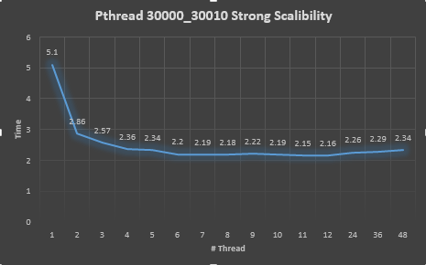
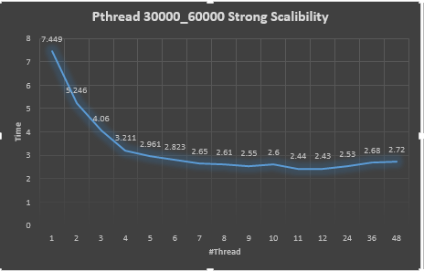

Slide 5
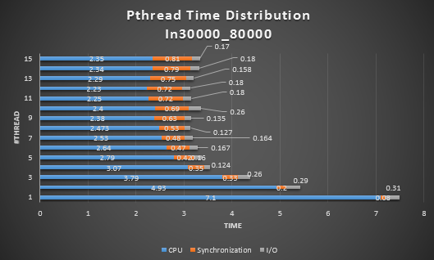

Slide 6
MPI_Sync
(For every process)
Every iteration, Isend current distance to all outgoing neighbor first.
Than Recv (# fanin) times, check ,whether it can update its distance.
不指明Recv的src，由發送方把自己的id包在訊息裡一起送。
每一回合都用Allreduce確認是否所有的Process都不再更新，若是，則跳離迴圈。

Slide 7
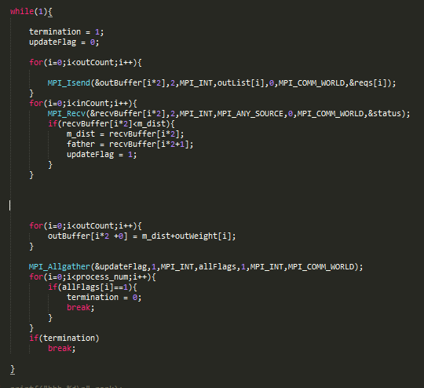

Slide 8
MPI_Async
Three types of message : Distance, token , termination
If receive distance, then update distance and send distance message to outgoing neighbor.
If receive token, change color according to flag and pass token to process (n+1)%#process if local terminated(relaxed).
If process 0 receive white token then send termination to all process.

Slide 9
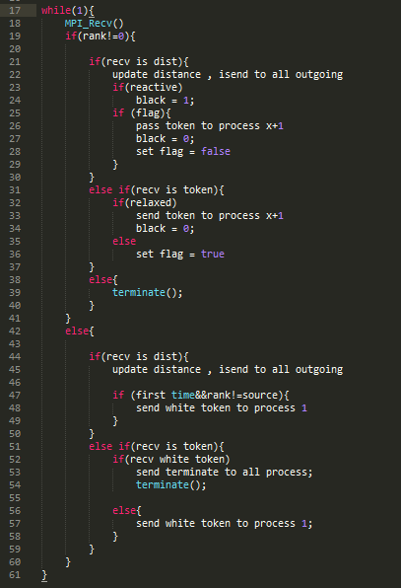

Slide 10
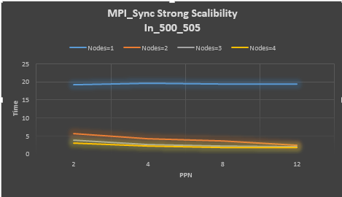
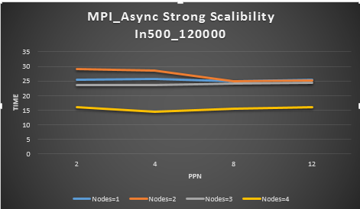

Slide 11
MPI版本 快在哪?
我不知道QQ

Slide 12
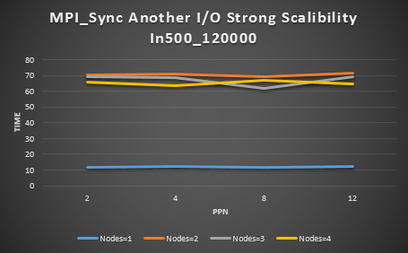
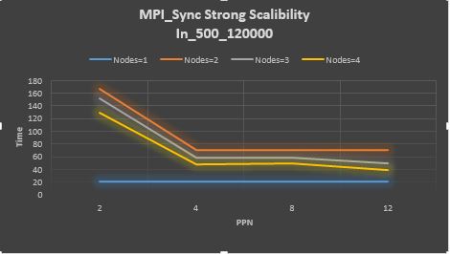
也許是因為暴力I/O

