Slide 1
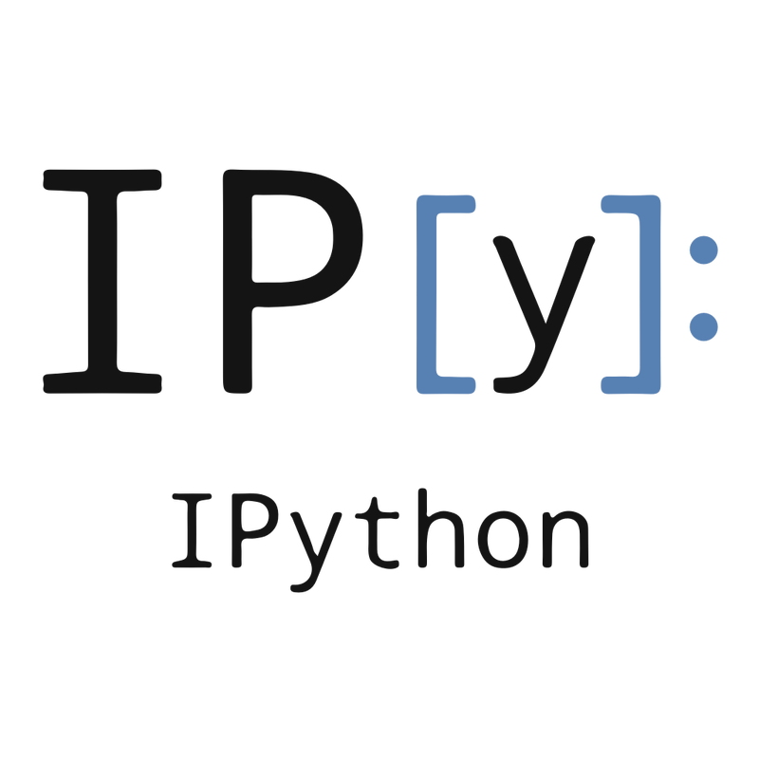
I A system for Interactive Scientific Computing
AUTHORS: Fernando Perez
Brian E Granger
(IEEE 2007)
Presented by: Rashmisnata Acharyya

Slide 2
Key Idea and Background
What is Ipython?
Why Ipython?
How, when and by whom?

Slide 3
Features of a Good Interactive Computing Environment

Slide 4
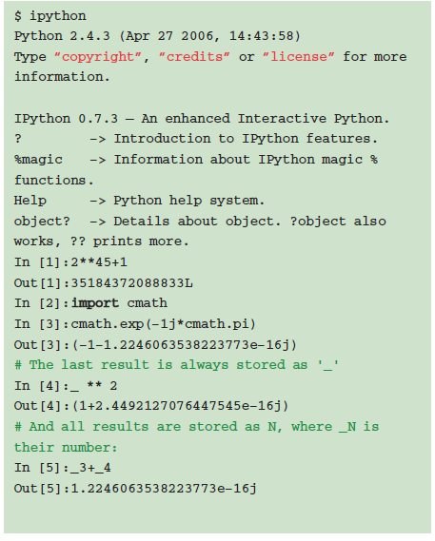
Access to all session states
-The session input-outputs are stored in a table
-All outputs are accessible by _N
-save it into a log file

Slide 5
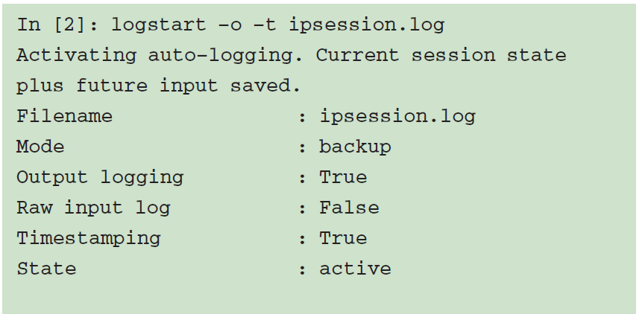
A control system
-offers set of control (magic commands) improving usability
-Inspired from traditional
Unix commands

Slide 6
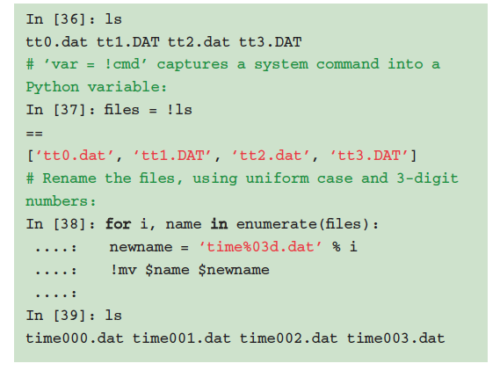
Operating System Access
-
-uses familiar commands (cd, ls ) for navigation into file system and direct execution by OS
-python execution using unix like commands
-This feature has led users to use Ipython as their default shell

Slide 7
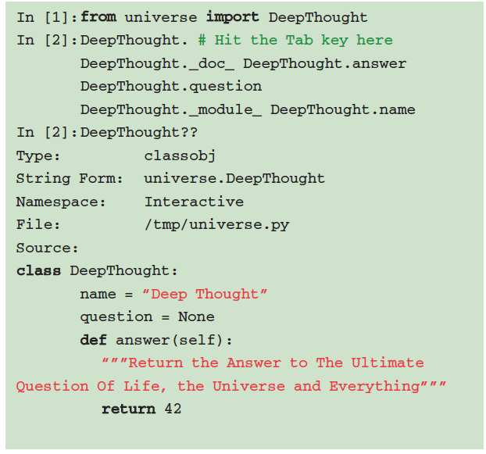
Dynamic Introspection and Help
-Interactive Help
-Explore various types of objects in language
-Helpful in developing code, exploring problem or use an unfamiliar library

Slide 8
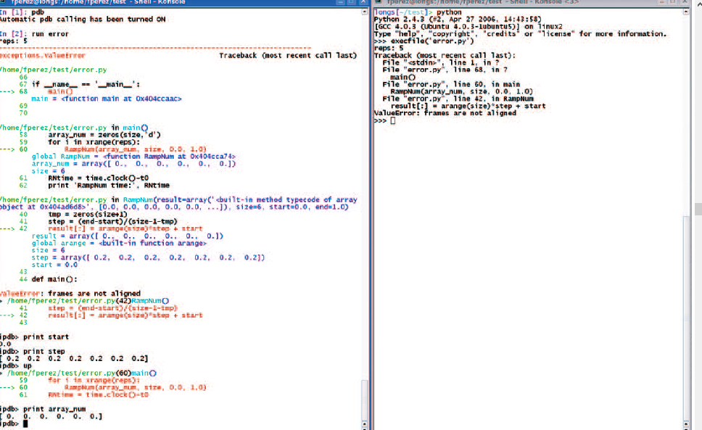
Access to program Execution
-Execution is done as if it was typed interactively
-Upon completion the program results update the session so that further exploration can be done
-ipdb is the default debugger which analyses from its in-memory state without the need of reloading libraries etc
-Need not reload libraries again and again.

Slide 9
IPYTHON : A BASE LAYER FOR INTERACTIVE ENVIRONMENT easy modification and customization

Slide 10
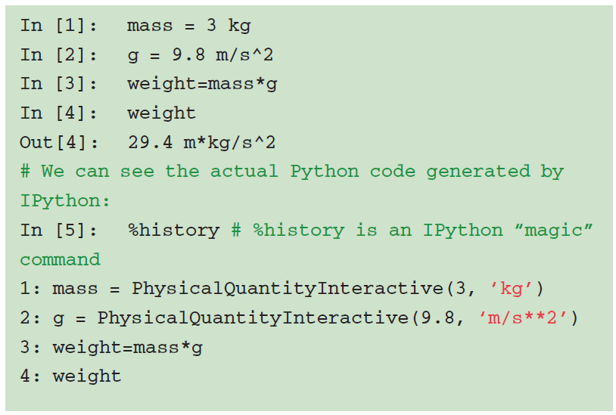
Input Syntax Processing
-IPython ships with a physics profile
-installs a special input filter.
-This filter recognizes text sequences that appear to be quantities with units
-Was extensively used in SAGE (Software for Algebra and Geometric experimentation) for transforming Numerical quantity to exact integers, rationals, floats etc

Slide 11
Error Handling
Three exception handlers
Users can register exception handlers to raise exceptions of registered type
PyRaf interactive environment at Space Telescope Scientist Institute
Handles internal errors separately from those meaningful to users

Slide 12
Tab Completion
PyMAD at neutron scattering Facility of Institute of Laue Langvin in Grenoble, France
Ipython runs on a system connecting Neutron spectrometer over a network.
Users interact with remote systems like local
Tab Completion operates over a network to fetch info of remote objects for display in local console

Slide 13
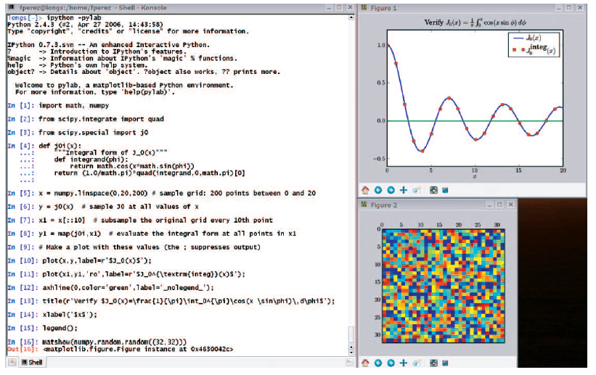
Graphical Interface ToolKit and Plotting
In Default Python command line stops while the plot window appears
Ipython and Matplotlib collaborated forming non-blocking shell (using o –pylab start up flag)
3D plotting is also possible with TVTK which provides integration of ipython libraries with high level API
Both TVTK and Matplotlib can run concurrently in Ipython

Slide 14
Interactive Parallel and Distributed Computing
styles of parallelism
Single program, multiple data (SPMD) parallelism.
Multiple program, multiple data (MPMD) parallelism.
Message passing using MPI.
Task farming.
Data parallel.
Combinations of these approaches.
Custom user defined approaches
IPython enables all types of parallel applications to be developed, executed, debugged and monitored interactively.

Slide 15
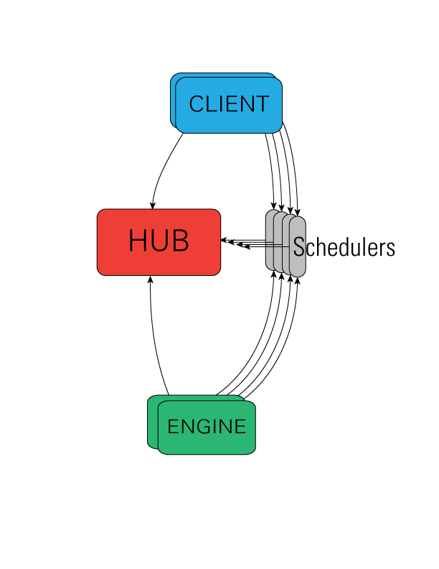
Interactive Parallel and Distributed Computing(cont..)
-The IPython engine is a Python instance that takes Python commands over a network connection.
-The IPython controller processes provide an interface for working with a set of engines
-Hub is the process that keeps track of engine connections, schedulers, clients, as well as all task requests and results.
- While the engines themselves block when user code is run, the schedulers hide that from the user to provide a fully asynchronous interface to a set of engines.
Source: http://ipython.org/ipython-doc/2/parallel/parallel_intro.html#examples

Slide 16
Explore:
Fernando Perez: IPython in depth: high productivity interactive and parallel python - PyCon 2014
https://www.youtube.com/watch?v=XFw1JVXKJss
http://ipython.org/
References:
http://ipython.org/
Wikipedia

Slide 17


Slide 18


